Slide 1
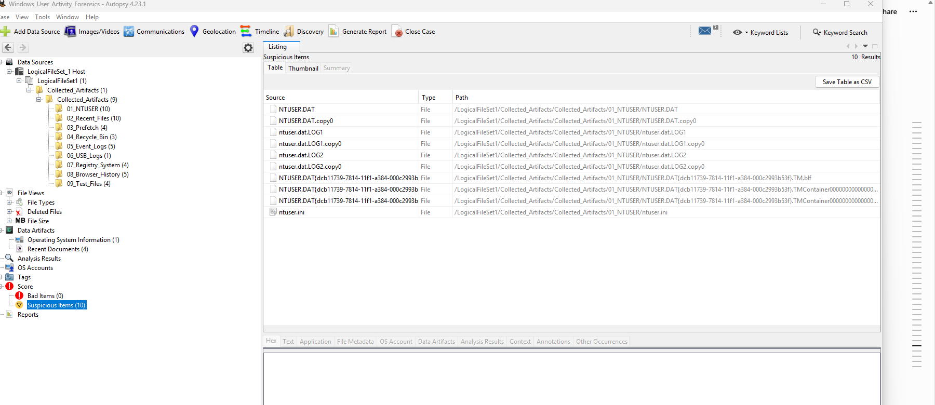
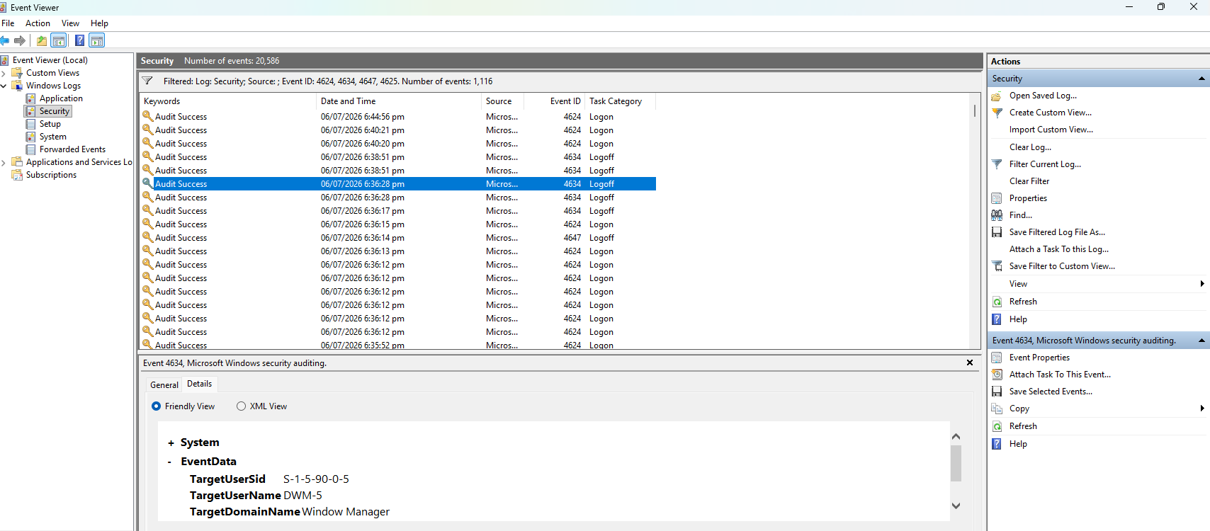
Windows User Activity
Forensics
PKCERT Digital Forensics Internship • Week 1 • Task 1
Autopsy: tagged evidence
Group 10: Muhammad Ubaid & Imtiaz Ali
3–5 minute presentation
Evidence-based timeline
Goal: reconstruct recent user actions from Windows artifacts.
Event Viewer: logon / logoff evidence
Notes:
Introduce the task: Windows User Activity Forensics. Say that the aim is to reconstruct what a user did in the last 48 hours using forensic artifacts and tools.

Slide 2
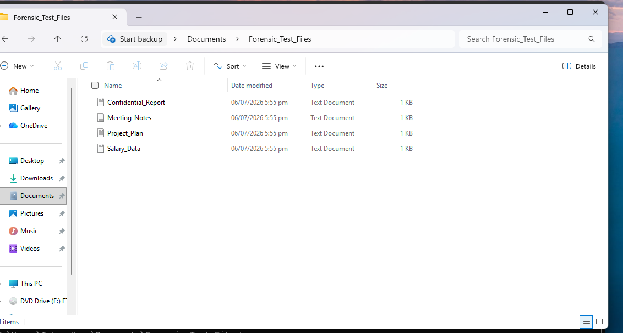
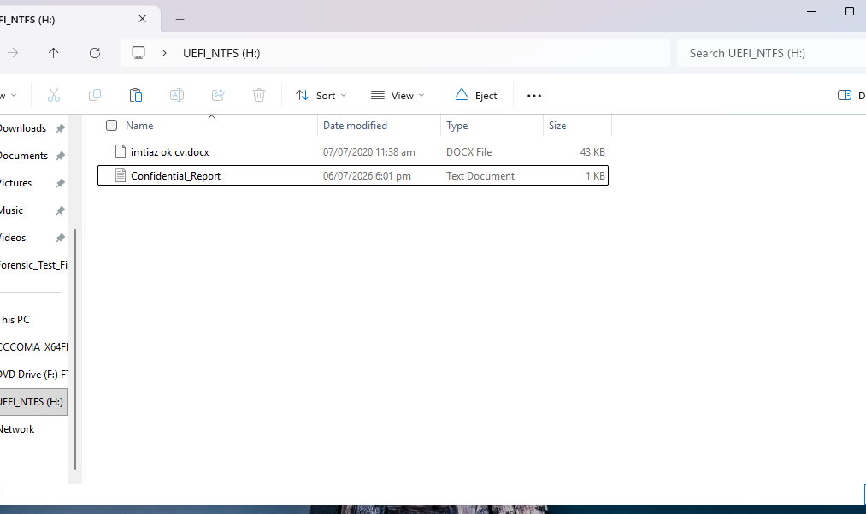
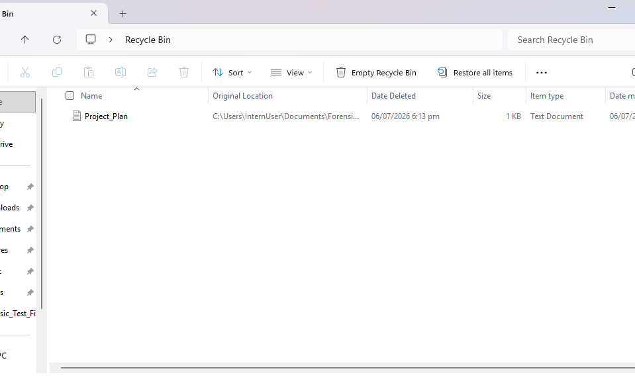
Case scenario & objectives
Simulated insider misuse investigation on a Windows workstation
Controlled lab files created by InternUser
Confidential_Report copied to USB
Deleted file left in Recycle Bin
What we needed to prove
Investigation scope
Which user logged in and when
Which files were opened or deleted
Which apps and commands were executed
Whether USB storage was used
A timeline for the last 48 hours
Training case: no real organization data. All actions were generated in a Windows VM and then examined using forensic tools.
Main suspect user: InternUser
PKCERT Digital Forensics Internship • Group 10 • Week 1 Task 1
Notes:
Explain the scenario in one sentence. Mention that we generated fake activity to create forensic evidence safely. List the objectives briefly.

Slide 3
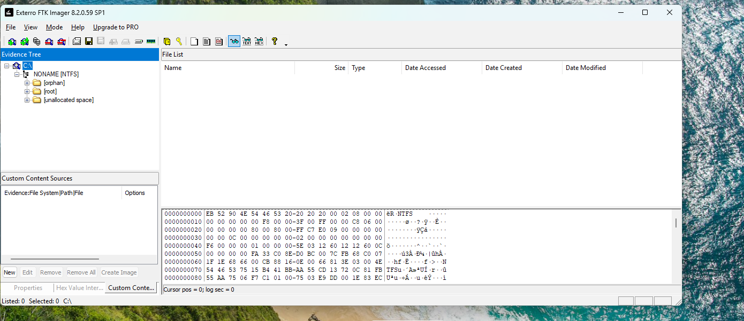
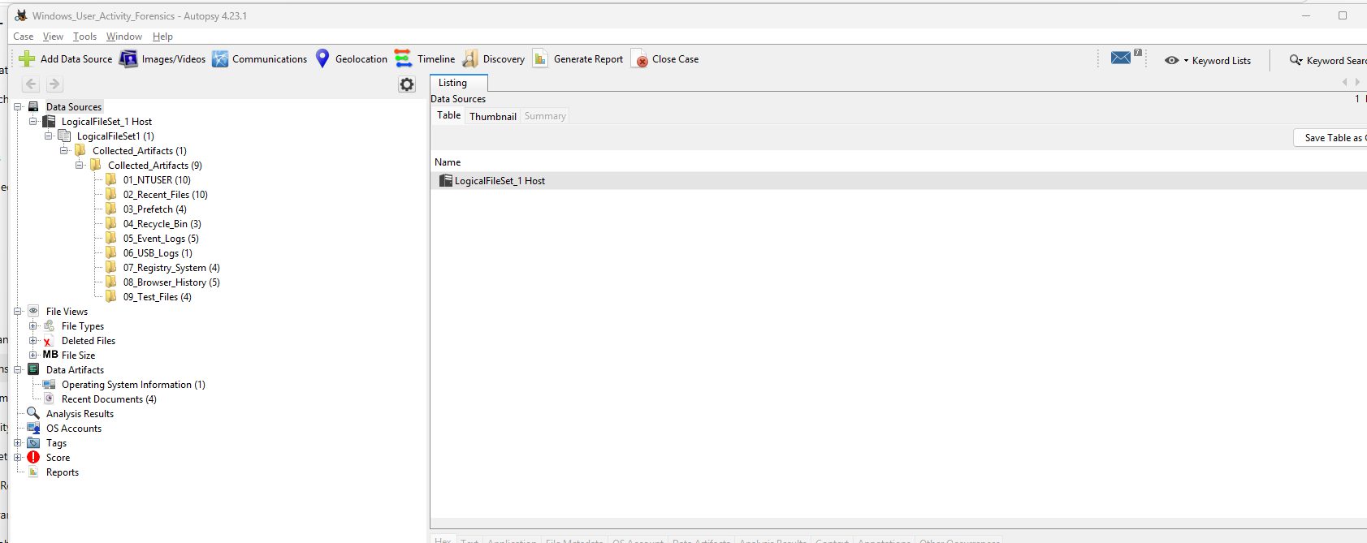
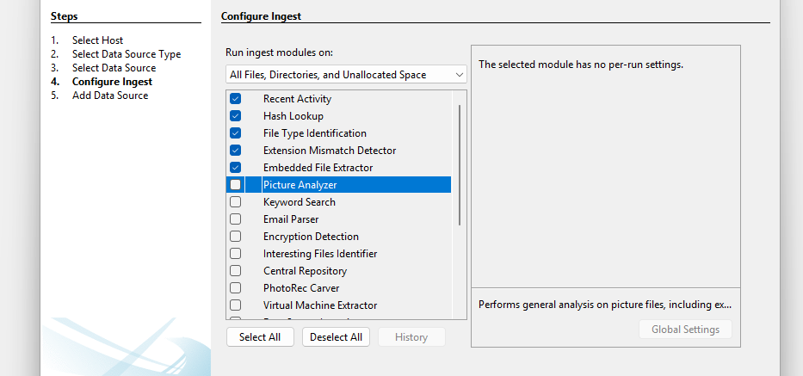
Methodology: from activity to evidence
We followed a simple collection → analysis → timeline process
1
2
3
4
5
User activity
FTK Imager
Event & Prefetch
Autopsy
Timeline
Files, apps, USB, deletion
Collect/export artifacts
Logon + execution history
Organize + search evidence
Correlate findings
C: drive loaded in FTK
Artifacts added in Autopsy
Ingest modules configured
Final output: formal report + 5-minute presentation
PKCERT Digital Forensics Internship • Group 10 • Week 1 Task 1
Notes:
Describe the process: generate user actions, collect artifacts in FTK, analyze with Event Viewer, WinPrefetchView and Autopsy, then build the timeline.

Slide 4
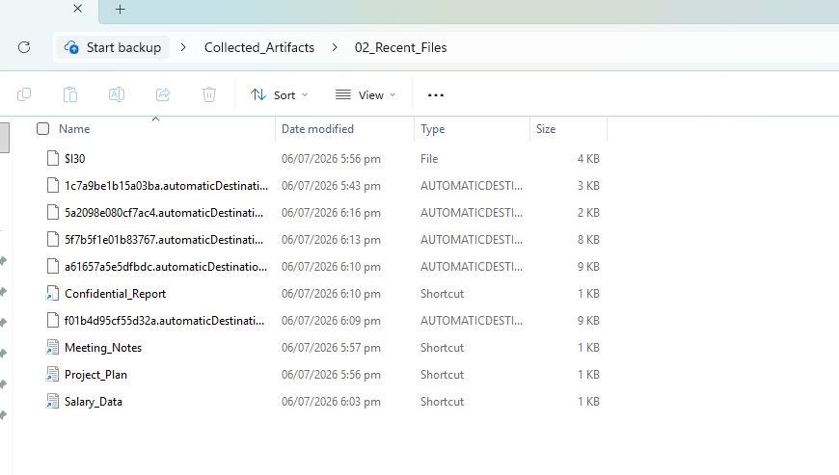
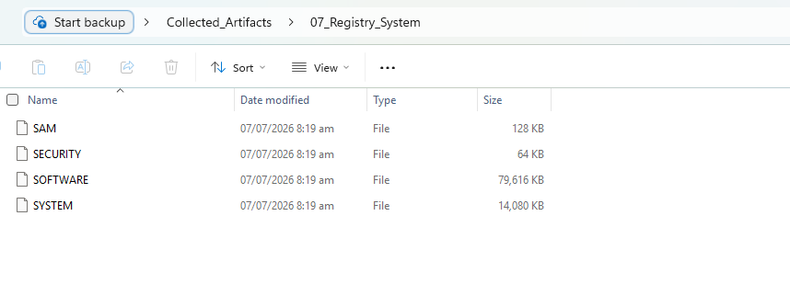
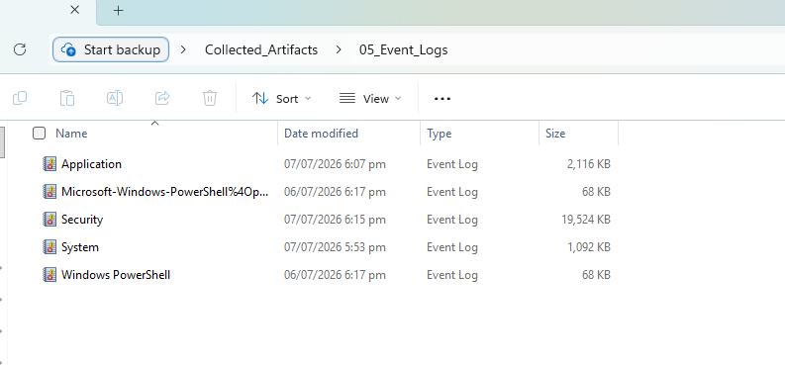
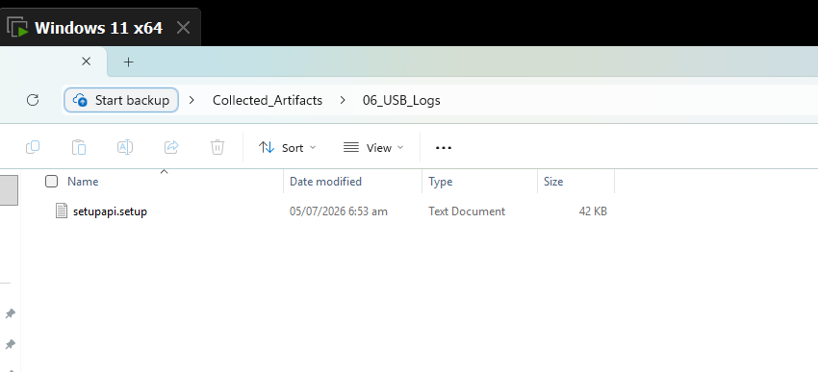
Tools used and what each one proved
Each tool had a specific role in the investigation
FTK Imager
Collected and exported evidence artifacts: NTUSER.DAT, Recent files, Prefetch, Recycle Bin, EVTX logs and USB logs.
Event Viewer
Filtered Security and System logs for logon/logoff and USB/device activity.
SYSTEM, SOFTWARE, SAM, SECURITY hives
Recent file artifacts
WinPrefetchView
Reviewed Prefetch records to confirm application execution history.
Analyzed exported artifacts, indexed folders, reviewed recent files and tagged suspicious evidence.
EVTX event logs
USB setupapi log
Autopsy
Collection tool ≠ analysis tool
FTK preserves and exports evidence; Autopsy helps review, search, and organize it.
PKCERT Digital Forensics Internship • Group 10 • Week 1 Task 1
Notes:
Explain tool roles simply. FTK Imager was mainly for evidence collection; Autopsy was for analysis; Event Viewer and WinPrefetchView gave direct supporting results.

Slide 5
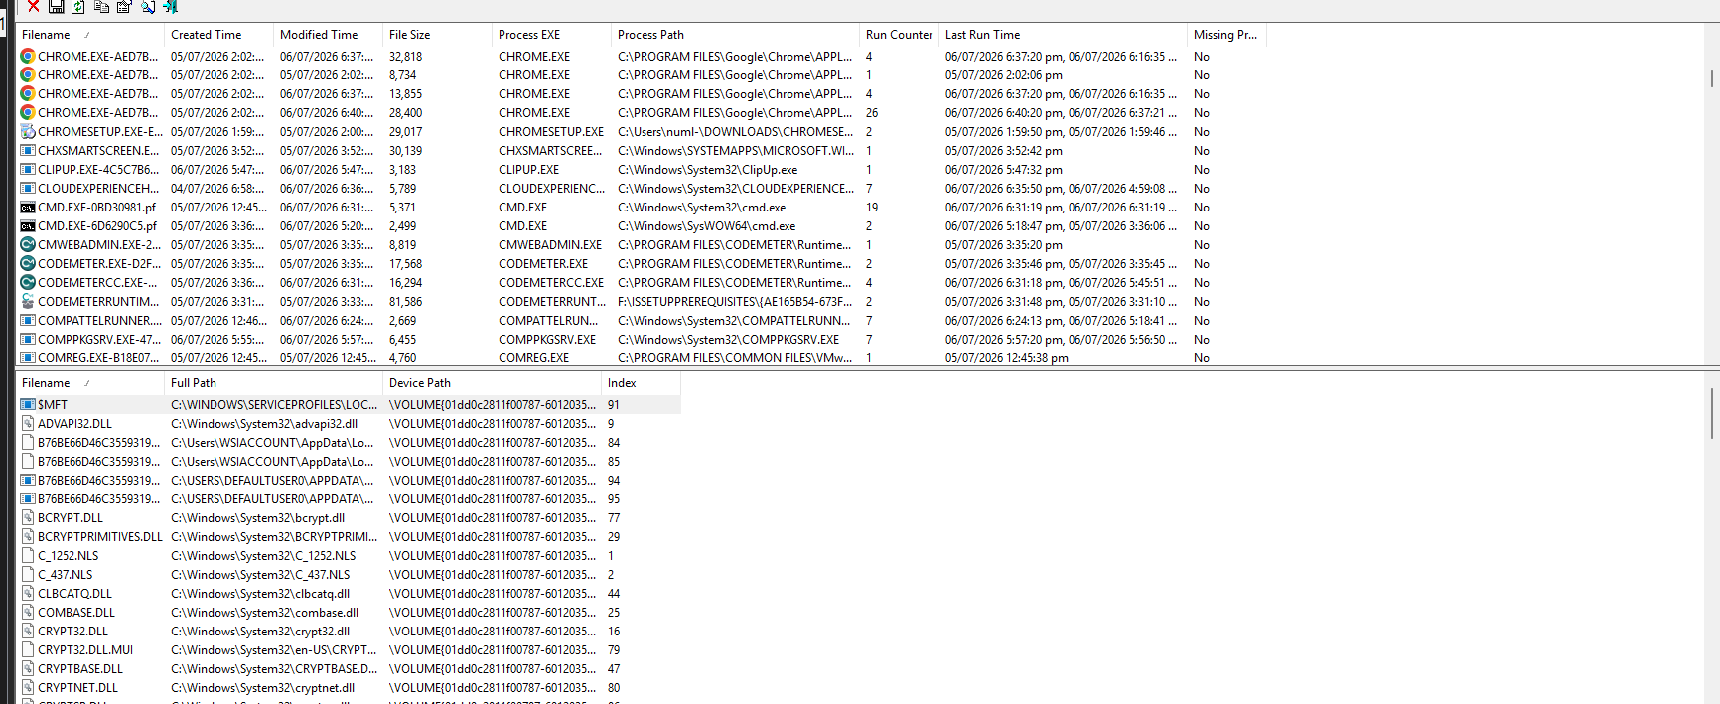
Evidence 1: login and application execution
Security logs and Prefetch records show active user interaction
Event Viewer: 4624, 4634 and 4647 events
WinPrefetchView: application execution history
4624
4647
.PF
Interpretation
InternUser had an interactive Windows session.
CMD, PowerShell, Notepad, Paint, Calculator, Chrome/Edge activity was visible.
Prefetch supports execution but not the exact document opened.
Successful logon
User initiated logoff
Prefetch records
PKCERT Digital Forensics Internship • Group 10 • Week 1 Task 1
Notes:
Point to Event Viewer first: login and logout establish the session. Then mention Prefetch: it confirms which programs were executed.

Slide 6
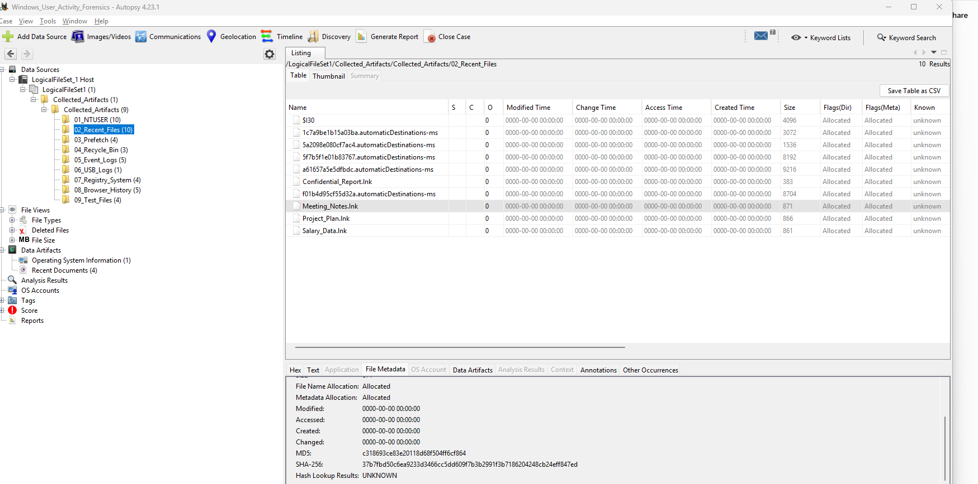
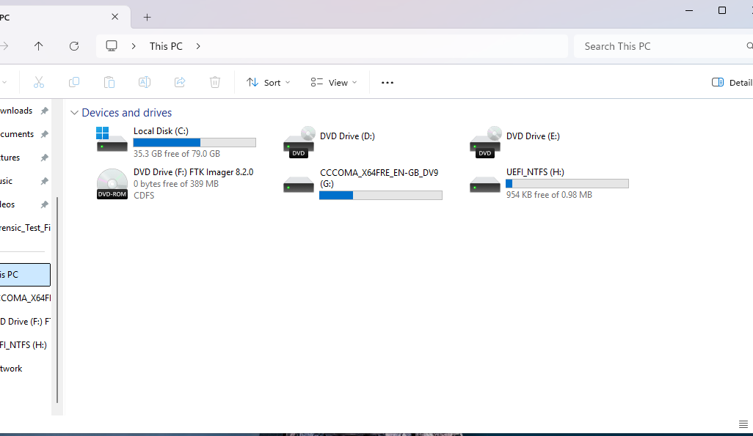
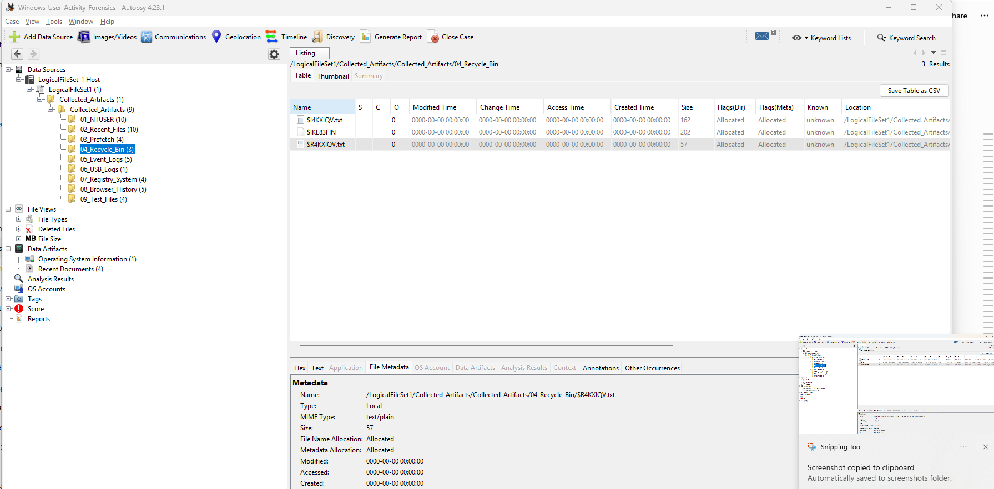
Evidence 2: accessed files, USB use and deletion
Recent files, USB traces and Recycle Bin artifacts connect the user actions
Autopsy: recent documents
USB mounted in VM
Autopsy: Recycle Bin artifacts
Correlated evidence
Why it matters
Recent shortcuts show Confidential_Report, Salary_Data, Project_Plan and Meeting_Notes were opened.
USB evidence shows removable storage was connected and used.
Recycle Bin shows Project_Plan was deleted but not permanently removed.
When multiple artifacts tell the same story, the activity timeline becomes stronger. Here, file access + USB access + deletion support the insider misuse scenario.
PKCERT Digital Forensics Internship • Group 10 • Week 1 Task 1
Notes:
Explain that recent files show what was opened. USB screenshots show a removable drive and copied file. Recycle Bin shows file deletion evidence.

Slide 7
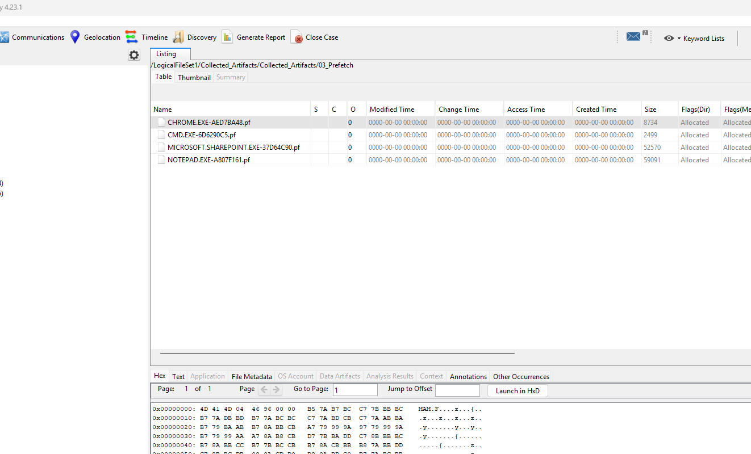
Autopsy analysis: one case view
Logical files workflow made the review faster and report-ready
All exported artifacts added as logical files
Prefetch files reviewed in Autopsy
Suspicious items and tagged evidence
1
Add artifacts
2
Run ingest
3
Review evidence
Collected_Artifacts folder imported as Logical Files.
Recent Activity, Hash Lookup, File Type Identification, Keyword Search.
Recent files, Prefetch, Recycle Bin, USB log, NTUSER.DAT.
4
Prepare output
Important findings were used in final timeline and report.
PKCERT Digital Forensics Internship • Group 10 • Week 1 Task 1
Notes:
Mention that Autopsy was used after FTK extraction. It helped organize all folders and allowed evidence review in a case-based format.

Slide 8
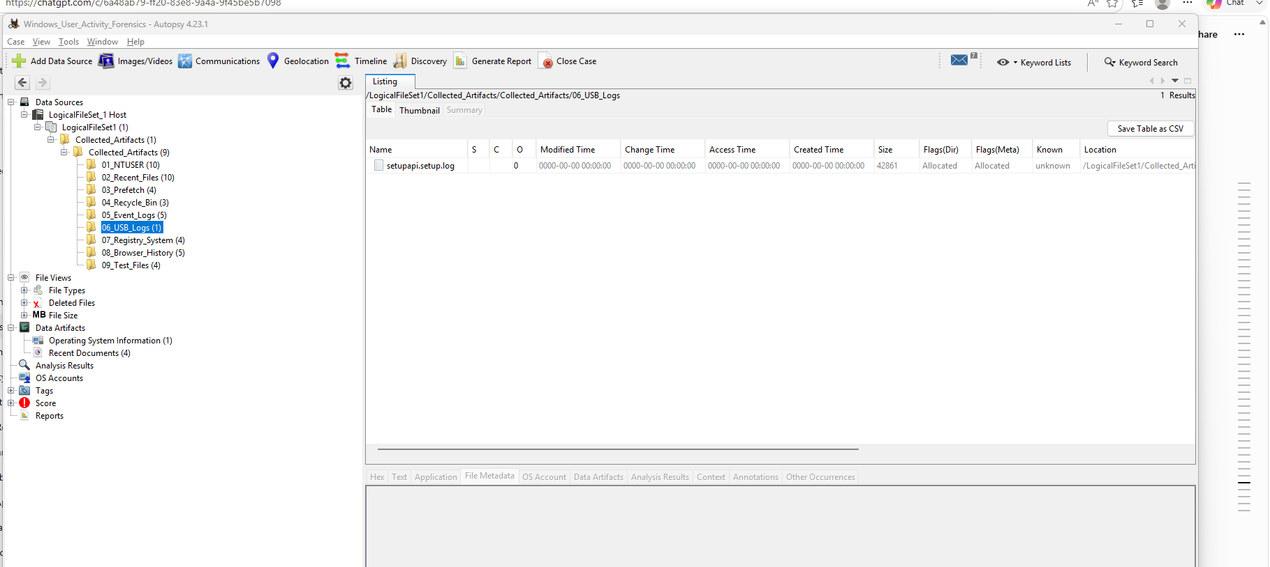
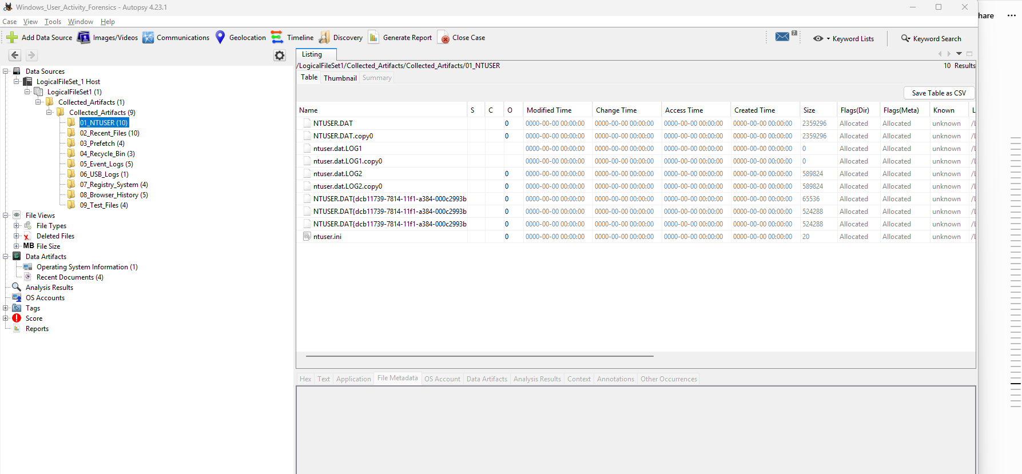
Reconstructed timeline & final findings
The evidence was correlated to explain what the user did
1
2
3
4
5
6
Logon
Opened files
Ran apps
Used USB
Deleted file
Logoff
4624
Recent
Prefetch
USB logs
Recycle Bin
4647
Deleted-file evidence
USB log artifact
NTUSER.DAT user registry
Key conclusion
The user logged in, opened test documents, ran multiple applications, used USB storage, deleted a file, and left supporting evidence across Windows artifacts.
PKCERT Digital Forensics Internship • Group 10 • Week 1 Task 1
Notes:
Close with the timeline. Say that no intent is claimed; the report only presents observable digital evidence.

