Slide 1
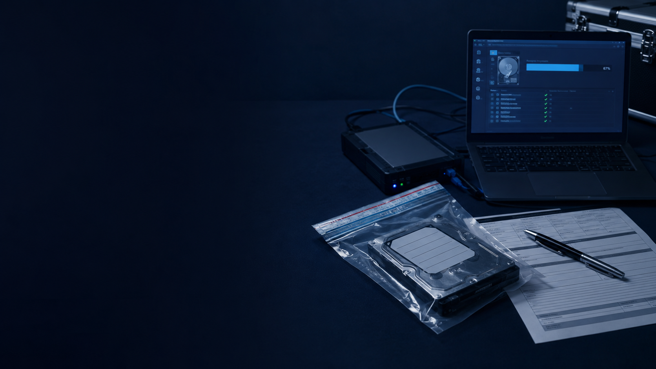
PKCERT DIGITAL FORENSICS INTERNSHIP 2026
Evidence Acquisition
& Imaging
Legal and Admissibility
Week 2 · Task 2 | Forensic Investigation Report
Group 10
Muhammad Ubaid · Imtiaz Ali · Javeria Hayat
15 July 2026

Slide 2
EVIDENCE ACQUISITION & IMAGING
Good tools are not enough for court
Digital evidence must be collected, copied, checked, and documented in a way that proves it stayed unchanged.
3 things the court needs
Integrity
The main question
Can we prove that the evidence shown in court is the same evidence that was originally found?
Authenticity
Complete record
Technical steps and legal rules work together.
PKCERT Digital Forensics Internship · Group 10
02

Slide 3
EVIDENCE ACQUISITION & IMAGING
A controlled process protects the evidence
01
02
03
04
05
06
Seize
Write-block
Image
Hash
Analyze
Document
Record device condition and location.
Stop any change to the original device.
Create a full bit-by-bit copy.
Compare digital fingerprints.
Work only on the verified copy.
Log every action and handover.
Result: the copy can be linked back to the original without unexplained changes.
PKCERT Digital Forensics Internship · Group 10
03

Slide 4
LEGAL FRAMEWORK · QSO 1984
QSO gives digital evidence legal recognition
The Qanun-e-Shahadat Order explains when electronic evidence can be accepted and proved in court.
Article 164
Modern devices and techniques
Allows courts to accept evidence produced through modern technology.
Article 73
Electronic documents
Treats electronic documents as primary evidence.
Article 78-A
Authenticity and certification
Requires the evidence to be shown as genuine and reliable.
Simple meaning: digital evidence is accepted when its source and authenticity can be proved.
PKCERT Digital Forensics Internship · Group 10
04

Slide 5
LEGAL FRAMEWORK · PECA 2016
PECA explains how evidence should be handled
QSO focuses on acceptance in court. PECA focuses on investigation, seizure, handling, and records.
Authorized seizure
The officer must have proper legal authority to seize a device or data.
Secure handling
Seized systems and data must be protected after collection.
Chain of custody
Schedule VI records each person, date, time, transfer, and reason.
Forensic lab procedure
Evidence must be handled through a controlled forensic process.
PECA turns technical work into a legally defensible procedure.
PKCERT Digital Forensics Internship · Group 10
05

Slide 6
CASE LAW
Pakistani cases show why proof and completeness matter
CASE 1
CASE 2
CASE 3
State v Ahmed Omer Sheikh
Mian Khalid Pervaiz v The State
(2021 SCMR 522)
Malik Khalid Pervez v State
A recording had no clear source and no forensic proof that it was unchanged.
The Supreme Court confirmed that digital evidence can be admitted when the correct procedure is followed.
Call data records were submitted without supporting recordings or transcripts.
Lesson: authenticity cannot be assumed.
Lesson: procedure supports admissibility.
Lesson: incomplete evidence may be insufficient.
PKCERT Digital Forensics Internship · Group 10
06

Slide 7
TECHNICAL–LEGAL MAPPING · 1 OF 2
Each acquisition step answers a legal challenge
Technical step
Legal link
What proves it
Risk if skipped
Seizure + record
PECA authorized procedure
Seizure memo, authority, device condition
Illegal collection challenge
Write-block
QSO 164 and 78-A
Write-blocker log
Claim that original was changed
Forensic image
QSO Article 73
Imaging tool report
Copy treated as unreliable
Hash before + after
QSO Article 78-A
Matching original and image hashes
No proof against tampering
Hashing and write-blocking directly support proof that the evidence stayed unchanged.
PKCERT Digital Forensics Internship · Group 10
07

Slide 8
TECHNICAL–LEGAL MAPPING · 2 OF 2
The evidence trail must continue through court
01
Analysis on copy
QSO Article 164
Analysis log shows the original was not touched.
02
Chain of custody
PECA Schedule VI
Signed record shows every handler and transfer.
03
Court presentation
QSO Articles 164 and 73
Examiner testimony and full records support the evidence.
A gap at any stage can weaken even a technically correct forensic image.
PKCERT Digital Forensics Internship · Group 10
08

Slide 9
TOP ADMISSIBILITY RISKS
Five mistakes can make strong evidence weak
01
Broken chain of custody
A missing transfer or signature creates doubt.
02
Missing or different hashes
Integrity cannot be confirmed.
03
Analysis on the original
The evidence may be changed during examination.
04
Unknown source
The origin of the evidence cannot be proved.
05
Incomplete submission
Logs without supporting records may not be enough.
Most failures are caused by weak procedure or missing proof—not by the forensic tool itself.
PKCERT Digital Forensics Internship · Group 10
09

Slide 10
PRACTICAL GUIDANCE
Our investigation should follow this checklist
COLLECT AND PRESERVE
ANALYZE AND PRESENT
Record the device state, location, date, and time.
Analyze only the verified image copy.
Use a write-blocker before connecting the device.
Sign every chain-of-custody handover.
Create a complete forensic image.
State the source of every evidence item.
Calculate and save hashes before and after imaging.
Submit full records, not isolated fragments.
If a step is not recorded, it is difficult to prove later.
PKCERT Digital Forensics Internship · Group 10
10

Slide 11
CONCLUSION
Legal admissibility is built during acquisition
QSO 1984
The key message
recognizes digital evidence and sets the basis for proving it in court.
Correct process
+ complete records
= defensible evidence
PECA 2016
guides lawful seizure, secure handling, and chain-of-custody records.
Courts need proof of integrity, source, and completeness.
Good forensic practice and legal compliance are the same workflow.
PKCERT Digital Forensics Internship · Group 10
11

Slide 12
FINAL TAKEAWAY
Preserve the original.
Prove the copy.
Document every step.
GROUP 10
Muhammad Ubaid
Imtiaz Ali
Javeria Hayat
This is what allows digital evidence to stand up in court.
Questions?
PKCERT Digital Forensics Internship · Week 2 Task 2

