Slide 1

Week 3
File-System Forensics
& Data Recovery
Scenario / Dataset Builder
Seed a disk image with deleted, hidden and renamed files for recovery practice.
dd • mkfs • shred • mv
Answer key + QA checklist
Group 10
NCERT Digital Forensics Internship

Slide 2
Task Snapshot
What we will build, why it matters, and what the dataset should test.
Objective
Main Learning
Final Deliverable
Create a realistic practice disk image for other groups to analyze. The image will include normal files, deleted files, hidden files, renamed files, and securely deleted files.
Understand how file systems store data, what happens after deletion, how hidden files are created, and why secure deletion is harder to recover.
Disk image + dataset description + build commands + answer key + QA checklist + short presentation for scenario design.
What other groups should recover
📄
Normal files
👁️
Hidden files
🗑️
Deleted files
🏷️
Renamed files
🧹
Shredded file
Visible expected files
Dot-prefix files
Recover with tools
Find by content/metadata
Understand limits
Group 10 • Week 3 • File-System Forensics & Data Recovery
02

Slide 3
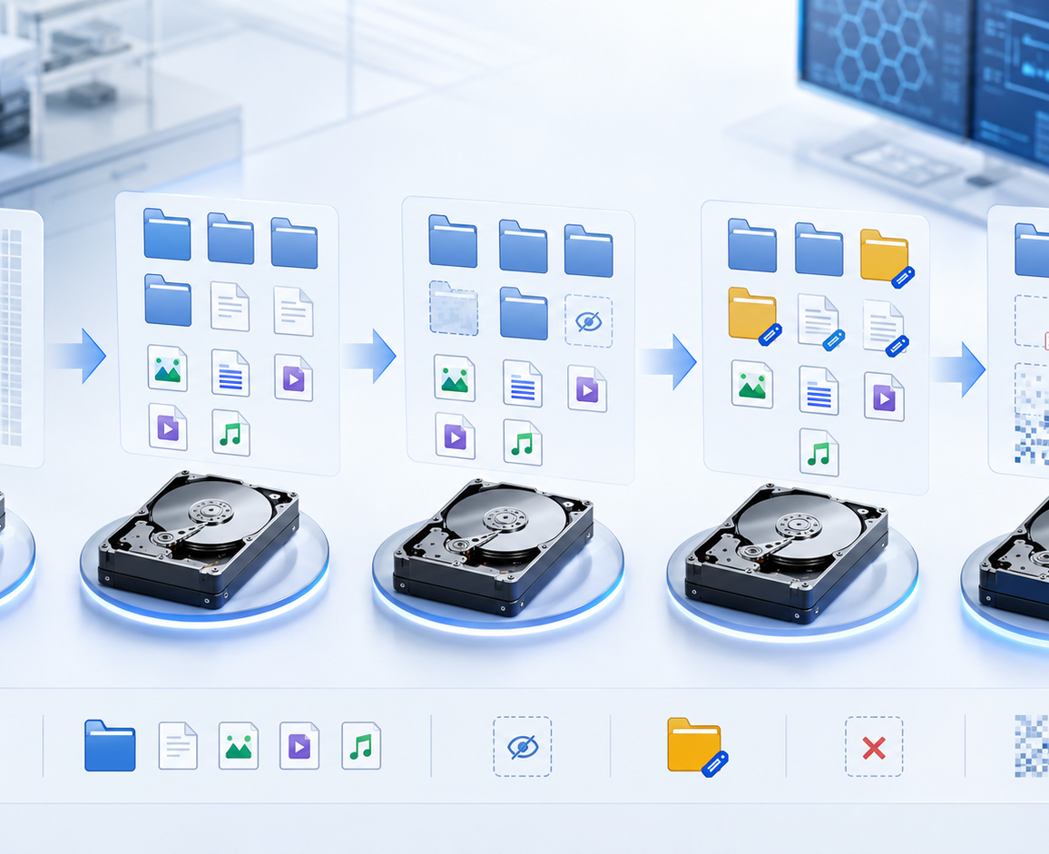
Scenario Design
A realistic story makes recovery more meaningful and easier to evaluate.
Case Story
A suspicious employee worked with project and personal files. Some files were removed, hidden, renamed, or wiped before handover.
What It Tests
File deletion recovery, hidden file discovery, renamed file identification, file type verification, and secure delete limits.
Dataset Goal
Give other groups a safe practice image where findings can be checked against an answer key and QA checklist.
Scenario name: Suspicious Employee Data Handling Case
Group 10 • Week 3 • File-System Forensics & Data Recovery
03

Slide 4
Build Workflow
From a blank disk image to a finalized forensic practice dataset.
1
Plan
2
Create Image
3
Format & Mount
4
Seed Files
5
Modify Evidence
6
Finalize
Scenario, file list, expected answers
dd creates blank disk image
mkfs creates file system; mount loop
Add normal and important files
hide, rename, delete, shred
unmount + checksum + docs
Key rule
Build once, document every step, and do not modify the image after final checksum.
dd if=/dev/zero of=week3_dataset.img bs=1M count=2048
mkfs.ext4 week3_dataset.img
sudo mount -o loop week3_dataset.img /mnt/week3case
sudo umount /mnt/week3case
sha256sum week3_dataset.img > week3_dataset_sha256.txt
Group 10 • Week 3 • File-System Forensics & Data Recovery
04

Slide 5
Inside the Dataset
Folder structure and expected file states inside the image.
/
├── Work
│ ├── meeting_notes_old.txt [renamed]
│ └── old_report.docx [shredded]
├── Personal
│ └── image.jpg [deleted]
├── Projects
│ ├── project_plan.txt [visible]
│ └── .salary_info.txt [hidden]
├── Secrets
│ └── password_notes.txt [visible]
├── Temp
│ └── temp_notes.txt [deleted]
└── readme.txt [visible]
Visible
readme.txt, project_plan.txt, password_notes.txt
Hidden
.salary_info.txt inside /Projects
Deleted
image.jpg and temp_notes.txt
Renamed
meeting_notes.txt → meeting_notes_old.txt
Shredded
old_report.docx overwritten before deletion
Group 10 • Week 3 • File-System Forensics & Data Recovery
05

Slide 6
Seeding Commands
The exact actions used to create the recovery challenges.
Normal files
Rename
Hide
echo "Meeting notes..." > /mnt/week3case/Work/meeting_notes.txt
echo "Project plan..." > /mnt/week3case/Projects/project_plan.txt
mv /mnt/week3case/Work/meeting_notes.txt \
/mnt/week3case/Work/meeting_notes_old.txt
mv /mnt/week3case/Secrets/salary_info.txt \
/mnt/week3case/Projects/.salary_info.txt
Delete
Secure delete
rm /mnt/week3case/Personal/image.jpg
rm /mnt/week3case/Temp/temp_notes.txt
shred -u -n 3 /mnt/week3case/Work/old_report.docx
Tip: keep a copy of every command in the report so the dataset can be verified and rebuilt.
Group 10 • Week 3 • File-System Forensics & Data Recovery
06

Slide 7
Answer Key & QA Checklist
The dataset is only useful if the expected results are clear.
Answer key
QA checklist
Visible
readme.txt, project_plan.txt, password_notes.txt
Should appear normally
✓
Image exists and opens
Hidden
.salary_info.txt
Found with ls -la / forensic tool
✓
EXT4 file system works
✓
Folders match report
Deleted
image.jpg, temp_notes.txt
Recoverable or partial
✓
Hidden file discoverable
Renamed
meeting_notes_old.txt
Identify by content
✓
Deleted file recovery can be attempted
Shredded
old_report.docx
Not fully recoverable
✓
Checksum generated
✓
Answer key completed
Group 10 • Week 3 • File-System Forensics & Data Recovery
07

Slide 8
Final Deliverables & Presentation Focus
What we will submit and what we will explain in 3–5 minutes.
Report
Dataset Package
Presentation
Dataset description
Scenario story
Tools and commands
Build steps
Answer key
QA checklist
week3_dataset.img
SHA-256 checksum
Documentation folder
Answer key file
Screenshots
Scenario design
What the image tests
Build workflow
Expected recovery tasks
Risks and limitations
Closing message
A good forensic dataset is not just a disk image. It needs a clear scenario, controlled evidence, documentation, and an answer key for verification.
Ready for teacher review and group testing.
Group 10 • Week 3 • File-System Forensics & Data Recovery
08

