Slide 1

Registration no: 12201238 Name: Imtiyaz Amad Bhat. Roll no: 50.
CA3: Data science toolbox practical work.
We will start with the data Analysis . Firstly, we will download the dataset known as heart disease failure detection dataset,
where we will do the Analysis through Machine learning models
like Linear and multiple Regression methods . This Dataset has been downloaded from the Kaggle.com website where you will be able to download and analyze the data with the help of
python libraries which we can use through Jupiter notebook server or goggle colab platforms . So, we go through the numerous steps of instruction where we will be analyze the data from one branch to another with the following steps given below:

Slide 2
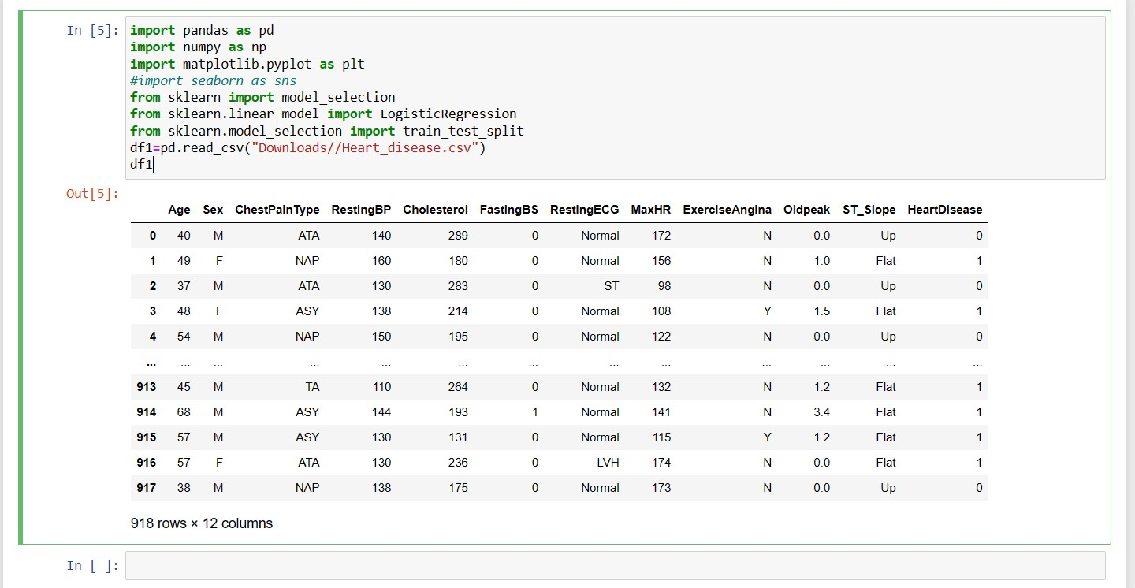
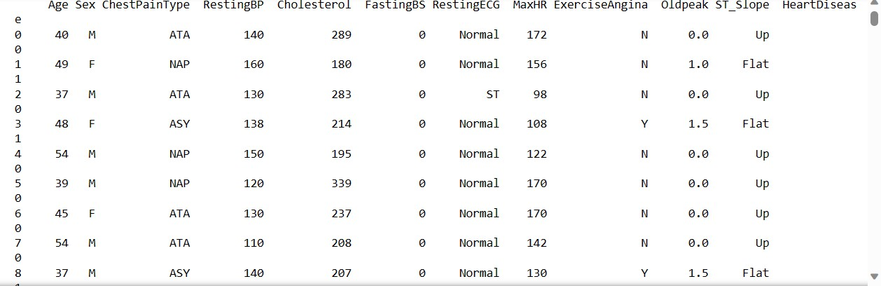
•
Now we will move forward only for EDA (Exploratory Data
Analysis).
Now I will only upload the screenshots of an working area.
•
This to string() function will print dataset as a whole.

Slide 3
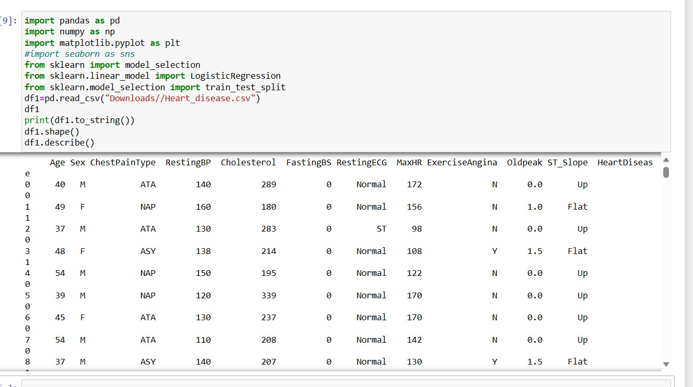
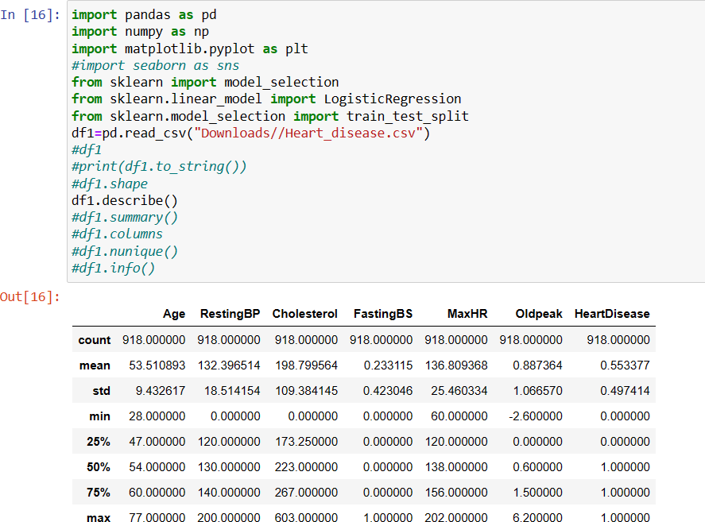
•
•

Slide 4
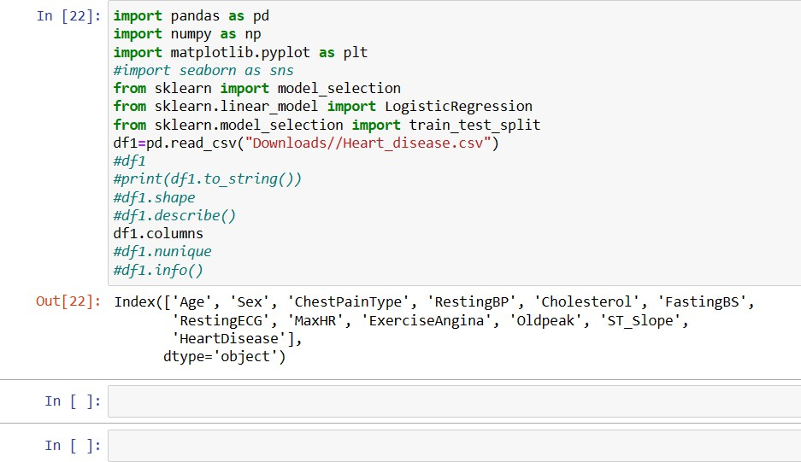
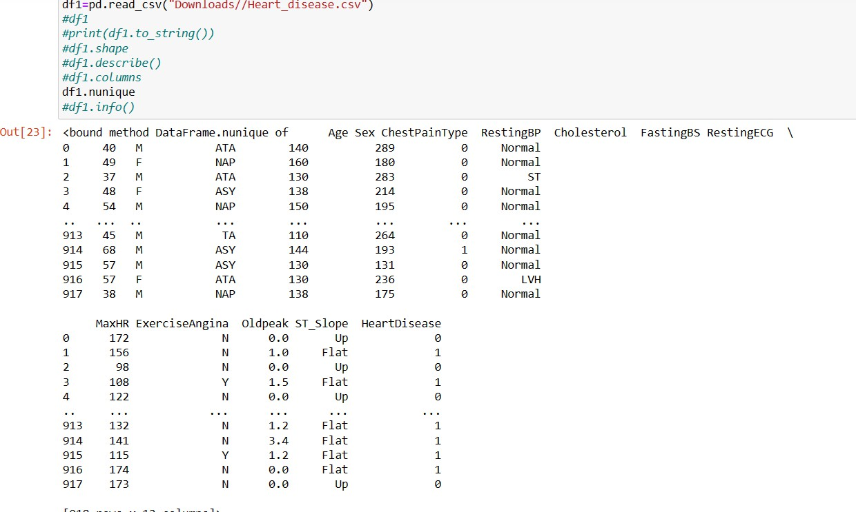
•
These are columns and describe commands .
•
Now data information by using data.info() command.

Slide 5
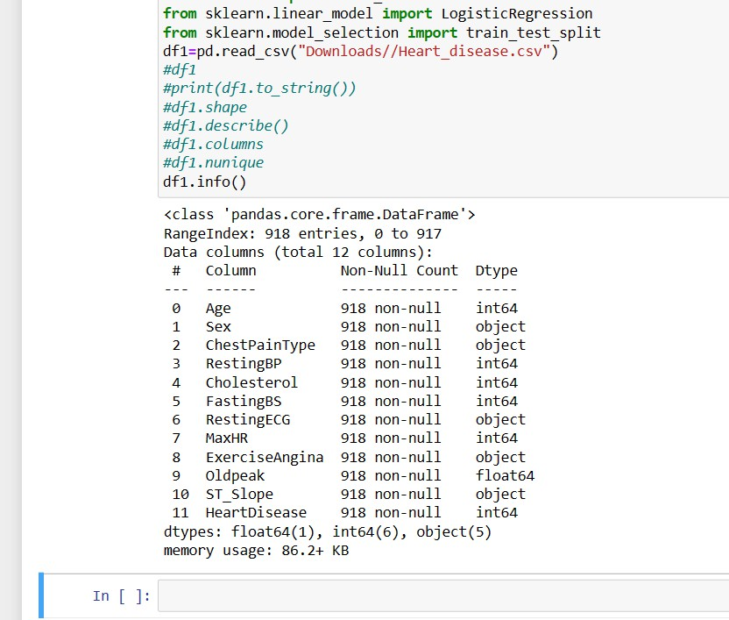
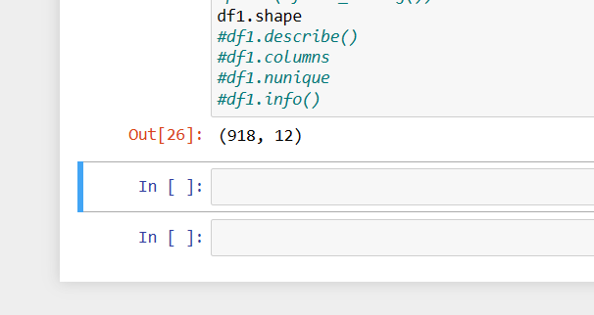
•
•

Slide 6
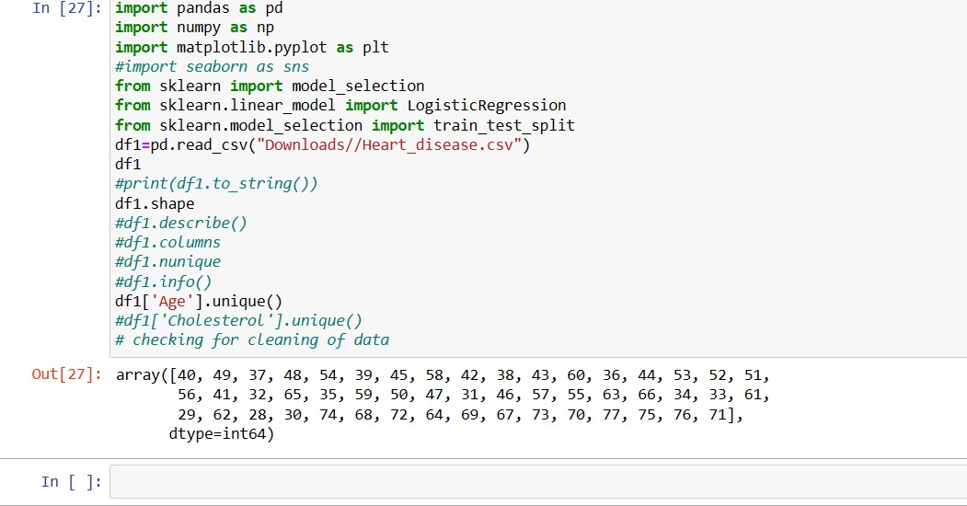
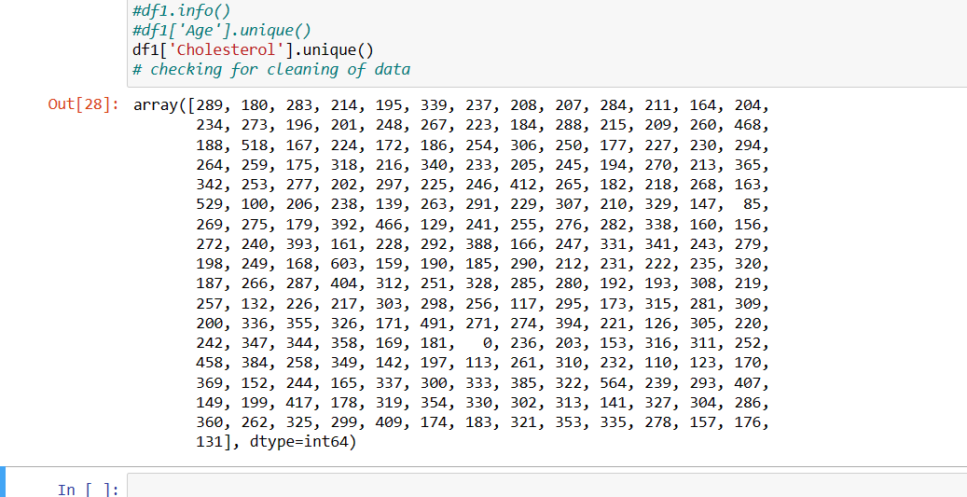
•
We are checking the uniqueness of the data.
•
We are now checking the uniqueness of the Cholesterol of the
data column.

Slide 7
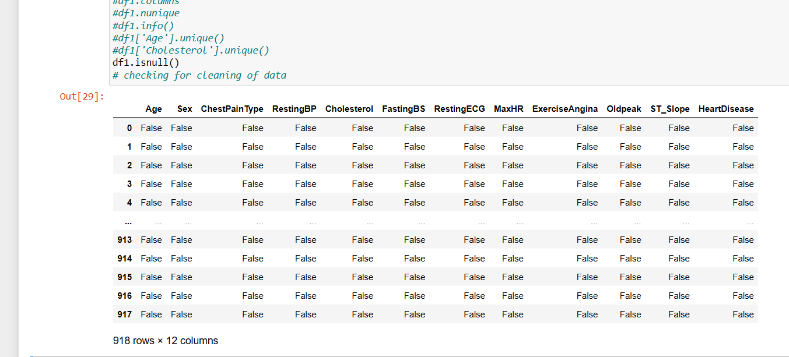
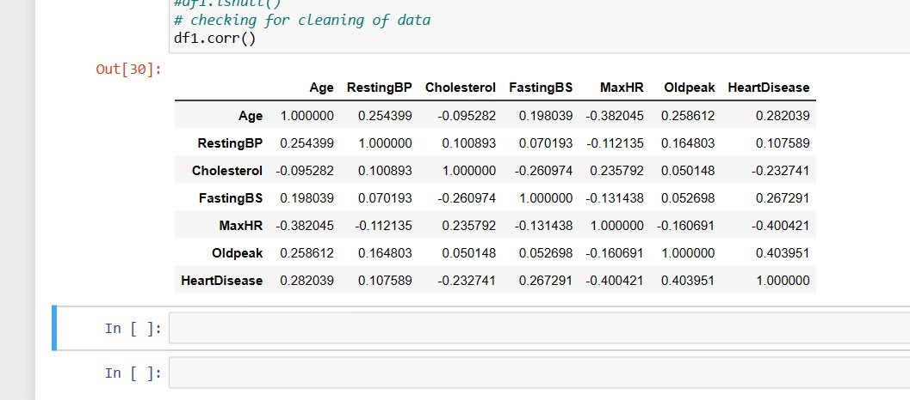
•
By the grace of the Almighty lord there is no null value in this
entire dataset.
Explore further for Analysis.
•
There is a correlation between the rows and columns.
2. Feature Selection of the dataset : We will use the columns and rows for data Analysis through correlation matrix.

Slide 8
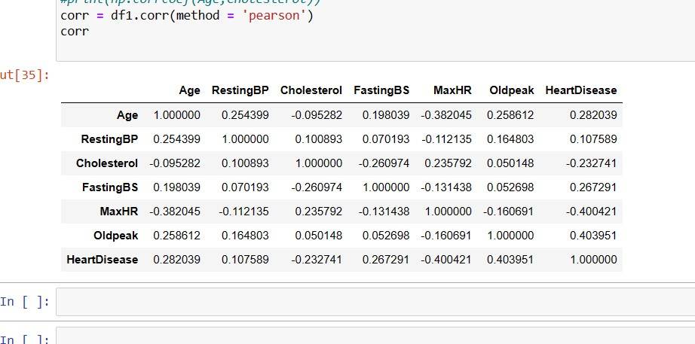
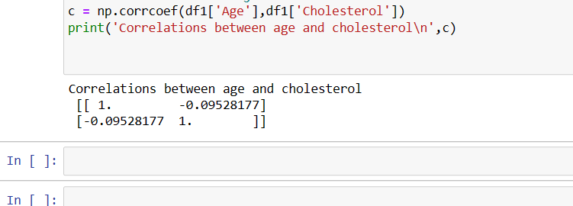
•
We have checked the correlation matrix using Pearson method.
Now we will check the relationship between the two dataset columns using corer method .
•
We can do it on many columns like Age and Rest Bp. We will try
to see if a person goes older his Bp will increase or decrease in this case of dataset.

Slide 9
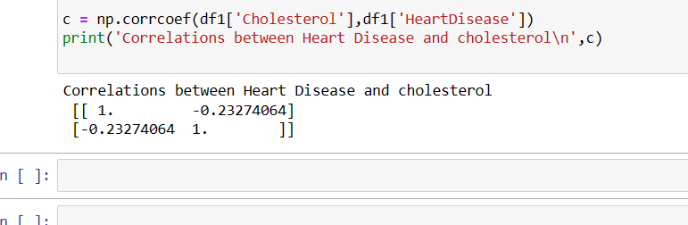
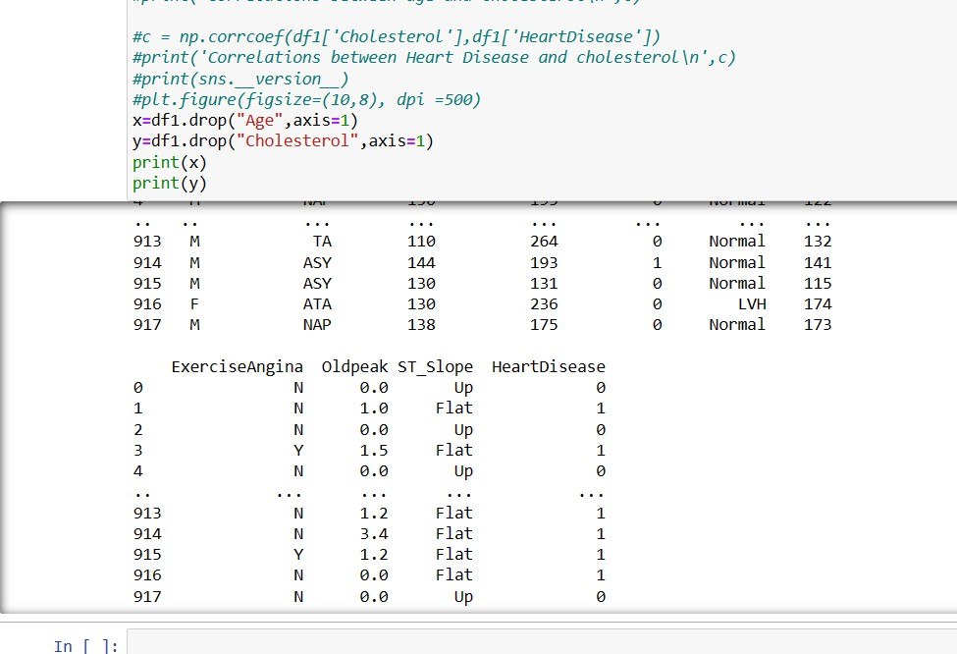
•
Now last step we will build the model and evaluate the model .
Based on that we will make the decision, or we can get the proper results through methods and also visualization. Here we will generate the model and evaluate the outputs from the coming datasets through various visualizations okk.
Now look at the process .
•

Slide 10
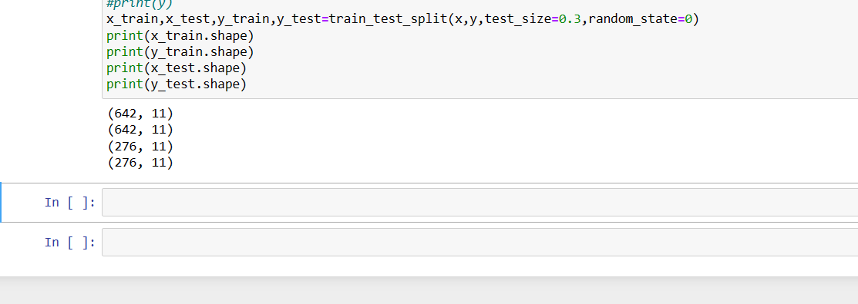
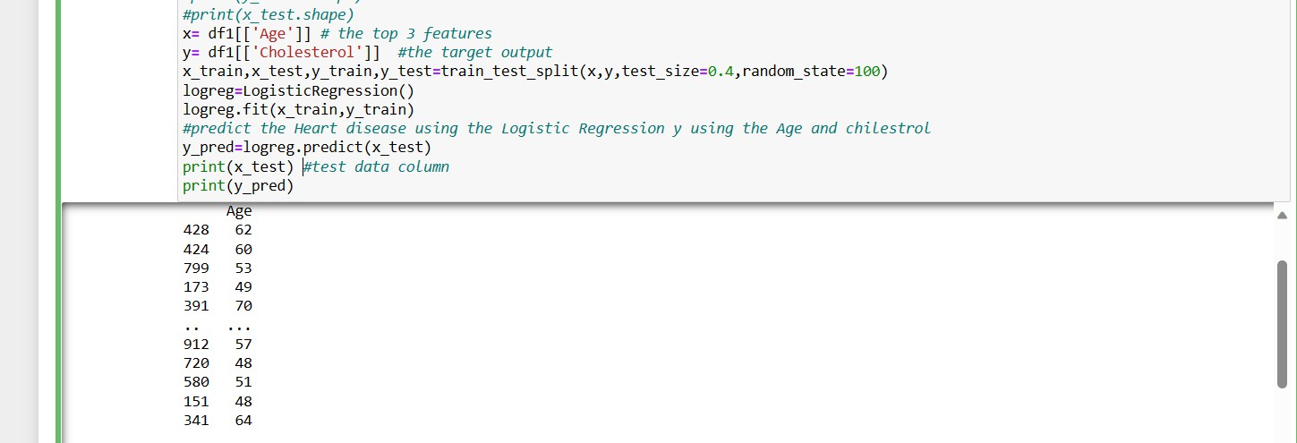
Now you have seen we have dropped the columns . Now on the basis of that we can do the Linear regression practices on the dataset.
Now splitting the data into an training and testing sets.
•
Now further implementation on the dataset.
•
I will show you to the more output of this model.

Slide 11
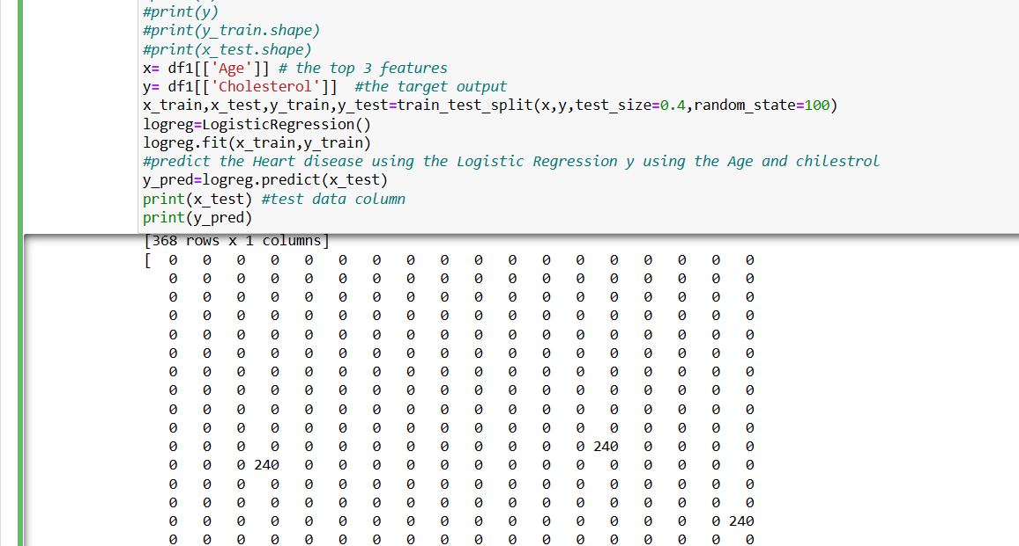
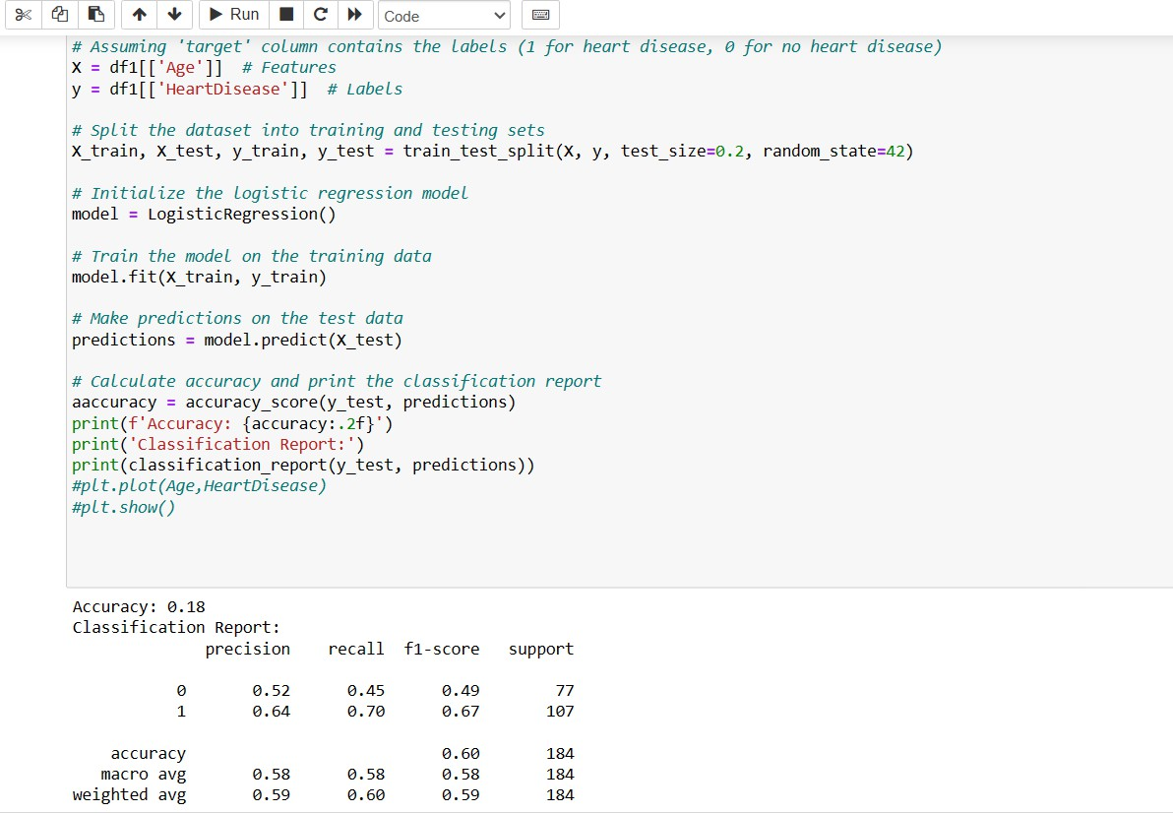
•
Now we will do regression analysis as well classification together
. I will show you in the below code .
•

Slide 12
In future we will do more analysis on that very particular dataset when I will be able to handle the data as a whole ,
THANKU .

