Slide 1
AIR QUALITY MANAGEMENT SYSTEM
Prepared by : Imtiyaz Tariq
Emp Id: 2155538

Slide 2
Introduction
Post COVID-19 monitoring air quality inside office buildings to provide safe environment for employees to work is very crucial. Air Quality Management System(AQMS) is a solution to address such necessity.

Slide 3
Use Case Statement
From the recent learning of the Pandemic, detecting levels of pollutants is crucial to make Work-From-Office safe, secure and possible.
It is decided to implement a continuous air quality monitoring system to make Work-From-Office safe and secure for all the employees.
The continuous air quality monitoring sensor systems are to be installed for each floor; the company is spread across three floors. The building is 3 floors. The air quality data from the sensors is transmitted to a Cloud based web-server.
The streaming sensor data is stored on Cloud based web-server. Air Quality data streamed from the sensors are continuously monitored and when the air quality level exceeds threshold values, the alerts and preventive actions are to be communicated to the individuals in the office premises to their desktop and Smartphone

Slide 4
Solution Proposed
Design an air quality monitoring system that can cover each floor of the office building
Monitor air quality index through sensors installed in each floor
Provide alerts and preventive actions to employees' smartphones when the air quality level exceeds threshold values
Provision to be made where alerts to be sent when pollutant level is out of range and users can access the application to view the status anytime.
to ensure full coverage of each floor span,
Air Quality Sensors to be installed adjacent to every existing node of overhead Smoke Detecting Sensors
Additionally, Air Quality Sensors to be installed in Smoking Zones on each floor
The sensors shall be connected to a microcontroller to control the sensors network
Data collected by microcontroller is transmitted to the cloud-based web-server for storage
Application on cloud-based web-server Analysis data
The whole system is to be fully integrated and automated with no need for manual intervention and independent of manual monitoring

Slide 5










Existing system
.NET API
Error log
Logic apps
notification to outlook mailbox
Dashboard
deviceError = true
IOT Hub
Blob
ADF Pipeline
Device Simulator
Threshold Breach = true
Database
Service Bus Queue
Logic apps
notification to outlook mailbox

Slide 6
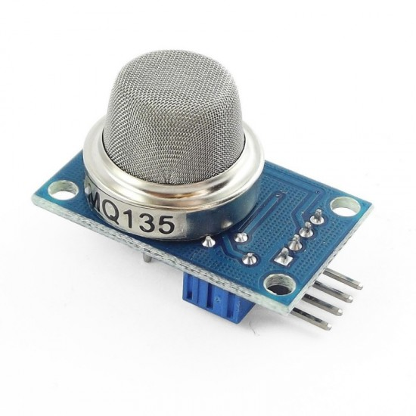

Existing system
.NET API
Error log
Logic apps
notification to outlook mailbox
Dashboard
deviceError = true
IOT Hub
Blob
ADF Pipeline
Air Quality Sensors Connected to Raspberry Pi
Threshold Breach = true
Database
Service Bus Queue
Logic apps
notification to outlook mailbox

Slide 7
Services Used In Azure
App services
IOT Hub
Storage Account
Azure Data Factory
Azure Logic Apps
Service Bus
Azure SQL Database

Slide 8
Backend (.NET Web API) Architecture
Register Method
Register
Stores user in the Db
Login method(returns JWT)
Login
Returns a token if user exists
Database
Sensors
Get Sensor data
Get request( with token)
Returns data if token is valid

Slide 9
Frontend(UI) Snapshots

Slide 10
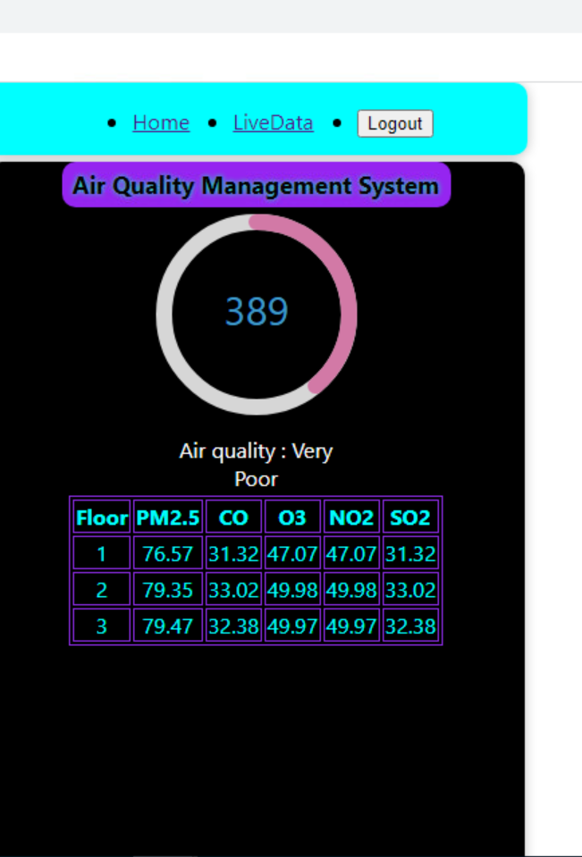
Homepage
Navigation Bar
Air Quality Index Meter
Air Quality Text
Floor-wise average data

Slide 11
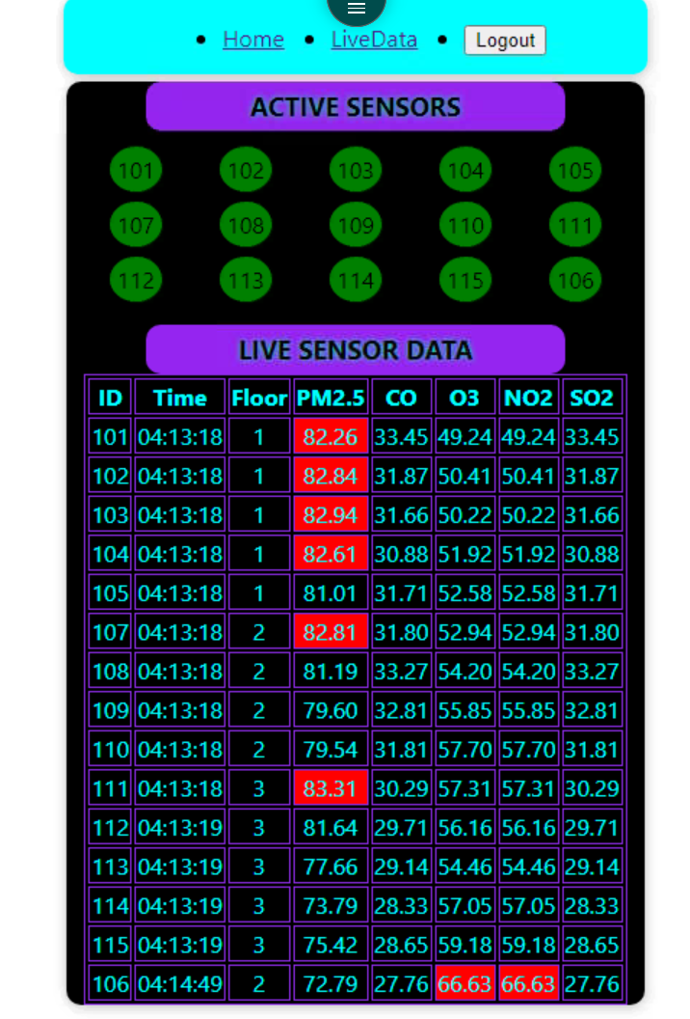
LiveData (Shows data from each sensor)
IDs of all the sensors that are transmitting data, if there’s a malfunctioning sensor we’ll know from here.
Live Data (Values which breach the safe threshold are shown in red)

Slide 12
Thank you

