Slide 1

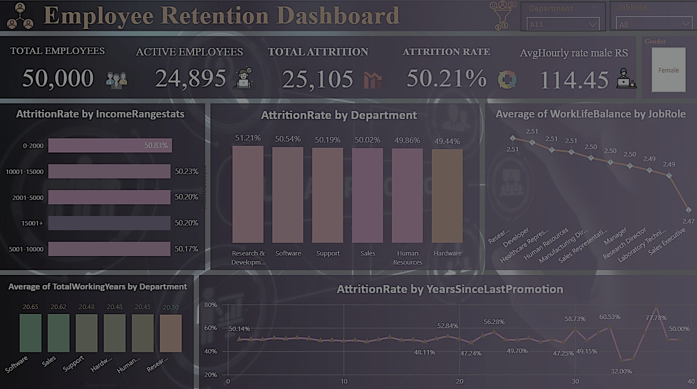

Employee Retention Project
Domain : HR Analytics
Group Members
IMTIYAZ PASHA
MOHAMMED ASIF
Apurwa Ekanath Bandivadekar
Susmita
Sourav Mahajan
VISHNU

Slide 2
Introduction
In this project represents a focused effort to utilize HR data for driving strategic decision-making. By analyzing critical workforce metrics, we aim to uncover actionable insights that will help the organization foster a productive and satisfied workforce.
What is Employee Retention?
Definition: The ability of an organization to retain its employees over a specific period.
Importance: Reduces recruitment costs, maintains institutional knowledge, and promotes organizational stability.
What is Employee Attrition?
Employee attrition refers to the reduction in an organization's workforce due to employees leaving voluntarily or involuntarily, and these positions are not immediately replaced
Project Goal:
To analyze retention trends, identify key factors influencing employee retention, and provide actionable insights.

Slide 3
Data Overview
Sources of Data:
Employee records, payroll data, satisfaction surveys, and promotion history.
Key Metrics in the Data:
Number of Employees : 50k
Number of Departments : 6 departments
Number Education Field : 6
Number Job Role : 10
Average Monthly Income : 26,015/month
Average Job Satisfaction : 2.4
Work Life Balance

Slide 4
Data Overview
Data Categories:
Highlight key variables used in analysis:
Demographics : Age, gender, education level.
Job Information : Job role, department, work-life balance score.
Compensation : Monthly income, hourly rates.
Promotions : Years at the company, years since last promotion.
Attrition Data : Status (active/left), reasons for attrition.

Slide 5
Objectives and KPIs
Objectives:
Understand workforce trends.
Identify attrition drivers.
Assess work-life balance impacts.
Provide actionable insights for HR strategy.
KPIs:
Average Attrition Rate for All Departments.
Average Hourly Rate of Male Research Scientists.
Attrition Rate vs. Monthly Income Stats.
Average Working Years for Each Department.
Job Role vs. Work-Life Balance.
Attrition Rate vs. Years Since Last Promotion.

Slide 6
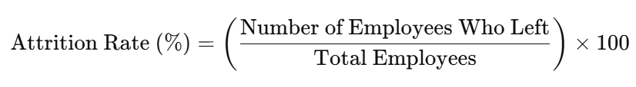
Average Attrition Rate for All Departments
The attrition rate represents the percentage of employees who leave the organization over a specific period. This KPI measures the average attrition rate across all departments to identify which areas experience higher turnover and require attention.
Importance of This KPI
Workforce Stability
2.Cost Implications
3.Productivity Impact
4.Employee Morale
Key Observations
High Attrition Departments: Research & Development (R&D) show departments show the highest attrition
Low Attrition Departments: Hardware show the low attrition, indicating higher job satisfaction or stability.
Possible Causes:
High pressure or workload in sales.
Limited career growth in HR roles.

Slide 7
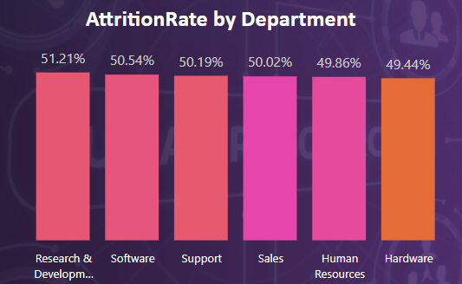
Visuals : Bar Chart: Attrition rates by department

Slide 8
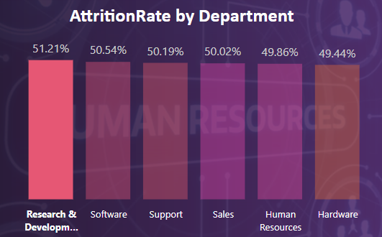
High Attrition Departments

Slide 9
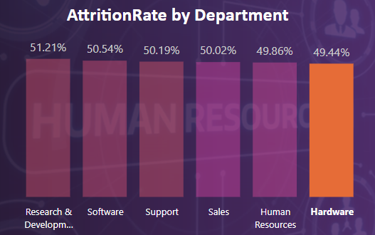
Low Attrition Departments

Slide 10
Average Hourly Rate of Male Research Scientists
Definition: This KPI calculates the average hourly pay for male research scientists within the organization. It is used to understand compensation patterns for a specific role and demographic.
Compensation Analysis:
Helps assess whether salaries are competitive within the industry for this role.
Identifies if male research scientists are fairly compensated in comparison to their counterparts in similar roles or organizations.
Workforce Satisfaction:
Directly impacts employee satisfaction and retention, especially in specialized roles like research scientists.
Fair compensation ensures motivation and productivity.
Budget Allocation:
Guides resource allocation for payroll and identifies cost optimization opportunities.
Diversity Consideration:
Sets the stage for comparing male and female compensation, ensuring equity across the workforce.

Slide 11
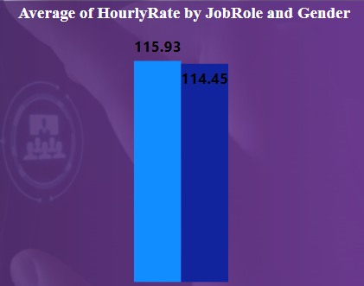


Visuals to Include:
Bar Graph: Average hourly rate of male research scientists

Slide 12
Attrition rate Vs Monthly income stats
Definition: This KPI examines the relationship between employee attrition rates and their monthly income levels. It identifies patterns that link compensation to employee retention and highlights whether income disparity contributes to turnover.
Data Source: Employee attrition data linked with monthly income.
Importance of This KPI:
Understanding Attrition Drivers:
Low monthly income may lead to dissatisfaction and higher turnover.
Identifies income thresholds that significantly impact retention.
Workforce Segmentation:
Helps categorize employees into risk groups based on income (e.g., low, mid, and high earners).
Compensation Policy Optimization:
Guides salary adjustments to minimize attrition.
Supports evidence-based decisions on structuring pay scales.

Slide 13
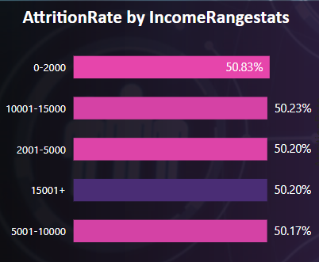
Visuals to Include:
Column Chart: Attrition rate for each income bracket.

Slide 14
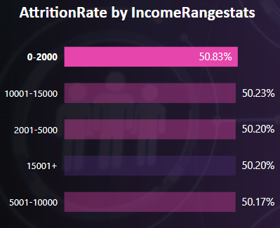
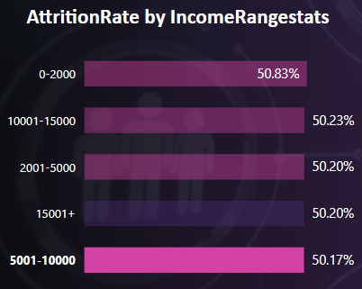
Key Observations
Higher Attrition in Income Brackets
Low Attrition in Income Brackets

Slide 15
Average working years for each Department
Definition: This KPI measures the average number of years employees have spent working in each department. It provides insights into employee tenure and the department's ability to retain talent over time.
Data Source: Employee records with start dates and current working years.
Importance of This KPI:
Retention Insights:
Highlights which departments succeed in retaining employees for extended periods.
Identifies departments with higher turnover rates.
Workforce Experience:
Longer tenure indicates experienced teams, which can positively influence productivity and mentorship.
Shorter tenure may suggest high attrition or the need for stronger retention strategies.
Organizational Stability:
Analyzing tenure across departments helps assess overall workforce stability and predict areas requiring intervention.

Slide 16
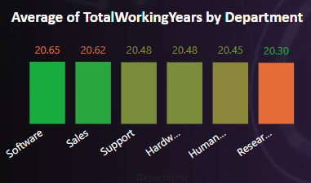
Visuals to Include:
Bar Chart: Average working years for each department.

Slide 17
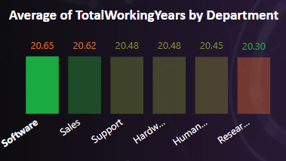
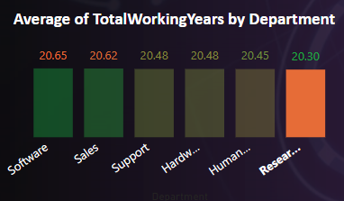
Key Observations
Software department has the highest average working years of 20.65 years, indicating employee satisfaction and career growth opportunities.
R&D department show an average of 3 years, likely due to high-pressure roles and competitive industry dynamics

Slide 18
Job Role Vs Work life balance
Definition: This KPI examines the relationship between different job roles and their perceived work-life balance scores. It highlights how employees across various roles rate their ability to manage work responsibilities alongside personal life, providing insights into job satisfaction and organizational culture.
Importance of This KPI:
Employee Well-Being:
Work-life balance is a critical factor influencing job satisfaction, mental health, and productivity.
Roles with poor scores may lead to burnout and higher attrition rates.
Identifying High-Pressure Roles:
Highlights roles where employees struggle to balance their professional and personal lives.
These roles may require workload redistribution or additional support.
Retention and Recruitment:
A good work-life balance enhances employee retention and serves as a competitive advantage when recruiting top talent.
Improving Organizational Culture:
Insights from this KPI can guide policy changes, such as flexible work arrangements or wellness initiatives.

Slide 19
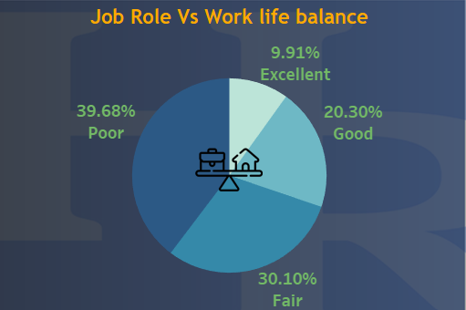
Visuals to Include:
Pai Chart: Average working years for each department.

Slide 20
Attrition Rate VS. Years Since Last Promotion Relationship
Definition: This KPI examines the relationship between employee attrition rates and the number of years since their last promotion. It highlights how career progression impacts employee retention and helps identify if lack of advancement opportunities contributes to turnover.
Importance of This KPI:
Career Growth as a Retention Driver:
Employees who feel stuck in their roles without promotions are more likely to leave for better opportunities.
This KPI helps uncover the critical time thresholds where employees become dissatisfied with career progression.
Talent Retention:
Identifies departments or roles where delayed promotions result in higher attrition, allowing targeted interventions.
Organizational Competitiveness:
Timely promotions enhance employee engagement and make the organization attractive to top talent.
Resource Planning:
Helps predict turnover risks and plan for talent gaps in critical roles.

Slide 21
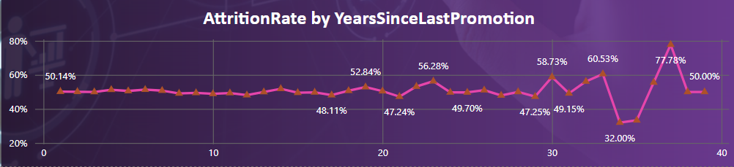
Visuals to Include:
Line Chart: Attrition rate as a function of years since last promotion.
Key Observations:
Moderate Attrition for 0–20 Years Since Promotion:
Attrition begins to rise, reaching 52%, as employees feel stagnant.
High Attrition for >20 Years Since Promotion:
Employees who have not been promoted for over 5 years exhibit a (52-77.7)% attrition rate, often leaving due to frustration with career stagnation.

Slide 22
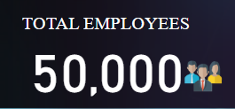
Cards
Total Employees
Definition: This card displays the total number of employees in the organization. It includes both active employees and those who have left.
Our total workforce, including both current and former employees, reflects the scope of our talent base and sets the context for deeper analysis.
Formula:
Total Employees=Active Employees + Total Attrition
Purpose:
Provides a snapshot of the organization's workforce size.
Serves as a baseline for calculating other metrics like attrition rate.

Slide 23
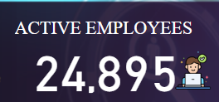
2. Active Employees
Definition: The number of employees currently working in the organization.
Currently, we have X active employees contributing to our operations, ensuring the organization’s productivity and success.
Formula:
Active Employees=Total Employees−Employees Who Left
Purpose:
Reflects the current workforce strength.
Helps in resource planning and workload distribution.

Slide 24
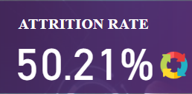
3. Attrition Rate
Definition: The percentage of employees who have left the organization over a specified period.
Our attrition rate is Y%, reflecting trends in employee retention and offering insights into areas for improvement.“
Formula:
Purpose:
Indicates the overall turnover rate of the organization.
Helps in evaluating employee retention strategies.

Slide 25
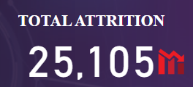
4. Total Attrition
Definition: This card shows the total number of employees who have left the organization.
A total of Z employees have left the organization, helping us pinpoint trends and strategize for better retention."
Formula:
Total Attrition= Total Employees - Employees Who Left the Organization
Purpose:
Helps identify the scale of turnover.
Can be analyzed further by department, role, or tenure for deeper insights.

Slide 26
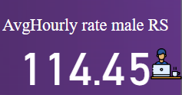
5.Average Hourly Rate of Male Research Scientists
Definition: This card displays the average hourly wage earned by male research scientists in the organization. It provides insights into compensation trends for a key demographic in a critical job role.
Usefulness in Presentation:
Compensation Benchmarking
Budget and Resource Allocation
Gender-Based Analysis
Purpose:
Show how this rate has changed over time to highlight adjustments for inflation or market competitiveness.

Slide 27
Employee Attrition Dashboard
Power-bi
Excel
Tableau

Slide 28
Employee Attrition Dashboard
Excel
Power-bi
Tableau

Slide 29
Excel: Employee Attrition Dashboard
Excel
Power-bi
Tableau

Slide 30
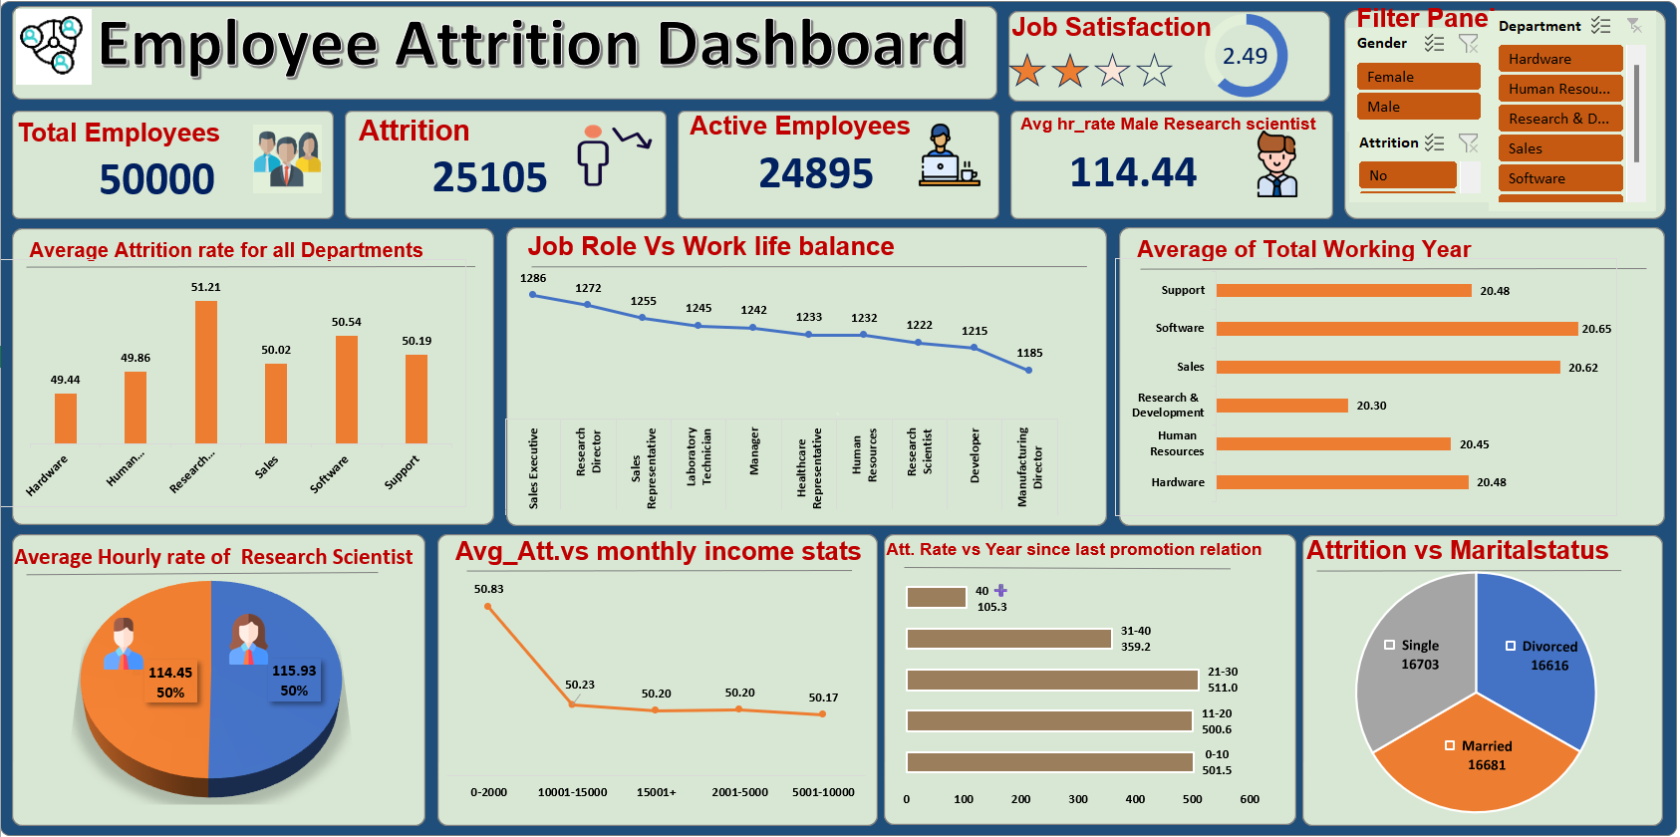

Slide 31
Employee Attrition Dashboard
Excel
Power-bi
Tableau

Slide 32
Power Bi: Employee Attrition Dashboard
Power-bi
Excel
Tableau

Slide 33
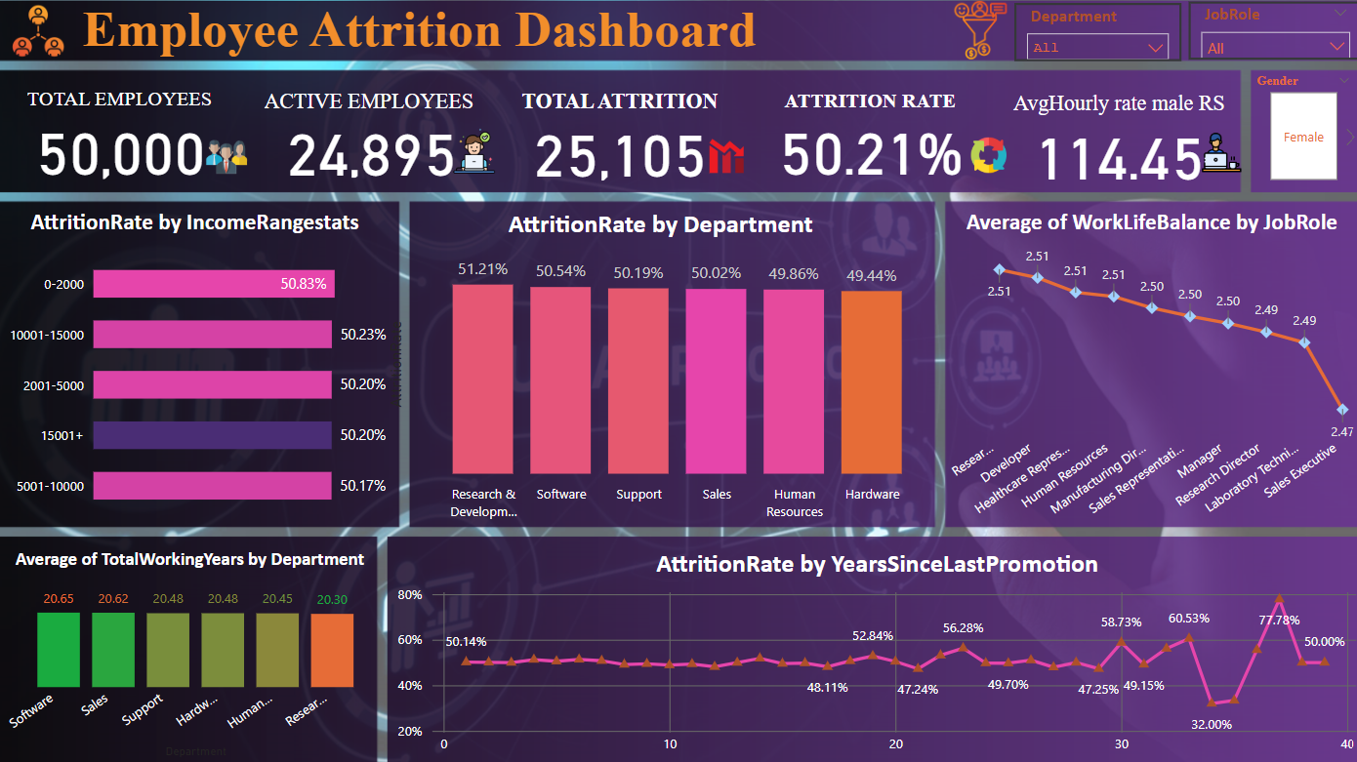

Slide 34
Employee Attrition Dashboard
Excel
Power-bi
Tableau

Slide 35
Tableau: Employee Attrition Dashboard
Tableau
Excel
Power-bi

Slide 36
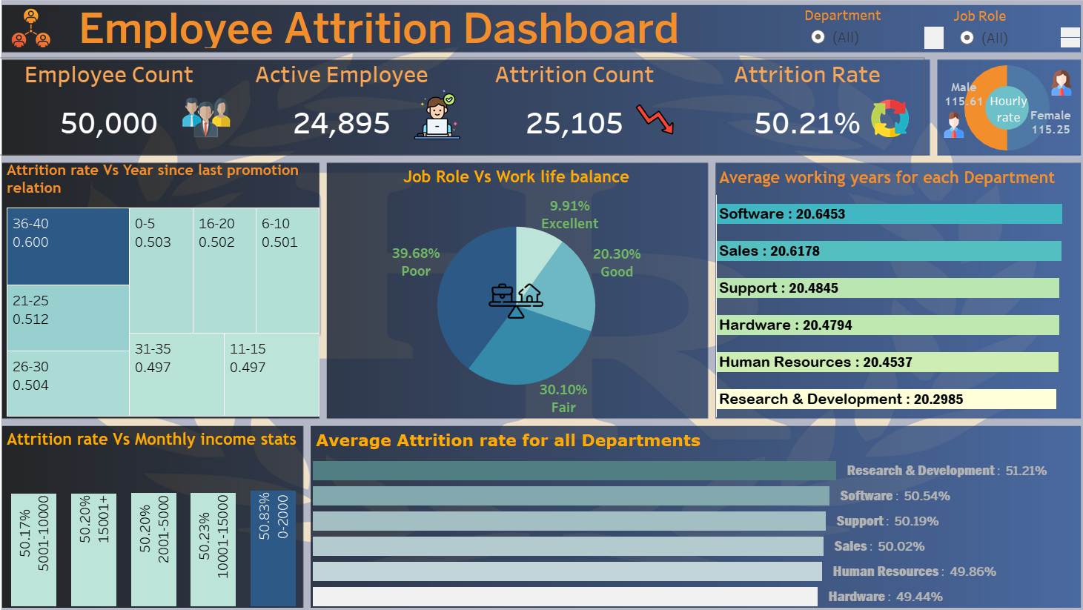

Slide 37
Insight
Focus on High Attrition Areas: Departments with attrition rates above the company average need targeted interventions.
Revise workload or provide career growth opportunities In department R&D.
Research & Development =51.21% Human Resources 50.57%
Hardware = 49.44% Research Scientist 48.19%
Gender Pay Equity : This KPI can also be used as a baseline to compare with female research scientists, ensuring fair pay Practices.
Income as a Attrition Factor:
Employees with low income may leave for better-paying opportunities, especially in competitive industries.
High-income earners exhibit greater loyalty, likely due to job satisfaction and financial stability.
Targeted Attrition Strategies:
Focus on addressing concerns of employees in the low-income group through salary adjustments or additional benefits.
Identify if low pay is concentrated in specific roles or departments.

Slide 38
Focus on Low-Scoring Roles:
Sales Executives and Managers with low scores may require workload adjustments or additional support, such as flexible scheduling.
Poor work-life balance in these roles may explain higher attrition rates or lower productivity.
Leverage High-Scoring Roles:
Roles with high work-life balance scores, such as R&D, can serve as benchmarks for improvement.
Overall Organizational Trend:
If most roles score poorly, it may indicate systemic issues such as high workloads or rigid work policies
Job Satisfaction:
High job satisfaction reduces turnover rates and promotes employee loyalty
Satisfied employees are more engaged, efficient, and likely to exceed expectations.
Research & Development =2.51 Healthcare Representative = 2.52
Software = 2.46 Manufacturing Director = 2.46

Slide 39
Performance and Organizational Success: High performance drives innovation, customer satisfaction, and profitability. Organizations that prioritize performance a) Increase productivity b)Enhance employee retention.
Research & Development =2.51 Human Resources 2.53
Sales = 2.48 Healthcare Representative 2.4
Promotion Delays Impact Retention:
Employees without promotions for extended periods are more likely to leave.
Roles or departments with frequent delays in promotions should be prioritized for review.
Early Intervention Opportunities:
The attrition trend shows critical time thresholds (e.g., after 3 years) where dissatisfaction begins to rise. Addressing career development proactively could mitigate risks.

Slide 40
Recommendations
Training & Development: Offer professional growth opportunities to improve retention.
Retention Strategy : Provide performance-based incentives or salary hikes for research scientists.
Internal Equity Audit: Ensure research scientists’ pay aligns with their experience, contributions, and similar roles across departments.
Flexible Work Arrangements: Offer remote work or hybrid schedules for roles with low work-life balance
Resource Allocation: Provide additional team members or support for roles with high workloads, such as Sales and Management.
Timely Promotions: Establish clear and achievable promotion paths for all roles to ensure employees feel valued
Career Development Programs: Offer alternative career growth opportunities, such as leadership training, for employees who might not be eligible for immediate promotions.
Regular Feedback: Implement biannual reviews to discuss career progression and gather feedback from employees on their growth expectations.
Recognition and Rewards : Acknowledge employee contributions regularly, even without formal promotions, to maintain morale and motivation.

Slide 41
Conclusion
In this project, we analyzed key HR metrics to uncover actionable insights into workforce trends, employee engagement, and organizational efficiency. By exploring correlations such as years since last promotion and attrition, and the impact of job roles on work-life balance, we identified critical areas for improvement.
Our findings emphasize the importance of timely promotions, equitable compensation, and targeted employee support programs. This analysis highlights how HR analytics can transform data into strategies that optimize workforce planning, enhance employee satisfaction, and strengthen the organization’s competitive edge.

Slide 42


