Slide 1
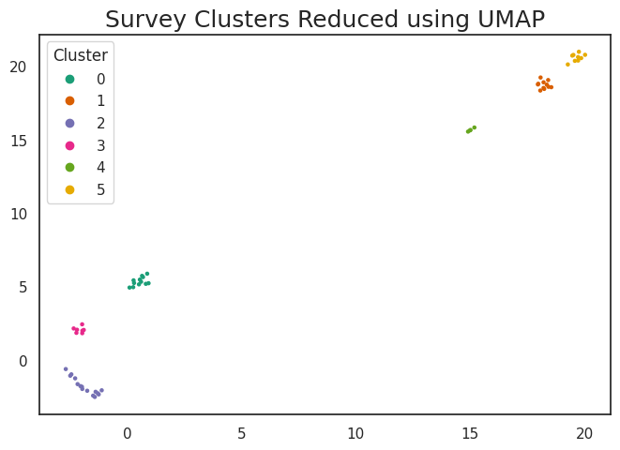
Cluster | Rules
0 | No Tribal Governance Discussion Focus on State
1 | No Community Discussion Focus on Maintenance
2 | No Continuing Education Discussion
3 | No Equipment discussion Focus on End User
4 | No Lab discussion Discusses background
5 | Focus on Environment and equipment installation

Slide 2
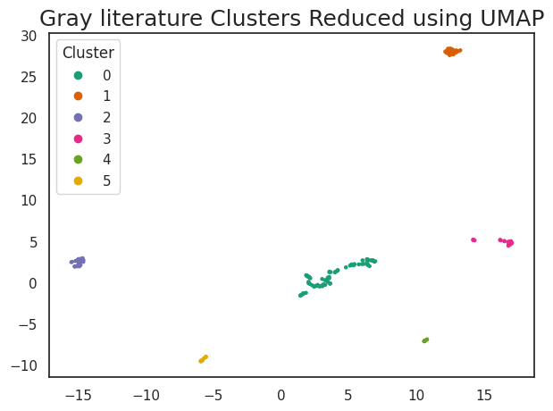
Cluster | Rules
0 | Not Stage Specific Federal Policies
1 | No Environment, Stage Specific, or regulations
2 | N/A
3 | n/a
4 | No Rules
5 | No Focus on Federal Policies or Background, Focused on system operators

Slide 3
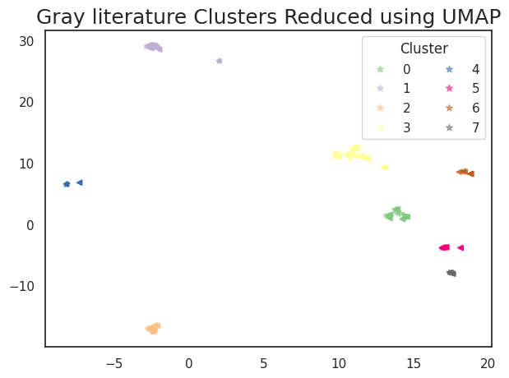
Cluster | Rules
0 | Background information but not Tribal Governance
1 | Federal Policies but no chemicals
2 | Environment and Regulations
3 | Not State or Potable Water
4 | Not Environment Potable Water
5 | Not Potable Focused on Water Received by the User System Breakdown
6 | No Focus on Federal Policies or Background, Focused on Strategic Planning
7 | No Rules

