Slide 1

A .NET Object from allocation to collection
Maoni Stephens
09/28/2021

Slide 2
Our very first object
public static int Main()
{
// class MaoniType has 2 int fields
MaoniType o = new MaoniType(128, 256);
// more stuff
return 0;
}
We want to see our very first object in memory

Slide 3
How do we do that?
public static int Main()
{
MaoniType o = new MaoniType(128, 256);
Console.ReadLine();
// more stuff
return 0;
}
I’ll use the SoS extension in windbg

Slide 4
We break into the debugger when ReadLine is waiting
0:008> !dumpheap -stat
Statistics:
MT Count TotalSize Class Name
00007ff9f3cc3478 1 24 System.Threading.Tasks.Task+<>c
00007ff9f3cad2d8 1 24 System.IO.Stream+NullStream
00007ff9f3ca7b60 1 24 System.IO.SyncTextReader
00007ff9f3ca3598 1 24 MaoniType
[omitted]
00007ff9f3bbb590 7 18056 System.Object[]
00007ff9f3cc4128 1 32792 System.Char[]
00007ff9f3c6d448 56 69466 System.String
Total 168 objects

Slide 5
Finding our object in memory
0:008> !dumpheap -type MaoniType
Address MT Size
000002b1447e3848 00007ff9f3ca3598 24
Statistics:
MT Count TotalSize Class Name
00007ff9f3ca3598 1 24 MaoniType
Total 1 objects

Slide 6
How are objects laid out in memory
0:008> !eeheap -gc
Number of GC Heaps: 1
generation 0 starts at 0x000002b1447d1030
generation 1 starts at 0x000002b1447d1018
generation 2 starts at 0x000002b1447d1000
ephemeral segment allocation context: none
segment begin allocated committed allocated size committed size
000002b1447d0000 000002b1447d1000 000002b1447edfb0 000002b1447f2000 0x1cfb0(118704) 0x21000(135168)
[omitted]
Our object is at 000002b1447e3848 (000002b1447e3848-generation 0 start = 12818)
(000002b1447edfb0 - 000002b1447e3848 = 42856)

Slide 7
How are segments created?
What is a segment?
It’s a unit of memory the GC acquires from the OS
What does “acquire” mean? How to acquire?
How does the OS acquire memory to give to us?

Slide 8
Let’s start from the beginning
What I talk about here is mostly the simplified views
I will explain the relevant parts, how they fix together and demystify some terms
Links throughout the slide deck so you can get more details
You can safely assume that there’s optimization everywhere

Slide 9

Parallelism
Speculative execution
On demand
Caching

Slide 10
How do we use DRAM?
Also referred to as physical memory or main memory
We don’t use physical memory directly
We use VM (Virtual Memory)
Provided by the VMM (Virtual Memory Manager, or MM) in the OS
Being able to use VM is really useful!
Every process thinks it has its own memory space
Enables both isolation and sharing
You can ask for more than what you use
Only pay for what you use with physical memory
You can have more virtual memory than your physical memory
A contiguous VM range doesn’t need the physical memory to be contiguous

Slide 11
How does the OS implement VM?
Hardware implements a mechanism called paging which allows the OS to implement virtual memory
Provided by the MMU (Memory Management Unit)
Memory divided in pages (usually 4k)
Virtual to physical page mapping in page tables (that the MMU walks)
When a virtual page doesn’t have a valid corresponding physical page, a page fault occurs
Control is transferred to the OS to provide a physical page (or an AV)
Demand paging
How to make it fast?
TLB (Translation Lookaside Buffer) and page table caching
Many videos on youtube, eg, this series
Intel Software Developer Manual Vol 1 Chap 3.3

Slide 12
Interacting with the MMU
MMU
CPU
Virtual Address
Physical Address
DRAM?
TLB
Reads
OS
Reads and writes
Page tables

Slide 13
How are physical pages organized
When the machine is booted, the OS puts all physical pages from DRAM on a list
When a physical page is allocated for a process to use, it becomes part of its WS (Working Set)
When a physical page is removed from WS, it can be returned either via a soft page fault or a hard page fault
Hard page faults are much more expensive so we try to avoid them!
This is what folks refer to as “started paging”
Avoiding them means we do NOT want to grow the heaps larger than the physical memory
Watch out for the physical memory load (physical memory in use / total)

Slide 14
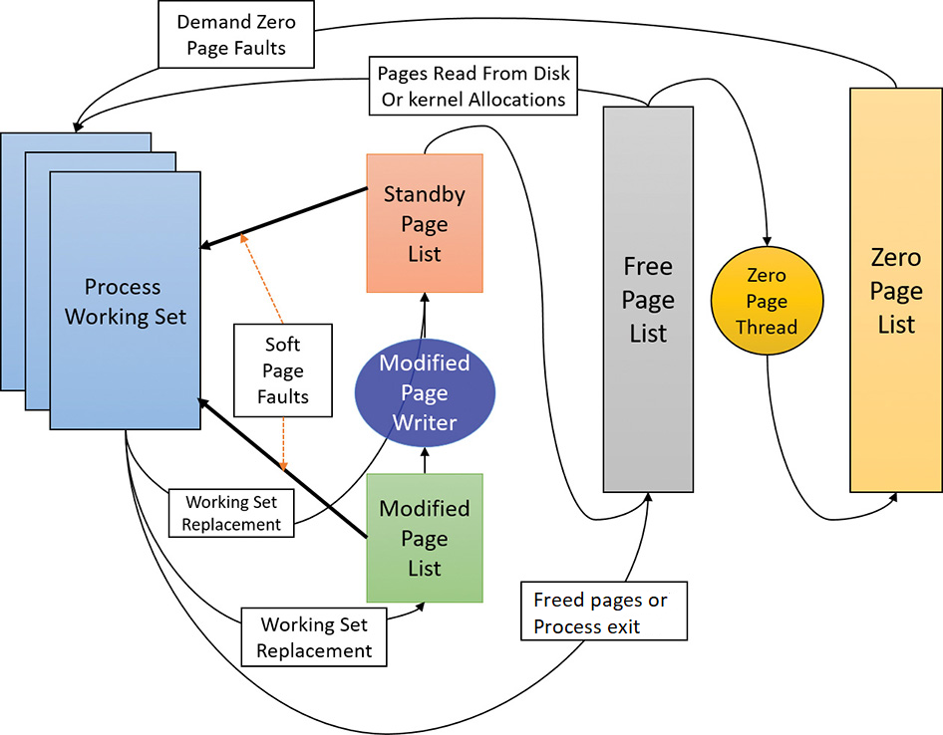
Page transition (From the “Windows Internals” book)

Slide 15
How does the GC acquire VM?
Because of demand paging, we can ask for a range of address that we might use later
This is called reserve (VirtualAlloc with MEM_RESERVE)
At this point you cannot store any data yet
When we need to store data in pages, tell the OS about them
This is called commit (VirtualAlloc with MEM_COMMIT)
Commit guarantees you will not get OOM when you need to use this space
Reserve is fast (relatively – you still incur a user <->kernel mode transition)
Commit is fast (relatively) at the time you call it… till you actually store data
A page fault occurs and physical memory is allocated at this time
Finally, we can store some data on this page!

Slide 16
Quick recap
Reserved
Committed
WS/physical memory (could be much smaller than Committed)
Windows Internals, Memory Management Chapter

Slide 17
Going back to our segment
Reserve memory for a segment
A large amount of space
No objects are stored yet

Slide 18
Going back to our segment
Need to store data on the segment! So we commit
Always commit the first 1 page since we need to store segment info
Commit as needed (usually 64k), decommit as needed
Committed

Slide 19
Going back to our segment
Need to store data on the segment! So we commit
Always commit the first 1 page since we need to store segment info
Commit as needed for objects (usually 64k)
Committed

Slide 20
Going back to our segment
Need to store data on the segment! So we commit
Always commit the first 1 page since we need to store segment info
Commit as needed for objects (usually 64k)
Committed

Slide 21
Constructing the MaoniType instance
GC does not give out memory for just one object (not always true)
It gives out an allocation context (a few KB)
No objects are constructed yet
Committed

Slide 22
Constructing the MaoniType instance
GC does not give out memory for just one object (not always true)
It gives out an allocation context (a few KB)
No objects are constructed yet
Allocation context
Committed

Slide 23
Constructing the MaoniType instance
Touch memory to write
A physical page is allocated and added to this process’s WS
0:008> dq 000002b1447e3848-8 l3
000002b1`447e3840 00000000`00000000 00007ff9`f3ca3598
000002b1`447e3850 00000100`00000080
Allocation context
Committed

Slide 24
Interacting with the MMU
MMU
CPU
Virtual Address
Physical Address
DRAM?
TLB
Reads
OS
Reads and writes
Page tables

Slide 25
Speeding things up
Note that this is an extremely simplified view
MMU
CPU
Virtual Address
Physical Address
Caches
DRAM
TLB
Reads
OS
Reads and writes
Page tables

Slide 26
Caches are much faster
Skylake cache latency (best case!)
L1 4 cycles
L2 12 cycles
L3 44 cycles (LLC – Last Level Cache)
(From Intel’s Optimization Reference Manual)
DRAM 60ns – 100ns

Slide 27
Why is cache latency not const
Caches for different cores need to be coherent
If a cache line only exists in one cache, it’s an easy case (relatively)
If it exists in multiple caches, how do you update the value?
Some cache coherency protocol needs to be implemented
MESI is a very common one
It’s expensive to update a cache line when shared by multiple caches!

Slide 28
When will the cache line be written to main memory?
If a cache line is modified, it will need to be written to main memory (at some point)
As long as it’s in a cache, the CPU can proceed
It’s up to the cache when/how to write the line back (as long as it does not lose the write)
Write policy: write back (more common) vs write through
Finally, we stored data on our page!

Slide 29
Back to the MaoniType instance
Page given by the OS, expensive but can be amortized
Our object is at 000002b1447e3848
Page start: 000002b1447e3000
Object start: 000002b1447e3848
Page end: 000002b1447e4000
Cache
Really slow, physical memory load is very high
Cheap
…
DRAM
Disk
More Expensive

Slide 30
Back to the MaoniType instance
0:008> !eeheap -gc
Number of GC Heaps: 1
generation 0 starts at 0x000002b1447d1030
generation 1 starts at 0x000002b1447d1018
generation 2 starts at 0x000002b1447d1000
ephemeral segment allocation context: none
segment begin allocated committed allocated size committed size
000002b1447d0000 000002b1447d1000 000002b1447edfb0 000002b1447f2000 0x1cfb0(118704) 0x21000(135168)
Our object is at 000002b1447e3848 (000002b1447e3848-generation 0 start = 12818)
(000002b1447edfb0 - 000002b1447e3848 = 42856)
generation 0 start
MaoniType instance
allocated
Allocated by Console.ReadLine

Slide 31

Back to GC land
You allocate…
And allocate some more…
After you’ve allocated enough
Yay, I collect!!!

Slide 32
How does GC determine if it should collect our object?
public static int Main()
{
MaoniType o = new MaoniType(128, 256);
GCHandle h = GCHandle.Alloc(o, GCHandleType.Weak);
GC.Collect();
Console.WriteLine("Collect called, h.Target is {0}",
(h.Target == null) ? "collected" : "not collected");
return 0;
}
Output - Collect called, h.Target is not collected

Slide 33
“Why is GC not collecting my object???”
Generational GC
GC.Collect() collects the whole heap
This means GC does NOT decide the objects’ lifetime
GC only gets told by others if an object is live
In this case JIT tells the GC that o is still live
User roots
JIT is free to lengthen the object lifetime till the end of method and has always been

Slide 34
[MethodImpl(MethodImplOptions.NoInlining)]
public static void TestLifeTime()
{
MaoniType o = new MaoniType(128, 256);
h = GCHandle.Alloc(o, GCHandleType.Weak);
}
public static int Main()
{
TestLifeTime();
GC.Collect();
Console.WriteLine("Collect called, h.Target is {0}",
(h.Target == null) ? "collected" : "not collected");
return 0;
}
Output: Collect called, h.Target is collected

Slide 35
What the heap looks like
GC#1 - start
Committed
object X

Slide 36
What the heap looks like
Committed

Slide 37
What the heap looks like
GC#1 - end
Committed

Slide 38
What the heap looks like
Committed

Slide 39
What the heap looks like
GC#2 - start
Committed

Slide 40
What the heap looks like
Committed

Slide 41
What the heap looks like
GC#2 - end
Committed

Slide 42
Some GCs later…
GC#N - start
Committed

Slide 43
Discovers the object is no longer rooted
Committed

Slide 44
Object is collected
Committed

Slide 45
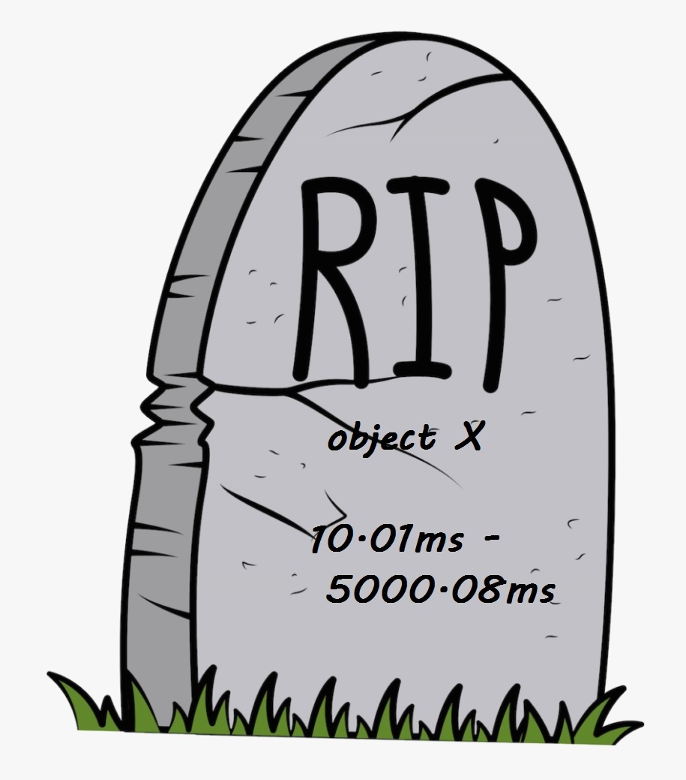
Object is collected
GC#N - end
Committed

Slide 46
Question – when do you measure?
Depending on when you measure, you can get VERY different results!
Does it matter? That depends on the problem
The more obvious the problem is, the less it matters
Less obvious problems mean more careful/methodical measurement is required
For less obvious problems, always start with a top level GC trace
It shows you the sizes at the start and the end of each GC
And a lot of other info about each GC

Slide 47
Question – do we need to change committed?
We established that we want to amortize cost of getting pages we from the OS
We don’t actually keep committing and decommitting!
We don’t decommit space we know we’ll put objects in right away.
The top level GC trace will show you the heap size
Committed is related to the amount of physical memory we use

Slide 48
Where to get help?
mem-doc
File an issue on our GH repo and ask there!
How to be efficient when you ask for help
Indicate the version of the runtime you are using
Describe the problem, impact and analysis you already did
Attach any perf data you can share

