Slide 1
Original pptx: JanetJulyManuscript_24Jan Analysis folder and data: JanuaryManuscript2_20230106_1930

Slide 2
Description
Figures
- Biorender
- Fig2: PlotLines.png y PlotPPT.pdf
- Fig3: RRnet_log2_sig_log2RR1Size x 4 categories
- Fig 4: MixFinal1.pdf + MixFinal2.pdf (FUMA results #-- in ProximityAndEQTLFinal3.R)
- Fig 5: AgeingDatabase8.pdf+ AgeingDatabase_Legend.pdf
SuppFigures
-Fig1: MultimorbidityHistogram.pdf
-Fig2A: Manhattan_xxx.png x 4
-Fig2B: QQplot_xx.png x 4
-Fig3A: VennSNPs.pdf (Venn Diagram rsIDs) - in ProximityAndEQTLFinal3.R
-Fig3B: Venn_All.pdf (Venn Diagram gene annotation) - in ProximityAndEQTLFinal3.R
Supplementary Table (excel)
Supp1A
Supp1B
Supp1C
Supp2
Supp3A
Supp3B
Supp4
Supp5
Supp6
Supp7
Supp8A
Supp8B
Table (excel)
-Demographic and lifestyle
-Prevalence
Appendix (excel)
- Read code tables
-Window imputation (end of ppt)
-Legend categories ICD10

Slide 3
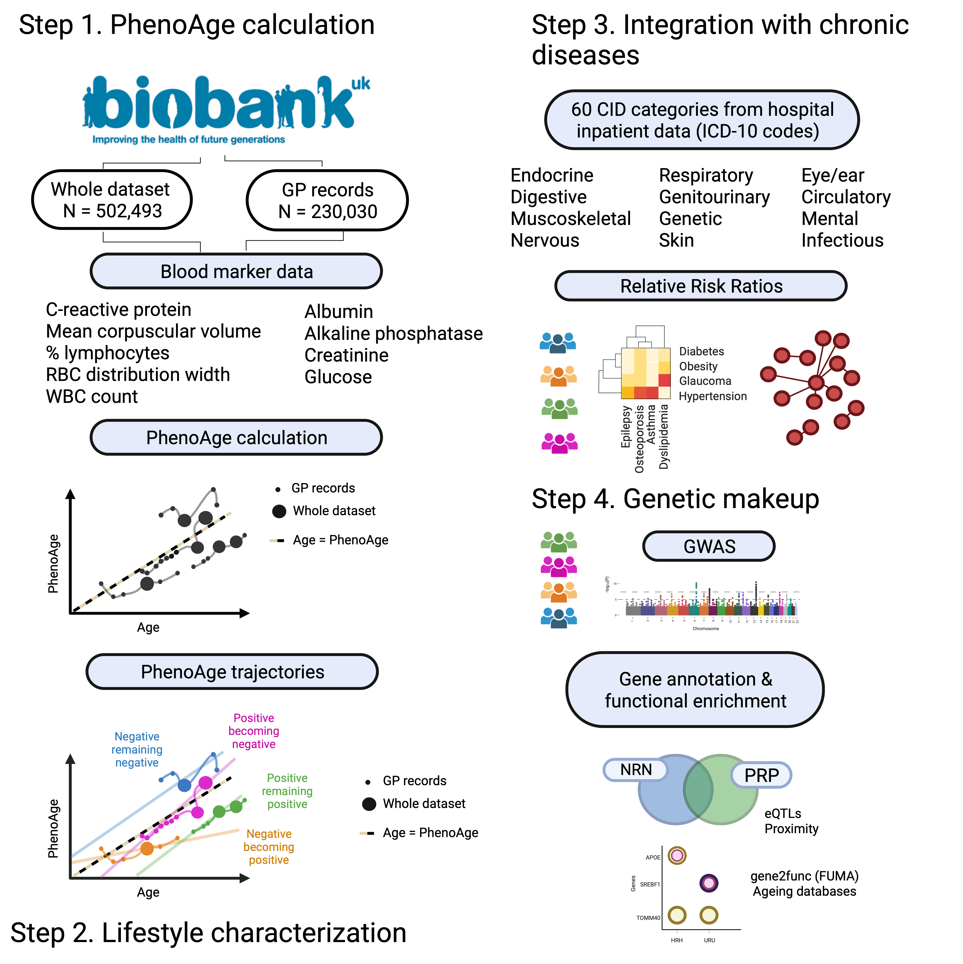
Figure 1

Slide 4
Figure 2

Slide 5
Table 1
Table.xlsx
Lifestyle factors |  | Positive remaining positive | Negative becoming positive | Positive becoming negative | Negative remaining negative
Total N (%) |  | 20395 (10.2) | 94130 (47.3) | 75122 (37.7) | 9569 (4.8)
Mortality (%) |  | 537 (2.6) | 4163 (4.4) | 6096 (8.1) | 1127 (11.8)
Age |  | 66.4 (8.1) | 66.1 (8.3) | 66.2 (8.4) | 67.4 (8.3)
Comorbidities |  | 2.8 (2.7) | 3.4 (3.3) | 4.0 (3.9) | 5.6 (4.6)
IPAQ activity group (MET)* (%) | low | 2636 (12.9) | 14289 (15.2) | 11939 (15.9) | 1802 (18.8)
 | moderate | 6989 (34.3) | 30797 (32.7) | 24356 (32.4) | 2911 (30.4)
 | high | 6975 (34.2) | 30962 (32.9) | 24175 (32.2) | 2677 (28.0)
 | (Missing) | 3795 (18.6) | 18082 (19.2) | 14652 (19.5) | 2179 (22.8)
Minutes of physical activity per week (MET)* |  | 2732.7 (2664.6) | 2673.8 (2714.5) | 2651.4 (2748.0) | 2503.0 (2789.6)
Last Recorded Age Father (Age and Death) |  | 71.2 (16.1) | 70.4 (16.7) | 70.0 (16.9) | 68.8 (18.0)
Last Recorded Age Mother (Age and Death) |  | 75.7 (13.8) | 74.8 (14.8) | 74.3 (15.2) | 73.4 (16.8)
Sex (%) | Female | 13497 (66.2) | 51751 (55.0) | 37890 (50.4) | 3853 (40.3)
 | Male | 6721 (33.0) | 41627 (44.2) | 36672 (48.8) | 5625 (58.8)
 | (Missing) | 177 (0.9) | 752 (0.8) | 560 (0.7) | 91 (1.0)
Smoking (%) | Previous | 6879 (33.7) | 32550 (34.6) | 26441 (35.2) | 3573 (37.3)
 | Current | 1123 (5.5) | 9421 (10.0) | 8144 (10.8) | 1628 (17.0)
 | Never | 12322 (60.4) | 51776 (55.0) | 40196 (53.5) | 4296 (44.9)
 | Prefer not to answer | 63 (0.3) | 320 (0.3) | 287 (0.4) | 62 (0.6)
 | (Missing) | 8 (0.0) | 63 (0.1) | 54 (0.1) | 10 (0.1)
Townsend_deprivation_index_at_recruitment |  | -1.8 (2.8) | -1.4 (3.0) | -1.3 (3.1) | -0.8 (3.3)
Overall_health_rating (%) | Excellent | 4148 (20.3) | 14658 (15.6) | 11454 (15.2) | 716 (7.5)
 | Good | 12641 (62.0) | 55263 (58.7) | 42840 (57.0) | 4416 (46.1)
 | Fair | 3125 (15.3) | 19839 (21.1) | 16487 (21.9) | 3219 (33.6)
 | Poor | 404 (2.0) | 3908 (4.2) | 3903 (5.2) | 1132 (11.8)
 | Do not know | 57 (0.3) | 348 (0.4) | 342 (0.5) | 62 (0.6)
 | Prefer not to answer | 12 (0.1) | 51 (0.1) | 41 (0.1) | 14 (0.1)
 | (Missing) | 8 (0.0) | 63 (0.1) | 55 (0.1) | 10 (0.1)
BMI |  | 26.0 (3.9) | 27.5 (4.7) | 27.8 (4.8) | 30.0 (5.9)

Slide 6
Table 2
Table.xlsx
Chronic diseases | All |  | Healthy remaining healthy | Healthy_Low_Prevalence | Healthy becoming Unhealthy |  | Healthy becoming unhealthy | Unhealthy_Cross_Prevalence | Unhealthy remaining unhealthy | Unhealthy_High_Prevalence
 | N = 146,845 | Prevalence (%) | N = 13, 383 | Prevalence (%) | N = 56,354 | Prevalence (%) | N = 68,450 | Prevalence (%) | N = 8,203 | Prevalence (%)
Hypertension | 57979 | 38.66 | 4240 | 29.800 | 26257 | 37.538 | 23023 | 40.031 | 4459 | 53.81
Colitis and related diseases | 39956 | 26.64 | 3553 | 24.972 | 17805 | 25.455 | 16076 | 27.952 | 2522 | 30.43
Esophagus, stomach and duodenum diseases | 36901 | 24.60 | 3118 | 21.915 | 16760 | 23.961 | 14630 | 25.438 | 2393 | 28.88
Osteoarthritis and other degenerative joint diseases | 35393 | 23.60 | 3045 | 21.401 | 16271 | 23.262 | 13779 | 23.958 | 2298 | 27.73
Solid neoplasms | 34630 | 23.09 | 3137 | 22.048 | 15255 | 21.809 | 14137 | 24.581 | 2101 | 25.35
Other musculoskeletal and joint diseases | 29639 | 19.76 | 2565 | 18.028 | 13636 | 19.494 | 11546 | 20.075 | 1892 | 22.83
Dyslipidemia | 28929 | 19.29 | 2136 | 15.013 | 13030 | 18.628 | 11565 | 20.108 | 2198 | 26.52
Other genitourinary diseases | 27003 | 18.00 | 2626 | 18.457 | 12290 | 17.570 | 10611 | 18.450 | 1476 | 17.81
Ischemic heart disease | 22956 | 15.31 | 1473 | 10.353 | 9812 | 14.028 | 9652 | 16.782 | 2019 | 24.36
Cataract and other lens diseases | 22120 | 14.75 | 2059 | 14.471 | 10101 | 14.441 | 8429 | 14.656 | 1531 | 18.47
Inflammatory arthropathies | 18965 | 12.65 | 1326 | 9.320 | 8074 | 11.543 | 7937 | 13.800 | 1628 | 19.65
Asthma | 18053 | 12.04 | 1308 | 9.193 | 8192 | 11.712 | 7280 | 12.658 | 1273 | 15.36
Anemia | 17197 | 11.47 | 994 | 6.986 | 7058 | 10.090 | 7535 | 13.101 | 1610 | 19.43
Diabetes | 16279 | 10.85 | 376 | 2.643 | 6084 | 8.698 | 7616 | 13.242 | 2203 | 26.58
Dorsopathies | 14453 | 9.64 | 1207 | 8.483 | 6348 | 9.075 | 5930 | 10.311 | 968 | 11.68
Atrial fibrillation | 13568 | 9.05 | 857 | 6.023 | 5408 | 7.731 | 6118 | 10.638 | 1185 | 14.30
Peripheral neuropathy | 13102 | 8.74 | 1102 | 7.745 | 5984 | 8.555 | 5096 | 8.861 | 920 | 11.10
Thyroid diseases | 12690 | 8.46 | 1163 | 8.174 | 5820 | 8.320 | 4883 | 8.490 | 824 | 9.94
Obesity | 12369 | 8.25 | 578 | 4.062 | 5042 | 7.208 | 5507 | 9.575 | 1242 | 14.99
Depression and mood diseases | 12123 | 8.08 | 863 | 6.066 | 5299 | 7.576 | 5063 | 8.803 | 898 | 10.84
Other digestive diseases | 12108 | 8.07 | 958 | 6.733 | 5301 | 7.578 | 4974 | 8.648 | 875 | 10.56
Other eye diseases | 10814 | 7.21 | 959 | 6.740 | 4841 | 6.921 | 4210 | 7.320 | 804 | 9.70
Chronic pancreas, biliary tract and gallbladder diseases | 10644 | 7.10 | 830 | 5.834 | 4732 | 6.765 | 4301 | 7.478 | 781 | 9.42
Prostate diseases | 10205 | 6.80 | 678 | 4.765 | 4397 | 6.286 | 4321 | 7.513 | 809 | 9.76
Copd, emphysema, chronic bronchitis | 9649 | 6.43 | 424 | 2.980 | 3913 | 5.594 | 4279 | 7.440 | 1033 | 12.47
Cerebrovascular disease | 8936 | 5.96 | 602 | 4.231 | 3783 | 5.408 | 3743 | 6.508 | 808 | 9.75
Heart failure | 8759 | 5.84 | 426 | 2.994 | 3174 | 4.538 | 4233 | 7.360 | 926 | 11.17
Neurotic, stress-related and somatoform diseases | 8565 | 5.71 | 720 | 5.060 | 3799 | 5.431 | 3495 | 6.077 | 551 | 6.65
Venous and lymphatic diseases | 8032 | 5.36 | 835 | 5.869 | 3667 | 5.242 | 3097 | 5.385 | 433 | 5.23
Ear, nose, throat diseases | 7822 | 5.22 | 654 | 4.597 | 3550 | 5.075 | 3170 | 5.512 | 448 | 5.41
Chronic kidney diseases | 7710 | 5.14 | 230 | 1.617 | 2495 | 3.567 | 3949 | 6.866 | 1036 | 12.50
Other cardiovascular diseases | 7491 | 4.99 | 443 | 3.114 | 3024 | 4.323 | 3319 | 5.771 | 705 | 8.51
Cardiac valve diseases | 7168 | 4.78 | 473 | 3.324 | 2874 | 4.109 | 3240 | 5.634 | 581 | 7.01
Osteoporosis | 6785 | 4.52 | 728 | 5.117 | 3056 | 4.369 | 2595 | 4.512 | 406 | 4.90
Other neurological diseases | 6088 | 4.06 | 433 | 3.043 | 2512 | 3.591 | 2662 | 4.629 | 481 | 5.80
Other metabolic diseases | 5866 | 3.91 | 351 | 2.467 | 2349 | 3.358 | 2618 | 4.552 | 548 | 6.61
Autoimmune diseases | 5015 | 3.34 | 335 | 2.355 | 2098 | 2.999 | 2155 | 3.747 | 427 | 5.15
Deafness, hearing impairment | 4749 | 3.17 | 376 | 2.643 | 2033 | 2.906 | 1970 | 3.425 | 370 | 4.46
Sleep disorders | 4364 | 2.91 | 224 | 1.574 | 1827 | 2.612 | 1874 | 3.258 | 439 | 5.30
Other respiratory diseases | 4163 | 2.78 | 174 | 1.223 | 1627 | 2.326 | 1949 | 3.389 | 413 | 4.98
Glaucoma | 4021 | 2.68 | 388 | 2.727 | 1844 | 2.636 | 1519 | 2.641 | 270 | 3.26
Migraine and facial pain syndromes | 3457 | 2.31 | 328 | 2.305 | 1593 | 2.277 | 1373 | 2.387 | 163 | 1.97
Peripheral vascular disease | 3446 | 2.30 | 185 | 1.300 | 1373 | 1.963 | 1524 | 2.650 | 364 | 4.39
Blood and blood forming organ diseases | 3419 | 2.28 | 224 | 1.574 | 1320 | 1.887 | 1551 | 2.697 | 324 | 3.91
Bradycardias and conduction diseases | 3216 | 2.14 | 195 | 1.371 | 1207 | 1.726 | 1523 | 2.648 | 291 | 3.51
Inflammatory bowel diseases | 2992 | 1.99 | 184 | 1.293 | 1265 | 1.808 | 1234 | 2.146 | 309 | 3.73
Other psychiatric and behavioral diseases | 2925 | 1.95 | 137 | 963 | 1191 | 1.703 | 1297 | 2.255 | 300 | 3.62
Dementia | 2853 | 1.90 | 220 | 1.546 | 1117 | 1.597 | 1265 | 2.200 | 251 | 3.03
Hematological neoplasms | 2791 | 1.86 | 172 | 1.209 | 1029 | 1.471 | 1362 | 2.368 | 228 | 2.75
Chronic ulcer of the skin | 2630 | 1.75 | 78 | 548 | 956 | 1.367 | 1262 | 2.194 | 334 | 4.03
Allergy | 2456 | 1.64 | 218 | 1.532 | 1164 | 1.664 | 958 | 1.666 | 116 | 1.40
Epilepsy | 2430 | 1.62 | 178 | 1.251 | 1095 | 1.565 | 978 | 1.700 | 179 | 2.16
Chronic liver diseases | 1911 | 1.27 | 64 | 0.450 | 704 | 1.006 | 909 | 1.581 | 234 | 2.82
Parkinson and parkinsonism | 1368 | 0.91 | 120 | 0.843 | 576 | 0.823 | 566 | 0.984 | 106 | 1.28
Other skin diseases | 1356 | 0.90 | 118 | 0.829 | 606 | 0.866 | 520 | 0.904 | 112 | 1.35
Blindness, visual impairment | 986 | 0.66 | 67 | 0.471 | 395 | 0.565 | 427 | 0.742 | 97 | 1.17
Multiple sclerosis | 846 | 0.56 | 82 | 0.576 | 396 | 0.566 | 329 | 0.572 | 39 | 0.47
Schizophrenia and delusional diseases | 534 | 0.36 | 31 | 0.218 | 219 | 0.313 | 238 | 0.414 | 46 | 0.56
Chronic infectious diseases | 380 | 0.25 | 18 | 0.127 | 156 | 0.223 | 168 | 0.292 | 38 | 0.46
Chromosomal abnormalities | 71 | 0.05 | 3 | 0.21 | 26 | 0.37 | 37 | 0.64 | 5 | 0.06

Slide 7
Supp Figure 1

Slide 8
Figure 3

Slide 9
Supp Figure 2A and 2B
Supplementary Figure X. QQPlot of GWAS analysis for the four categories. A) Healtht remining healthy, B) Unhealthy remanining unhealthy, C) Heakthy Cross , D) Unhealthy
Supplementary Figure X. Manhattan plots of GWAS analysis, with 20 randomly annotated intergenic variants of above log(p)>5 value for the four categories. Annotation was perfromed using the Ensembl Variant Effect Predictor (VEP) database. A) Healtht remining healthy, B) Unhealthy remanining unhealthy, C) Heakthy Cross , D) Unhealthy.

Slide 10
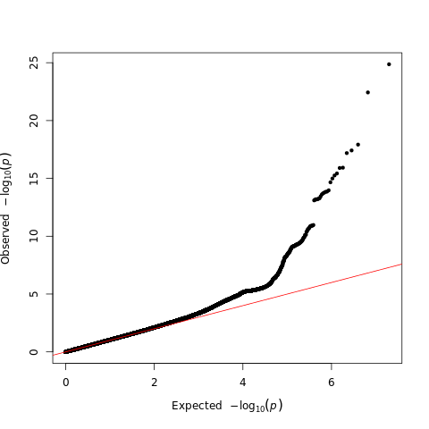
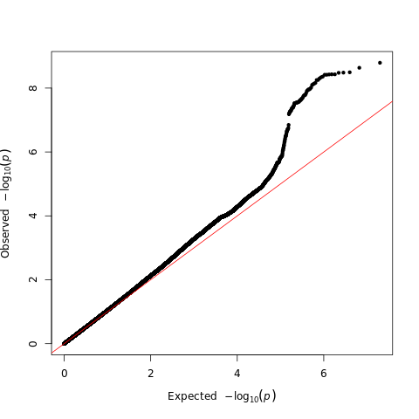
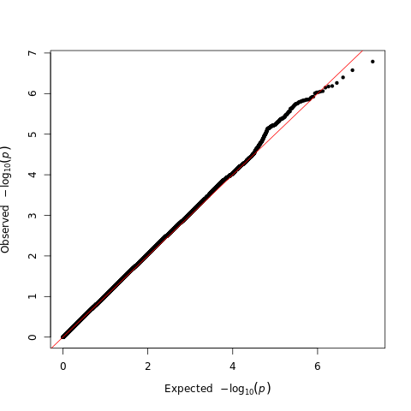
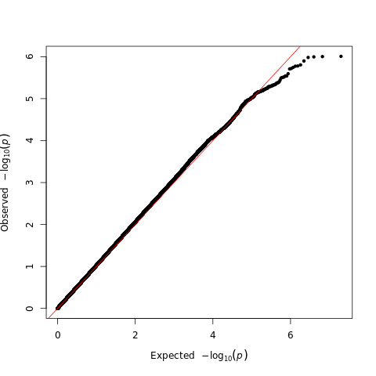
Supp Figure 2A and 2B
A
B
Supplementary Figure X. QQPlot of GWAS analysis for the four categories. A) Healtht remining healthy, B) Unhealthy remanining unhealthy, C) Heakthy Cross , D) Unhealthy
C
D
Supplementary Figure X. Manhattan plots of GWAS analysis, with 20 randomly annotated intergenic variants of above log(p)>5 value for the four categories. Annotation was perfromed using the Ensembl Variant Effect Predictor (VEP) database. A) Healtht remining healthy, B) Unhealthy remanining unhealthy, C) Heakthy Cross , D) Unhealthy.

Slide 12
Supp Figure 3A and 3B

Slide 13
Figure 4
Healthy remainig healthy (HRH)
Gene Sets
Unhealthy remainig unhealthy (URU)
Log of adjusted p value

Slide 14
Figure 5

