Slide 1

⌂
RentEase
PROPERTY PLATFORM
CAPSTONE • GROUP 8
Property Rental &
Listing Portal
A Full-Stack Web Application for Property Rentals and Listings
PRESENTED BY
N. Dharma • L. Siddartha
P. Dhanush • R. Prasanth
UNDER THE GUIDANCE OF
Rishabh Verma
ORGANIZATION
NexTurn
NEXTERN 2026 | PROPERTY RENTAL & LISTING PORTAL
01/07

Slide 2
02 / PROJECT
Problem Statement
Finding a rental home and managing property details can take time. RentEase brings these tasks into one website.
People need to search for homes by city, area, rent and property type.
Owners need to add properties and upload photos.
People need to ask owners questions and request property visits.
Admins need to check listings before they appear in search.
The website has three roles: Admin, Owner / Agent and Seeker.
NEXTERN 2026 • GROUP 8
02/07
02/07

Slide 3
03 / PROJECT
Project Objectives
Keep rental property details in one place.
Help people find properties using search filters.
Let owners add and update property details and photos.
Let seekers save properties and searches.
Let seekers send enquiries and request visits.
Let admins approve or reject property listings.
NEXTERN 2026 • GROUP 8
03/07
03/07

Slide 4
04 / PROJECT
Technology Used
Frontend
Backend
Database
React + Vite
Python Flask REST API
PostgreSQL
Database tools
Login security
Run services
SQLAlchemy
JWT access and refresh tokens
Docker Compose
NEXTERN 2026 • GROUP 8
04/07
04/07

Slide 5
05 / PROJECT
System Architecture
User
Frontend
Backend
SQLAlchemy
Database
Admin / Owner / Seeker
React + Vite
Flask REST API
Connects app to data
PostgreSQL
JWT is used for login and access to the website.
Docker Compose runs the web app, API and database services.
Only verified listings appear in public search; rejected and rented listings are hidden.
NEXTERN 2026 • GROUP 8
05/07
05/07

Slide 6
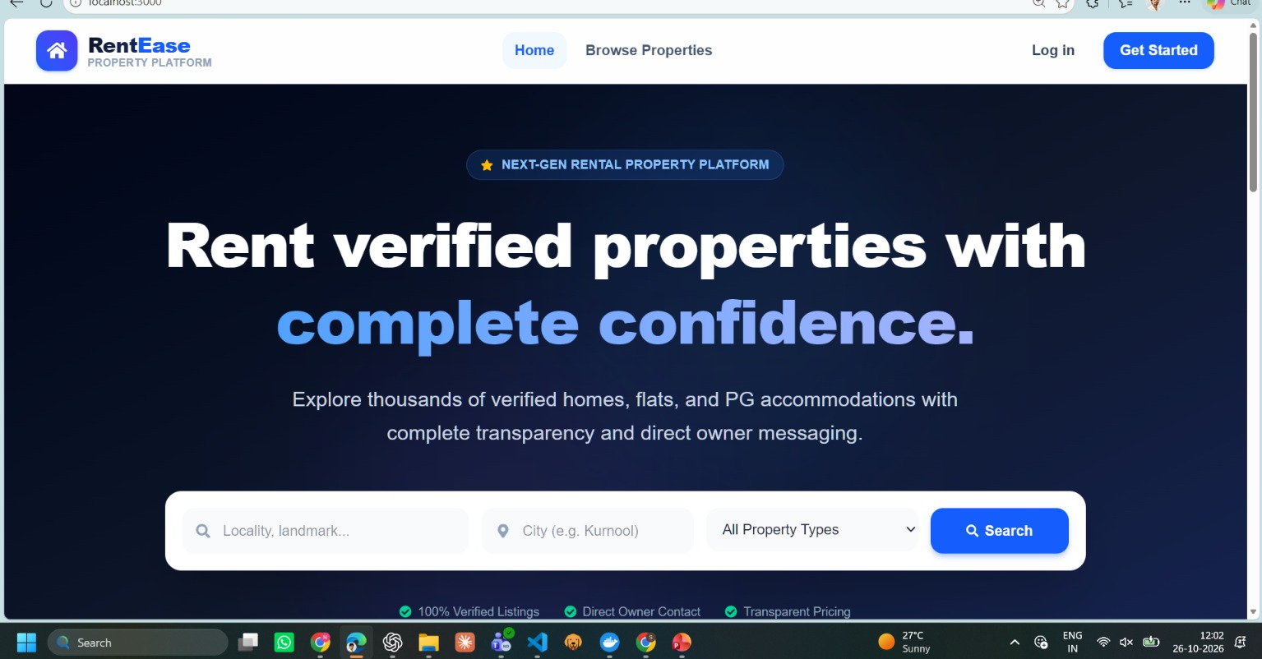
06 / PROJECT
RentEase Homepage and Features
Main Features
Add and manage property listings
Upload property photos
Search, sort and filter properties
Save favourite properties and searches
Send enquiries and messages
Request property visits
Admin checks property listings
Owner can view listing activity
NEXTERN 2026 • GROUP 8
06/07
06/07

Slide 7
⌂
RentEase
✦
Thank You
PROPERTY RENTAL & LISTING PORTAL
NEXTERN 2026 • GROUP 8
07/07

