Slide 1
基本面分析
小组成员：
徐桐、杨宁、时雪庆、潘鹤铭、张红燕、关祺昌、吴佳兴

Slide 2
成员分工
徐桐：
编写MFC中数据库管理类(DataBaseMgr)，为各个界面提供获取股票数据的统一接口；实现导入数据库、清空数据库功能；MFC各部分整合与代码审查。
杨宁：
编写MFC中详细信息窗体类(DataPanel)，利用从DataBaseMgr中获取的股票详细信息在窗体中显示；使用High-speed charting控件进行柱形图绘制。
时雪庆：
编写MFC中股票搜索窗体类(SearchPanel)，利用从DataBaseMgr中获取的股票代码与股票名在窗体中显示；处理窗体中的搜索选项并传递到DataBaseMgr中。

Slide 3
成员分工
吴佳兴：
编写MFC中估值窗体类(Foresee)，使用从DataBaseMgr中获取的现金流量数据与用户输入数据进行计算。
潘鹤铭：
编写Python脚本对已下载好的主要指标CSV文件进行数据预处理，主要是计算几列数据的均值、方差。
张红燕：
编写Python脚本对已下载好的三个综合数据CSV文件进行数据预处理，主要是母公司资产负债表、合并资产负债表与其他资产负债信息表的合并，并计算一些比率。

Slide 4
成员分工
孙守志：
查阅JoinQuant金融数据平台手册，使用Python脚本下载获取母公司资产负债表、合并资产负债表、与其他资产负债信息表，并将下载的生数据交予张红燕同学进行数据预处理。
关祺昌：
查阅MindGo金融数据平台手册，使用Python脚本下载获取股票代码-中文名称表、主要指标表、现金流量表、资产负债表、利润表，并将下载的生数据交予潘鹤铭同学进行数据预处理。

Slide 5
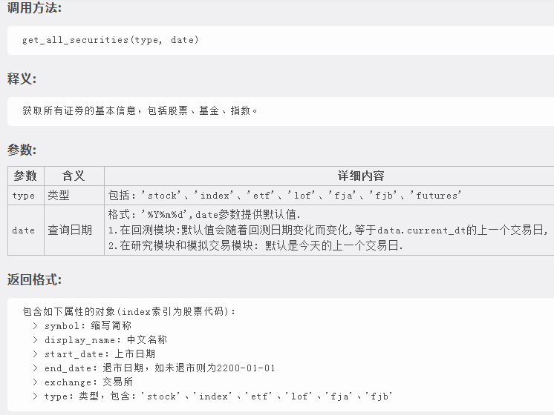
MindGo数据下载
下载 股票代码-中文名称 表
df = get_all_securities('stock')
df=df.drop(['start_date',
'end_date',
'exchange',
'type',
'benchmark',
'name',
'parent',
'round_lot',
'underlying_symbol'],
axis=1)
df.to_csv('CodeName.csv',
index=False)

Slide 6
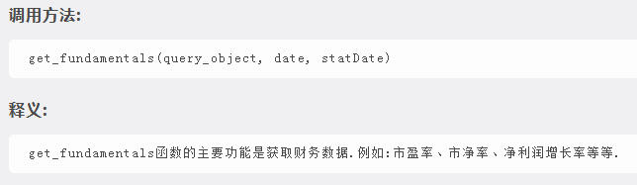
MindGo数据下载
下载 主要指标 表
（ashareprofit.roic_ttm 会有很多数据缺少）
import numpy as np
#生成季度列表2005s1~2019s4
list_days = []
for year in list(range(2005,2010)):
for season in list(range(1,5)):
list_days.append(str(year) + 'q' + str(season))
#获取数据
q=query(income.symbol,income.date,income.report_date,income.profit_from_operations,cashflow.net_cash_flows_from_opt_act,profit_sq.roe,growth_sq.opt_profit_growth_ratio,cashflow.net_cash_flows_from_opt_act,cashflow.cash_paid_for_assets,income.basic_eps)
df = get_fundamentals(q, list_days)
q2 = query(ashareprofit.roic_ttm)
df2 = get_fundamentals(q2, list_days)
df['symbol'] = df['income_symbol']
df['date'] = df['income_date']
df['date_repo'] = df['income_report_date']
df['profit_from_operations'] = df['income_profit_from_operations']
df['net_cash_flows_from_opt_act'] = df['cashflow_net_cash_flows_from_opt_act']
df['roe'] = df['profit_sq_roe']
df['opt_profit_growth_ratio'] = df['growth_sq_opt_profit_growth_ratio']
df['NmC'] = df['cashflow_net_cash_flows_from_opt_act'] - df['cashflow_cash_paid_for_assets']
df['basic_eps'] = df['income_basic_eps']
df['roic_ttm'] = df2['ashareprofit_roic_ttm']
df=df.drop(['income_symbol','income_date','income_report_date','income_profit_from_operations','cashflow_net_cash_flows_from_opt_act','profit_sq_roe','growth_sq_opt_profit_growth_ratio','cashflow_net_cash_flows_from_opt_act','cashflow_cash_paid_for_assets','income_basic_eps'],axis=1)
df.to_csv('MainDG.csv',index=False)

Slide 7
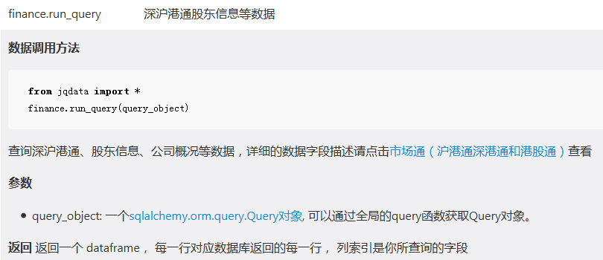
JoinQuant数据下载
from jqdata import finance
import pandas
import datetime
print("Start")
#获取所有股票列表
list_stock = list(get_all_securities().index)
#获取所有备选的季度日期
list_days = []
for year in list(range(2005,2020)):
for month in [3,4,6,7,9,10,12,1]:
for day in list(range(20,31)):
list_days.append(datetime.date(year,month,day))
list_days.append(datetime.date(year,month,31-day))
#新建dataframe
df_out = pandas.DataFrame(columns=['code','pub_date','report_date','other_receivable','advance_payment','total_assets'])
#按股票代码循环获取数据并添加到df_out中
for s in list_stock:
df = finance.run_query(query(finance.STK_BALANCE_SHEET_PARENT.code,
finance.STK_BALANCE_SHEET_PARENT.pub_date,
finance.STK_BALANCE_SHEET_PARENT.report_date,
finance.STK_BALANCE_SHEET_PARENT.other_receivable,
finance.STK_BALANCE_SHEET_PARENT.advance_payment,
finance.STK_BALANCE_SHEET_PARENT.total_assets).filter(finance.STK_BALANCE_SHEET_PARENT.code==s).order_by(
finance.STK_BALANCE_SHEET_PARENT.pub_date))
df_out = pandas.concat([df_out,df[df['pub_date'].isin(list_days)]])
#df_out中各列改名
df_out.columns = ['symbol','date','date_repo','other_receivableA','advance_paymentA','total_assetsA']
#df_out输出为csv文件
df_out.to_csv('LotsofInfoA.csv',index=False)
print("End")

Slide 8
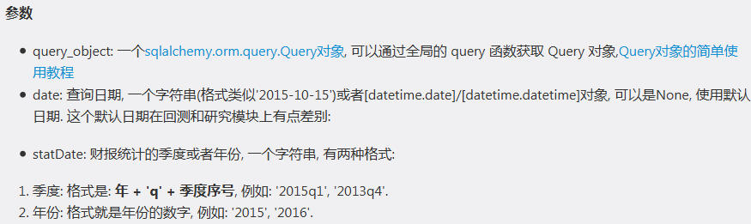
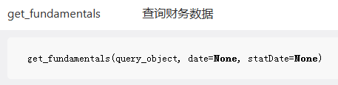
JoinQuant数据下载
下载 综合信息（其他部分）
from jqdata import finance
import pandas
import datetime
print("Start")
#生成季度列表
list_days = []
for year in list(range(2005,2010)):
for season in list(range(1,5)):
list_days.append(str(year) + 'q' + str(season))
df_out = pandas.DataFrame(columns=
['code','pubDate','bill_receivable','account_receivable','accounts_payable','notes_payable','inventories',’advance_peceipts','fixed_assets','constru_in_process'])
for day in list_days:
q=query(balance.code,balance.pubDate,balance.bill_receivable,balance.account_receivable,balance.accounts_payable,balance.notes_payable,balance.inventories,balance.advance_peceipts,balance.fixed_assets,balance.constru_in_process)
df = get_fundamentals(q, statDate=day)
df_out = pandas.concat([df_out,df])
df_out.to_csv('LotsofInfoD.csv', index=False)

Slide 9
股票基本面分析 --预处理综合信息
学号：161407227
姓名：张红燕

Slide 10
综合分析数据预处理
一、需求分析
从本组员那里获得三个预处理的.CSV文件：LotsofInfoA.csv母公司的资产负债表、LotsofInfoB.csvA合并资产负债表、LotsofInfoD.csv其他的资产负债信息，这三个表在导入数据库之前要进行预先处理，这样的话在MFC里就不需要进行复杂的数学计算。
最终需要生成一个LotsofInfo-PX.csv文件来存储我们需要的信息，根据需要作为源数据导入数据库，为综合分析表提供所需数据。
二、代码解析

Slide 11
综合分析数据预处理
import pandas as pd
import numpy as np
#打开母公司资产负债表
dfA = pd.read_csv('LotsofInfoA.csv')
#只取上午数据
dfA = dfA.loc[list(range(0,len(dfA),2))]
#打开合并资产负债表
dfB = pd.read_csv('LotsofInfoB.csv')
#只取上午数据
dfB = dfB.loc[list(range(0,len(dfB),2))]
#打开其他资产负债信息表
dfD = pd.read_csv('LotsofInfoD.csv')
#只取上午数据
dfD = dfD.loc[list(range(0,len(dfD),2))]
#根据股票号、日期、报告期合并母公司资产负债表与合并资产负债表，并保存为dfC
dfC = pd.merge(dfB,dfA,on=['symbol','date','date_repo'],how='left')
#根据股票号、日期合并dfC为其他资产负债信息表
dfE = pd.merge(dfC,dfD,on=['symbol','date'],how='left')

Slide 12
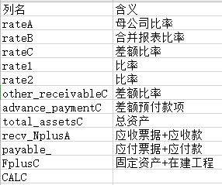
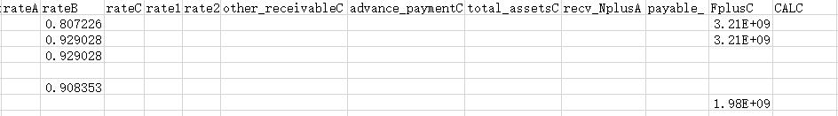
综合分析数据预处理
#新建各待计算的列并赋予初值0
dfE['rateA'] = 0
dfE['rateB'] = 0
dfE['rateC'] = 0
dfE['rate1'] = 0
dfE['rate2'] = 0
dfE['other_receivableC'] = 0
dfE['advance_paymentC'] = 0
dfE['total_assetsC'] = 0
dfE['recv_NplusA'] = 0
dfE['payable_'] = 0
dfE['FplusC'] = 0
dfE['CALC'] = 0

Slide 13
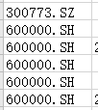
综合分析数据预处理
#逐行计算处理
len_dfE = len(dfE)
for ele in range(len_dfE):
#修改股票代码后缀 XSHE改为SZXSHG改为SH
dfE.loc[ele,'symbol'] = dfE.iloc[ele]['symbol'].replace('XSHE','SZ')
dfE.loc[ele,'symbol'] = dfE.iloc[ele]['symbol'].replace('XSHG','SH')
#计算各项指标
# 计算母公司比率rateA
dfE.loc[ele,'rateA'] = dfE.iloc[ele]['other_receivableA'] / (dfE.iloc[ele]['other_receivableA'] + dfE.iloc[ele]['advance_paymentA'])
#计算合并报表比率rateB
dfE.loc[ele,'rateB'] = dfE.iloc[ele]['other_receivableB'] / (dfE.iloc[ele]['other_receivableB'] + dfE.iloc[ele]['advance_paymentB'])
#计算差额比率other_receivableC
dfE.loc[ele,'other_receivableC'] = dfE.iloc[ele]['other_receivableB'] - dfE.iloc[ele]['other_receivableA']
#计算差额预付款项advance_paymentC
dfE.loc[ele,'advance_paymentC'] = dfE.iloc[ele]['advance_paymentB'] - dfE.iloc[ele]['advance_paymentA']

Slide 14
综合分析数据预处理
#计算total_assetsC
dfE.loc[ele,'total_assetsC'] = dfE.iloc[ele]['total_assetsB'] - dfE.iloc[ele]['total_assetsA']
#计算rateC
dfE.loc[ele,'rateC'] = dfE.iloc[ele]['other_receivableC'] / (dfE.iloc[ele]['other_receivableC'] + dfE.iloc[ele]['advance_paymentC'])
#计算rate1
dfE.loc[ele,'rate1'] = dfE.iloc[ele]['notes_receivable'] / (dfE.iloc[ele]['notes_receivable'] + dfE.iloc[ele]['accounts_receivable'])
#计算rate2
dfE.loc[ele,'rate2'] = dfE.iloc[ele]['notes_payable'] / (dfE.iloc[ele]['account_payable'] + dfE.iloc[ele]['notes_payable'])
#计算recv_NplusA
dfE.loc[ele,'recv_NplusA'] = dfE.iloc[ele]['notes_receivable'] + dfE.iloc[ele]['accounts_receivable']
#计算payable_
dfE.loc[ele,'payable_'] = dfE.iloc[ele]['notes_payable'] + dfE.iloc[ele]['account_payable']
#计算FplusC
dfE.loc[ele,'FplusC'] = dfE.iloc[ele]['fixed_assets'] + dfE.iloc[ele]['constru_in_process']

Slide 15
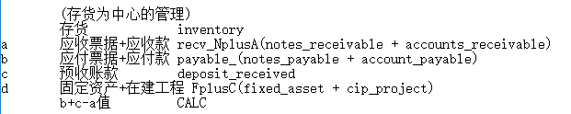
综合分析数据预处理
#计算CALC
dfE.loc[ele,'CALC'] = dfE.iloc[ele]['payable_'] + dfE.iloc[ele]['deposit_received'] - dfE.iloc[ele]['recv_NplusA']

Slide 16
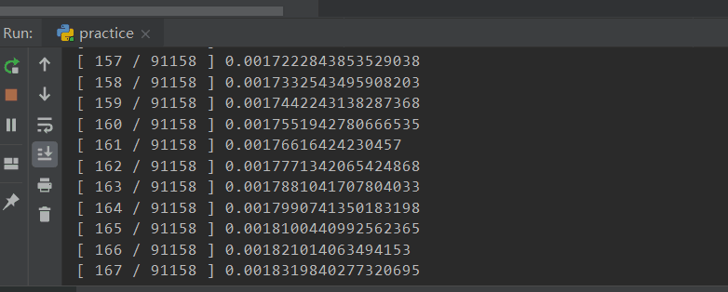
综合分析数据预处理
#显示进度
print('[ ' + str(ele+1) + ' / ' + str(len_dfE) + ' ] ' + str((ele+1) / len_dfE))
#删除多余列
del(dfE['fixed_assets'])
del(dfE['constru_in_process'])
#保存预处理后的表，index=False去掉自动生成的index列
dfE.to_csv('LotsofInfo-PX.csv', index=False)

Slide 17
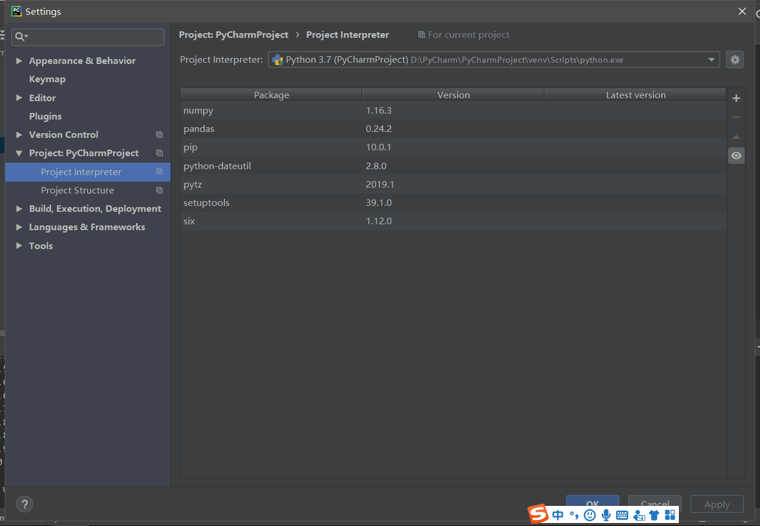
综合分析数据预处理
下载pandas 和import numpy两个工具包

Slide 18
主要指标数据预处理
import pandas as pd
import numpy as np
#打开主要指标表
df = pd.read_csv('MainDG.csv')
#新增待计算的均值方差列
df['roe_ave'] = 0 #净资产收益率平均值
df['roe_vic'] = 0 #净资产收益率方差
df['roic_ttm_ave'] = 0 #投入资本回报率平均值
df['roic_ttm_vic'] = 0 #投入资本回报率方差
df['NmC_ave'] = 0 #自由现金流平均值
df['NmC_vic'] = 0 #自由现金流方差
df['opt_profit_growth_ratio_ave'] = 0 #营业利润平均值
df['opt_profit_growth_ratio_vic'] = 0 #营业利润方差

Slide 19
主要指标数据预处理
#获取表中所有股票名（不重复）
list_stock = []
for ele in df['symbol']:
if(ele not in list_stock):
list_stock.append(ele)
len_list = len(list_stock)
i = 1
#循环计算均值方差
for code in list_stock:
tdf = df[df['symbol'] == code]
tdf['roe_ave'] = np.sum(tdf['roe']) / len(tdf)
tdf['roe_vic'] = np.var(tdf['roe'])
……
tdf['opt_profit_growth_ratio_ave'] = np.sum(tdf['opt_profit_growth_ratio']) / len(tdf)
tdf['opt_profit_growth_ratio_vic'] = np.var(tdf['opt_profit_growth_ratio'])
df[df['symbol'] == code] = tdf
print('[ ' + str(i) + '/' + str(len_list) + ' ] ' + str(i / len_list * 100))
i += 1
#保存预处理计算结果
df.to_csv('MainDG_px.csv', index=False)

