Slide 1


IIKH
Class01 Team2
20190323 배인경 20193057 김승아 20191673 이주연 20195999 이채현 20195812 황현수
PRESENTATION SPEAKER: 20190323 배인경 20193057 김승아 20191673 이주연

Slide 2
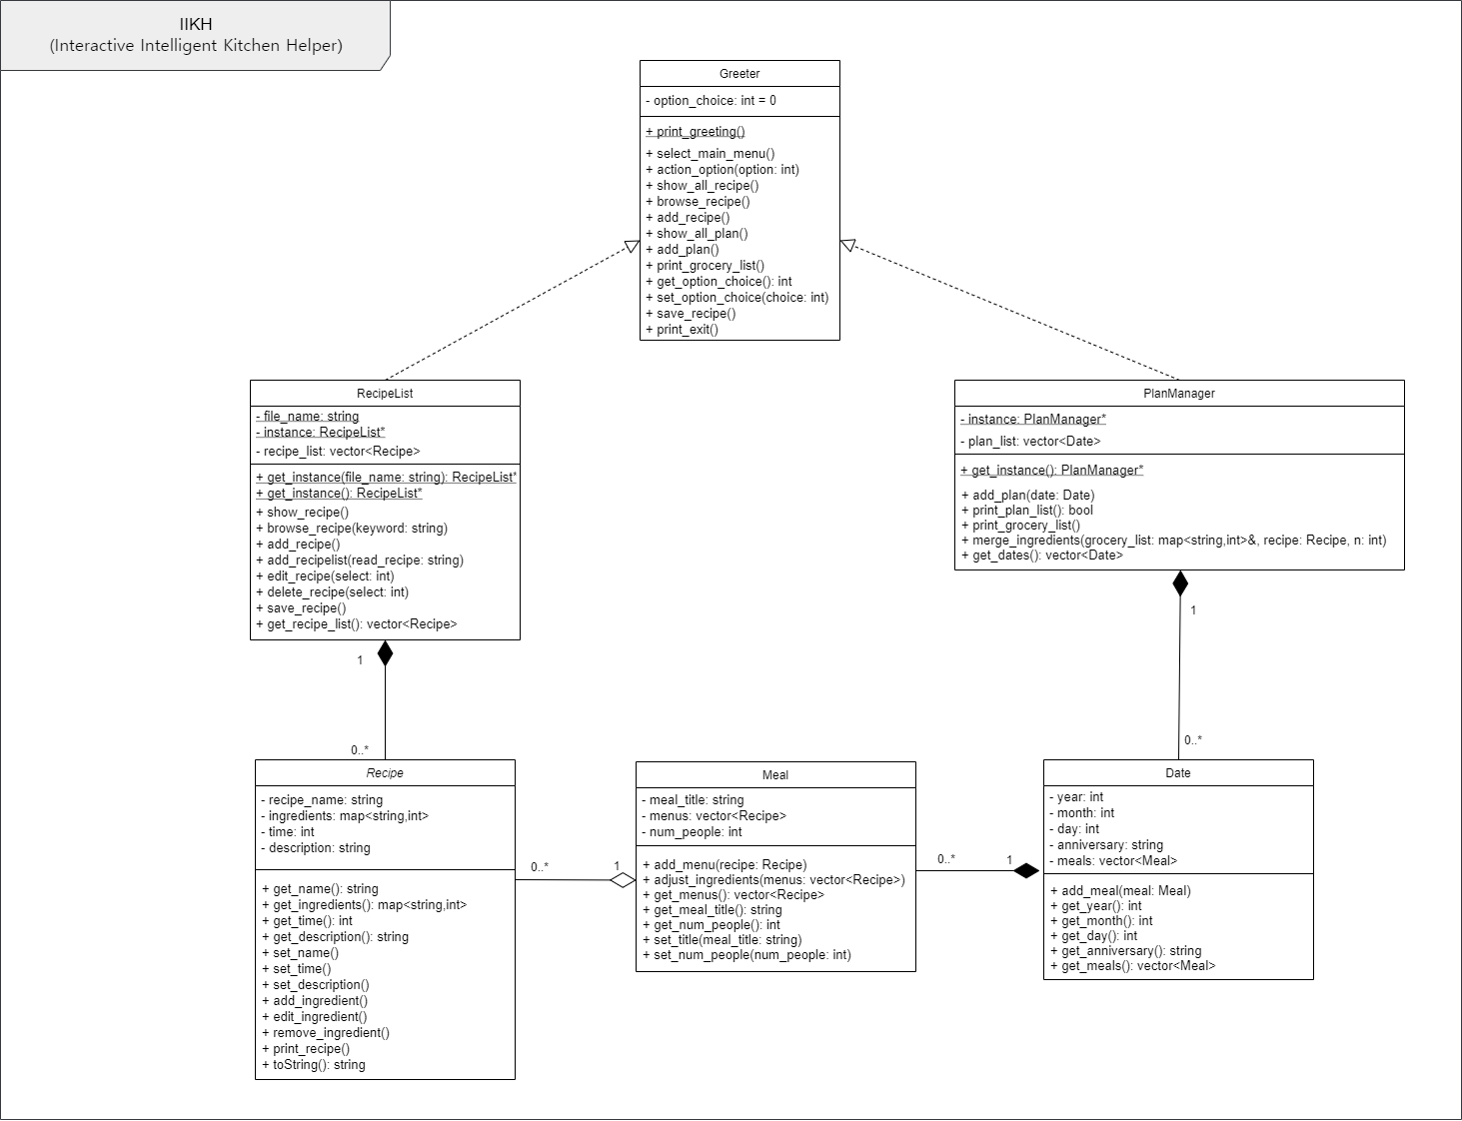
Class Structure

Slide 3
Bottom-up approach
PlanManager
Date
Meal
Recipe
Recipe List

Slide 5
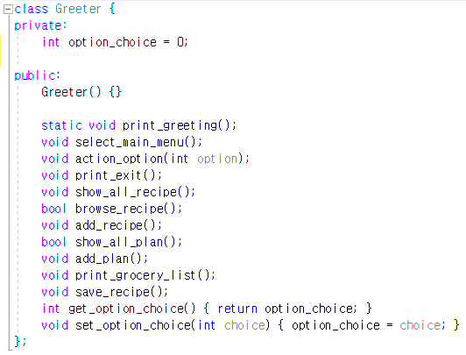
Greeter class
Program greeting
Main Menu->select function

Slide 6
IIKH
Recipe Database
Meal Plans

Slide 7

RecipeList Class
Recipe Database
Show all recipe
Browsing
Editing
Adding

Slide 8

PlanManager Class
Show all plan
Add new plan
Print grocery list
- automatically scaled by the number of people in meal plan

Slide 9

Let’s Demo~!!
Start

