Slide 1
The following slide will be distributed for preparation before the pre-Mol-MDT meeting
No clinical data such as sex, age, year of diagnosis, clinical diagnosis or material block number in the following slide.

Slide 2

MDT
18 MAY 2026
XX XXX 2026
DNA
MDT
Report
xx
XXX
2022
DNA
MTB
Report
MTB
Report
MTB
Report
IPD2225
CNS/Brain
TSO500
MDT
Report
OUS
RNA
Version string: 2.2.0.12/0.3.2:22-06-07/1.0.0/1.0.0/hg19/TR
Patient
SUMMARY OF KEY FINDINGS
Variants that alter protein coding sequence
42
splicing: None reported
Gene_symbol | Protein_change_short | Coding_status | AF_tumor_DNA
TP53 | G245D | missense | 0.20
RB1 | R445X | stop_gained,splice_region | 0.18
PTEN | T319X | frameshift | 0.06
MSH2 | N596del | inframe_deletion | 0.56
LZTR1 | W469X | stop_gained | 0.61
HNF1A | P289fs | frameshift | 0.05
CIC | S146X | frameshift | 0.14
ARID1B | R1845C | missense | 0.02
ATM | V2115I | missense | 0.17
AXIN1 | A441T | missense | 0.11
BCORL1 | R1299Q | missense | 0.02
FAT1 | S4566R | missense | 0.17
FAT1 | V1577I | missense | 0.05
GNAS | G414R | missense | 0.05
PRDM1 | A379T | missense | 0.17
PTEN | G36R | missense | 0.05
LATS2 | I993T | missense | 0.60
NOTCH1 | R1663W | missense | 0.36
NOTCH3 | A399T | missense,splice_region | 0.21
DNMT3A | Q356X | stop_gained | 0.04
SETD2 | R70X | stop_gained | 0.20
MEF2B | T274fs | frameshift | 0.20
CD276 | R111H | missense | 0.22
ERCC1 | V126I | missense | 0.17
FGF8 | T133M | missense | 0.05
NUP93 | P656L | missense | 0.19
PRKDC | A1947T | missense | 0.20
GEN1 | N154D | missense | 0.40
-
SNVs/ indels | Total nr of SNVs/indels in protein coding sequence alter protein coding sequence |  | Copy number variants |  | Gene fusions RNA
Y of D:
34
28
fusion: None reported
OUS
15
TMB |  | status
Mut/Mb
MS
Stable 5 unstable out of 121
Low
o
Intermediate
High
Primary tumor naive Archived FFPE
5
20
Potentially overestimated TMB*
Bio-material
Description of InPreD calculations:
Tumor Mutation Burden, TMB (DRUP equivalent): VAF>=0.05, depth>=50, excludes synonymous.
*If tumor only, the somatic and germline origin of some of the assessed variants is uncertain which may cause the TMB value to be overestimated.
Observed TMB: Eligible variant / Effective Panel Size (Millions of bases):
TMB is not available (blank) when Effective Panel Size < 1.14 (90% of the target bases have read depth at least 50). Manual inspection is needed.
Indicative threshold for Microsatellite (MS) status: Unstable if proportion of unstable MS sites ≥ 20%, Likely unstable when between 20% and >=10%, otherwise stable. Unreliable when number of usable sites is less than 40.
Reports from the LocalApp from Illumina:
TMB includes synonymous (eligible variants):
Percentage of unstable MS sites (unstable / usable MS site count):
Fusion filter criteria: at least 3 unique supporting reads, one of which must be a split read (a single read covering the fusion breakpoint). Splice variant with involved exons in parenthesis.
Initial report:
Orange header refers to this report being in the initial reporting phase. In the final report for Mol-MDT the header will be blue.
Variants of uncertain significance (VUS) refer to variants with unknown/ unclear / inconclusive / contradictory functional consequence in cancer. Level of evidence for experimental treatment follows ESCAT guidelines and will be defined by the respective study/trial.
The tumor content is estimated by a pathologist unless otherwise specified. This tumor content is used as input in the post processing pipeline (TSOPPI).
Tumor content
~50%
23/1.27
TMB = 14.9 (19)
MSI = 4.13 (5/121)
Infrastructure for
Precision Diagnostics
VAF=variant allele fraction ,
CN=copy number (assumes ploidy 2).
# Variant of unclear significance (VUS)

Slide 3
The following slides are for the molecular tumor board
Contains clinical information from the file “InPreD_PRONTO_metadata”.

Slide 4
MDT
18 MAY 2026
XX XXX 2026
DNA
MDT
Report
MTB
Report
Trial ID MRARE-X-xxxx
IPD2225
CNS/Brain
TSO500
MDT
Report
OUS
RNA
Version string: 2.2.0.12/0.3.2:22-06-07/1.0.0/1.0.0/hg19/TR
M/66y
CLINICAL CASE:
Patient
BIOMATERIAL:
Y of D:
-
Comment_pathy Comment_sample
OUS
Primary tumor naive Archived FFPE
Bio-material
DNA:25materialX RNA:25materialX
Tumor content
~50%
Infrastructure for
Precision Diagnostics
Inclusion site

Slide 5

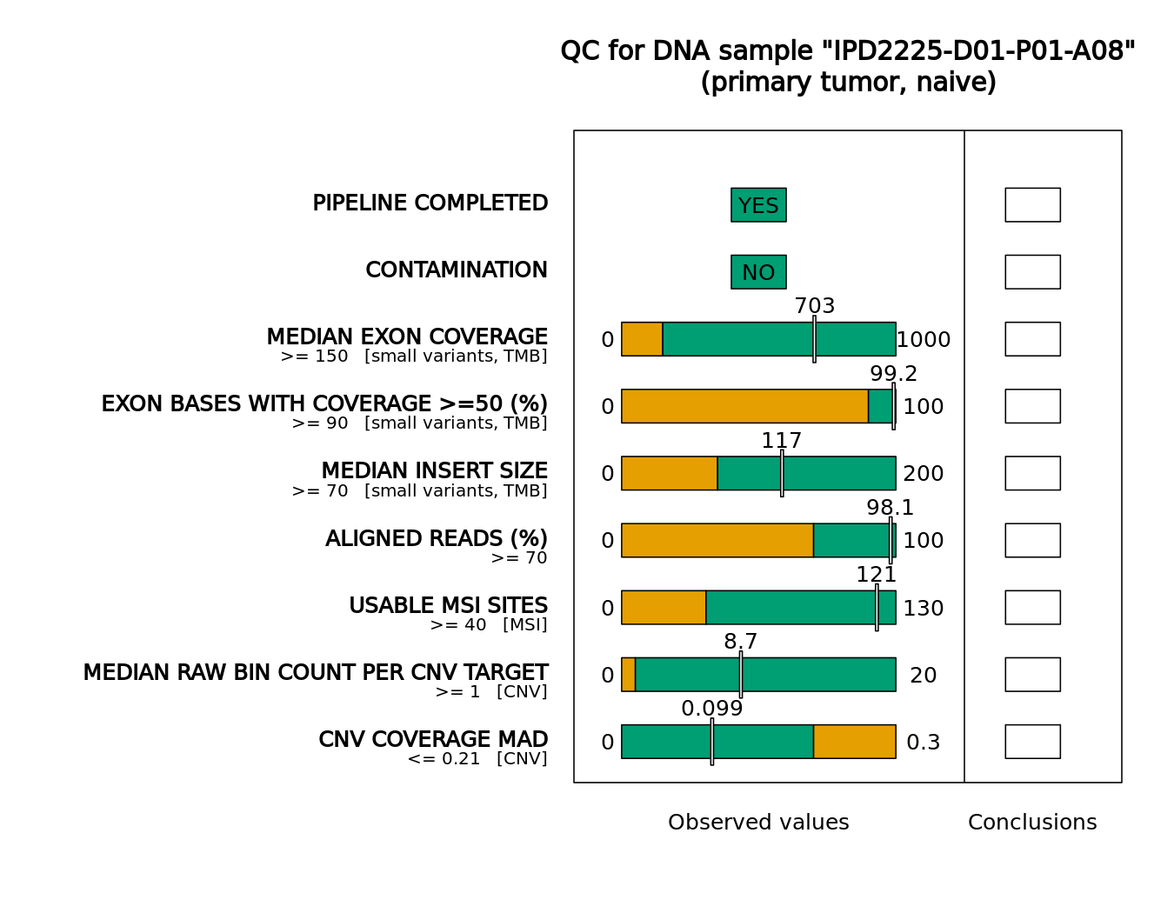
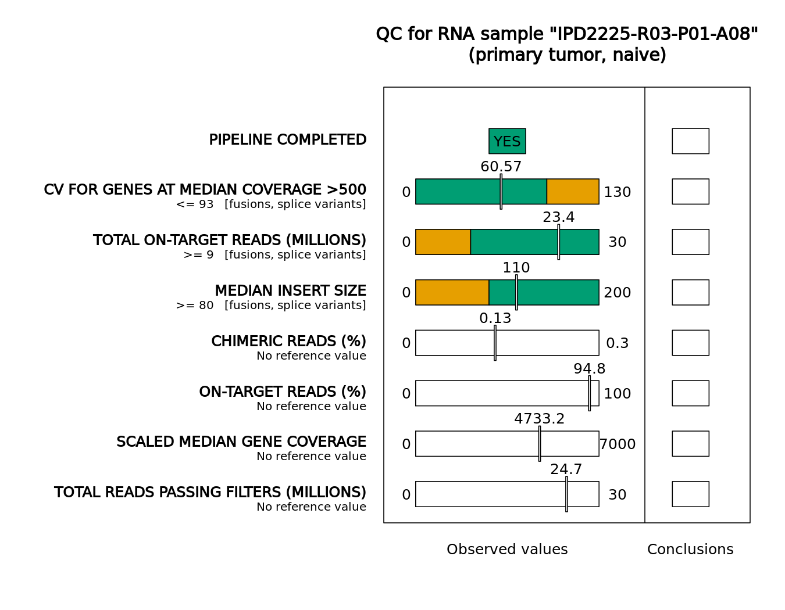
MDT
18 MAY 2026
XX XXX 2026
DNA
MDT
Report
MTB
Report
Trial ID MRARE-X-xxxx
IPD2225
CNS/Brain
TSO500
MDT
Report
OUS
RNA
Version string: 2.2.0.12/0.3.2:22-06-07/1.0.0/1.0.0/hg19/TR
Patient
M/66y
QUALITY CONTROL MEASURES OF SEQUENCING DATA
SEQUENCING FACILITY
Y of D:
-
Approved if observed quality metrics are within regions marked green
Department of Pathology,
Oslo University Hospital
OUS
Primary tumor naive Archived FFPE
DNA
Bio-material
DNA:25materialX RNA:25materialX
Tumor content
~50%
RNA
Infrastructure for
Precision Diagnostics
VAF=variant allele fraction ,
CN=copy number (assumes ploidy 2).

Slide 6
MDT
18 MAY 2026
XX XXX 2026
DNA
MDT
Report
MTB
Report
Trial ID MRARE-X-xxxx
IPD2225
CNS/Brain
TSO500
MDT
Report
OUS
RNA
Version string: 2.2.0.12/0.3.2:22-06-07/1.0.0/1.0.0/hg19/TR
Patient
M/66y
SUMMARY OF KEY FINDINGS
Variants that alter protein coding sequence
42
splicing: None reported
Gene_symbol | Protein_change_short | Coding_status | AF_tumor_DNA
TP53 | G245D | missense | 0.20
RB1 | R445X | stop_gained,splice_region | 0.18
PTEN | T319X | frameshift | 0.06
MSH2 | N596del | inframe_deletion | 0.56
LZTR1 | W469X | stop_gained | 0.61
HNF1A | P289fs | frameshift | 0.05
CIC | S146X | frameshift | 0.14
ARID1B | R1845C | missense | 0.02
ATM | V2115I | missense | 0.17
AXIN1 | A441T | missense | 0.11
BCORL1 | R1299Q | missense | 0.02
FAT1 | S4566R | missense | 0.17
FAT1 | V1577I | missense | 0.05
GNAS | G414R | missense | 0.05
PRDM1 | A379T | missense | 0.17
PTEN | G36R | missense | 0.05
LATS2 | I993T | missense | 0.60
NOTCH1 | R1663W | missense | 0.36
NOTCH3 | A399T | missense,splice_region | 0.21
DNMT3A | Q356X | stop_gained | 0.04
SETD2 | R70X | stop_gained | 0.20
MEF2B | T274fs | frameshift | 0.20
CD276 | R111H | missense | 0.22
ERCC1 | V126I | missense | 0.17
FGF8 | T133M | missense | 0.05
NUP93 | P656L | missense | 0.19
PRKDC | A1947T | missense | 0.20
GEN1 | N154D | missense | 0.40
-
SNVs/ indels | Total nr of SNVs/indels in protein coding sequence alter protein coding sequence |  | Copy number variants |  | Gene fusions RNA
Y of D:
34
28
fusion: None reported
OUS
15
TMB |  | status
Mut/Mb
MS
Stable 5 unstable out of 121
Low
o
Intermediate
High
Primary tumor naive Archived FFPE
5
20
Potentially overestimated TMB*
Bio-material
23/1.27
DNA:25materialX RNA:25materialX
TMB InPreD calculated as Eligible variant / Effective Panel Size in Millions of bases:
Report from the LocalApp from Illumina: TMB including synonymous (eligible variants):
TMB = 14.9 (19)
Tumor content
~50%
Infrastructure for
Precision Diagnostics
VAF=variant allele fraction ,
CN=copy number (assumes ploidy 2).
# Variant of uncertain significance (VUS)

Slide 7
MDT
18 MAY 2026
XX XXX 2026
Trial ID MRARE-X-xxxx
IPD2225
TSO500
DNA
MDT
Report
CNS/Brain
RNA
OUS
Version string: 2.2.0.12/0.3.2:22-06-07/1.0.0/1.0.0/hg19/TR
Patient
M/66y
SUMMARY OF KEY FINDINGS
Variants that alter protein coding sequence
42
splicing: None reported
Gene_symbol | Protein_change_short | Coding_status | AF_tumor_DNA
TP53 | G245D | missense | 0.20
RB1 | R445X | stop_gained,splice_region | 0.18
PTEN | T319X | frameshift | 0.06
MSH2 | N596del | inframe_deletion | 0.56
LZTR1 | W469X | stop_gained | 0.61
HNF1A | P289fs | frameshift | 0.05
CIC | S146X | frameshift | 0.14
ARID1B | R1845C | missense | 0.02
ATM | V2115I | missense | 0.17
AXIN1 | A441T | missense | 0.11
BCORL1 | R1299Q | missense | 0.02
FAT1 | S4566R | missense | 0.17
FAT1 | V1577I | missense | 0.05
GNAS | G414R | missense | 0.05
PRDM1 | A379T | missense | 0.17
PTEN | G36R | missense | 0.05
LATS2 | I993T | missense | 0.60
NOTCH1 | R1663W | missense | 0.36
NOTCH3 | A399T | missense,splice_region | 0.21
DNMT3A | Q356X | stop_gained | 0.04
SETD2 | R70X | stop_gained | 0.20
MEF2B | T274fs | frameshift | 0.20
CD276 | R111H | missense | 0.22
ERCC1 | V126I | missense | 0.17
FGF8 | T133M | missense | 0.05
NUP93 | P656L | missense | 0.19
PRKDC | A1947T | missense | 0.20
GEN1 | N154D | missense | 0.40
-
SNVs/ indels | Total nr of SNVs/indels in protein coding sequence alter protein coding sequence |  | Copy number variants |  | Gene fusions RNA
Y of D:
34
28
fusion: None reported
OUS
15
TMB |  | status
Mut/Mb
MS
Stable 5 unstable out of 121
Low
o
Intermediate
High
Primary tumor naive Archived FFPE
5
20
Potentially overestimated TMB*
Bio-material
Biomarkers
DNA:25materialX RNA:25materialX
Gene | Variant | Type |  | VAF/ CN | Variant GoF/ LoF | Pathway/ function | Therapeutic context |  | Level of Evidence
 |  |  |  |  |  |  | Sensitive | Resistant | Patient’s tumor type | Other tumor type
--
Variant classification
Tumor content
~50%
Additional results: Variants of potential relevance
Gene | Variant | GoF/LoF | Comments
XXXX | xxx | LoF/GoF
Infrastructure for
Precision Diagnostics
VAF=variant allele fraction ,
CN=copy number (assumes ploidy 2).
# Variant of uncertain significance (VUS)

Slide 8
Sequence data summary for IPD2225-D01-P01-A08: Variants that alter protein code and splice sites. TSOPPI Version string: Version string: 2.2.0.12/0.3.2:22-06-07/1.0.0/1.0.0/hg19/TR (N=28, Page 1/2)
Gene_symbol | Genomic_coordinates_in_hg19_build | Ensembl_transcript_ID | Exon_number | Protein_change_short | HGVS_syntax | Change_summary | Coding_status | Read_depth(variant reads/total reads) | AF_tumor_DNA | Filter_rescued
TP53 | chr17:g.7577547C>T | ENST00000269305 | exon7 | G245D | NM_000546:c.734G>A | TP53 NM_000546:c.734G>A,p.(G245D),p.(Gly245Asp) | missense | 149/756 | 19.8%
RB1 | chr13:g.48953730C>T | ENST00000267163 | exon14 | R445X | NM_000321:c.1333C>T | RB1 NM_000321:c.1333C>T,p.(R445X),p.(Arg445Ter) | stop_gained,splice_region | 66/370 | 18.1%
PTEN | chr10:g.89720798GTACT>G | ENST00000371953 | exon8 | T319X | NM_000314:c.955_958del | PTEN NM_000314:c.955_958del,p.(T319X),p.(Thr319Ter) | frameshift | 29/490 | 6.1%
MSH2 | chr2:g.47702189CAAT>C | ENST00000233146 | exon12 | N596del | NM_000251:c.1786_1788del | MSH2 NM_000251:c.1786_1788del,p.(N596del),p.(Asn596del) | inframe_deletion | 377/670 | 56.4%
LZTR1 | chr22:g.21348266G>A | ENST00000215739 | exon13 | W469X | NA:c.1407G>A | LZTR1 NA:c.1407G>A,p.(W469X),p.(Trp469Ter) | stop_gained | 281/463 | 60.7% | Yes
HNF1A | chr12:g.121432116G>GC | ENST00000257555 | exon4 | P289fs | NM_000545:c.863_864insC | HNF1A NM_000545:c.863_864insC,p.(P289fs),p.(Pro289AlafsTer28) | frameshift | 30/594 | 5.1%
CIC | chr19:g.42791371CAG>C | ENST00000575354 | exon3 | S146X | NM_015125|NM_001379484|NM_001379485:c.436_437del | CIC NM_015125|NM_001379484|NM_001379485:c.436_437del,p.(S146X),p.(Ser146Ter) | frameshift | 101/723 | 14.1%
ARID1B | chr6:g.157527808C>T | ENST00000346085 | exon20 | R1845C | NA:c.5533C>T | ARID1B NA:c.5533C>T,p.(R1845C),p.(Arg1845Cys) | missense | 26/1183 | 2.2%
ATM | chr11:g.108188244G>A | ENST00000278616 | exon43 | V2115I | NA:c.6343G>A | ATM NA:c.6343G>A,p.(V2115I),p.(Val2115Ile) | missense | 70/425 | 16.5%
AXIN1 | chr16:g.348185C>T | ENST00000262320 | exon6 | A441T | NM_003502:c.1321G>A | AXIN1 NM_003502:c.1321G>A,p.(A441T),p.(Ala441Thr) | missense | 59/543 | 11.0%
BCORL1 | chrX:g.129159172G>A | ENST00000540052 | exon6 | R1299Q | NM_001184772|NM_001379450|NM_001379451:c.3896G>A | BCORL1 NM_001184772|NM_001379450|NM_001379451:c.3896G>A,p.(R1299Q),p.(Arg1299Gln) | missense | 16/766 | 2.2%
FAT1 | chr4:g.187509817T>G | ENST00000441802 | exon27 | S4566R | NM_005245:c.13696A>C | FAT1 NM_005245:c.13696A>C,p.(S4566R),p.(Ser4566Arg) | missense | 228/1387 | 16.5%
FAT1 | chr4:g.187549389C>T | ENST00000441802 | exon9 | V1577I | NM_005245:c.4729G>A | FAT1 NM_005245:c.4729G>A,p.(V1577I),p.(Val1577Ile) | missense | 55/1159 | 4.8%
GNAS | chr20:g.57429560G>A | ENST00000371100 | exon1 | G414R | NM_080425:c.1240G>A | GNAS NM_080425:c.1240G>A,p.(G414R),p.(Gly414Arg) | missense | 39/754 | 5.2%

Slide 9
Sequence data summary for IPD2225-D01-P01-A08: Variants that alter protein code and splice sites. TSOPPI Version string: Version string: 2.2.0.12/0.3.2:22-06-07/1.0.0/1.0.0/hg19/TR (N=28, Page 2/2)
Gene_symbol | Genomic_coordinates_in_hg19_build | Ensembl_transcript_ID | Exon_number | Protein_change_short | HGVS_syntax | Change_summary | Coding_status | Read_depth(variant reads/total reads) | AF_tumor_DNA | Filter_rescued
PRDM1 | chr6:g.106553170G>A | ENST00000369096 | exon5 | A379T | NM_001198:c.1135G>A | PRDM1 NM_001198:c.1135G>A,p.(A379T),p.(Ala379Thr) | missense | 206/1185 | 17.4%
PTEN | chr10:g.89653808G>A | ENST00000371953 | exon2 | G36R | NM_000314:c.106G>A | PTEN NM_000314:c.106G>A,p.(G36R),p.(Gly36Arg) | missense | 23/461 | 5.2%
LATS2 | chr13:g.21549298A>G | ENST00000382592 | exon8 | I993T | NM_014572:c.2978T>C | LATS2 NM_014572:c.2978T>C,p.(I993T),p.(Ile993Thr) | missense | 697/1159 | 60.2%
NOTCH1 | chr9:g.139399156G>A | ENST00000277541 | exon26 | R1663W | NA:c.4987C>T | NOTCH1 NA:c.4987C>T,p.(R1663W),p.(Arg1663Trp) | missense | 54/151 | 36.4%
NOTCH3 | chr19:g.15299983C>T | ENST00000263388 | exon8 | A399T | NM_000435:c.1195G>A | NOTCH3 NM_000435:c.1195G>A,p.(A399T),p.(Ala399Thr) | missense,splice_region | 153/733 | 20.9%
DNMT3A | chr2:g.25469976G>A | ENST00000264709 | exon9 | Q356X | NM_175629:c.1066C>T | DNMT3A NM_175629:c.1066C>T,p.(Q356X),p.(Gln356Ter) | stop_gained | 32/752 | 4.3%
SETD2 | chr3:g.47165918G>A | ENST00000409792 | exon3 | R70X | NM_014159:c.208C>T | SETD2 NM_014159:c.208C>T,p.(R70X),p.(Arg70Ter) | stop_gained | 172/849 | 20.3%
MEF2B | chr19:g.19257143TG>T | ENST00000162023 | exon12 | T274fs | NA:c.819del | MEF2B NA:c.819del,p.(T274fs),p.(Thr274ProfsTer?) | frameshift | 79/399 | 20.0%
CD276 | chr15:g.73994848G>A | ENST00000318443 | exon3 | R111H | NM_001024736:c.332G>A | CD276 NM_001024736:c.332G>A,p.(R111H),p.(Arg111His) | missense | 169/761 | 22.3%
ERCC1 | chr19:g.45923631C>T | ENST00000013807 | exon3 | V126I | NM_001369408|NM_001369410|NM_001369409|NM_001369411|NM_202001:c.376G>A | ERCC1 NM_001369408|NM_001369410|NM_001369409|NM_001369411|NM_202001:c.376G>A,p.(V126I),p.(Val126Ile) | missense | 109/657 | 16.6%
FGF8 | chr10:g.103531266G>A | ENST00000320185 | exon5 | T133M | NM_033163:c.398C>T | FGF8 NM_033163:c.398C>T,p.(T133M),p.(Thr133Met) | missense | 33/719 | 4.7%
NUP93 | chr16:g.56871587C>T | ENST00000308159 | exon18 | P656L | NM_014669:c.1967C>T | NUP93 NM_014669:c.1967C>T,p.(P656L),p.(Pro656Leu) | missense | 189/997 | 19.0%
PRKDC | chr8:g.48775011C>T | ENST00000314191 | exon44 | A1947T | NM_006904:c.5839G>A | PRKDC NM_006904:c.5839G>A,p.(A1947T),p.(Ala1947Thr) | missense | 136/687 | 19.9%
GEN1 | chr2:g.17946275A>G | ENST00000381254 | exon4 | N154D | NM_001130009:c.460A>G | GEN1 NM_001130009:c.460A>G,p.(N154D),p.(Asn154Asp) | missense | 281/706 | 39.9%

Slide 10
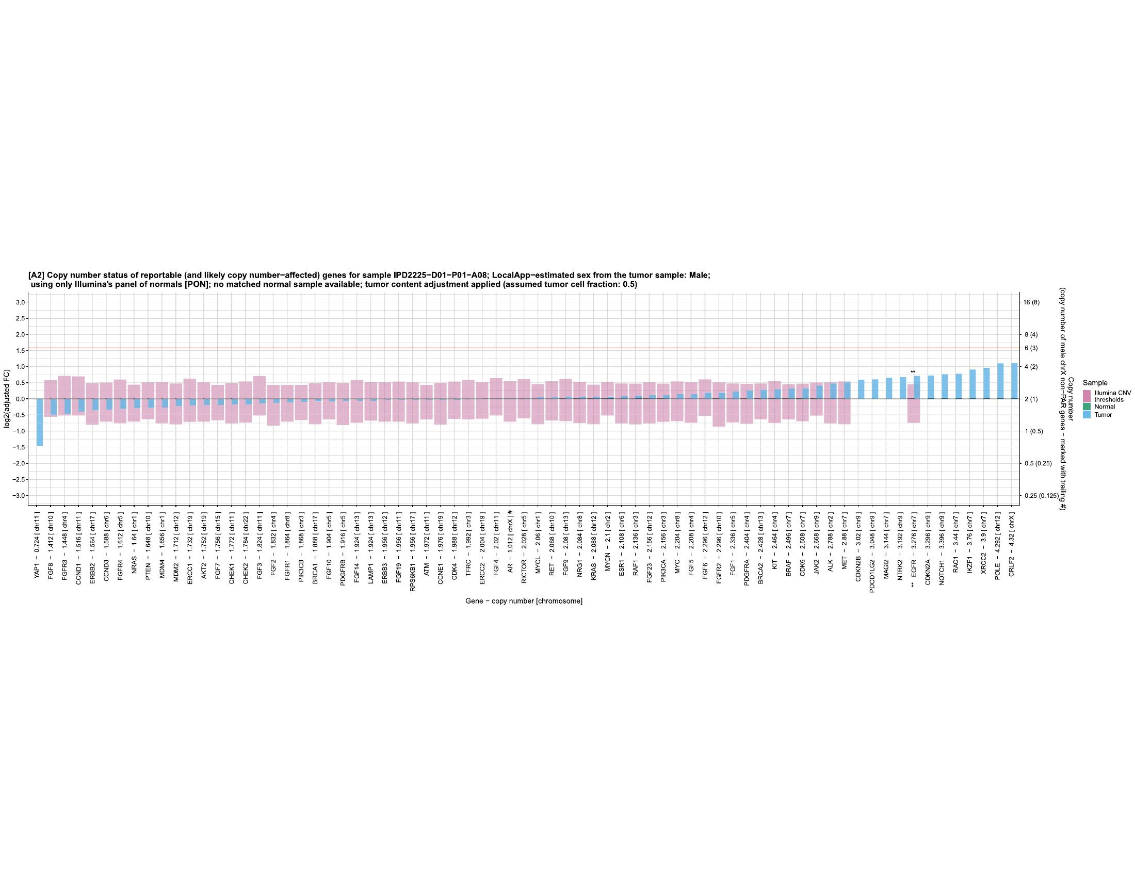

Slide 11
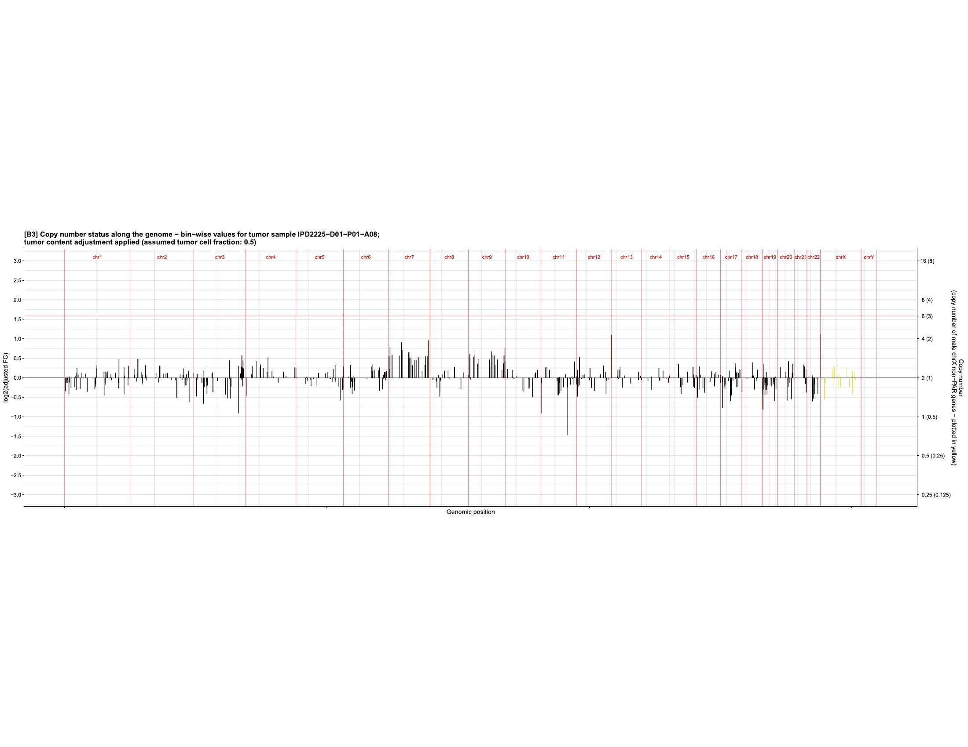
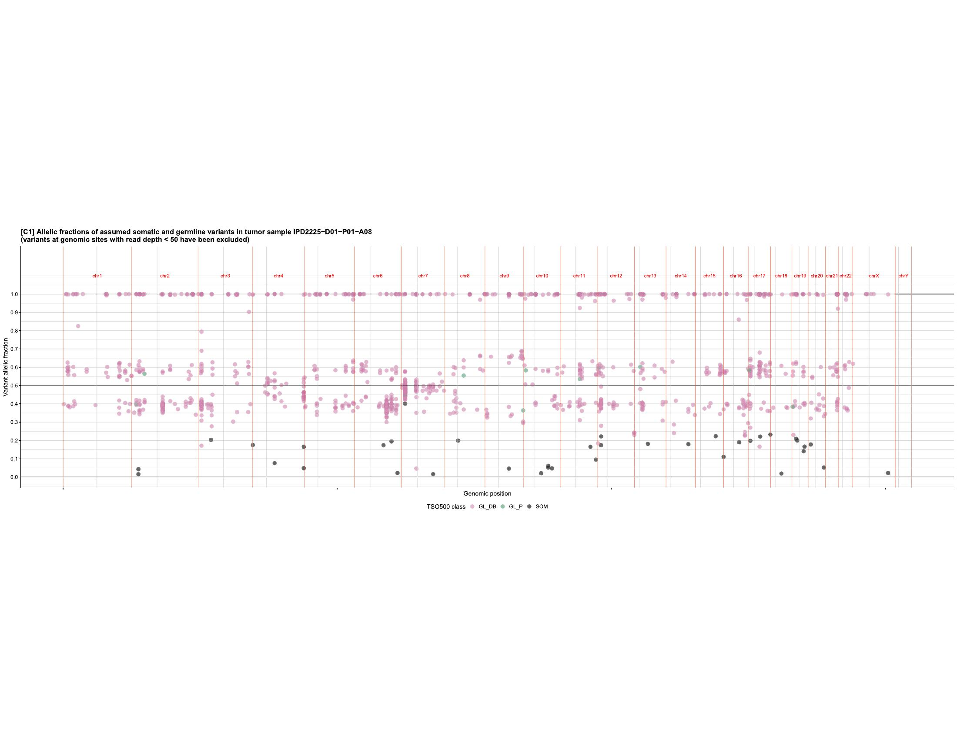

Slide 12
MTB
Report
Standard templates for text and tables in the report:
MTB
Report
Reported fusions:
Gene1 | Gene2 | PairedAlt | SplitAlt | Support %
AA (exonX) Chr Y | BB (exonX) Chr Y |  |  | x%
Biomarkers and variant/gene-drug association
F1 Liquid CDx
Gene Alterations
Any overlap TSO500:
Add. biomarkers:
Biomarkers potentially relevant for immune therapy | None reported
Gene | Variant | Type | VAF/ CN | Variant GoF/ LoF | Pathway/ function | Therapeutic context |  | Level of Evidence
 |  |  |  |  |  | Sensitive | Resistant | Patient’s tumor type | Other tumor type
--
Variant classification
¤ : According to ESMO guidelines, genetic testing is recommended for the reported XX variant.
TSO500 ctDNA
Tumor DNA not represented
According to ESMO guidelines, recommendation for genetic counseling does not apply for the variants reported
Additional results: Variants of potential biological and diagnostic relevance
Gene | Variant | GoF/LoF | Comments
XX | xx | LoF/GoF Unknown
# Variant of unknown significance (VUS)
& Variants previously reported (in Myeloid panels)
Somatic variants
Overlap with
TSO500 HT: YES
Add. biomarkers: NO
Additional results: Copy number variant
TSO500 ctDNA
Additional results: Variants of unknown significance in treatment relevant genes
Variants of potential relevance
Gene | Variant | VAF/ CN | GoF/ LoF | Pathway/ function | Comments
Mutation hotspot
*OncoKB
**PMID:XX
***PMID:XX
Somatic variants
Overlap with
TSO500 HT: YES
Add. biomarkers: YES
(See comments)
TSO500 ctDNA

