Slide 1
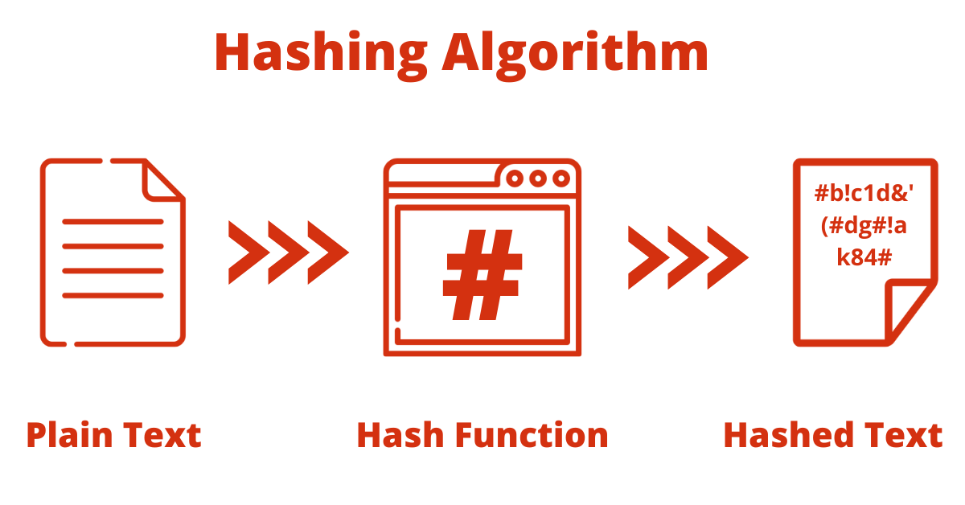
ICONIC HASHING
ALGORITHM
MPBI PROJECT BY:
NAME: DEEP DHAKATE
ROLL NO: FY21A133
DIV: A

Slide 2
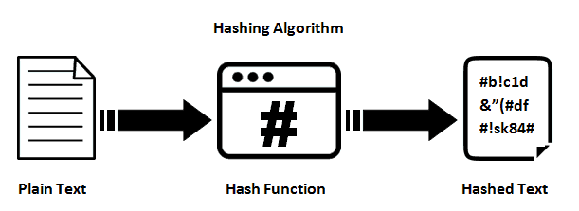




HASHING ALGORITHM
IH-ALGORITHM
MD5 VS IHA
CONCLUSION

Slide 3
What is Hashing ?
Hashing is the process of transforming any given key or a string of characters into another value. This is usually represented by a shorter, fixed-length value or key that represents and makes it easier to find or employ the original string. A hash function generates new values according to a mathematical hashing algorithm, known as a hash value or simply a hash. To prevent the conversion of hash back into the original key, a good hash always uses a one-way hashing algorithm. Hashing is relevant to -- but not limited to -- data indexing and retrieval, digital signatures, cybersecurity and cryptography.

Slide 4

Why Is Hashing Necessary?
> Hashing gives a more secure and adjustable method of retrieving data compared to any other data structure.
> Hashed passwords cannot be modified, stolen, or jeopardized. No well-recognized and efficient key or encryption scheme exists that can be misused. Also, there is no need to worry if a hash code is stolen since it cannot be applied anywhere else.
> Two files can be compared for equality easily through hashing. There is no need to open the two documents individually.
Application of Hashing:
> Password Verification
> Compiler Operation
> Rabin-Karp Algorithm
> Data Structures
> Message Digest

Slide 5
ICONIC HASHING ALGORITHM
What is Iconic Hashing Algorithm(IHA)?
IHA is a unique hashing algorithm which works on the base 10 digits for hashing. This algorithm works on each of these digits to convert them into an unpredictable format. The overall size of the hash is 38, 6 greater than the size of MD5 hashing algorithm. The algorithm is designed such that operations made on the digits is almost impossible to reverse, and its really hard even for a machine to reverse it using all the possible digits.
upper_case = [["A", "01"], ["B", "02"], ["C", "03"], ["D", "04"], ["E", "05"], ["F", "06"], ["G", "07"], ["H", "08"], ["I", "09"], ["J", "11"], ["K", "22"], ["L", "33"], ["M", "44"], ["N", "55"], ["O", "66"], ["P", "77"], ["Q", "88"], ["R", "99"], ["S", "12"], ["T", "13"], ["U", "14"], ["V", "15"], ["W", "16"], ["X", "17"], ["Y", "18"], ["Z", "19"]]
number = [["1", "601"], ["2", "602"], ["3", "603"], ["4", "604"], ["5", "605"], ["6", "606"], ["7", "607"], ["8", "608"], ["9", "609"], ["0", "610"], [" ", "00"]]
symbols = [["~", "1000"], ["`", "1001"], ["!", "1002"], ["#", "1003"], ["$", "1004"], ["%", "1005"], ["^", "1006"], ["&", "1007"], ["*", "1008"], ["(", "1009"], [")", "1010"], ["-", "1011"], ["_", "1012"], ["=", "1013"], ["+", "1014"], ["{", "1015"], ["}", "1016"], ["[", "1017"], ["]", "1018"], [":", "1019"], [";", "1020"], ['"', "1021"], ["'", "1022"], ["|", "1023"], ["\\", "1024"], ["<", "1025"], ["@", "1026"]]

Slide 6

WORKING OF IHA
In IH each characters are represented by a unique digit and the combination of this digits is called cipher array. Similar to MD5, the cipher array is padded depending upon its length. Three keys are generated in order to hash the cipher array. Key 1, sums out twice of all the numbers present in array, key 2 is the middle element present in array and key 3 is generated by taking sum of first and last element. The array is hashed using special formula. At last the hash is again padded to transform its length into 38.

Slide 7

VULNERABILITIES IN MD5
MD5 is considered weak and insecure; an attacker can easily use an MD5 collision to forge valid digital certificates. The most well-known example of this type of attack is when attackers forged a Microsoft Windows code-signing certificate and used it to sign the Flame malware. As such, MD5 is not suitable for applications like SSL certificates or digital signatures that rely on this property for digital security. Researchers additionally discovered more serious flaws in MD5, and described a feasible collision attack -- a method to create a pair of inputs for which MD5 produces identical checksums.

Slide 8


MD5 vs IHA
MD5 is the most used hashing algorithm even though it has vulnerabilities. In IHA the probability of getting a same hash of two different is not possible. This is because MD5 works on binary digits(0, 1) and IHA works on base 10 digits. Even the length of IHA is greater than MD5. It is impossible to reverse IHA due to its mathematical algorithm. The formula works on three different keys with modulus of 11.

Slide 9


THANK
YOU

