Slide 1
OOP
PROJECT
Inventory Management System
A Java Swing desktop application for managing shop products, stock, sales and low-stock alerts.
Java • Swing • MySQL
IMS
Technologies Used
Java
Swing GUI
MySQL
JDBC
OOP Concepts

Slide 2
Agenda
Presentation flow
1
2
3
4
5
Problem
Solution
Design
Code
Demo
Manual stock records are slow, repeated and unreliable.
Desktop inventory system for products and stock operations.
Use case, class and sequence diagrams explain structure.
Java classes, interface, JDBC and Swing event handling.
Add, search, sell, low-stock alert and restock.
Goal of Presentation
To explain how our system applies OOP concepts with a real Java Swing GUI and MySQL database.

Slide 3
Requirements Gathering & Analysis
Understanding what a small shopkeeper needs from an inventory system
Shopkeeper Needs
Manual Record Problems
Features Identified
• Quickly add new products
• View all available stock
• Search product by ID or name
• Update price and quantity
• Sell and reduce stock
• Restock when new items arrive
• Register entries can be lost
• Stock counting takes more time
• Human mistakes in quantity
• Hard to find old products fast
• No automatic warning for low stock
• Difficult to maintain neat records
• Add / View / Update / Delete
• Search by ID and by name
• Sell product and reduce stock
• Restock product quantity
• Low stock alert threshold
• Database storage using MySQL

Slide 4
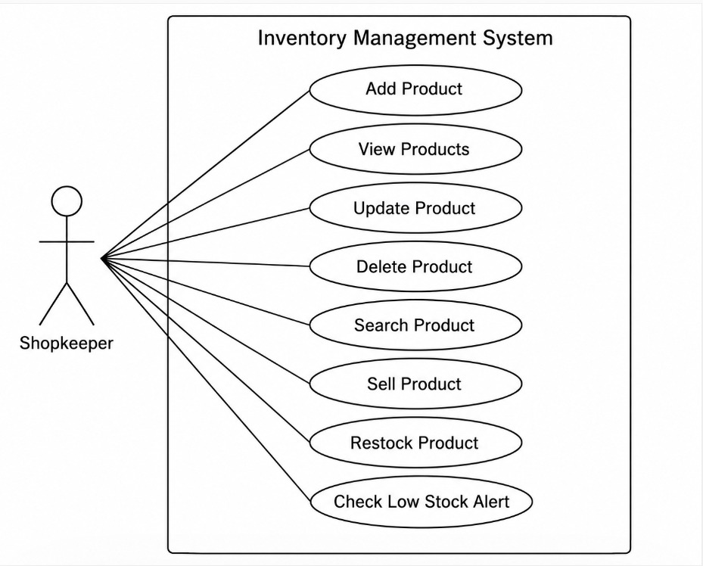
Use Case Diagram
Shopkeeper — Inventory Management System
Notes:
Image prompt for Slide 4: Create a clean black-and-white UML use case diagram for an Inventory Management System. One stick actor labeled Shopkeeper on the left. A system boundary rectangle labeled Inventory Management System. Inside it place 8 ellipses: Add Product, View Products, Update Product, Delete Product, Search Product, Sell Product, Restock Product, Check Low Stock Alert. Connect the actor to all use cases. Style should be simple, academic, and suitable for a second-semester OOP presentation.

Slide 5
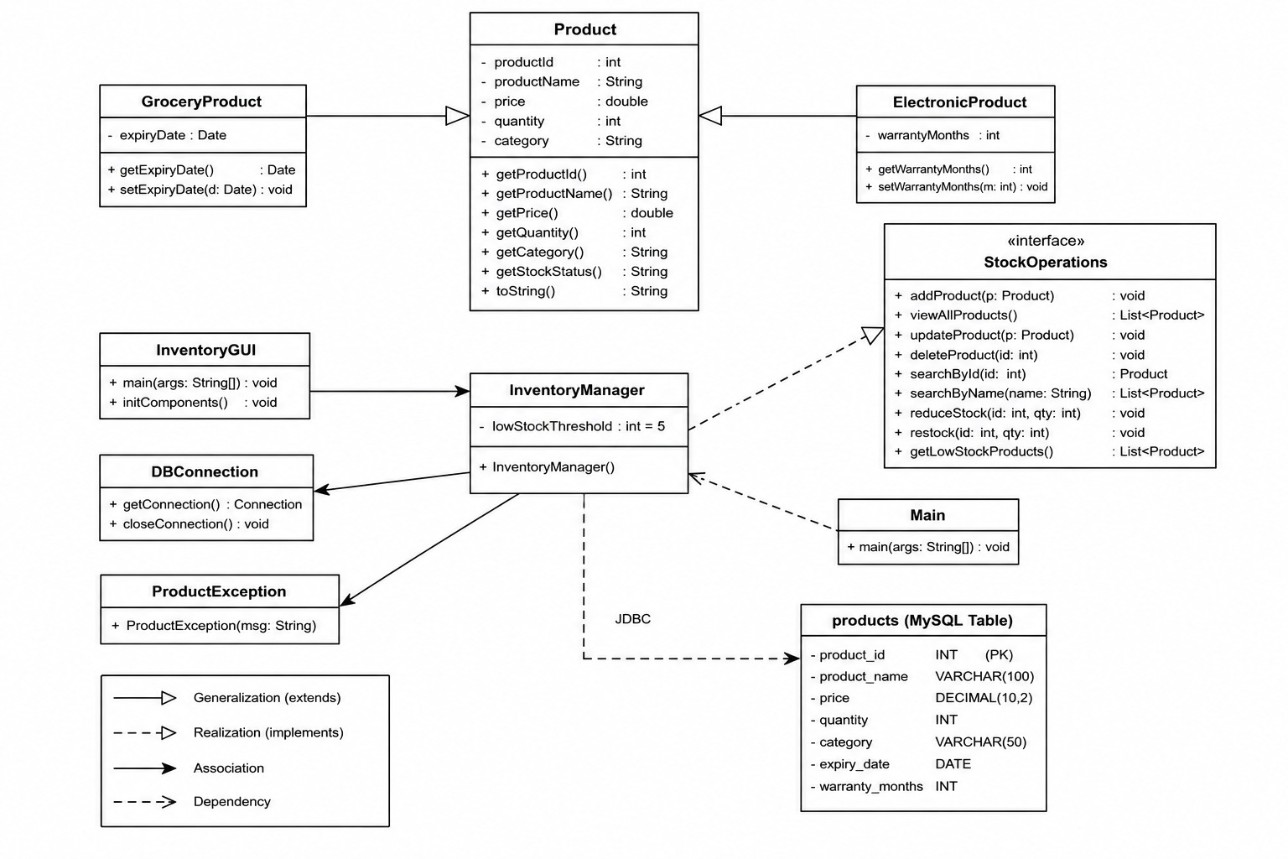
Class Diagram
Main classes and relationships used in the project
Notes:
Image prompt for Slide 5: Design a simple UML class diagram for a Java Swing MySQL Inventory Management System. Include Product parent class with attributes productId, productName, price, quantity, category and methods getters, setters, getStockStatus(), toString(). GroceryProduct extends Product and adds expiryDate. ElectronicProduct extends Product and adds warrantyMonths. StockOperations is an interface with addProduct, viewAllProducts, updateProduct, deleteProduct, searchById, searchByName, reduceStock, restock, getLowStockProducts. InventoryManager implements StockOperations. Also show InventoryGUI, DBConnection, ProductException, Main and products database table. Use clean boxes, empty triangle inheritance arrows, dashed implements arrow, solid associations.

Slide 6
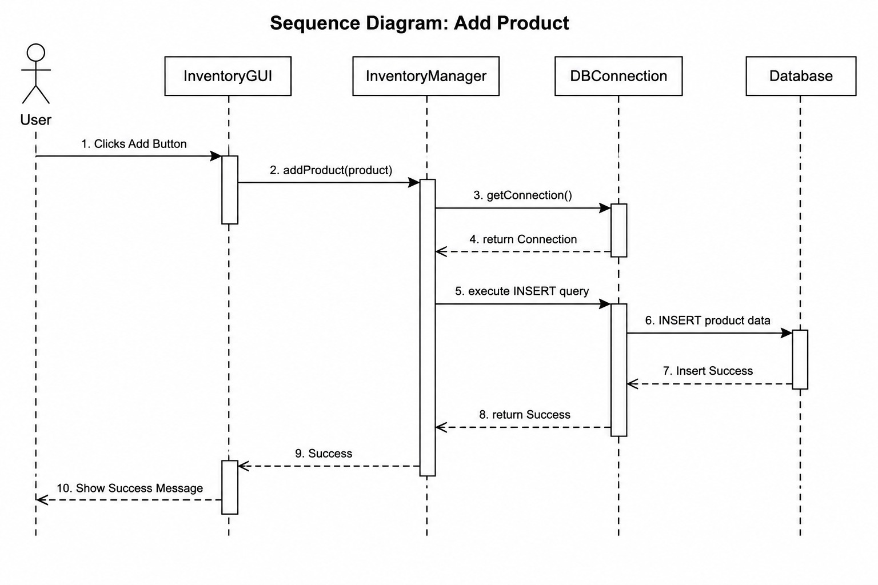
Sequence Diagram – Add Product
Flow from user action to database INSERT and success message
Notes:
Image prompt for Slide 6: Create a UML sequence diagram for Add Product in a Java Swing Inventory Management System. Lifelines: User, InventoryGUI, InventoryManager, DBConnection, Database. Messages: User clicks Add button, GUI calls addProduct(product), Manager calls getConnection(), DBConnection returns connection, Manager executes SQL INSERT, Database confirms, Manager returns success, GUI shows success message. Use clean vertical dashed lifelines and horizontal arrows with labels.

Slide 7
OOP Concepts Used
How the project used basic object-oriented programming ideas
Encapsulation
Product fields are private and accessed through getters/setters.
Polymorphism
Product reference can hold different product child types.
Inheritance
GroceryProduct and ElectronicProduct extend Product.
Interface
StockOperations defines stock methods for InventoryManager.
Exception Handling
ProductException shows meaningful errors and alerts.

Slide 8
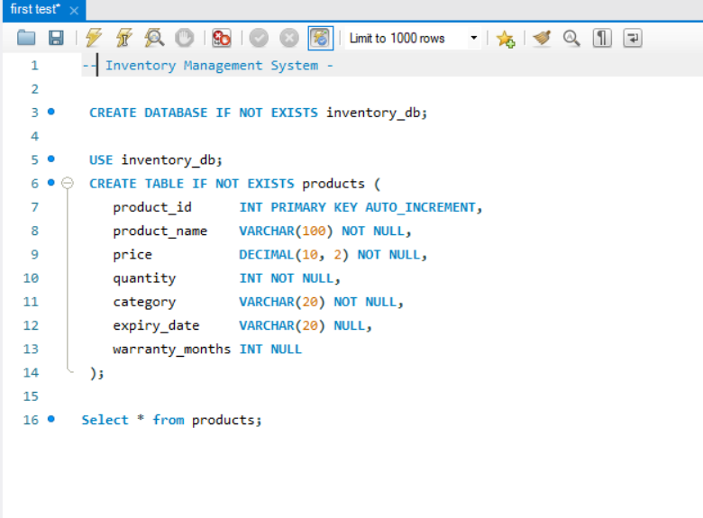
Database Design
MySQL table is used to store inventory data
Table Name: products
Column
Type / Purpose
product_id
Primary key / unique ID
product_name
Name of item
price
Selling price
quantity
Available stock
category
Grocery / Electronic / Other
expiry_date
Only for grocery products
warranty_months
Only for electronic products
Database keeps the data permanently, so records do not disappear when the GUI is closed.

Slide 9
Features – Part 1
Add Product, View All Products, and Search Product
Inventory Management System
Inventory Management System
Inventory Management System
Add Product
View All Products
Search Product
Name: Milk Pack
ID | Name | Qty | Price
Search By: ID / Name
Price: 250
1 Milk Pack 12 250
Enter: Milk Pack
Qty: 12
2 Charger 8 900
Result:
Category: Grocery
3 Blue Pen 20 180
Milk Pack | Qty 12
Expiry: 2026-06-15
ADD PRODUCT
REFRESH TABLE
SEARCH
9

Slide 10
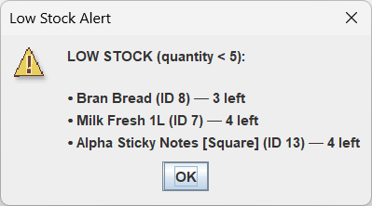
Features – Part 2
Sell, Restock and Low Stock Alert popup
Sell Product
Stock Operation Window
• User enters product ID
• System checks available quantity
• Quantity is reduced after sale
• If remaining stock is low, alert appears
Sell / Restock
Product ID: 4
Quantity: 3
Restock Product
Action: Sell Product
• User enters product ID
• New stock quantity is added
• Updated value is saved in database
• Table shows latest quantity
SUBMIT
10
Notes:
Image prompt for Slide 10: Create a realistic Java Swing warning dialog screenshot. Title: Low Stock Alert. Message: Sale completed. LOW STOCK ALERT: [ProductName] has only [X] unit(s) left. Include a yellow/red warning icon and OK button. Style should look like a simple Windows Java Swing dialog for an academic presentation.

Slide 11
InventoryManager.java
Business logic class: implements StockOperations and talks to the database
Main Responsibilities
• Implements StockOperations interface
• Handles 9 inventory methods
• Validates product and quantity data
• Runs INSERT, SELECT, UPDATE, DELETE queries
• Maps ResultSet data into Product objects
• Throws ProductException for errors / alerts
11
Notes:
Image prompt for Slide 11: Generate a clean code screenshot showing reduceStock() method from InventoryManager.java. Code should include parameter validation, searchById(), stock availability check, SQL UPDATE query, try-with-resources, executeUpdate(), updated product fetch, LOW_STOCK_THRESHOLD = 5 check, and throwing ProductException with a low stock alert message. Use readable monospace syntax highlighting.

Slide 12
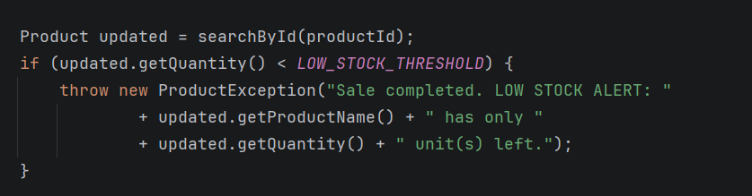
Low Stock Alert Logic
Threshold = 5, alert after sale if remaining quantity becomes low
Sell button clicked
Fetch updated product
quantity ≤ 5?
Throw
ProductException
Yes
No
reduceStock() called
Update database
quantity = quantity - soldQty
Continue
normal message
12

Slide 13
InventoryGUI.java + How Everything Connects
Swing windows collect input, manager handles logic, database stores records
InventoryGUI.java
InventoryManager.java
DBConnection.java
MySQL Database
Buttons, forms, JTable, dialogs
Business logic + StockOperations methods
Creates JDBC connection to MySQL
products table stores all inventory data
Data Flow Summary
• User fills form in Java Swing GUI
• Button listener calls InventoryManager method
• Manager validates and runs SQL through DBConnection
• MySQL sends result back to manager
• GUI refreshes table or shows message popup

Slide 14
Challenges & Solutions
Problems faced during development and how we solved them
Challenge
Solution Applied
What We Learned
Understanding JDBC
Used try-with-resources for Connection and PreparedStatement to auto-close database resources.
Database code becomes safer and closes resources automatically.
GUI and Manager Separation
Kept GUI for input/output and used InventoryManager for logic.
A project is easier to maintain when classes have clear jobs. (Delegation of Responsibility)
Low Stock Alert Placement
Checked stock after reduceStock() and used ProductException for alert message.
Alerts should be triggered from the business logic, not random GUI code.

Slide 15
Conclusion & Future Work
Final summary of the Inventory Management System project
Conclusion
Future Improvements
• A working desktop inventory system was developed in Java.
• Swing GUI makes the system simple for shopkeepers.
• MySQL stores products permanently.
• OOP concepts are applied through classes, inheritance, interface and exceptions.
• Login system for admin/user security
• Billing module for customer invoices
• Sales reports by day or month
• Export inventory to Excel or PDF
• Better dashboard with charts
Thank You
Questions?
Notes:
Live Demo Script (No extra slide): 1. Run Main.java in the IDE. 2. Show the main Inventory Management System window. 3. Add a sample product, e.g., Milk Pack, price 250, quantity 7, category Grocery, expiry date. 4. Click View All Products and show that the product appears in the table. 5. Search the product by ID or name. 6. Use Sell Product and reduce quantity below 5. 7. Show the Low Stock Alert popup. 8. Use Restock Product to increase quantity again. 9. View all products again and show the updated quantity. 10. End by explaining that GUI calls InventoryManager, and InventoryManager updates MySQL through DBConnection.

