Slide 1
Factory Method & Abstract Factory Pattern
By Ina Fløysvik Pedersen
Notes:
Welcome to my Presentation of Factory Method and Abstract Factory Design Patterns.

Slide 2
Common for both patterns
Creational
Factory Pattern
Fant ny god kilde for å lære om design patterns se link: https://refactoring.guru/design-patterns
Notes:
Creational pattern type Both Factory Method and Abstract Factory is Creational patterns from the Gang of Four design patterns. The Creational pattern type consist of patterns which deals with object creation. The idea of these patterns is to abstract the object instantiation process. The Creational patterns will help making your system independent of how its objects are created, composed, and represented. For example, when you have a lot of new statements in your client code and tightly coupled classes, you can use concrete implementations to make your system loosely coupled and manage you new statements better by using the Creational Patterns.
Factory Pattern Now days both Factory Method and Abstract Factory design pattern is put into Factory Design Pattern, where the Factory pattern refer to either Factory Method or Abstract Factory.

Slide 3
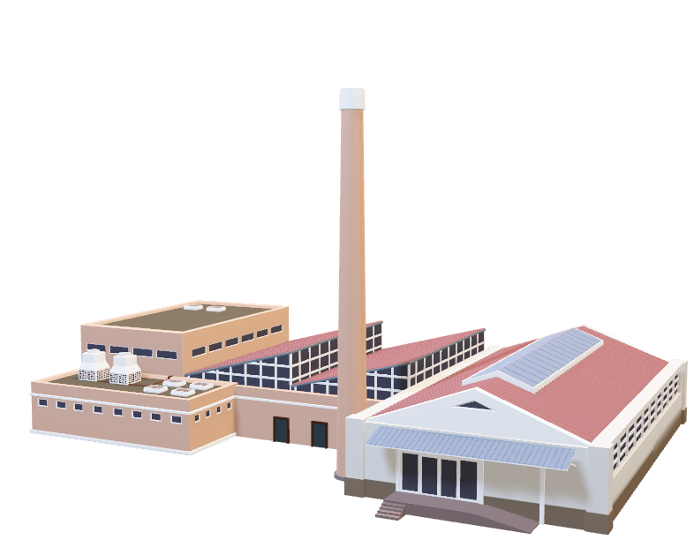
Factory Method Pattern
Intent
Suggest replacing
Products
https://github.com/InaFPedersen/DesignPatterns/tree/main/Creational/FactoryMethod
Notes:
Intent The Factory Method’s intent is to define an interface for creating an object, but to let subclasses decide which class to instantiate. In other words the Factory Method provides an interface for creating objects in a superclass, but it allows the subclasses to alter the type of objects that will be created.
Replace The Factory Method pattern suggest that we replace direct object construction calls (using the new operator) with calls to a special factory method. But don’t take this wrong, the objects will still be created via the new operator, but it is being called from within the factory method.
Products The objects returned by a factory method are often referred to as products.

Slide 4
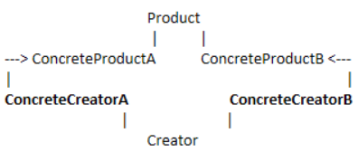
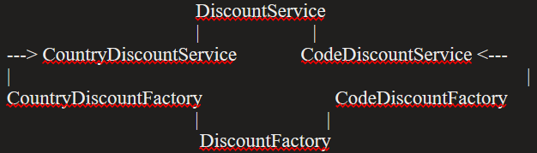
Factory Method Pattern Structure
Example

Slide 5




Factory Method: Use cases
Use cases:
Can’t anticipate
Subclass control
Delegate responsibility
Reusable objects
Notes:
The Factory Method has a few use cases where it is good to use this pattern.
The first one is when a class can’t anticipate the class of objects it must create, in other words when you don’t know in advance which types of object you code should work with. When that is the case, the concrete creators can take on this responsibility.
The second use case is when a class wants it subclasses to specify the objects it creates. This enables the scenario in which standard components or classes can be extended via subclasses. As the first use case the concrete creator takes on the responsibility for creating objects.
The third use case, is when classes delegate responsibility for creation to one of several helper subclasses and you want to localize the knowledge of which helper subclass is the delegate. Localization of that knowledge is now at level of which ever part of your application is responsible for providing the concrete implementation of the creator that is needed.
The fourth use case is when you use the Factory Method as a way to enable reusing of existing object. Where the logic inside of the factory method can take care of either creating an object or reusing an existing one as it sees fit. Of you are renewing the instances yourself, you will either have to write code like that wherever you renew it or put in a reusable method(the factory method).

Slide 6

Factory Method: Consequences
Consequences:
Eliminate binding
Avoid tight coupling
SOLID
Subclass creation

Slide 7
Factory Method: Related Patterns
Abstract Factory
Prototype
Template Method
Notes:
Factory Method is closely related to the Abstract Factory pattern. As Abstract Factory is often implemented with factory methods.
There is also a relation between Factory Method and another creational pattern the Prototype pattern. Where Prototypes don’t require subclassing creators, and they are not based on inheritance, which is a plus when you favor composition over inheritance. However, the prototype pattern often require an initialize operation on the Product class, which the factory method doesn’t. So in other words the factory method is based on inheritance, but it doesn’t require the initialization step, while Prototype favors composition.
Lastly, there is also a relation between Factory Method and the behavioral pattern Template Methods. Factory Methods are usually called within Template Methods

Slide 8

Abstract Factory Pattern
Intent
Declare interfaces
https://github.com/InaFPedersen/DesignPatterns/tree/main/Creational/AbstractFactory
Notes:
The intent of the Abstract Factory pattern is to provide an interface for creating families of related or dependent objects without specifying their concrete classes.
The first thing the Abstract Factory pattern suggests is to explicitly declare interfaces for each distinct product of the product family. Then you can make all variants of products follow those interfaces. The next move would be to declare the Abstract Factory an interface with a list of creation methods for all products that are part of the product family. And these methods must return abstract product types represented by the interfaces.

Slide 9
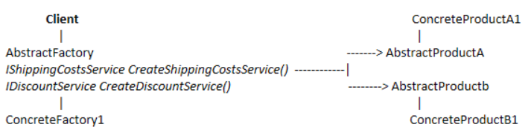
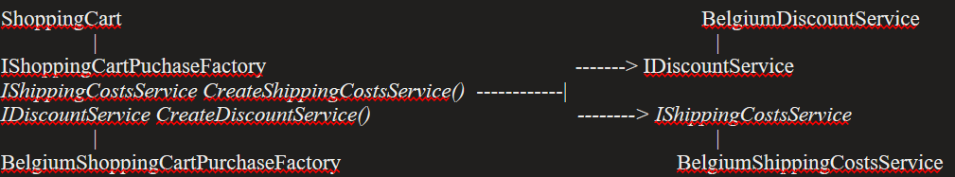
Abstract Factory Pattern Structure
Example
Notes:
As in Factory method the white image is the pattern structure and the black image is the example put into the pattern structure. You can choose if you want to use an abstract base class or interface when you takle Abstract Factory, in this example we will use interfaces. And in this example we will continue to build onto the example from the Factory Method. We want to convey that these objects belong together, in other words create a family of related objects a shopping cart purchase factory. This is an interface which contains methods to create an IDiscountService, that method is named CreateDiscountService, and a method to create an IShippingCostsService, named CreateShippingCostsService, you can see all of these to the left in the black image. This is the family of services required for one purchase, which also means that we need to define these interfaces, an IDiscountService which exposes a DiscountPercentage and an IShippingCostService which exposes the ShippingCosts. Concrete implementation could then be a BelgiumShoppingCartFactory, which related BelgiumDiscountServices and BelgiumShippingCostsServices. The responsibility for creating these concrete service implementations lies with the BelgiumShoppingCartPurchaseFactory via the CreateDiscountService and CreateShippingCostService method, respectively. On top on the left side, we have the client, that is the ShoppingCart, which uses one of the shopping cart factories to create the two services it needs. The Shopping cart works with an ISHoppingCartPurchaseFactory, an interface, not an implementation, which allows it to work with any concrete implementation.
A common way to provide the concrete factory implementation is via the constructor. Optionally add methods that use the concrete service implementations. As an example we could add a method to the client, CalculateCosts, which calculates the actual purchase costs using the two concrete service implementations. Seeing the client works on the interface using one of these factories or adding a new factory, it can be done without having to change the client because the contracts remain the same and the client doesn’t need to know about the concrete implementations.

Slide 10
Abstract Factory: Use cases
Use cases:
Independent
Reveal interfaces
Product Families
Notes:
Abstract Factory has a few use cases where it will be beneficial to use Abstract Factory in the solution.
The first is when a system should be independent of how its products are created, composed and represented, where the client doesn’t know about these concerns.
Second, is when you want to provide a class library of products and you only want to reveal their interfaces and their implementations. The decoupling between client and factory and products is a win in this regard.
Third, when a system should be configured with one of multiple families of products. As we learned, the abstract factory deals with product families, products that belong together.
And lastly, use Abstract Factory when a family of related product objects is designed to be used together and you want to enforce this constraint.

Slide 11

Abstract Factory: Consequences
Consequences:
Isolates concrete classes
SOLID
Exchange product families
Consistency
Extend difficulties
Notes:
This pattern has a few consequences.
First, it isolates concrete classes because it encapsulates the responsibility and the process of creating product objects. In other words, clients are isolated from the implementation classes, and that is mostly an advantage because it means that we are avoiding tight coupling. You can thus, easily introduce new products without breaking the client code, and that means that we are adhering to the SOLID principle open/closed.
Second, seeing the code to create product is contained in one place, we are adhering to the SOLID principle single responsibility as well. It also makes exchanging product families easy. Seeing the class of a concrete factory only appears once in an application where you instantiate it, it is easy to change that concrete factory. You can switch it out for another one by changing that one line of instantiating code as the rest of the system works on the interface and not on the implementation.
Third, it promotes consistency among products. This is because products in the same family are created by the same factory. Seeing an application only uses one abstract factory at a time, the products that are used are related and compatible with each other.
A potential disadvantage is that supporting new kinds of products is rather difficult. If you want to extend the abstract factory, you have to change the factory interface, which also means changing the implementation of all of its subclasses.

Slide 12
Abstract Factory: Related Patterns
Factory Method
Prototype
Singleton
Notes:
Abstract Factory is related to Factory Method, where the Abstract factory classes are often implemented with factory methods.
Abstract Factory is also related to Prototype pattern, where Abstract factory can be implemented using the prototype pattern.
Abstract Factory is related to Singleton, where the Concrete factory, an abstract factory implementation is often implemented as a singleton.

Slide 13
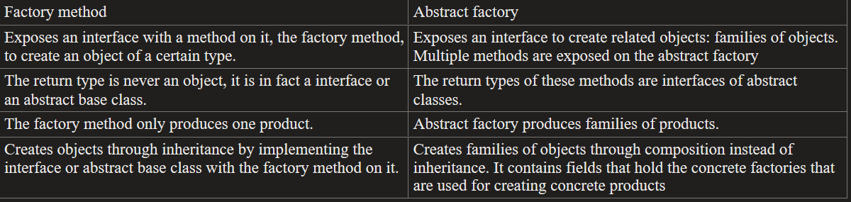
Comparing Factory Method & Abstract Factory
Notes:
As we saw in both Factory Method and Abstract Factory, these two patterns are closely related to each other, in fact they are both referred to as the factory pattern. The table you see here compares the two patterns with each other. And as you see they have both similarities and small differences. And the best thing you can combine Abstract Factory and Factory method to create your system.

Slide 14
Questions?

