Slide 1
Mediator & Strategy Pattern
By Ina Fløysvik Pedersen
Notes:
Welcome to a presentation of the Mediator and Strategy Design Patterns

Slide 2
Common for both patterns
Behavioral
Abstract classes/Interfaces
Notes:
Both the Mediator and Strategy are behavioral design pattern. Behavioral patterns defines ways to communicate between classes or objects. They characterize complex control flow, that is difficult to follow at runtime, and they let you concentrate on the way objects are interconnected.
When setting up both pattern you have to look at what your project needs, when you are going to choose, if you are going to use abstract classes, or interfaces. An abstract class can‘t be instantiated, and is designed to be inherited, while interfaces is a contract, and don’t have any implementations.

Slide 3
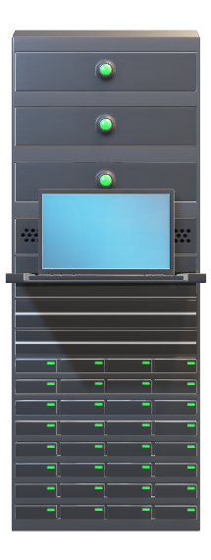

Mediator Pattern
Encapsulates
Communication
MediatR
Example
Notes:
The intent of the mediator pattern is to define an object, that is the mediator, which encapsulates how a set of objects interact. It does this by forcing objects to communicate via that mediator. And by doing so, it promotes loose coupling by keeping the objects from referring to each other explicitly, and it also lets you control and vary their interactions independently.
An example of this is a set of objects that need to interact with each other, but in order to do that, they would need to hold references to each other. When you got a lot of objects, and they all need to hold all of the references and managing them and keeping communication in sync would become a big problem. But by using the mediator pattern the mediator provide a central object, which maintains references of objects that want to communicate with each other, and handles communication between all the objects, and everything becomes more manageable.
If you code in .NET you might have heard about MediatR, this is .NET’s implementation of the mediator pattern. The MediatR is a NuGet package that supports requests/response, commands, queries, notifications and events synchronous and asynchronous.

Slide 4
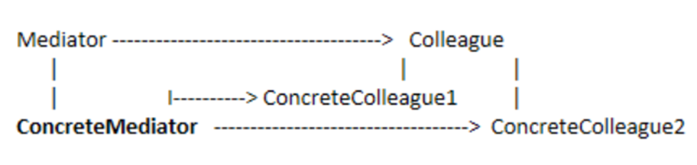
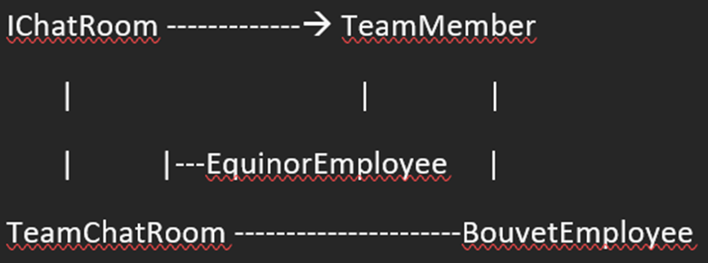
Mediator Pattern Structure
Example
Notes:
Now let’s look at the structure that is shown in the white image and connect it to an example which is shown in black. Say we have a chatroom like slack, where you have a whole lot of users and different ways you can communicate such as private chat or a public chatroom for a group of people. In the private chat/chatrooms it is important that only the people that is a member of that chat can read and write messages, while in the public chatrooms you have to just join the chat to be able to write and read the conversations. By using the mediator pattern, we can custom build, who has access to which messages. This can be done like this: The Chatroom would define the interface for communication, this could be either an abstract class or an interface. In this demo, we will use an interface and call it IChatRoom. A concrete implementation of the IChatRoom would be a TeamChatRoom. In the chatroom we would need users, let’s call those Team Members, these would communicate with each other, but instead of communicating directly with each other they would communicate with the chatroom. We can have Two example concreteTeamMembers, and those could be Equinor employee and Bouvet employee. Bouvet would have a chatroom that is only available for them, as would Equinor, but both employee types could communicate via a public chatroom where they could collaborate and discuss. The mediator would filter and give access to those who is in the groups, and the group that have access to a specific private chatroom and would hide that chatroom for those who don’t have access. By holding on to the individual user’s references.

Slide 5
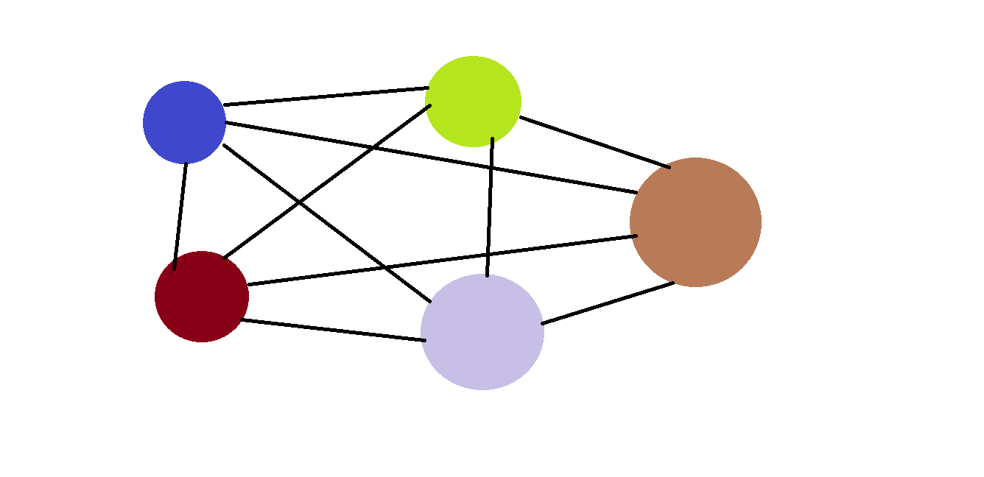
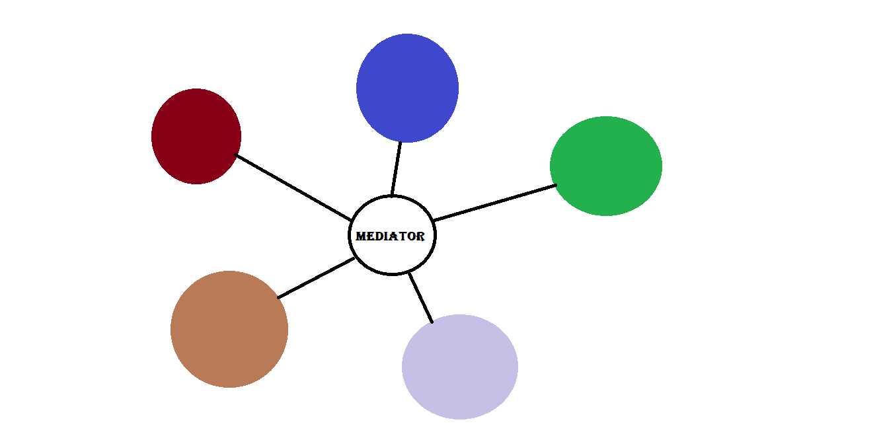
Mediator: Use cases
Use cases:
Complex communication
Refers to many
Behavior distribution
Notes:
It is a few good use cases where it would be appropriate to use the mediator pattern. When a set of objects communicate in a complex way. When an object refers to and communicate with many different objects and it has tight coupling. And When behavior that is distributed between several classes should be customizable without a lot of subclassing.

Slide 6

Mediator: Consequences
Consequences:
Limiting subclassing
Decouples colleagues
Open/Closed Principle
Complexity
Notes:
The consequences of using Mediator design pattern is: Limiting subclassing to the minimal It decouples colleagues, and make the system/application loosely coupled It simplifies object protocols, where you switch out the many-to-many interactions, with one-to-many interactions. By changing this to one-to-many you implement the SOLID principle called Open/Closed Principle. A disadvantage with using Mediator Pattern is that the mediator centralizes control, which as a consequence can make the mediator complex, and could be hard to maintain.

Slide 7
Mediator: Related Patterns
Facade
Chain of Responsibility
Command
Observer
Notes:
The mediator is related to the pattern Façade. Where mediator pattern abstracts communication between objects. The façade pattern abstracts the interface to the subsystem objects to promote ease of use.
And if we look at the part which connect senders and receivers of requests, the mediator pattern is related to Chain of responsibility pattern, Command pattern and the observer pattern. And these four patterns can be used together to optimize the connect senders and receivers.
And that is Mediator in a small box!

Slide 8

Strategy Pattern
Commonly used
define, encapsulate, interchangeable
Notes:
Strategy Pattern is one of the most commonly used design pattern, the intent of this pattern is to define a family of algorithms, encapsulate each one, and make them interchangeable. Strategy lets the algorithm vary independently from clients that use it, so we can make each algorithm in a separate class and make them interchangeable.

Slide 9

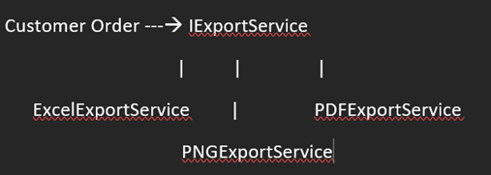
Strategy Pattern Structure
Example
Notes:
For the strategy pattern structure, let’s look at the structure that is shown in the white image and connect it to an example which is shown in black. Say we have a system that has tables, and as a user you want to export it locally on your computer, the export could be to a excel document, an image (png) or a pdf. The logic for the export is quite similar but with a small difference. In this case strategy pattern would come in handy, the user can choose which export method they wish to export in at runtime. The order the user makes is the context, while the interface or abstract class that defines one method the Export, would be the strategy. While the concrete strategy would be the export options that the user can choose between.

Slide 10



Strategy: Use cases
Use cases:
Many related
Different variants
uses data, code or dependencies
Different behaviors
Notes:
It is a few good use cases where it would be appropriate to use the strategy pattern. When many related classes differ only in their behavior, not in their interface, the strategy would provide a way to configure a class with one of many behaviors. Or When you need different variants of an algorithm, where you want to be able to switch at runtime. Or When your algorithm uses data, code or dependencies that the clients shouldn’t know about. Or When a class defines many different behaviors which appear as a bunch of conditional statements like when you deal with large ifs or switch statements.

Slide 11

Strategy: Consequences
Consequences:
Avoid hardwiring
No context changing
Choices at runtime
Requires knowledge from user
Overhead in communication
Complexity
Notes:
The strategy pattern avoids hardwiring the behavior, by using an alternative to subclassing, by replacing inheritance with composition. You can introduce the strategies without changing the context, using the Solid principle, open/closed. The strategies provide choices for implementation with the same behavior needed and the client choose the most fitting at runtime. A drawback of strategy pattern is that if the client inject the strategy to use, then the client also need to have knowledge on the differences between the options. Another disadvantage is that it is a bit overhead in communication between the strategy and context. And lastly a disadvantage is that strategy pattern introduce an additional number of objects making it more complex.

Slide 12
Strategy: Related Patterns
Flyweight
Bridge
State
Template Method
Notes:
Strategy pattern is related to several patterns. Flyweight – where strategy objects make good flyweight. Bridge & State where both also is based on composition but solves a different problem Template method which allows varying part of an algorithm though inheritance: a static approach, while strategy allows behavior to be switched at runtime through composition which is a dynamic approach.
And that is Strategy in a small box!

Slide 13
Questions?
22.03.23 Part 3 of design patterns with Abstract Factory and Factory Method as theme

