Slide 1

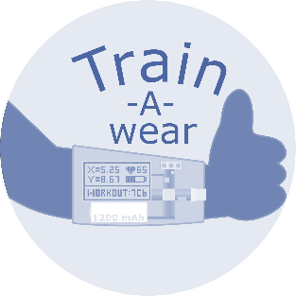
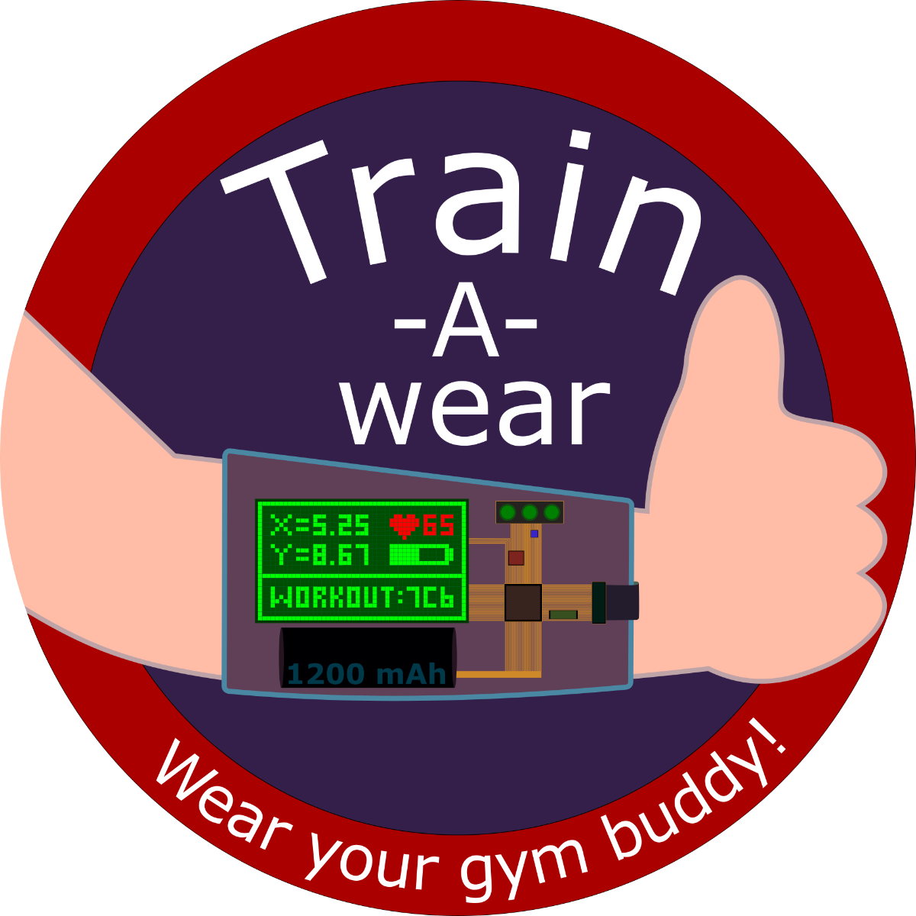
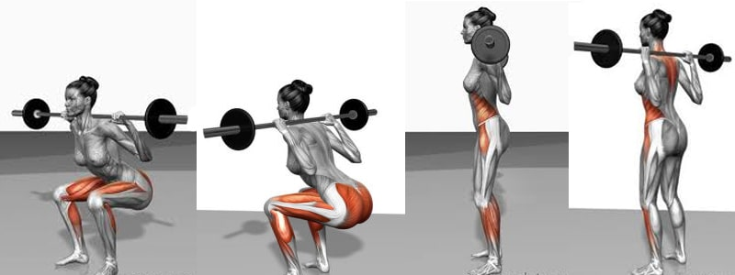



Classic exercises plus variations to up your game
Squats
x
Plank
x
y
z
z
y
Bicep curls
x
73% Only aerobic
Leg raises
y
z
With feedback on your Android smartphone and progress overview accessible anytime!
@WearTrain
Health survey for England 2016 NHS

Slide 2
