Slide 1

“Pong”
A Classic Arcade Game
Presented By:
Inam Ul Hassan
Ukasha Zaheer
M. Huzaifa
Kinza Batool

Slide 2
Overview:
Pong, the iconic arcade game that captivated players for decades, has been reimagined in this C++ implementation. Dive into the world of object-oriented programming as we explore the intricate mechanics and design choices that bring this classic to life on the modern screen.

Slide 3
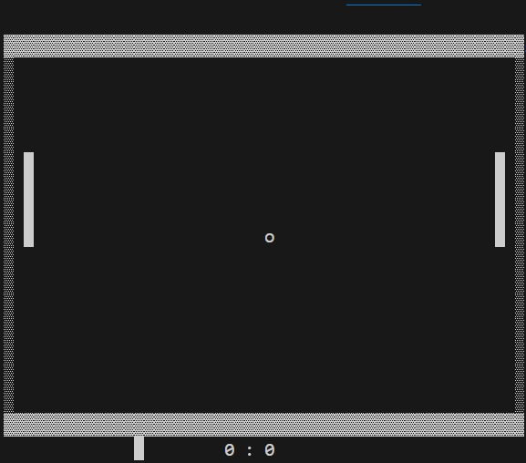
Output :

Slide 4
Game Objects: The Building Blocks
The Ball
The Paddles
Game Manager
As the heart of the game is the cBall class, which represents the ball's movement and direction. With its ability to change direction and respond to collisions, the ball is the driving force behind the gameplay.
The cPaddle class controls the player-controlled paddles, allowing them to move up and down to intercept the ball. The paddles' positioning and movement are crucial for scoring points and keeping the game in play.
The cGameManager class oversees the entire game, handling input, logic, and drawing the game state to the console. It coordinates the interactions between the ball, paddles, and scoring to ensure a seamless and engaging experience.

Slide 5

Game Loop: The Heartbeat of Pong
Rendering
Input
The game's state is then rendered to the console, using ASCII characters to depict the ball, paddles, and playing field. The cGameManager's Draw() function is responsible for this visual representation, ensuring the game is displayed accurately to the players.
The game continuously checks for user input, allowing players to control the paddles and start the ball's movement. This input is handled by the cGameManager class, which translates keyboard commands into paddle movements.
1
2
3
Logic
The game's logic, managed by the cGameManager, updates the positions of the ball and paddles based on the current state of the game. This includes detecting collisions, updating scores, and resetting the ball when a player scores.

Slide 6
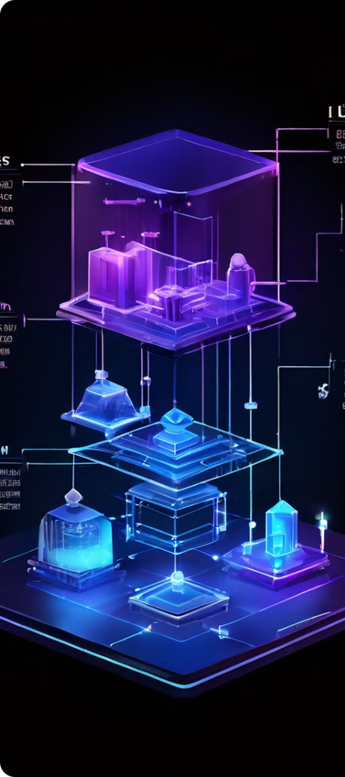
#include <conio.h>
#include <time.h>
#include <Windows.h>
Object-Oriented Design: Encapsulation and Inheritance
1
Encapsulation
2
Inheritance
The game's core classes, cGameObject, cBall, and cPaddle, demonstrate the principles of encapsulation. Each class hides its internal implementation details and exposes only the necessary public methods and properties, ensuring a clean and modular design.
The cBall and cPaddle classes inherit from the base cGameObject class, which provides common functionality such as position tracking and reset capabilities. This inheritance hierarchy allows for code reuse and a clear separation of concerns, making the overall design more maintainable and extensible.
3
Polymorphism
The virtual reset() function in the cGameObject class showcases the use of polymorphism. This allows the derived classes, cBall and cPaddle, to provide their own implementation of the reset functionality, tailored to their specific needs.
4
Enums
5
Libraries
eDirection
eController
#include <conio.h>
#include <time.h>
#include <Windows.h>

Slide 7

Game States and Scoring
Scoring
Game Over
Pause and Reset
The game keeps track of the scores for both players, updating them whenever a player scores a point. The ScoreUp() function in the cGameManager class is responsible for this, resetting the ball and paddles after a score is recorded.
The game continues until one player reaches a score of 10, at which point the game ends and the quit flag is set. This ensures a clear and satisfying conclusion to the match, providing a sense of accomplishment for the winner.
The game also allows players to pause the action by pressing the 'q' key, and reset the game by pressing 'w', 's', 'i', or 'j' when the ball is stopped, allowing for a more flexible and customizable gameplay experience.

Slide 8



Input Handling: Responsive Controls
Player 1
Player 2
Pause
The 'w' and 's' keys control the movement of Player 1's paddle, allowing them to move the paddle up and down to intercept the ball.
The 'i' and 'j' keys control the movement of Player 2's paddle, enabling them to strategically position their paddle to return the ball.
The 'q' key allows players to pause the game, giving them a chance to take a break ,reset and quit the game state.

Slide 9



Ball Behavior: Realistic Collisions
Paddle Collisions
Wall Collisions
Score Conditions
When the ball collides with a paddle, its direction is updated based on the position of the collision. This creates a more realistic and challenging gameplay experience, as players must time their paddle movements precisely to return the ball effectively.
The ball's direction is also updated when it collides with the top or bottom walls of the playing field, ensuring that the ball continues to bounce back and forth, keeping the game in play.
If the ball reaches the left or right edge of the playing field, the corresponding player scores a point, and the ball is reset to the center of the screen to start a new round.

Slide 10
Future Enhancements: Expanding the Pong Experience
Power-ups
Obstacles
Multiplayer
Introduce special power-ups that players can collect, granting them temporary advantages like faster ball speed, larger paddles, or the ability to curve the ball's trajectory.
Add dynamic obstacles to the playing field, such as moving walls or teleportation gates, that players must navigate around to keep the ball in play and score points.
Expand the game to support online or local multiplayer, allowing players to compete against each other in real-time and adding a new layer of strategy and social interaction to the classic Pong experience.

Slide 11
Thanks!

