Slide 1
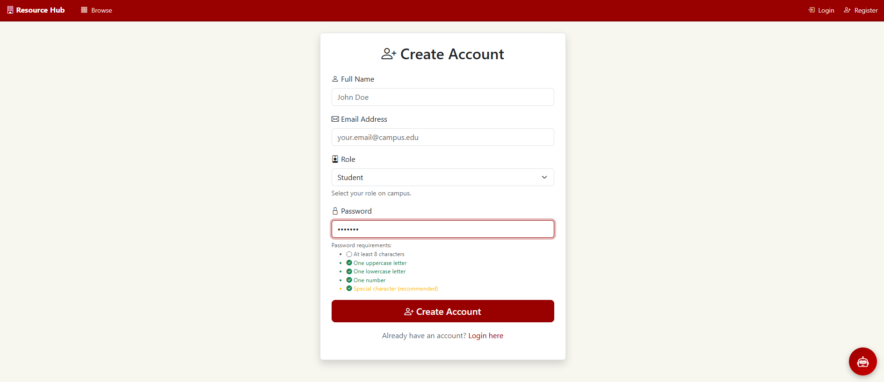
Account Creation and Login Is Simple For All Users To Complete
Admin access is given internally and not available for anybody to sign up for.
Here you can choose your role as a user between staff and student. Certain roles get certain privileges.
Password creation has set requirements to ensure a secure and complex enough password has been set.
Account Creation
Adding Resources
Reserve A Resource
Admin Resources
Messaging
1

Slide 2
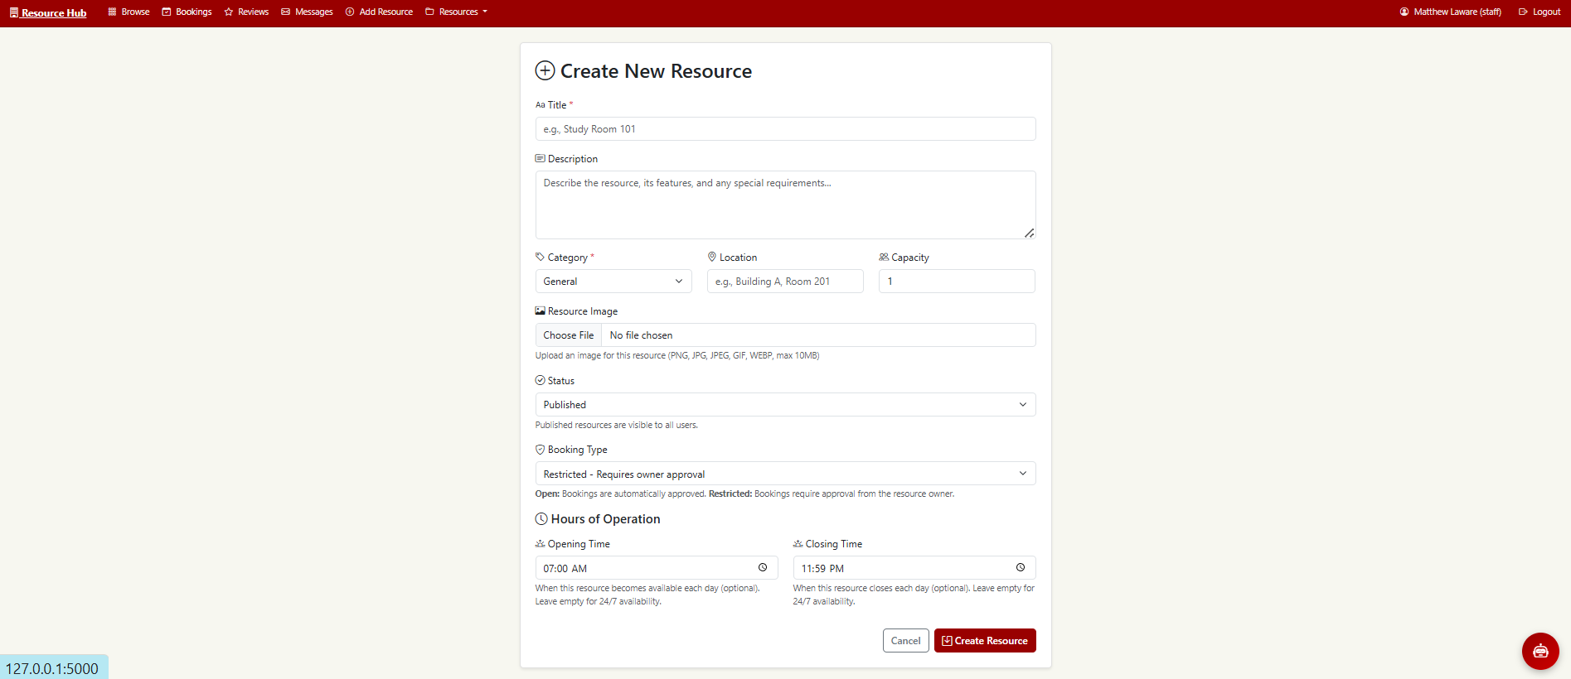
Adding Resources Allows The User To Adjust A Multitude Of Settings About The Resource
Status refers to if the resource is open to the public, archived and not available, or a draft.
The “Add Resources” button allows for users (staff and admin) to easily add resources that can be available to all students/staff.
The booking type can either be restricted or open. Restricted resources require approval from you for anyone to book a time with this resource. Open resources can be scheduled by anyone with no approval required.
The resource creation requires certain aspects such as the title and category. The category section allows you to choose the type of resource you have (computer, study room, etc.).
Account Creation
Adding Resources
Reserve A Resource
Admin Resources
Messaging
2

Slide 3
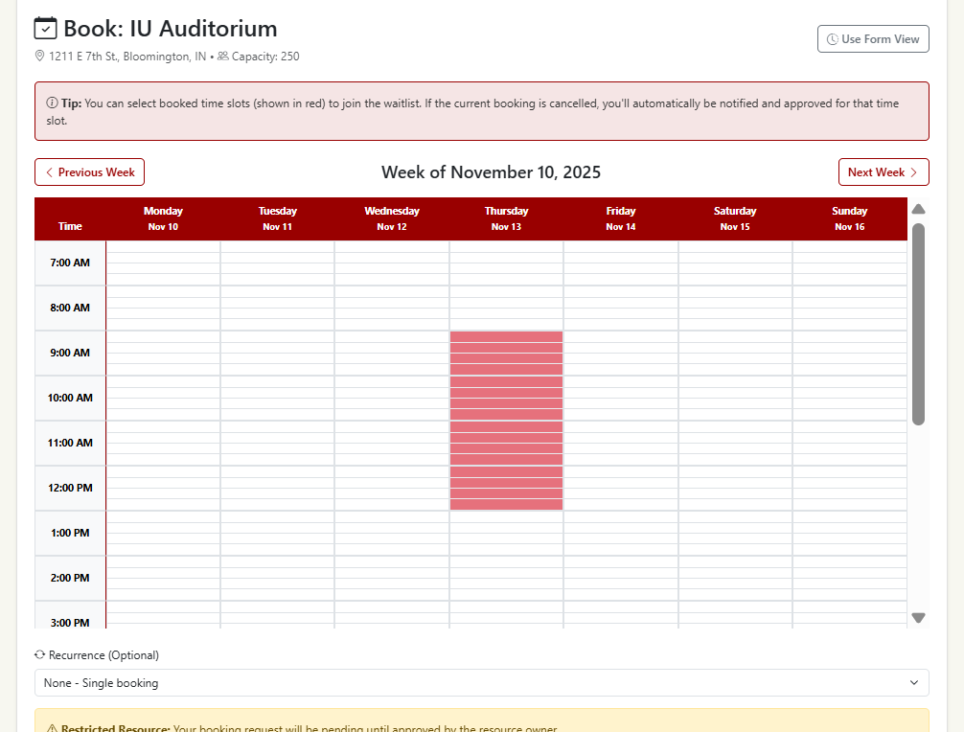
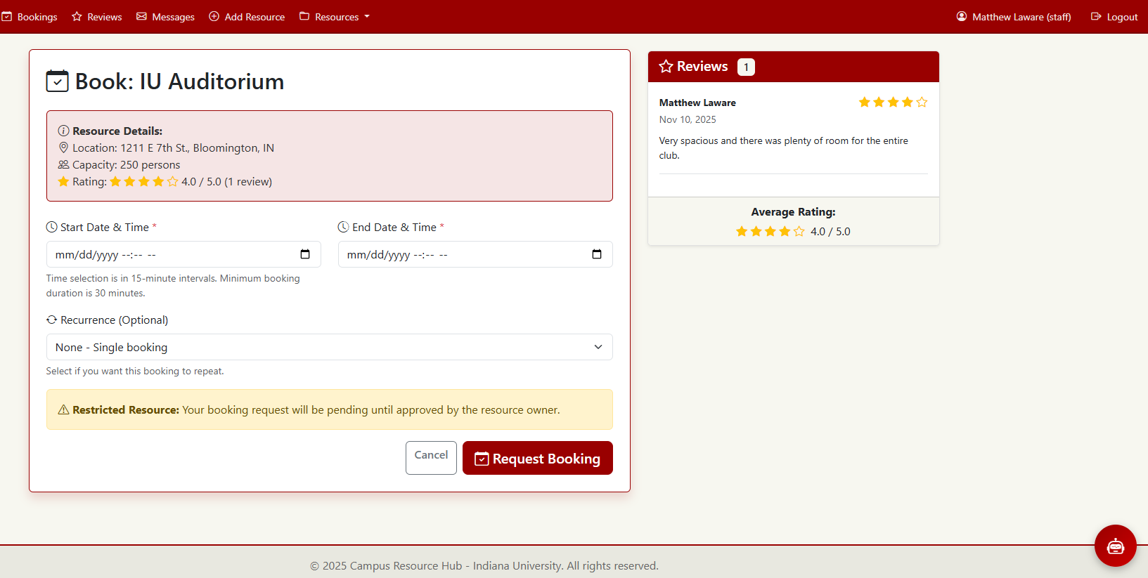
Reserving Resources Can Be Done Through A Form View and A Calendar View
Booking resources can also be done through a form view for a simplistic view of times. The user can select the form view and fill out the start and end date manually.
Reviews will also be displayed that have been left by past users.
The red area within the calendar shows a slot that has already been booked. Booking on this slot will automatically add you to the waitlist for that resource.
Users have the option to choose the recurrence of a resource (weekly, bi-weekly, monthly, etc.)
Account Creation
Adding Resources
Reserve A Resource
Admin Resources
Messaging
3

Slide 4
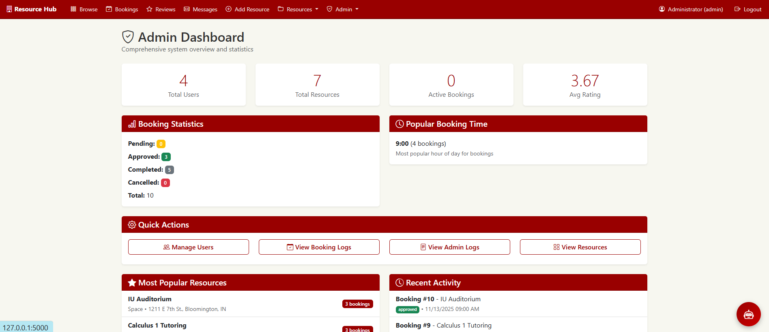
Admin Privileges Offer Full Control Over All Resources, Bookings, and Users
Other comprehensive statistics are shown to see activity levels from users.
Booking statistics can be shown here to see the total number of accepted, completed, pending, and canceled bookings from all users.
All activity and booking activities are tracked on this dashboard with a booking log and recent activity metrics.
Options to manage users are given to delete, add, and adjust user settings.
Account Creation
Adding Resources
Reserve A Resource
Admin Resources
Messaging
4

Slide 5
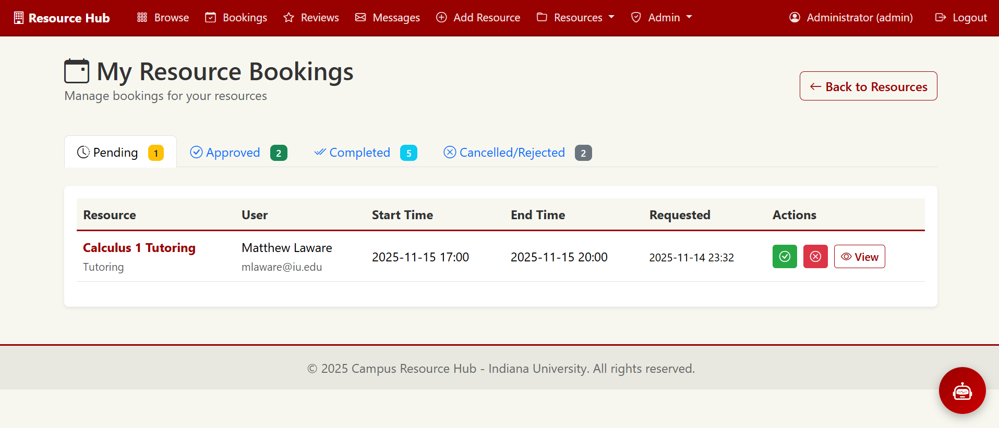
Resource Bookings Can Be Accepted or Rejected By The Resource Owner
The “My Resource Bookings” option is present under the “Resources” tab
The staff or admin that created a resource can see all the booking options for their own specific resources.
The resource owner (admin or staff) can accept or deny restricted resources with the green and red buttons.
Account Creation
Adding Resources
Reserve A Resource
Admin Resources
Messaging
5

Slide 6
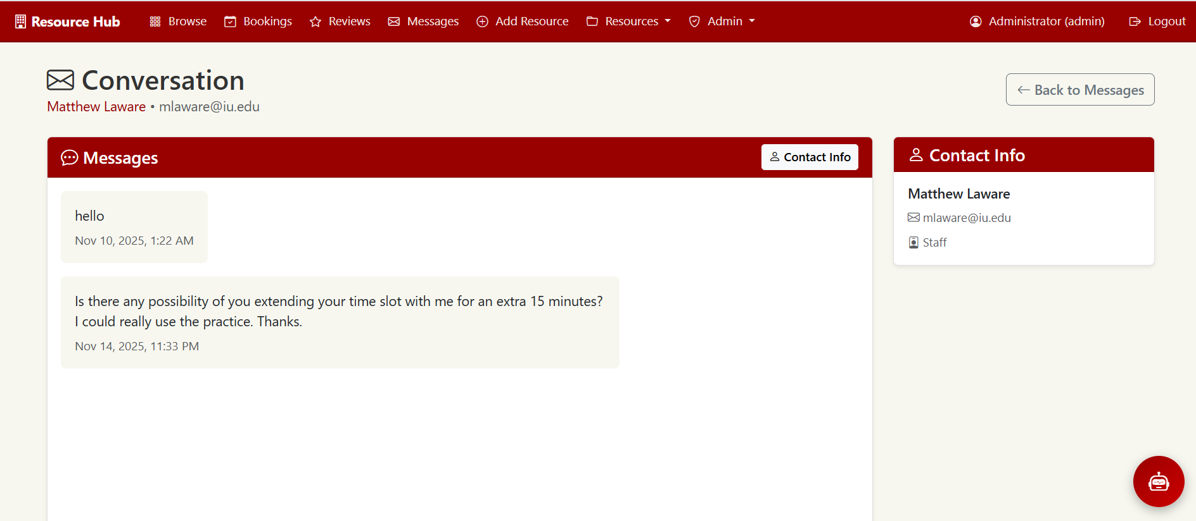
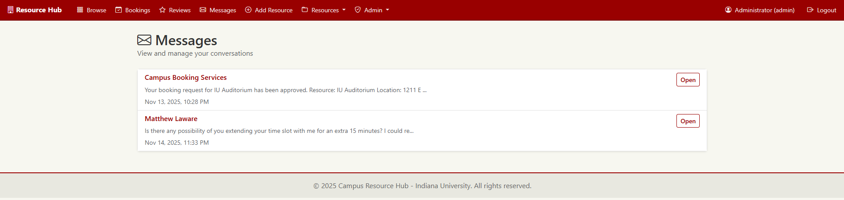
Messages Can Be Sent From Users To Resource Owners For Any Questions or Comments
Contact information of the user messaging the resource owner is shown as well as all conversation history with the user.
Messages will show up under the messages tab where a listing of all messages will be present.
Messages can be sent back and forth from the resource owner and a potential user of the resource. This can be used for any questions that a user may have about a resource.
Account Creation
Adding Resources
Reserve A Resource
Admin Resources
Messaging
6

