Slide 1
FINAL PROJECT
AME 520 UNDERSTANDING ACTIVITY
PRESENTATION BY: SHREYA MISHRA

Slide 2
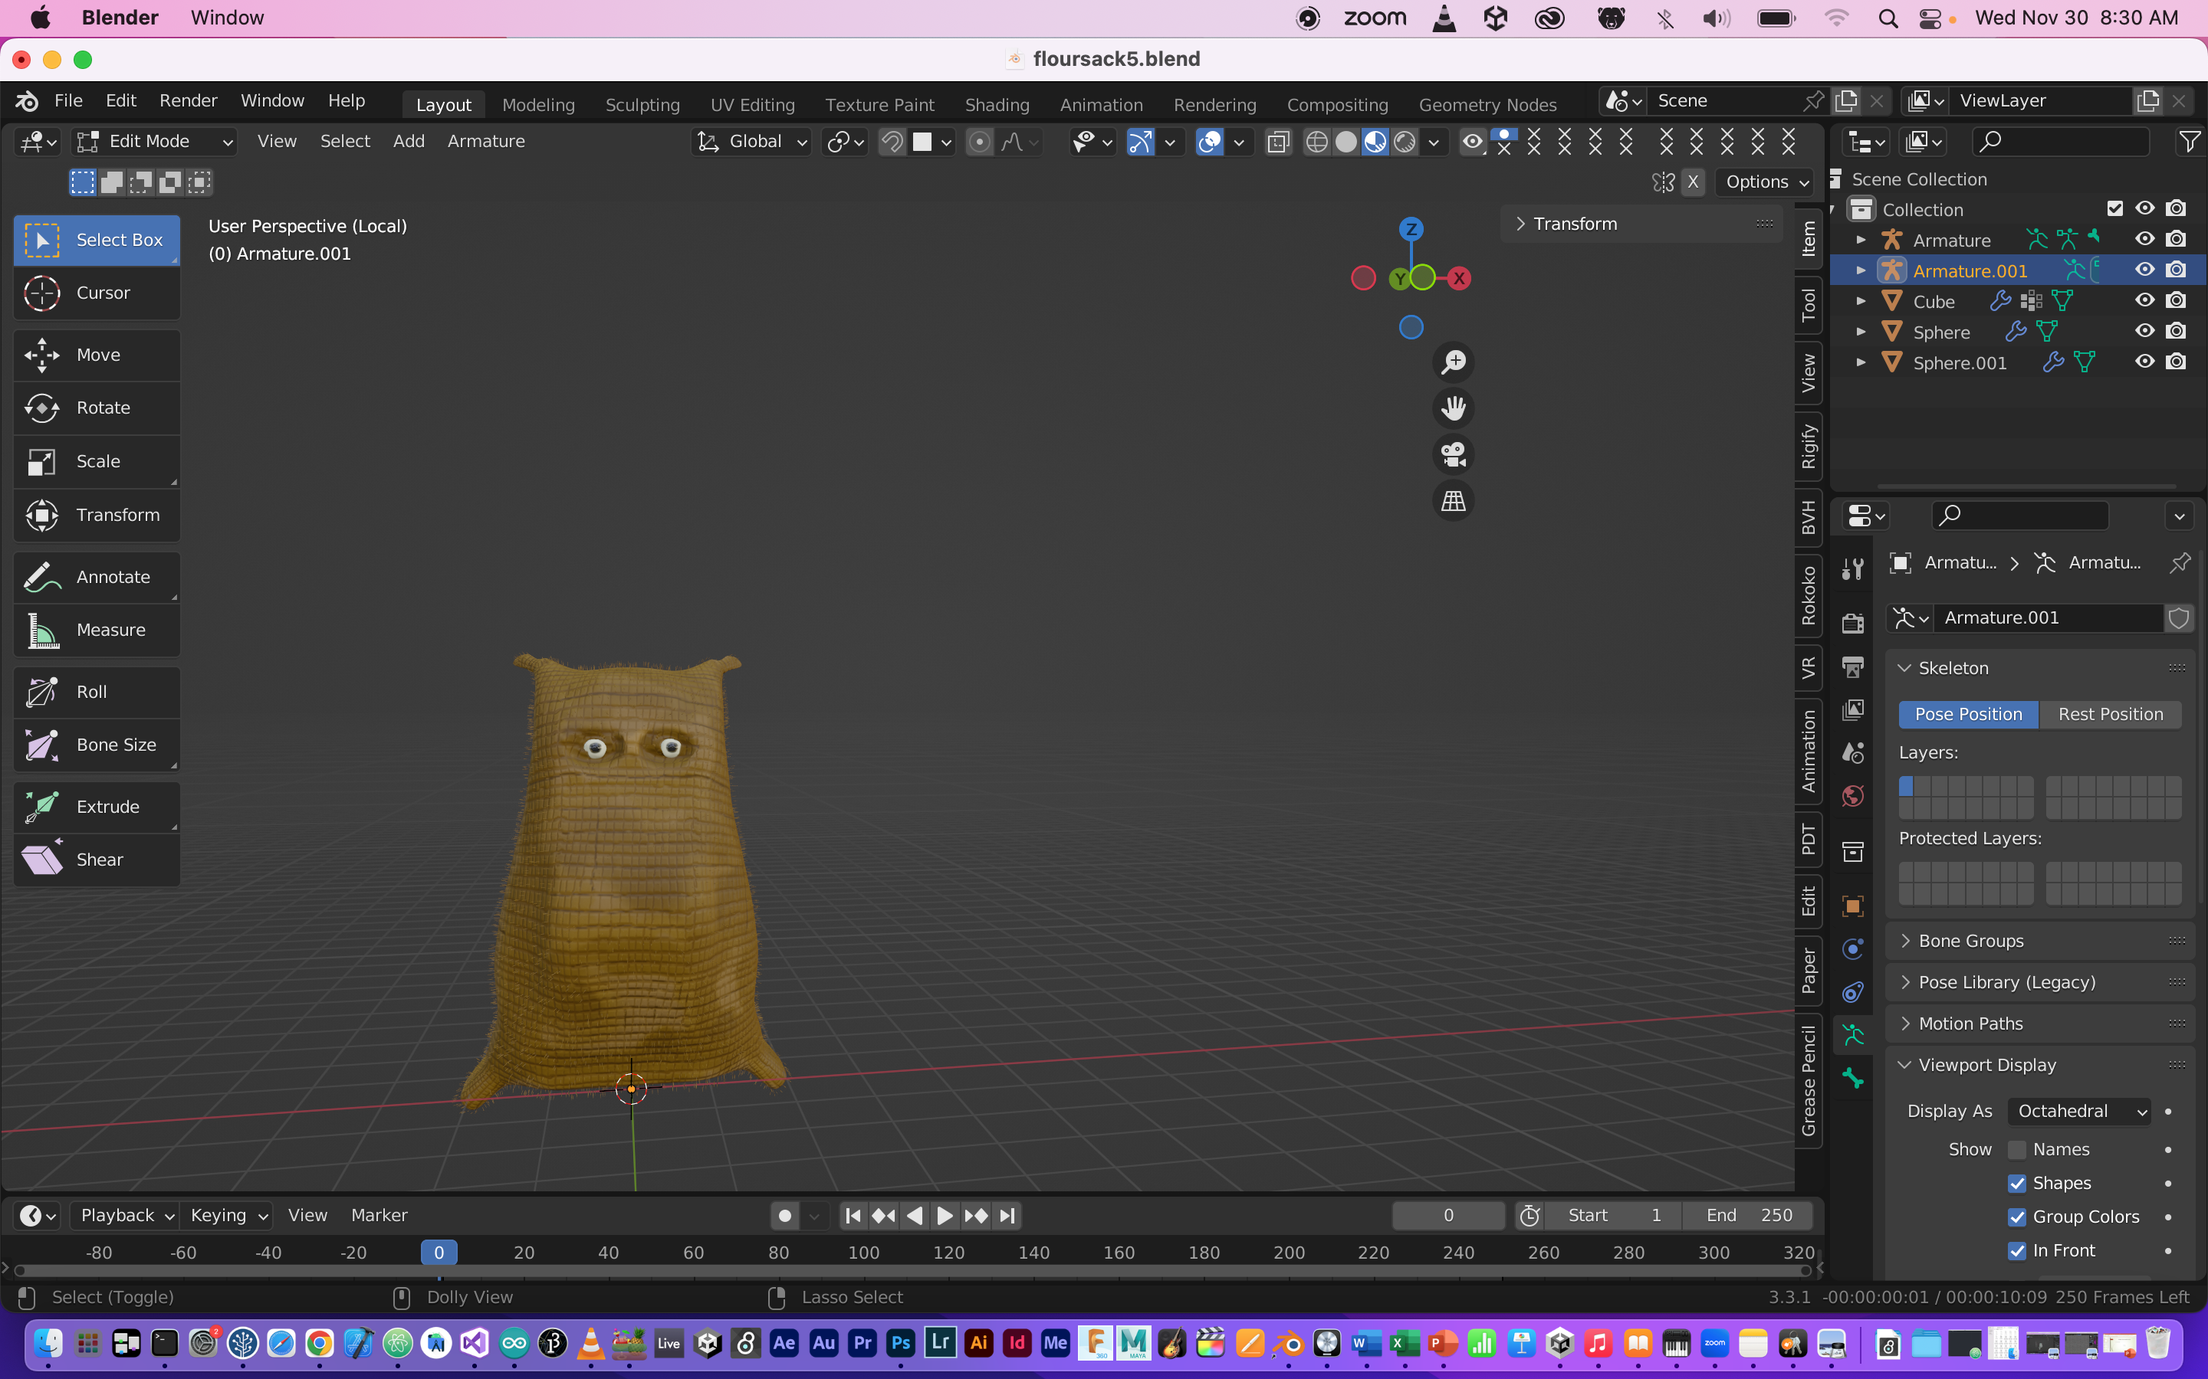
COOKIE THE GOLDEN SACK

Slide 3
ABOUT THE PROJECT
My aim was to create a 3D model of any inanimate object and then apply recorded motion capture to that model. So, that the model could imitate the recorded movements.
For the final project I selected a flour sack as an inanimate object.
Main question that I was trying to answer was that how an inanimate object would imitate simple as well as complex human walking movements.

Slide 4
TECHNIQUES AND SOFTWARE
To implement the idea, I recorded a motion capture using motive software in mocap studio.
And Used Blender for modelling and rigging and retargeting the mocap.

Slide 5
INTENT OF MOCAP
While I was recording, I imagined walking along the square and tried slow walking, walking across the diagonal of the square and other types of walking movements. I also tried walking with long steps.
The intent was simply to experience different types of walking movements so that I could use them in future.

Slide 6
ORIGINAL SCRIPTING OF CHARACTER
I designed a flour sack who was lying in a warehouse since last few months. He was bored of his routine, so he decided to explore the human world all by himself. Because he doesn’t know anything about the outside world, so he is scared a bit. The name of the sack is cookie because it’s a flour sack and cookies are generally made of flour.
Since he is new to walking, he rarely knows the mechanism of walking and he is trying to practice the movements in the warehouse.
The one who is practicing these movements is me, because I’m trying to retarget recorded mocap to the character.

Slide 7
STEPS INVOLVED
3D Modelling
UV Un Wrapping
Creating the texture
Texturing the character
Rigging the character
Retargeting Mocap to the character

Slide 8
CHALLENGES
Rigging the the character in such a way so that it copies human movement was tough choice.
While I was rigging the character, I wasn’t sure that how it will behave after retargeting.
The model was rigged but retargeting using rokoko tool was quite difficult for this character and copying constraints wasn’t working either.
Retargeting using rokoko tools is easy when the target object has the same skeleton as the source.

Slide 9
Was I able to Achieve my target?
I was able to achieve my target but movements generated are so slow.
I really need to improve the quality of the movements generated.
The movements generated are slightly different from what I thought.

Slide 10
FUTURE PLANS
My character is soul of the script that I decided .
I was able to model the character and retarget mocap into it.
But I still have to work on creating an environment like warehouse , for my character.
Further I can extend the story like on how the character will explore the world.

Slide 11
THANK YOU!

