Slide 1
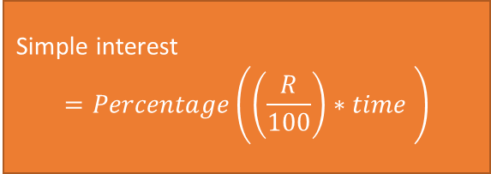
Flow chart for simple interest
start
Input percentage
Input Time
Input Rate
Simple interest
$$=Percentage\left(\left(\frac{R}{100}\right)∗time \right)$$
Output Simple interest
Stop

Slide 2

start
Flow chart for compund interest
Input percentage
Input Time
Rate = rate/100
Input Rate
Input number
CI$=Percentage\left(1+\frac{Rate}{number}\right)number x time$
Output CI
Stop

Slide 3

start
Flow chart for Annuity Plan
Input Pmt
Input Time
Rate = rate/100
Input Rate
Input number
- 1
AP$=Pmt ∗ \left(1+\frac{Rate}{number}\right)number x time$
Rate
number
Output Ap
Stop

