Slide 1
Intra-Layer Parallelism on Tiled NVDLA Accelerators in ESP
Wenxuan Xu • CSEE E6868 Final Presentation • Spring 2026

Slide 2
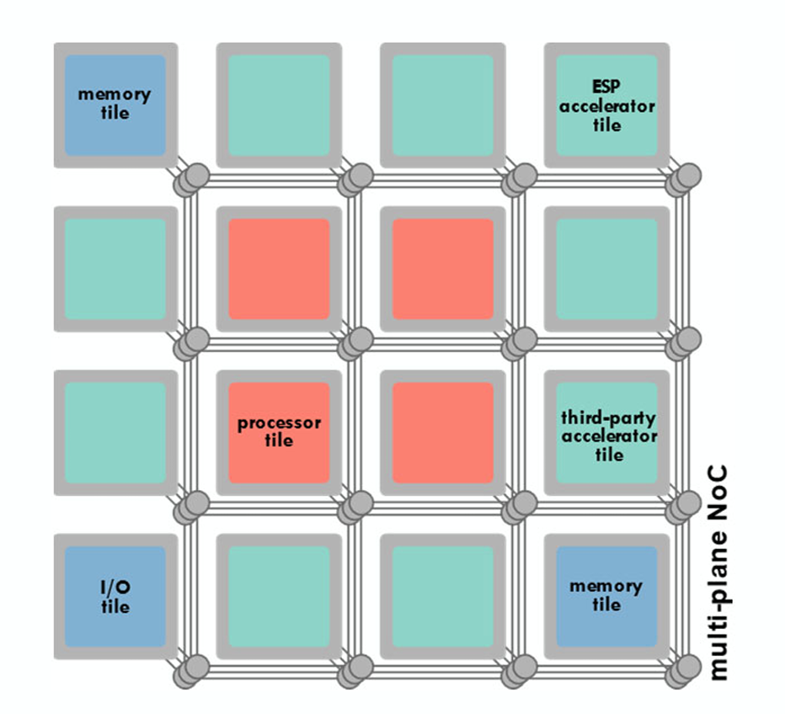
Background
Edge deep-learning workloads are growing faster than what a single small accelerator can handle efficiently.
Tiled architectures are attractive because they scale by replicating smaller accelerators.
ESP already supports integrating NVDLA as a third-party accelerator.
Goal: enable coarse-grained INTRA-LAYER PARALLELISM by splitting one neural-network layer across multiple NVDLA instances.
[ image source: Prof. Luca Carloni, CSEE-E6868 Lecture 3, Spring '26 ]

Slide 3
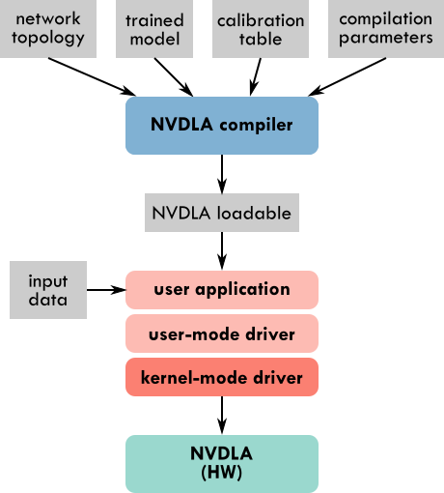
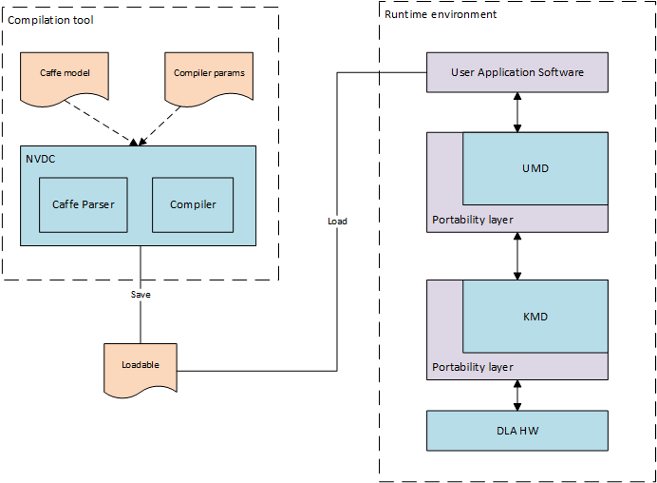
NVDLA Overview
Left: ESP's third-party-accelerator integration framework. Right: NVDLA software stack — UMD (user-mode driver) and KMD (kernel-mode driver) between the loadable file and the NVDLA HW.

Slide 4
Why Output-Channel Split?
Candidate partitioning strategies considered:
output-channel split — primary strategy
input-channel split — needs partial-sum reduction across tiles
input-feature (spatial) split — needs halo / border exchange
batch split — trivially parallel but only helps throughput, not latency
Why output-channel split first:
No halo / border issues — each tile reads the SAME input
Each tile gets its own SUBSET of weights + biases (independent compute)
Correctness check is trivial: concat(splits) along channel axis = full output
Lowest-risk path to a working proof of concept

Slide 5
Approach Pivot Since Midterm
Original plan (proposal): modify NVDLA runtime + driver to split workloads at runtime.
Midterm finding: runtime is good at re-binding buffers and selecting an instance, but it is NOT designed to re-shape compiled descriptors.
Refined plan — generate split loadables at COMPILE time:
Compiler emits self-consistent low-level descriptors per partition
Runtime synchronizes one launch per tile and dumps outputs separately
Validation reduced to: concat(split outputs) vs full baseline
Strategy chosen: output-channel split → no halo, no cross-tile reduction.

Slide 6
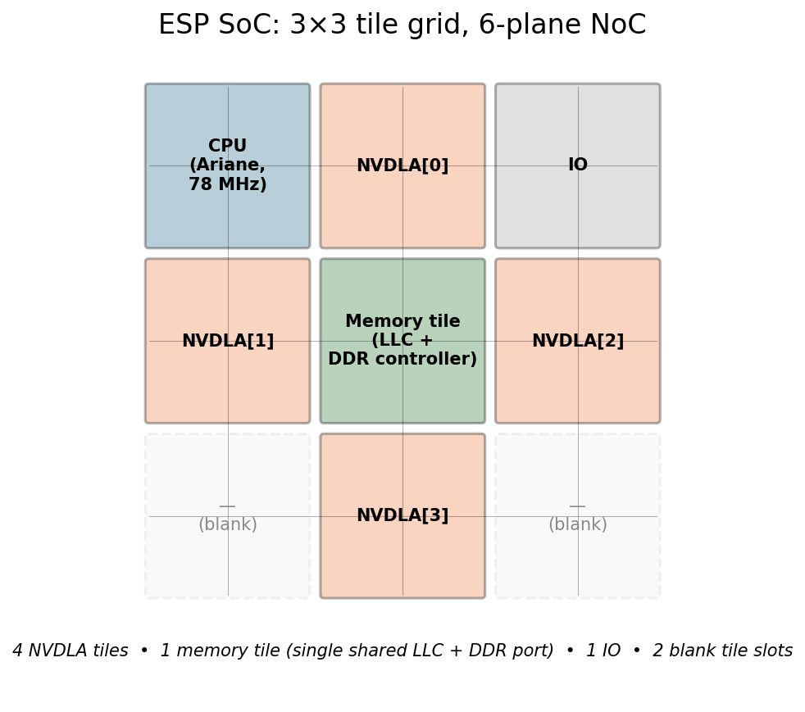
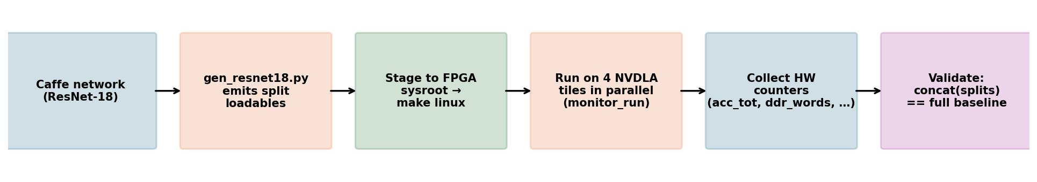
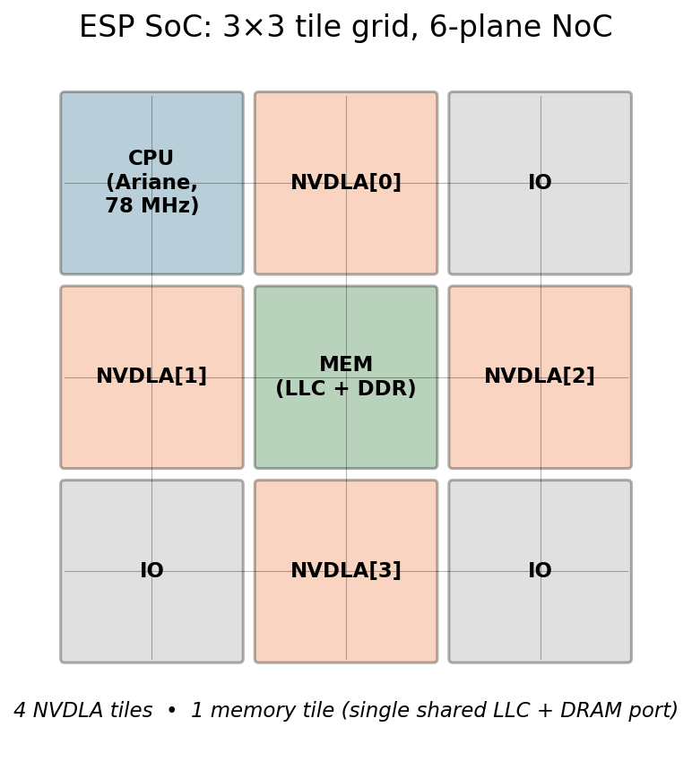
System Setup & Workflow
ESP SoC config
• 4 NVDLA tiles + 1 memory tile + 1 CPU + 1 IO
• 6-plane NoC; all tiles share 78 MHz base clock
• nv_small_fpga: 8×8 INT8 MACs, 4-beat × 64-bit AXI
• Single shared LLC + DDR controller port
Target model: ResNet-18
• Well-known reference, INT8-quantizable
• 18 weighted layers across 4 residual stages
• 11 distinct conv shapes — span input-heavy
to weight-heavy regimes
End-to-end workflow

Slide 7
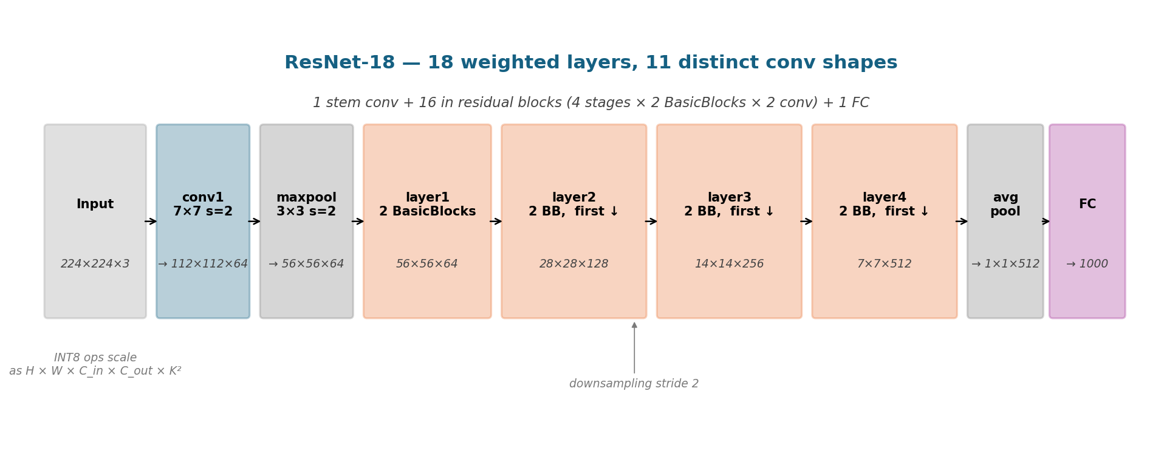
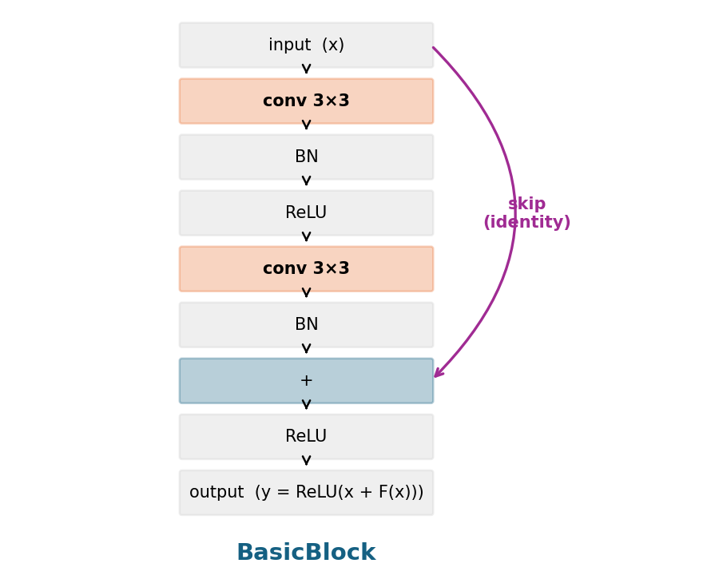
Target Model — ResNet-18
Why ResNet-18 for this study
• Manageable size (~11.7M parameters), well-studied → easy to validate.
• 11 distinct conv shapes give a wide range of arithmetic intensities,
from input-bound conv1 (large H×W, small C_in)
to weight-bound layer4 (small H×W, large C_in × C_out).
• Standard in the SImba paper too — direct comparison context.
• INT8 quantization works cleanly with NVDLA's nv_small_fpga.

Slide 8
Correctness Verification — PASS = 11 / 11
Tested every distinct conv shape in ResNet-18 (11 layers). For each layer:
Run baseline FULL-layer loadable on instance 0 (rawdump)
Run 4-way O-channel split in parallel on instances 0–3 (rawdump)
Concatenate the 4 split output.dimg along channel dim
md5sum compare against full baseline
Result: 11 PASS / 0 FAIL — bit-exact identical for every layer.
Output-element counts confirm the expected ResNet-18 shapes:
conv1 = 64×112×112 = 802,816 | layer1 = 200,704
layer2 = 100,352 | layer3 = 50,176 | layer4 = 25,088
→ Output-channel split is mathematically sound; all subsequent timing measurements operate on KNOWN-CORRECT compute.

Slide 9
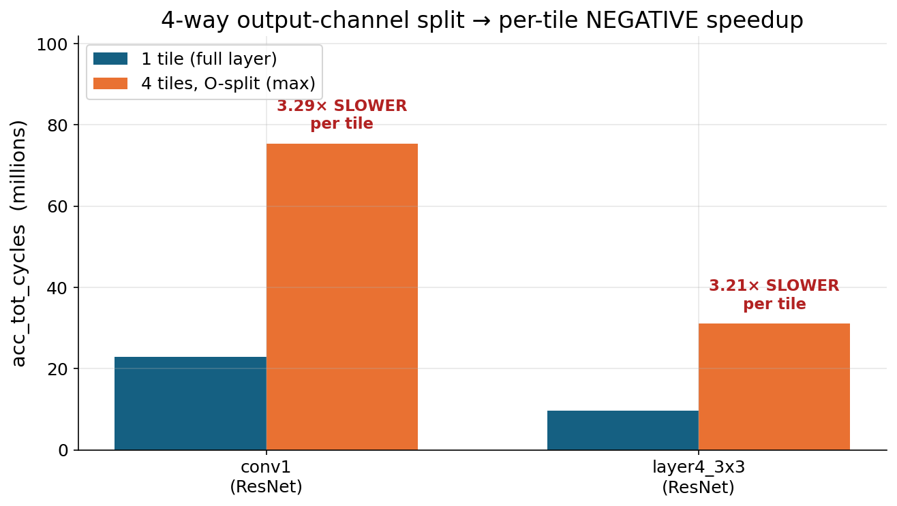
Headline Result — 4-way Split Gives NEGATIVE Speedup
HW-cycle analysis
• Single-tile: 22.95 / 9.70 M cycles
• 4-way (max): 75.41 / 31.09 M
• Per-tile work runs ~3.2× LONGER
• Real speedup ≈ 0.30× (NEGATIVE)
• Submit-time wall-clock: ~4× slower
Memory-bound %
→ ~100% in every measurement
(acc_tot − acc_mem ≤ 6 cycles)

Slide 10
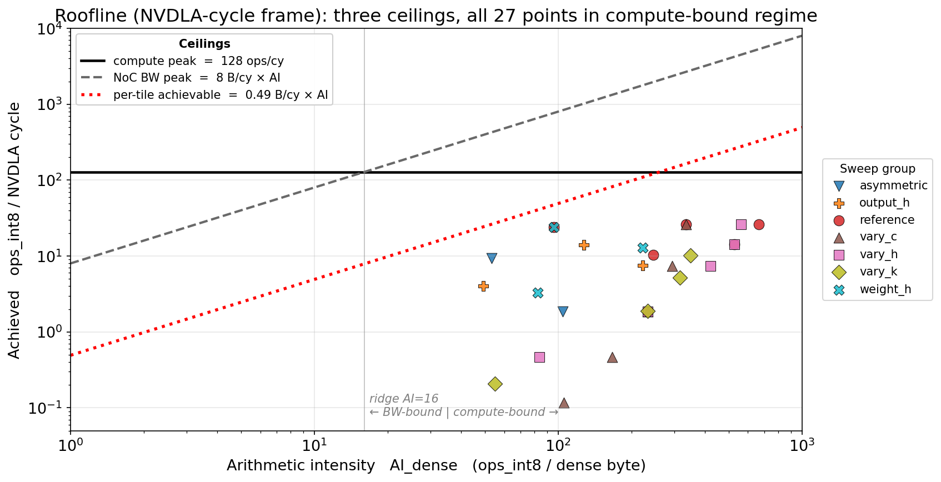
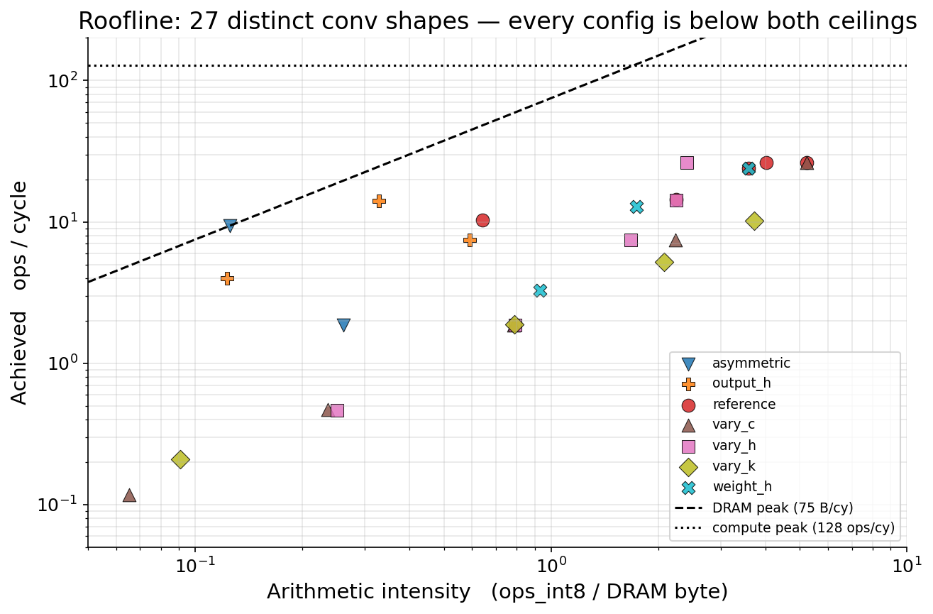
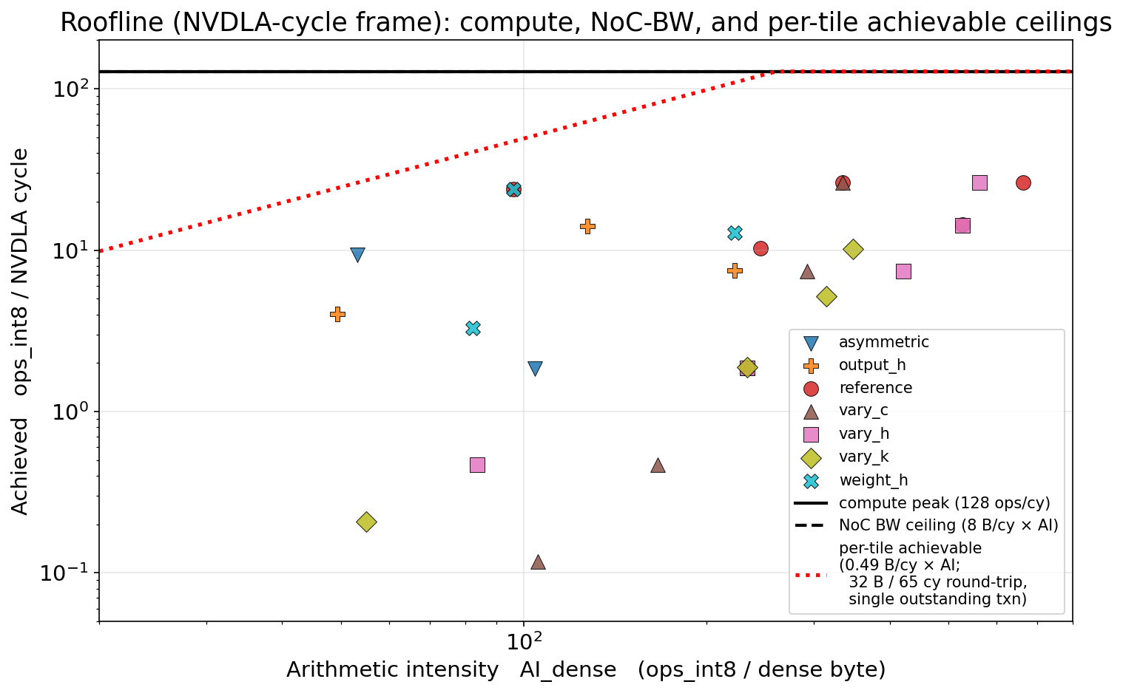
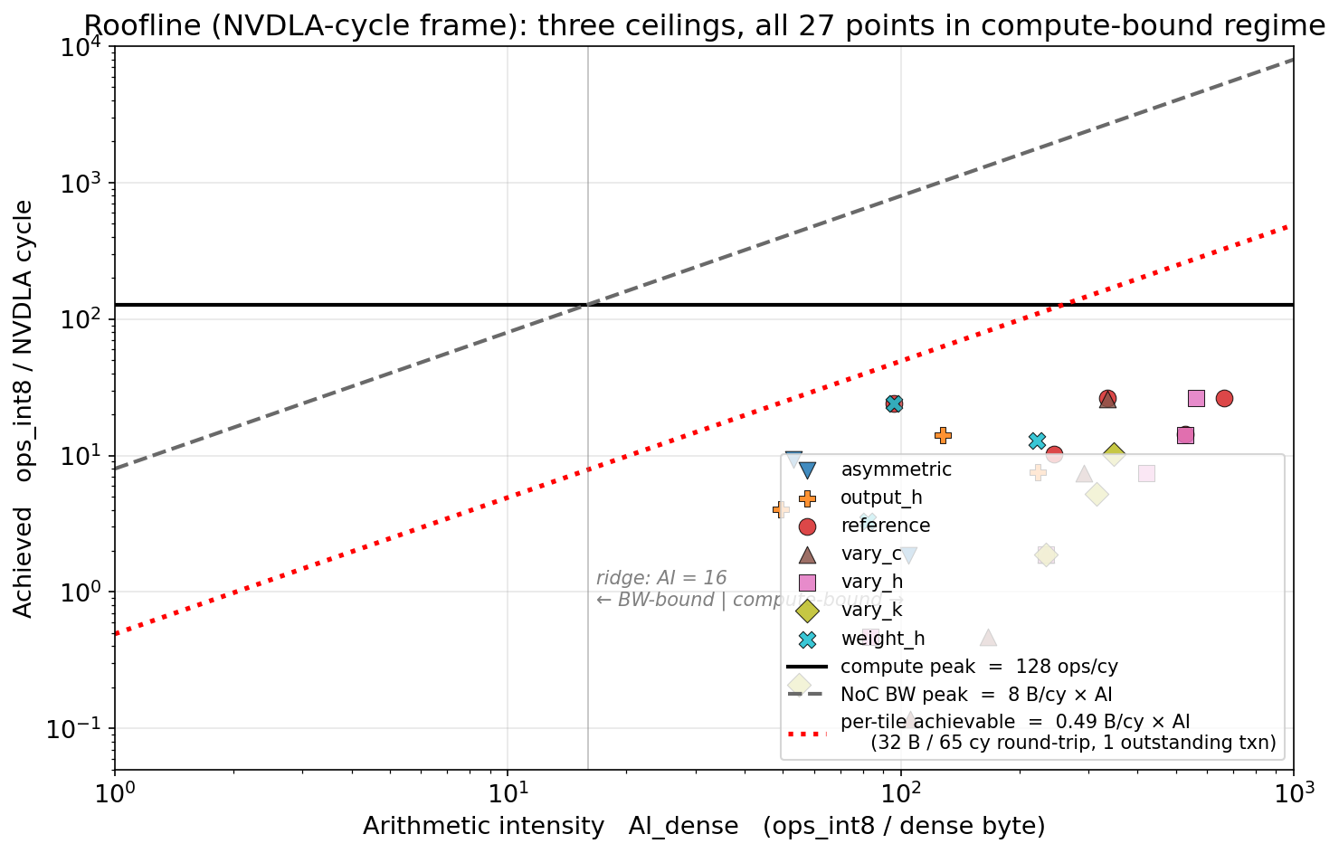
Roofline Characterization — 27 Distinct Conv Shapes
Takeaway
All 27 configs: AI_dense > 16 → NoC BW does not bind, compute peak should be the limit.
Best achieved: 26.3 ops/cy = 20.6 % of peak. Most points cluster on the red dotted line → latency-bound, not bandwidth-bound.
AI_dense = ops_int8 / (weight + input + output bytes). Roofline reads: ops/cy ≤ min(compute peak, bandwidth × AI).

Slide 11
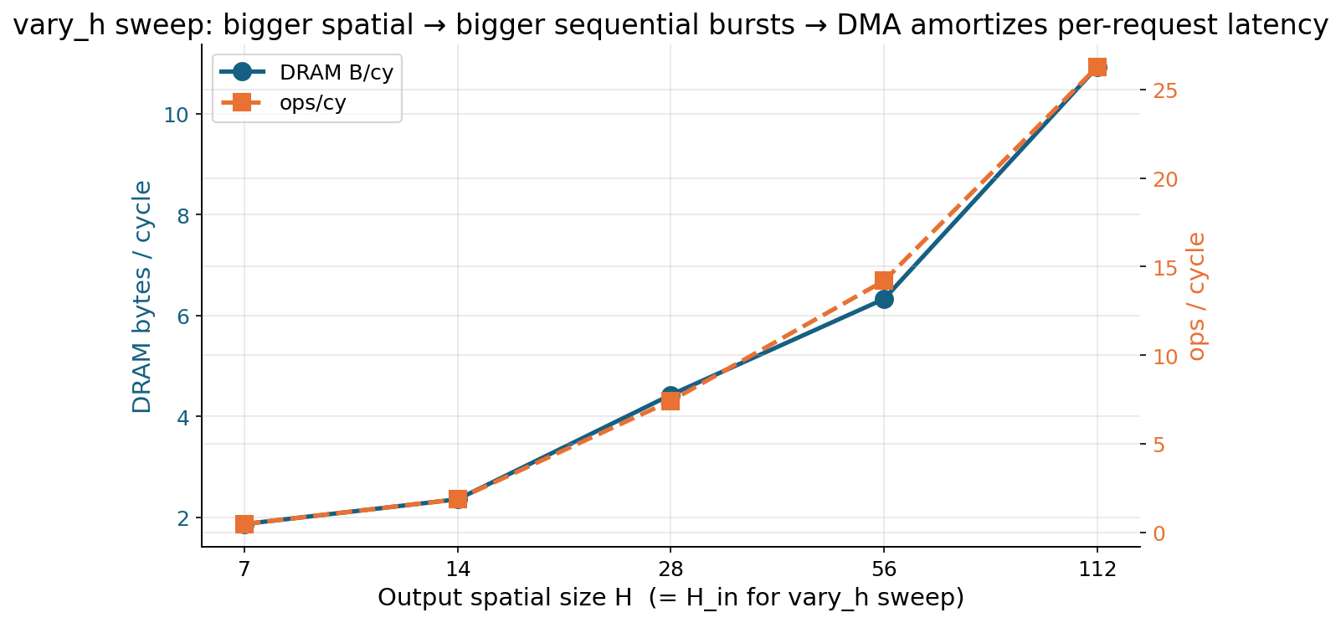
vary_h Sweep — Direct Evidence for Latency-Bound
What changes
Fixed: C_in = C_out = 64,
K = 3, stride = 1
Vary: H ∈ {7, 14, 28, 56, 112}
Bigger spatial =
bigger sequential bursts.
DMA pipelines longer bursts,
amortizing per-request
round-trip latency.
→ LATENCY, not bandwidth,
is the binding constraint
for most workloads.

Slide 12
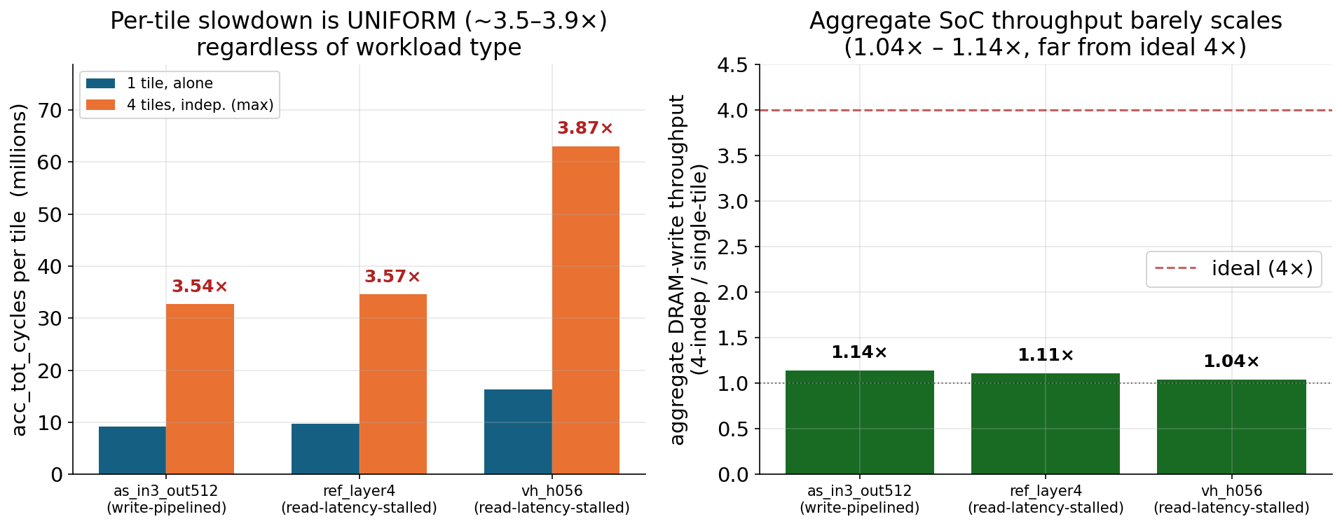
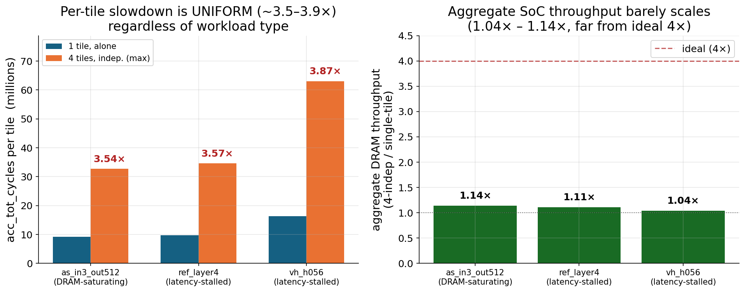
Multi-Tile Contention — 4 Independent Copies
Same loadable run on 4 NVDLA tiles in parallel — NO cooperation, only contention. Per-tile slowdown is ~3.5–3.9× UNIFORMLY across write-pipelined and read-latency-stalled workloads. Aggregate SoC throughput barely scales (1.04× – 1.14×, far from ideal 4×).

Slide 13
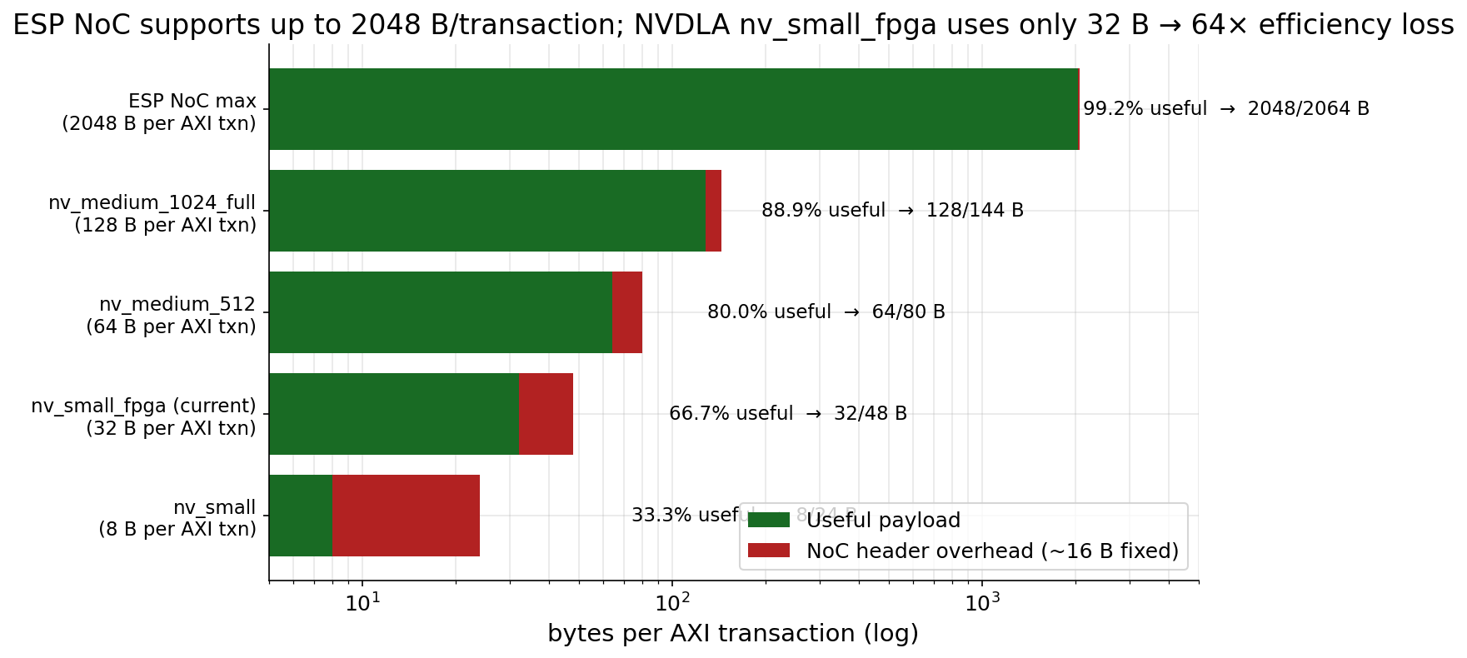
Root Cause — Two Stacked Mechanisms
Mechanism 1 — Burst size
ESP NoC: up to 256 beats × 8 B = 2048 B per AXI transaction. NVDLA nv_small_fpga issues 4 beats × 8 B = 32 B. → 64× efficiency loss.
Mechanism 2 — Outstanding-transaction serialization
ESP allows ONE outstanding AXI transaction per master — no pipelining of round-trips. NVDLA can issue multiple internally, but the SoC stack serializes them.
→ Effective per-tile bandwidth ≈ 32 B / ~65 cy round-trip ≈ 0.49 B / NVDLA-cy ≈ 38 MB/s/tile. Explains the ~7 M-cycle floor seen on every workload.

Slide 14
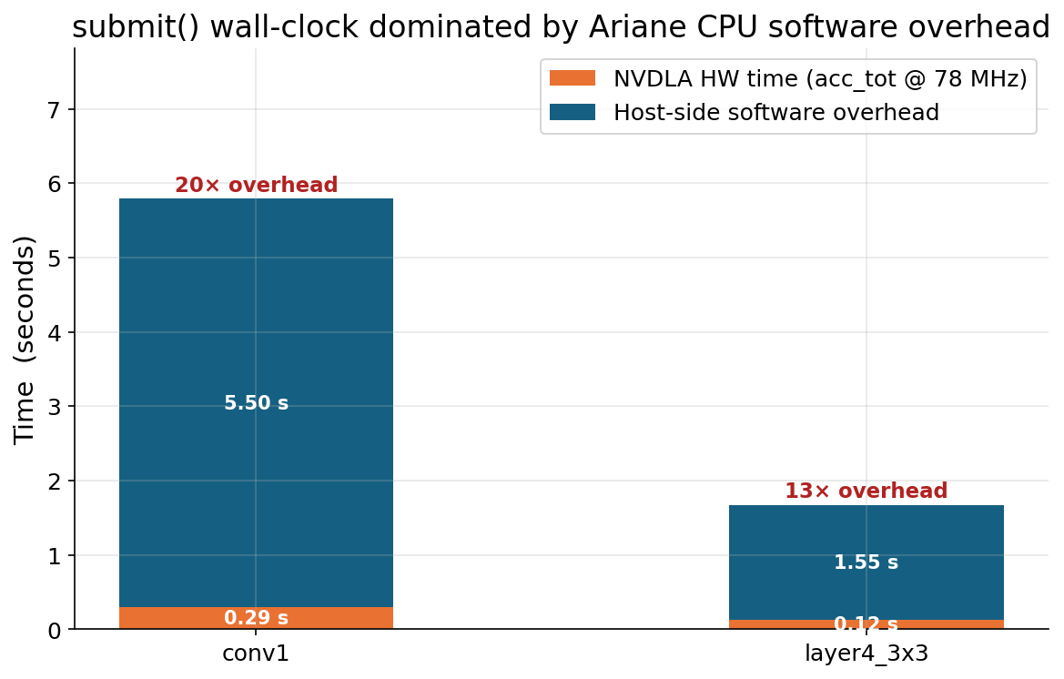
Submit Time — Mostly Host-Side Software, Not NVDLA HW
Where the time goes
Submit-time wall-clock includes:
• Loadable parsing (FlatBuffer)
• DMA buffer allocation
• Weight memcpy
• NVDLA register programming
(hundreds of MMIO writes)
• IRQ wait + buffer teardown
All tiles share BASE_FREQ = 78 MHz
(CPU, NVDLA, memory tile shell;
DDR controller is its own domain).
Ariane CPU running C++ runtime
→ ~5–15× ratio vs NVDLA HW cycles.
Implication: HW counters
(acc_tot, ddr_words) are the right
basis for performance claims —
NOT submit-time wall-clock.

Slide 15
Milestones — Reached & Not Reached
✓ REACHED
Single-NVDLA baseline reproduced on FPGA
Multi-NVDLA instantiation (4 tiles)
Complete ResNet-18 parallelism workflow:
– compile, split, deploy, run, validate
– 11 distinct conv shapes covered
– bit-exact correctness verified per layer
Per-layer characterization across full network
Roofline study (27 conv shapes) for diagnosis
Multi-tile contention analysis (4-indep)
Two stacked root-causes identified
(burst size + outstanding-txn serialization)
✗ NOT REACHED
End-to-end ResNet-18 inference WITH split-layer chaining (would require automatic activation reconstruction at every split→merge boundary; per-layer workflow is in place)
Alternative split methods (input-channel, batch, spatial) — not pursued; output-channel was the diagnostic-priority target
Positive speedup — found and explained the cause instead
Direct measurement of NVDLA-tile NoC traffic — counter wiring gap (mon_noc.tile_inject does not fire for NVDLA bulk data)
2-tile contention sweep + NVDLA HW perf-register read — FPGA access lost before final session

Slide 16
Future Work — Three Concrete Experiments
1. Cheap (no resynth): 2-tile and 3-tile contention curves + read NVDLA's internal CDMA-stall HW perf registers via /dev/mem.
Distinguishes graceful contention (NoC arbitration) from single-resource serialization (LLC port)
Localizes whether the binder is per-tile or shared
2. One resynth jump: rebuild with nv_small_256_full (adds 2nd NVDLA memory port; SECONDARY_MEMIF_ENABLE).
Same 32 B AXI bursts, but 2× memory ports per tile
Tests whether NVDLA's per-tile AXI port is the binder
3. Bigger jump: rebuild with nv_medium_512 (PRIMARY_MEMIF_WIDTH = 128 → 64 B per AXI transaction).
Doubles per-transaction payload — directly tests the burst-size hypothesis
nv_medium_1024_full / nv_large extend further to 128 B per transaction
Other directions: SOC_NMEM = 2 (multiple memory tiles); input-channel split; end-to-end ResNet-18 inference.

Slide 17
Conclusions
Engineering: built and verified output-channel split on 11 ResNet-18 layers — bit-exact correct.
Negative result: 4-way split gives ~0.30× per-tile speedup. Universal across layer types and across non-cooperative tile pairs.
Diagnosis: every workload is 100 % memory-bound. Binding constraint is per-AXI-transaction memory round-trip latency, not raw bandwidth.
Concrete structural cause identified: NVDLA nv_small_fpga issues 32 B bursts vs the NoC's 2048 B capacity → 64× per-transaction overhead, ~7 M-cycle floor per invocation.
Implication: tile-level parallelism on this platform is bounded by the memory subsystem until either NVDLA's burst size is widened (nv_medium_*) or the SoC adds memory tiles (SOC_NMEM > 1).
The negative speedup is a property of the platform configuration, NOT a flaw in the partitioning strategy.

Slide 18
References
Y. S. Shao et al., "Simba: Scaling Deep-Learning Inference with Multi-Chip-Module-Based Architecture," MICRO 2019.
P. Mantovani et al., "Agile SoC Development with Open ESP," ICCAD 2020.
L. P. Carloni, "ESP: The Open-Source SoC Platform," VLSID 2020.
G. Tombesi, J. Zuckerman, J. Yang, W. Baisi, K. Lee, D. Giri, L. P. Carloni, "An Open-Source DNN Acceleration Fabric with Flexible Inter-Layer Pipelining Support," OSCAR 2025.
A. Reuther et al., "Survey of Machine Learning Accelerators," HPEC 2020.
NVIDIA Corporation, "NVDLA Open Source Project," http://nvdla.org/.
System-Level Design Group, Columbia University, "Guide — How to: integrate a third-party accelerator (e.g. NVDLA)," ESP Documentation, 2021.

