Slide 1
Intra-Layer Parallelism on Tiled NVDLA Accelerators in ESP
CSEE E6868 - Embedded Scalable Platforms - Spring 2026
Wenxuan Xu

Slide 2
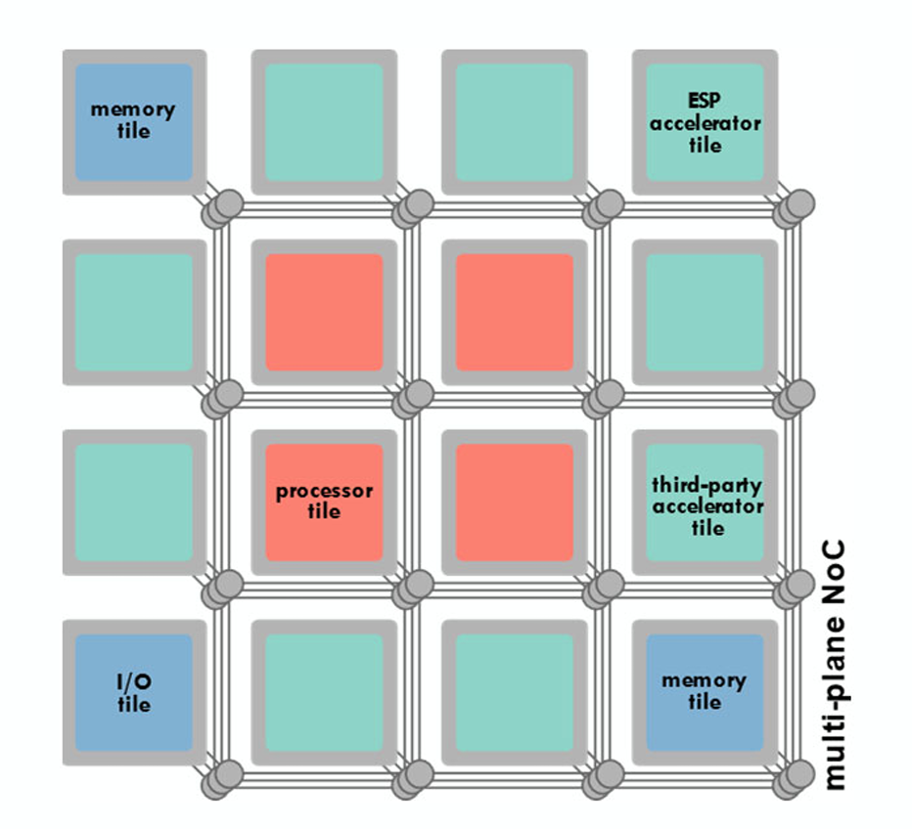
Background
Edge DL workloads are growing faster than what one small accelerator can handle efficiently
Tiled architectures are attractive because they scale by replicating smaller accelerators
ESP already supports integrating NVDLA as a third-party accelerator
Our goal is to enable coarse-grained intra-layer parallelism by splitting one layer across multiple NVDLA instances.
[ Image source: Prof. Luca Carloni , CSEE-E6868 Lecture 3 , Spring ‘26 ]

Slide 3
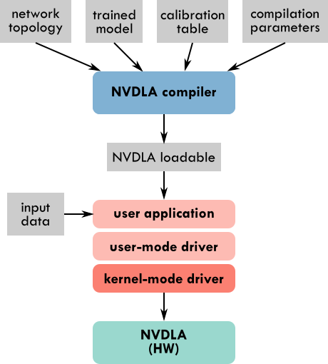
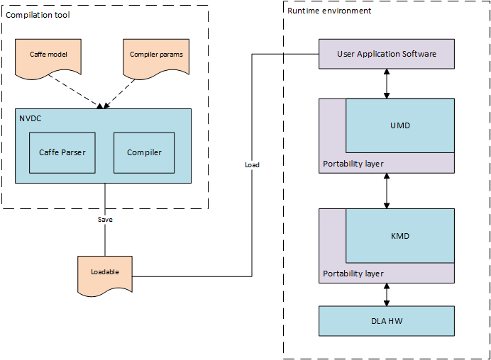
NVDLA Overview
[ Image source: System-Level Design Group at Columbia University, "Guide – How to: integrate a third-party accelerator," ESP Documentation, 2021. ]
[ Image source: NVIDIA, "Software Manual," NVDLA Documentation. ]

Slide 4
Progress So Far: Baseline
Completed the official single-NVDLA ESP tutorial with bitstream deployment
Confirmed the official ESP flow already supports selecting NVDLA instances with --instance
Esp supports parallel independent runs across multiple instances
split-layer execution is the next step

Slide 5
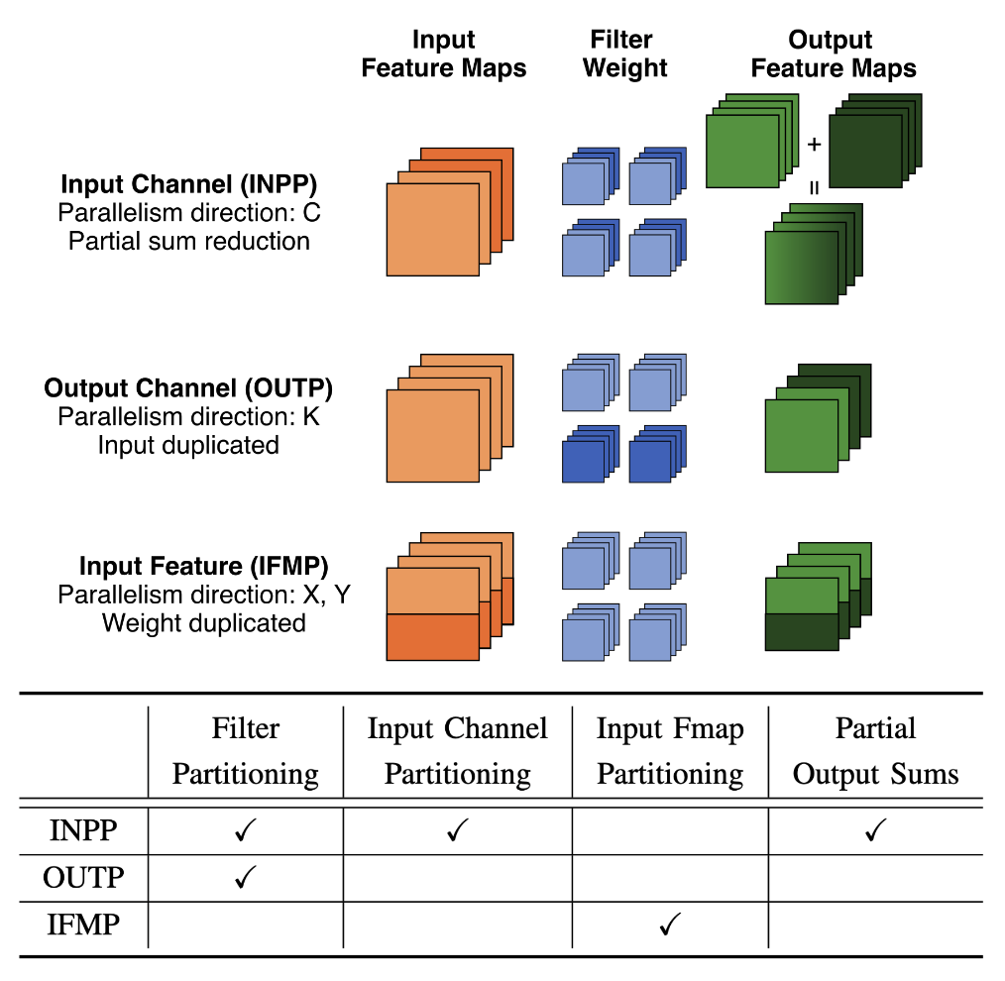
What is the best way to partition a layer across tiles?
Candidate strategies:
output-channel split
input-channel split
input-feature split
Why choose output-channel split
Output-channel split avoids halo/border issues from spatial tiling
Both instances can read the same input activation
Each instance gets its own subset of weights and biases
Correctness checking is straightforward against the single-instance baseline
This is the lowest-risk path to the current milestone
[ Image source: G. Tombesi et al., OSCAR 2025. ]
Notes:
In coarse grain intra-layer paprallelism, each tile is assigned to a distinct spatial or channel partition. We have different types of parallelism schemes, and we can see in the image on the left how they they apply to
a 2D convolution layer • Input Channel Parallelism (INP) : Each accelerator is responsible for a subset of input channels
and the corresponding subsets of filters, generating partial outputs that are accumulated to form
the final result.
• Output Channel Parallelism (OUTP) : Filters are distributed across accelerators, each of
which processes the full set of input channels for its assigned filters, producing complete output
feature maps for those filters.
• Feature Map Parallelism (FMP) : The spatial dimension of the input feature map is partitioned.
Each accelerator processes a distinct spatial region using all the filters; thus, each produces a
complete slice of the output feature maps.
By selecting an appropriate parallelism scheme, the accelerators can optimize utilization and
match the memory constraints of the system.

Slide 6
Progress So Far: Validating Example
Chosen milestone example: isolate LeNet conv1 as a one-layer network
Split conv1 output channels from 20 into 10 + 10
Generate three loadables:
baseline full-layer loadable
split part 0 loadable
split part 1 loadable
Validation rule: concat(part0, part1, axis=channel) == full output
Added helper runtime support to launch multiple loadables in one process, but outputs are still kept separate for validation

Slide 7
Future Plans
Extend the same split method to more parallel instances.
Perform a performance study: latency, speedup, efficiency, memory-bandwidth pressure, and scaling limits.
Explore additional split methods:
output-channel split
output-spatial split
input-channel split
batch split
Move from a single isolated layer to a larger end-to-end model flow.

Slide 8
References
G. Tombesi, J. Zuckerman, J. Yang, W. Baisi, K. Lee, D. Giri, and L. P. Carloni, "An Open-Source DNN Acceleration Fabric with Flexible Inter-Layer Pipelining Support," OSCAR 2025.
L. Carloni , "Lecture 3: How to Write a Project Proposal and Introduction to ESP ," CSEE-E6868: Embedded Scalable Platforms , Columbia University , Spring ‘26
NVIDIA Corporation, "Software Manual," NVDLA Documentation, 2026. [Online]. Available: https://nvdla.org/sw/contents.html
System-Level Design Group at Columbia University, "Guide – How to: integrate a third-party accelerator (e.g. NVDLA)," ESP Documentation, Aug. 2021. [Online]. Available: https://www.esp.cs.columbia.edu/docs/thirdparty_acc/thirdparty_acc-guide/

