Slide 1
Parallel ILLT
By: Elie Saad

Slide 2
Overview
Problem Statement and Description
Definitions
Cholesky Factorization
Incomplete Cholesky Factorization
Parallel Incomplete Cholesky Factorization
Program Testing

Slide 3
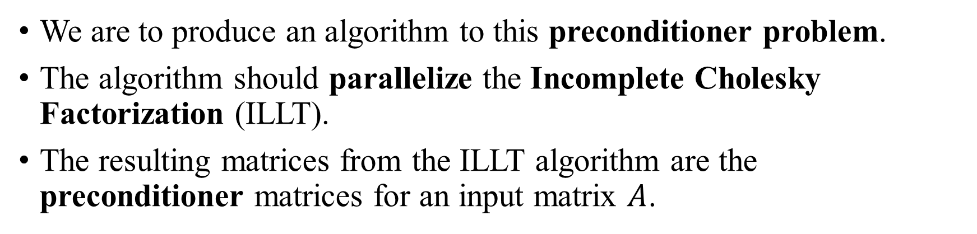
Problem Statement and Description
“Parallel ILLT for sparse symmetric matrices divided by columns. We remember only non-zeros of the matrix.”
We are to produce an algorithm to this preconditioner problem.
The algorithm should parallelize the Incomplete Cholesky Factorization (ILLT).
The resulting matrices from the ILLT algorithm are the preconditioner matrices for an input matrix $A$.

Slide 4
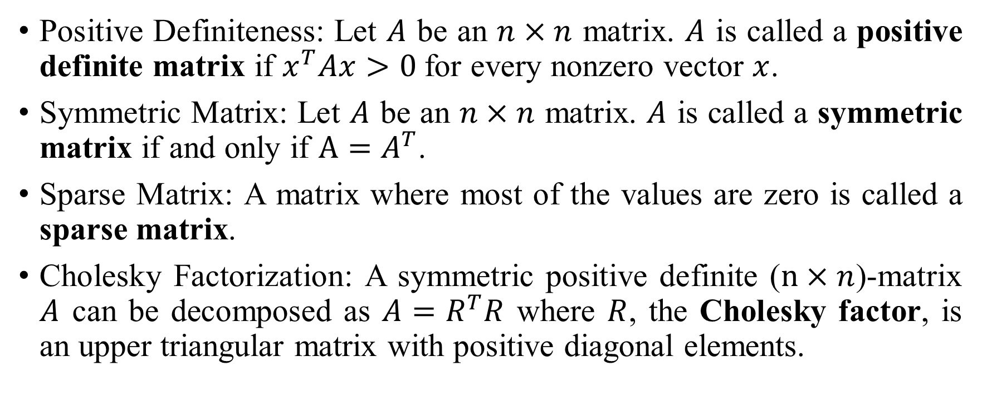
Definitions
Positive Definiteness: Let $A$ be an $n×n$ matrix. $A$ is called a positive definite matrix if $x^{T}Ax>0$for every nonzero vector $x$.
Symmetric Matrix: Let $A$ be an $n×n$ matrix. $A$ is called a symmetric matrix if and only if $A=A^{T}$.
Sparse Matrix: A matrix where most of the values are zero is called a sparse matrix.
Cholesky Factorization: A symmetric positive definite ($n×n$)-matrix $A$ can be decomposed as $A=R^{T}R$ where $R$, the Cholesky factor, is an upper triangular matrix with positive diagonal elements.

Slide 5
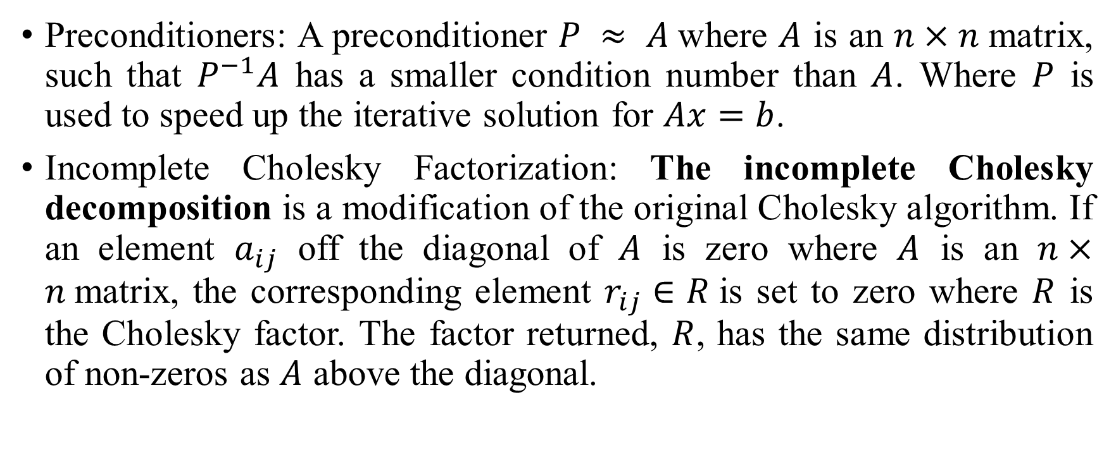
Definitions
Preconditioners: A preconditioner $P ≈ A$where $A$ is an $n×n$matrix, such that $P^{−1}A$ has a smaller condition number than $A$. Where $P$ is used to speed up the iterative solution for $Ax=b$.
Incomplete Cholesky Factorization: The incomplete Cholesky decomposition is a modification of the original Cholesky algorithm. If an element $a_{ij}$ off the diagonal of $A$ is zero where $A$ is an $n×n$matrix, the corresponding element $r_{ij}∈R$is set to zero where $R$ is the Cholesky factor. The factor returned, $R$, has the same distribution of non-zeros as $A$ above the diagonal.

Slide 6

Cholesky Factorization
$\left[\begin{matrix}a_{11} & ⋯ & a_{1n} \\ ⋮ & ⋱ & ⋮ \\ a_{n1} & ⋯ & a_{nn}\end{matrix}\right]$ =
$\left[\begin{matrix}L_{11} & 0 & 0 & ⋯ & 0 \\ L_{21} & L_{22} & 0 & ⋯ & 0 \\ ⋮ & ⋮ & ⋮ & ⋱ & ⋮ \\ L_{n1} & ⋯ & ⋯ & L_{n,n−1} & L_{nn}\end{matrix}\right]×\left[\begin{matrix}L_{11} & L_{21} & L_{31} & ⋯ & L_{n1} \\ 0 & L_{22} & L_{32} & ⋯ & L_{n2} \\ ⋮ & ⋮ & ⋮ & ⋱ & ⋮ \\ 0 & ⋯ & ⋯ & 0 & L_{nn}\end{matrix}\right]$

Slide 7
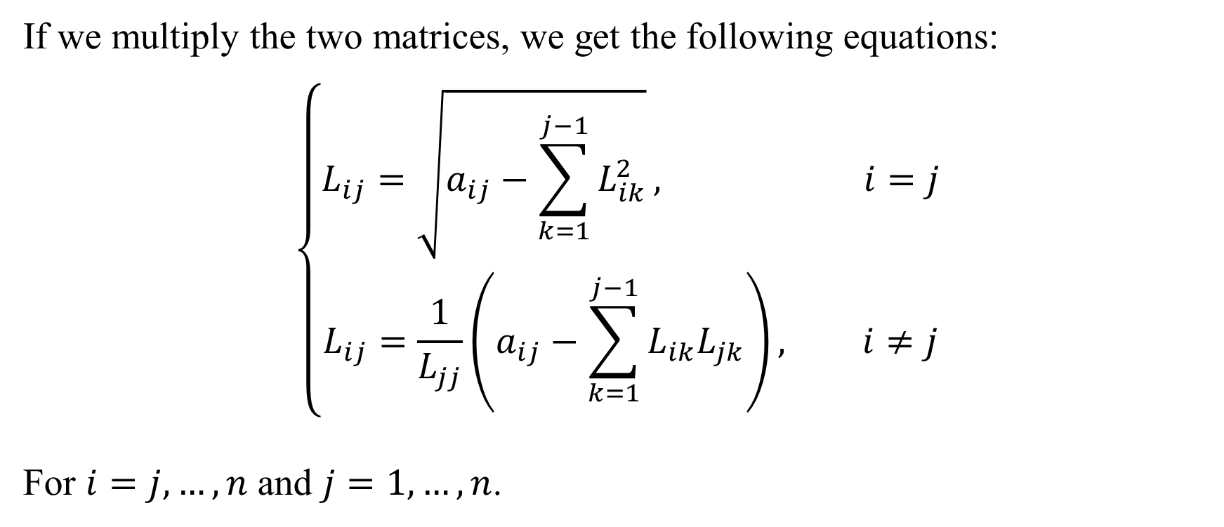
Cholesky Factorization
If we multiply the two matrices, we get the following equations:
$$\left\{\begin{aligned}L_{ij}=\sqrt{a_{ij}−\sum_{k=1}^{j−1}{L_{ik}^{2}}}, i=j \\ L_{ij}=\frac{1}{L_{jj}}\left(a_{ij}−\sum_{k=1}^{j−1}{L_{ik}L_{jk}}\right), i≠j\end{aligned}\right.$$
For $i=j,…,n$ and $j=1,…,n$.

Slide 8
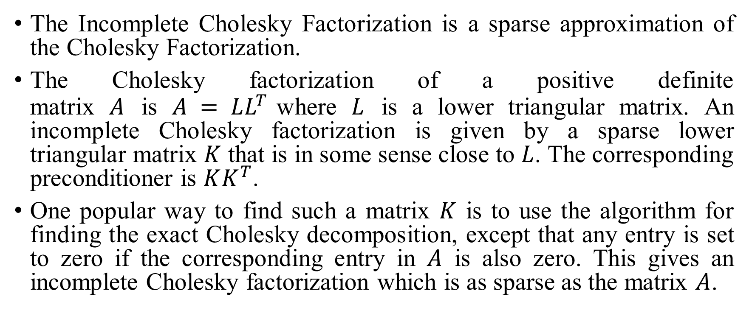
Incomplete Cholesky Factorization
The Incomplete Cholesky Factorization is a sparse approximation of the Cholesky Factorization.
The Cholesky factorization of a positive definite matrix $A$ is $A = LL^{T}$where $L$ is a lower triangular matrix. An incomplete Cholesky factorization is given by a sparse lower triangular matrix $K$ that is in some sense close to $L$. The corresponding preconditioner is $KK^{T}$.
One popular way to find such a matrix $K$ is to use the algorithm for finding the exact Cholesky decomposition, except that any entry is set to zero if the corresponding entry in $A$ is also zero. This gives an incomplete Cholesky factorization which is as sparse as the matrix $A$.

Slide 9
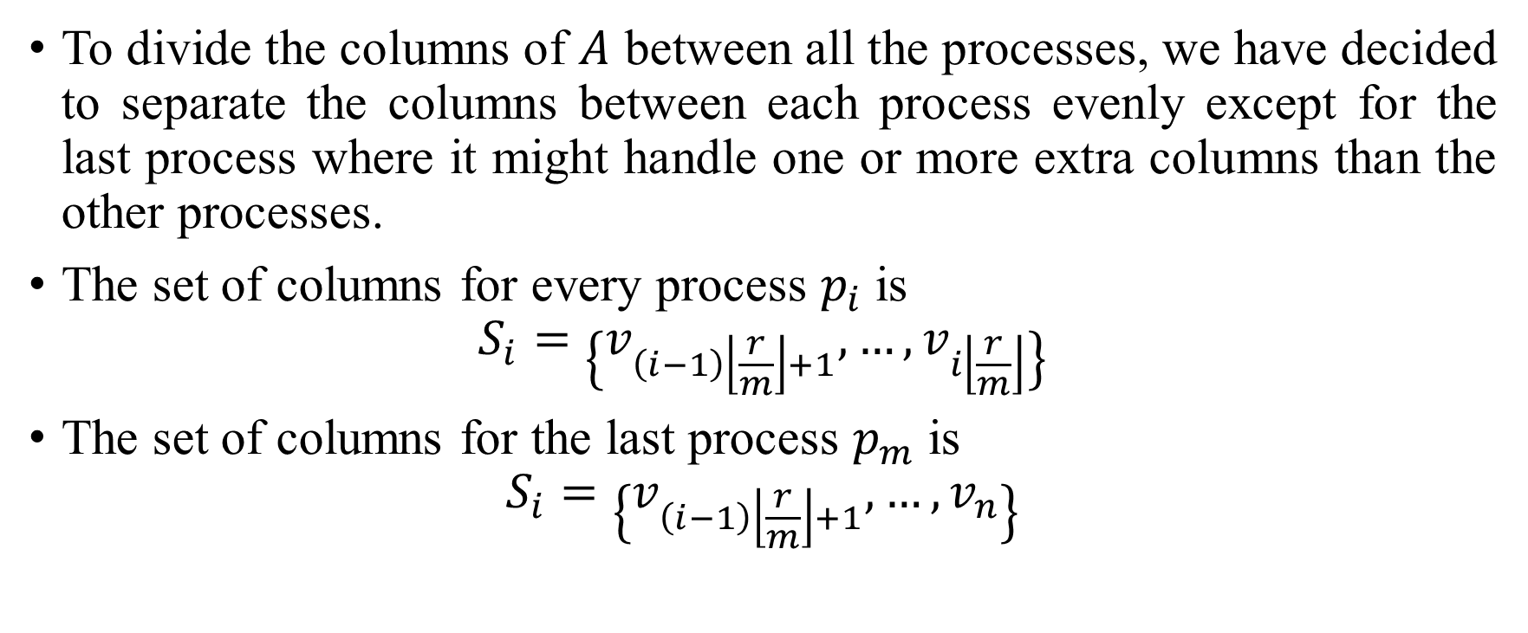
Parallel Incomplete Cholesky Factorization
To divide the columns of $A$ between all the processes, we have decided to separate the columns between each process evenly except for the last process where it might handle one or more extra columns than the other processes.
The set of columns for every process $p_{i}$ is
$$S_{i}=\left\{v_{\left(i−1\right)\left\lfloor \frac{r}{m}\right\rfloor +1},…,v_{i\left\lfloor \frac{r}{m}\right\rfloor }\right\}$$
The set of columns for the last process $p_{m}$ is
$$S_{i}=\left\{v_{\left(i−1\right)\left\lfloor \frac{r}{m}\right\rfloor +1},…,v_{n}\right\}$$

Slide 10
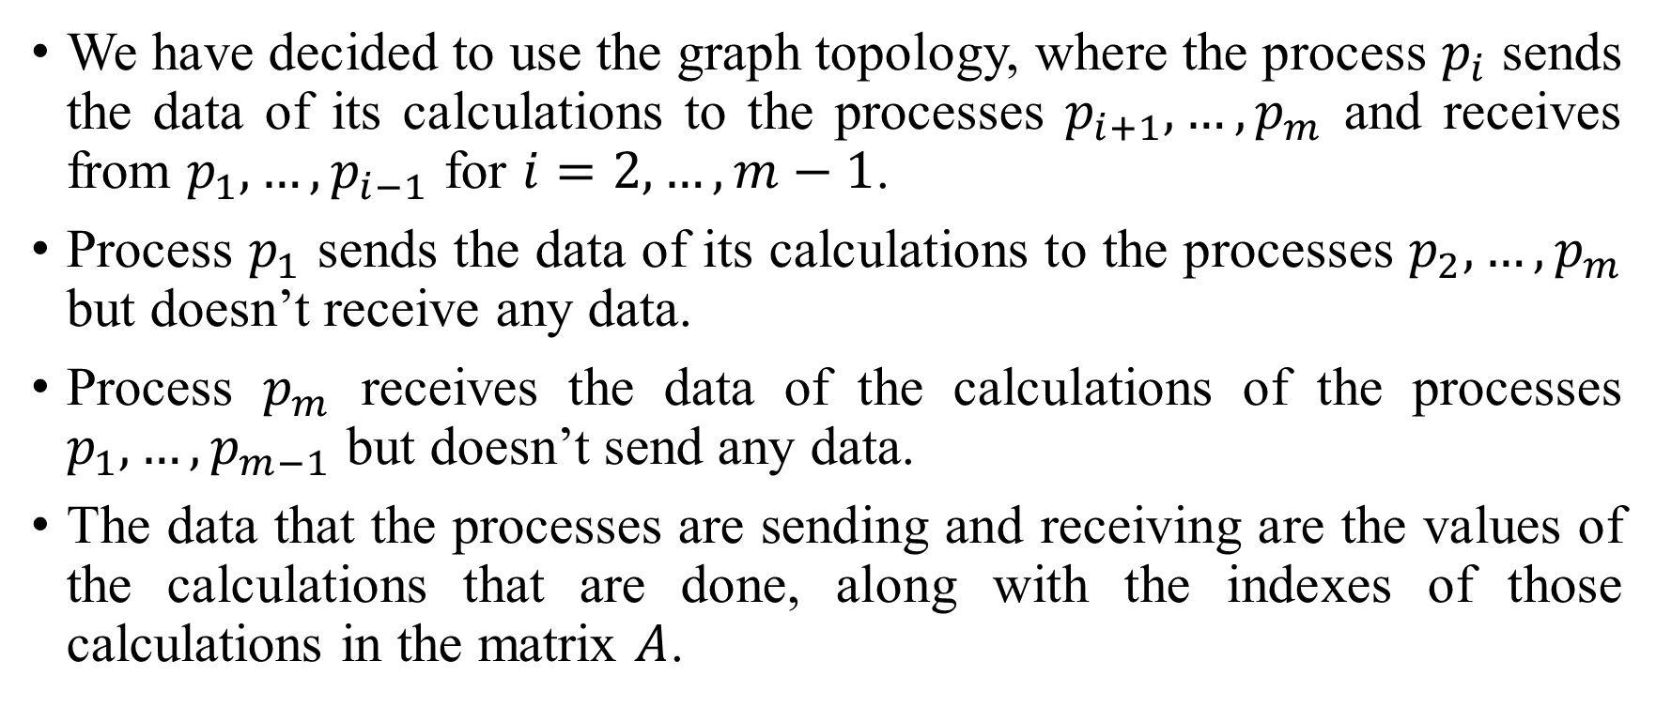
Parallel Incomplete Cholesky Factorization
We have decided to use the graph topology, where the process $p_{i}$ sends the data of its calculations to the processes $p_{i+1},…,p_{m}$ and receives from $p_{1},…,p_{i−1}$ for $i=2,…,m−1$.
Process $p_{1}$ sends the data of its calculations to the processes $p_{2},…,p_{m}$ but doesn’t receive any data.
Process $p_{m}$ receives the data of the calculations of the processes $p_{1},…,p_{m−1}$ but doesn’t send any data.
The data that the processes are sending and receiving are the values of the calculations that are done, along with the indexes of those calculations in the matrix $A$.

Slide 11
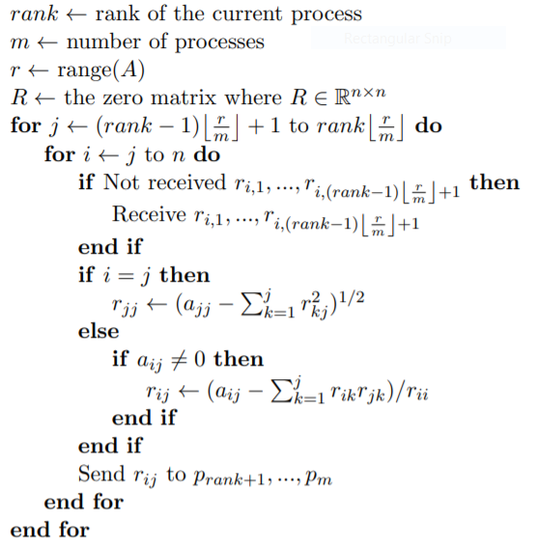
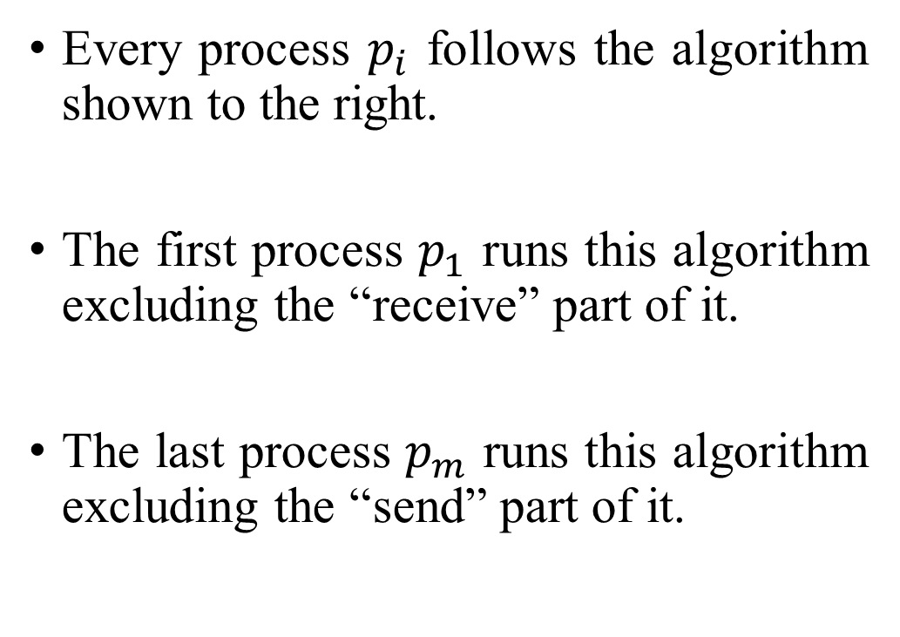
Parallel Incomplete Cholesky Factorization
Every process $p_{i}$ follows the algorithm shown to the right.
The first process $p_{1}$ runs this algorithm excluding the “receive” part of it.
The last process $p_{m}$ runs this algorithm excluding the “send” part of it.

Slide 12
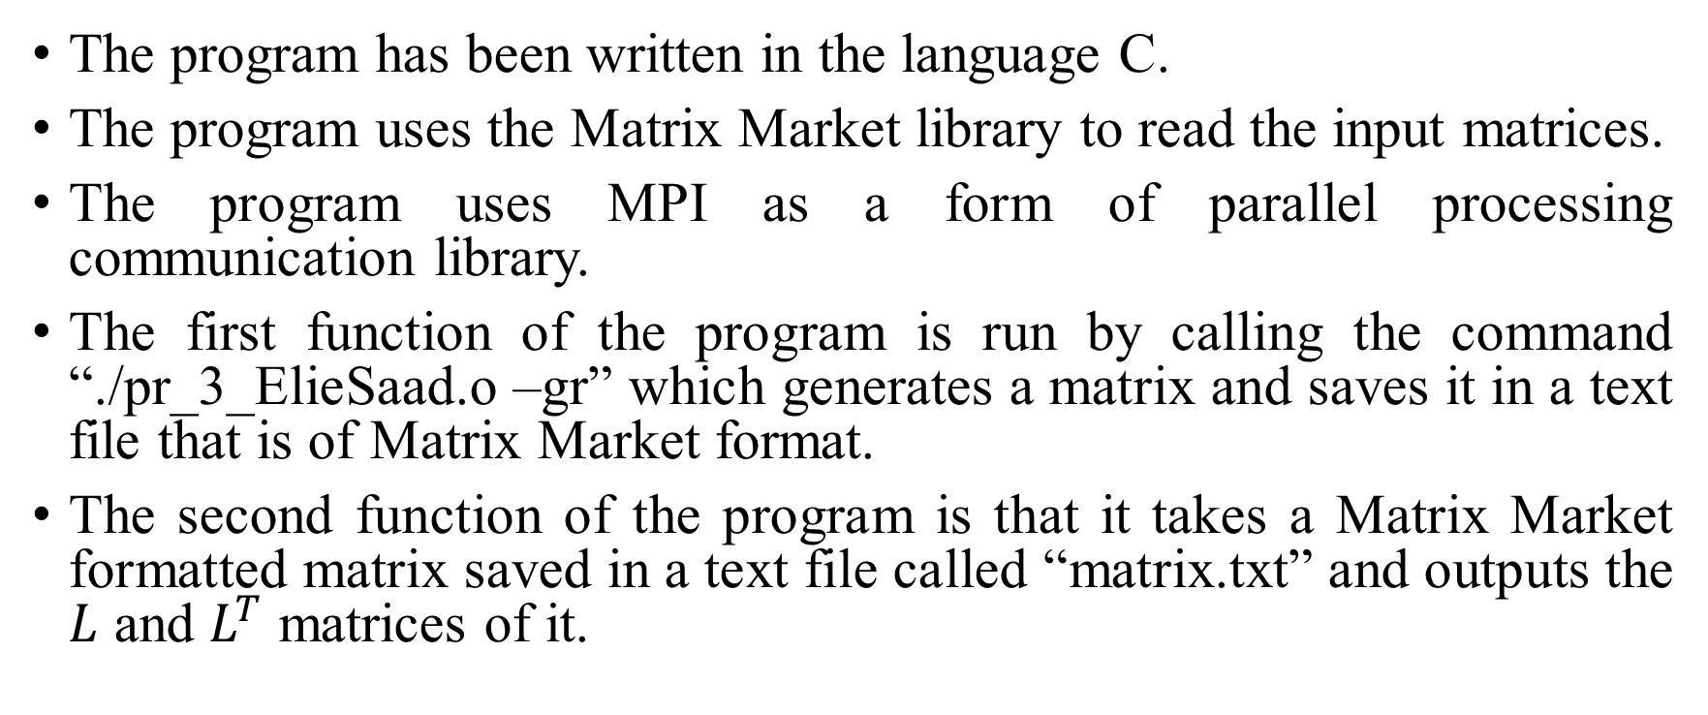
Program Testing
The program has been written in the language C.
The program uses the Matrix Market library to read the input matrices.
The program uses MPI as a form of parallel processing communication library.
The first function of the program is run by calling the command “./pr_3_ElieSaad.o –gr” which generates a matrix and saves it in a text file that is of Matrix Market format.
The second function of the program is that it takes a Matrix Market formatted matrix saved in a text file called “matrix.txt” and outputs the $L$ and $L^{T}$ matrices of it.

Slide 13
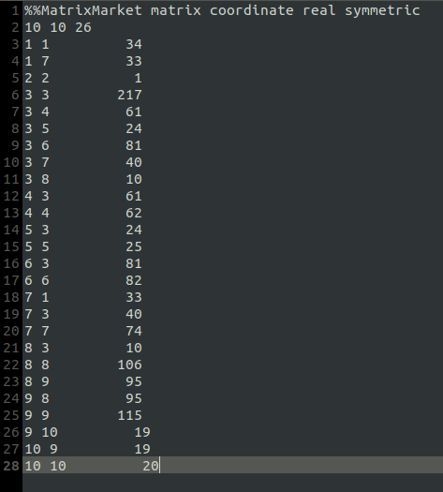
Program Testing
The “matrix.txt” file that is of the Matrix Market format in our testing is shown.

Slide 14
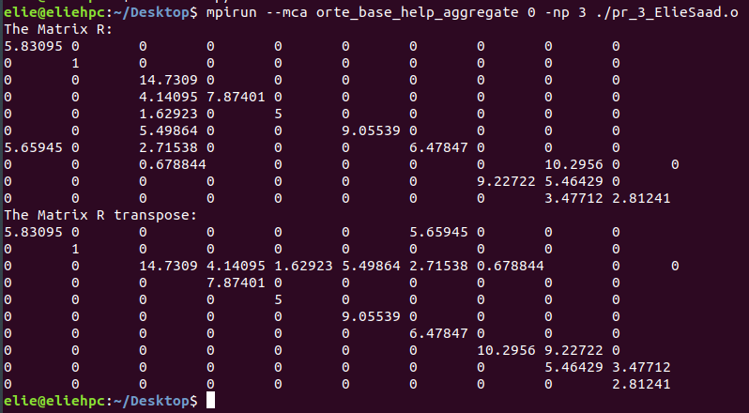
Program Testing
The following is the output of our program

Slide 15
Thank You.

