Slide 1

ELECTRIC VEHICLES | TRANSPORTATION AND MOBILITY
EV Highway Corridor Reliability Gap Analysis
A Python-Based Data Analysis and geospatial analysis of fast-charging coverage on six Indian national highways
Inbavathi Murugan
Student ID: AF05309783
Course: AIML | Batch: ANP-D7444
Anudip Foundation
Notes:
Introduce the project: it asks whether fast chargers along six national highways actually cover the routes, not just how many chargers exist.

Slide 2
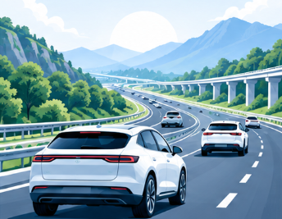
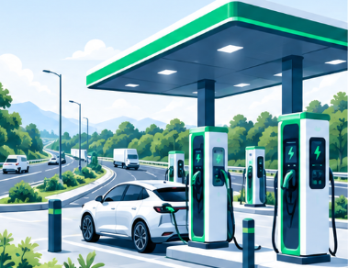
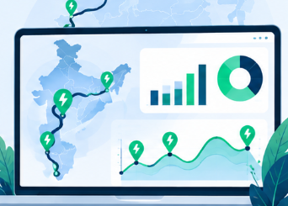



Industry Overview
EV and Mobility Industry
Why Highway Charging Matters
Role of Data Analysis
India's road transport is shifting towards electric vehicles
10,377,820 EV registrations in the 2017–2026 dataset (2026 partial)
Charging networks must keep pace with vehicles on the road
Combines registrations, charger records and road geometry
Turns coverage into measurable kilometres
Helps planners decide where new chargers are needed first
Long-distance trips depend on fast chargers along the route
One long uncovered stretch can break an intercity journey
Highways link states, so gaps are not only a local problem
Notes:
Set the scene: EV adoption is growing, highway charging decides whether long trips are practical, and data analysis lets planners measure gaps instead of guessing.

Slide 3


Problem Statement
The Challenge
Charger count does not equal coverage
Who Is Affected
Fast-charging infrastructure is distributed unevenly across states and routes
A highway can have many chargers nearby and still contain long stretches without one
EV registration growth and charger rollout do not always match
EV owners and drivers
243
Fleet and bus operators
fast chargers near NH-66
376 km
Charging network operators
still uncovered on the same highway
Planners and policymakers
Notes:
Key message: counting chargers is not enough. NH-66 has 243 nearby fast chargers but still has a 376 km uncovered stretch.

Slide 4


Project Objectives
Analyze EV registrations across states and Union Territories
1
Examine charging station distribution and operational status
2
Evaluate charging coverage on six national highways
3
Identify uncovered highway stretches and long gaps
4
Compare gap indicators using sensitivity analysis and clustering
5
Notes:
Five objectives, moving from demand (registrations) to supply (chargers) to corridor coverage, gaps, and finally comparison across indicators.

Slide 5



Proposed Solution and Analysis Questions
combined into one analysis
EV registrations
Charging stations
National highways
State and UT boundaries
Approach
Analysis Questions
Clean and standardise all datasets
Split highways into ~25 km segments
Draw a 5 km corridor buffer; match fast chargers
Flag segments with no fast charger within 50 km
Compare states: EV Desert Index, sensitivity, K-Means
Which states and UTs have the most EV registrations?
How many chargers are operational, and how many are fast (≥25 kW)?
What share of each of the six highways has fast-charger coverage?
Where are the longest uncovered stretches (>50 km)?
Do charger counts alone reflect corridor coverage?
Which states hold the most uncovered highway length?
Notes:
Explain the pipeline: four datasets feed one Python workflow. Fast charger means 25 kW or above; a segment is uncovered when no fast charger lies within 50 km.

Slide 6
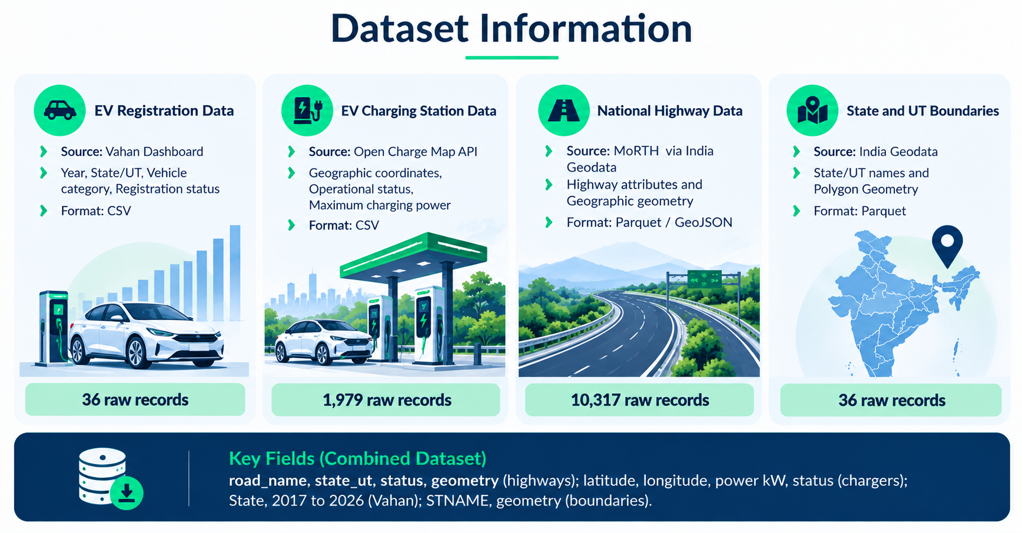

Dataset Information
Dataset Information
EV Registration Data
EV Charging Station Data
National Highway Data
State and UT Boundaries
Source: Vahan Dashboard
Year, State/UT, Vehicle category, Registration status.
Format: CSV
Source: Open Charge Map API.
Geographic coordinates, Operational status, Maximum charging power.
Format: CSV
Source: MoRTH via India Geodata
Highway attributes and Geographic geometry.
Format :Parquet / GeoJSON
Source: India Geodata
State/UT names and Polygon Geometry.
Format: Parquet
36 raw records
1,979 raw records
10,317 raw records
36 raw records
road_name, state_ut, status, geometry (highways); latitude, longitude, power kW, status (chargers); State, 2017 to 2026 (Vahan); STNAME, geometry (boundaries).
Notes:
Four dataset groups. Only documented counts are shown. Dimensions and dtypes should be read from the notebook outputs when presenting.

Slide 7
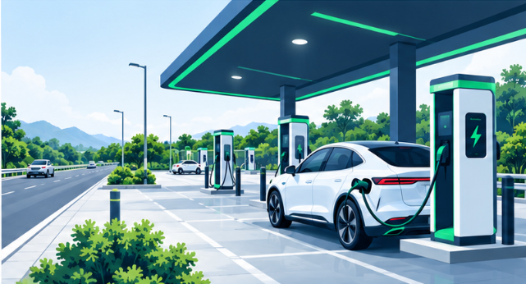
Data Collection and Understanding
Collection
EV registrations: exported from the Vahan dashboard (Electric, Active, calendar years 2017 to 2026)
Chargers: Open Charge Map API (free key)
Highways and boundaries: India Geodata (open licence).
Boundaries: India Geodata state and UT polygons
The datasets contain a combination of tabular and geospatial information. Registration data supports state- and year-level analysis, while charging stations and highway geometries support spatial distance and coverage analysis.
PLACEHOLDER
Insert Jupyter Notebook screenshot: duplicate check and geometry validation output
Inspection checks
Data types
Missing values
Duplicate checks
Geometry validity
Notes:
Describe how each dataset was obtained and inspected. Replace the two placeholders with real notebook screenshots; do not quote counts that are not in the notebook output.

Slide 8
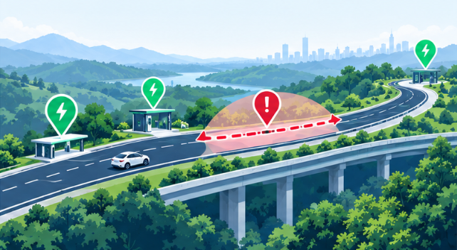
Data Cleaning and Transformation
1,979
1,841
1,822
1,421
10,317 → 9,507
raw
cleaned
operational
fast chargers (≥25 kW)
highway records, original → cleaned
Charging station records
Cleaning steps
~25 km
highway segment
5 km
corridor buffer
Checked and handled duplicate records.
Checked missing values.
Validated geographic geometries and coordinates.
Standardized inconsistent state names.
Reviewed highway attributes.
Filtered charging stations based on operational status.
Prepared cleaned datasets for subsequent analysis.
50 km
gap threshold
≥25 kW
fast charger
Notes:
Documented results: 1,979 raw charger records, 1,841 after cleaning, 1,822 operational, 1,421 fast. Highways: 10,317 to 9,507. Parameters are project assumptions, not measured results.

Slide 9
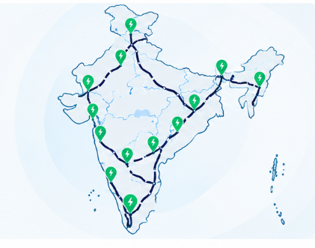
Exploratory Data Analysis
10,377,820
60%
~98,551 km
EV registrations in the 2017–2026 dataset
Approximate share of mapped road network identified as uncovered
(about 60%) of the mapped road network has no fast charger within 50 km
2026 data is partial
Analyses performed
State-level EV registration analysis
Charger distribution across states
Highway coverage on six national highways
Ranked states using the EV Desert Index.
Sensitivity analysis of gap indicators
Three-cluster K-Means analysis
Notes:
Three headline numbers. Note that 2026 registrations are partial. The index, sensitivity analysis and clusters are shown through the figures on the next slide.

Slide 10
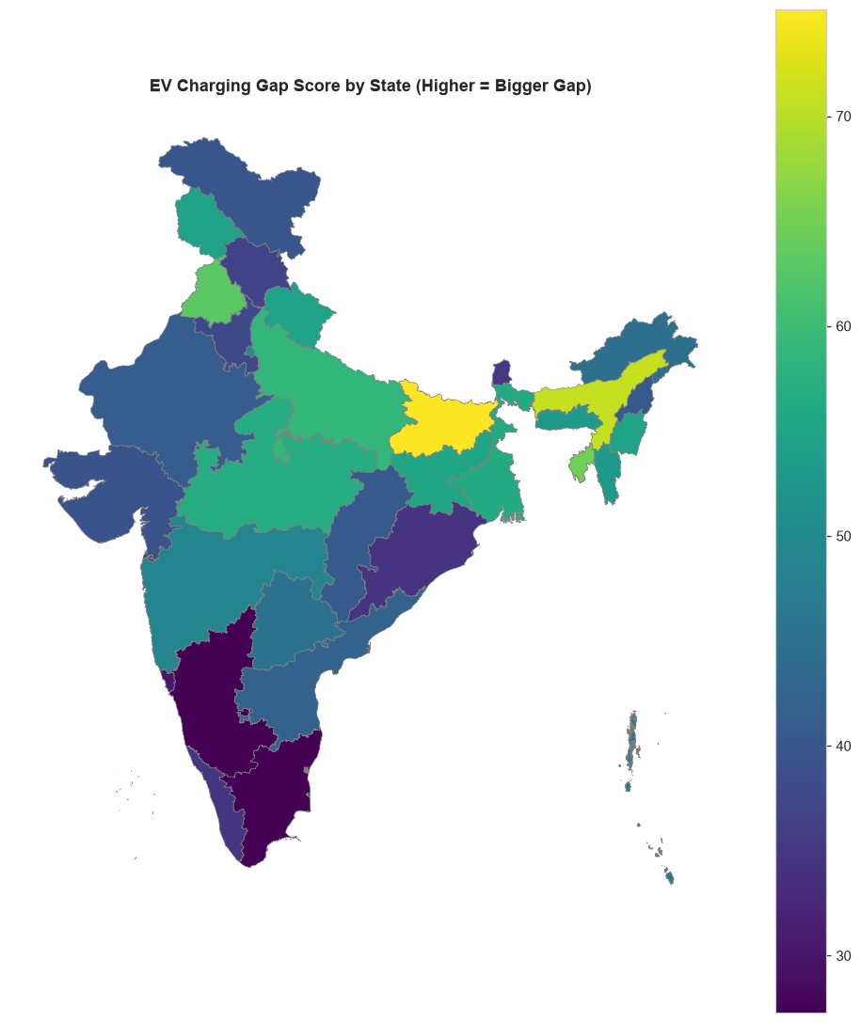
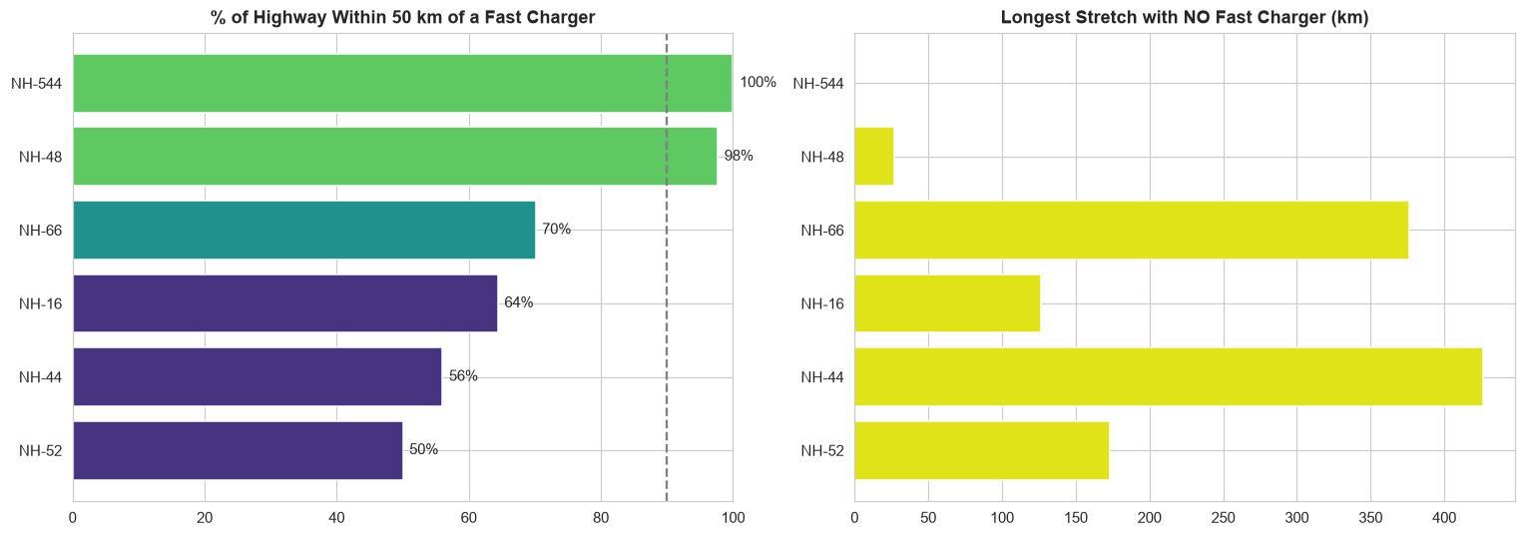
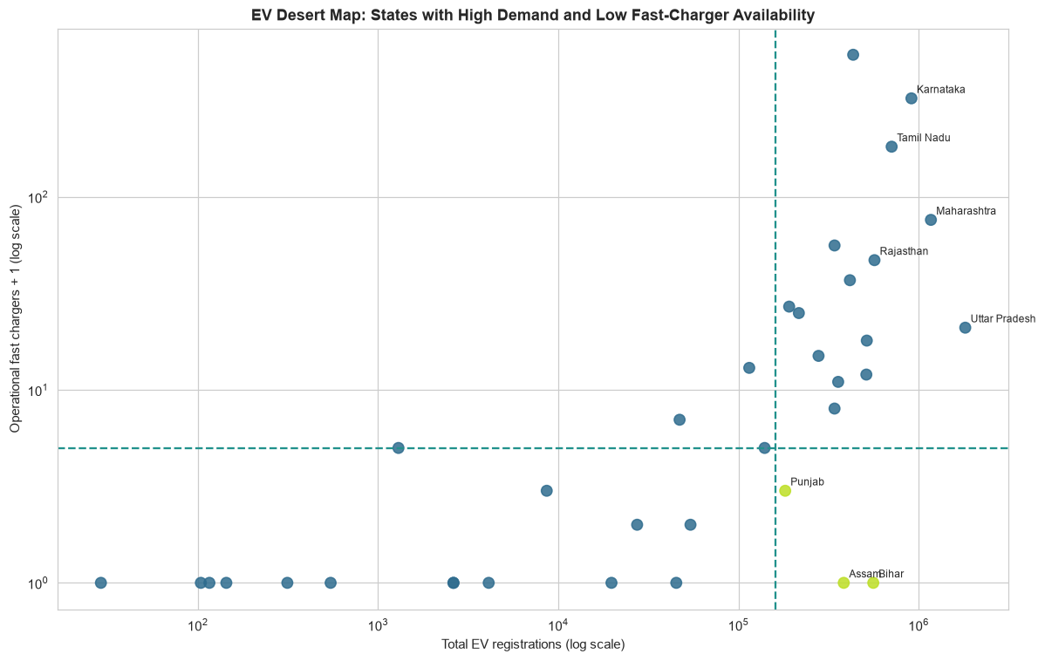
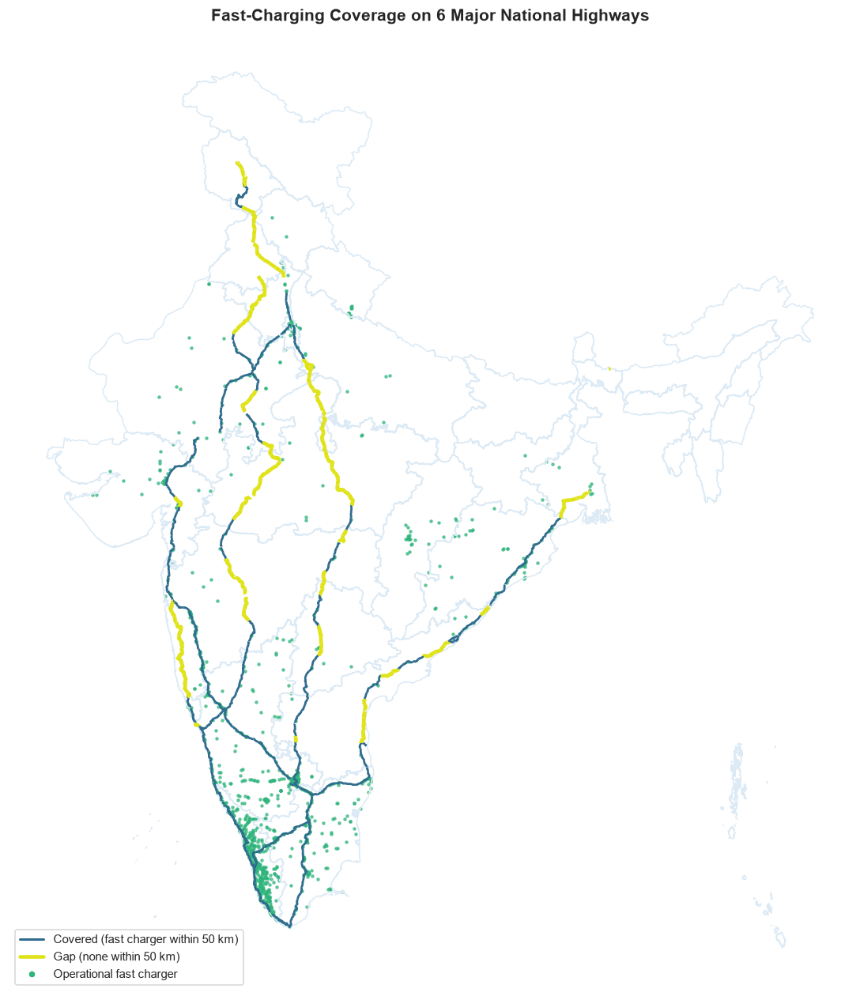
Data Visualization
PLACEHOLDER
Insert Gap Map: 6 Highways figure
Gap Map: 6 Highways
Purpose: Locate uncovered stretches
Shows: Highways with 50 km gaps marked
Insight: Longest gap: ~427 km on NH-44
PLACEHOLDER
Insert Highway Scorecard figure
Highway Scorecard
Purpose: Compare highway coverage
Shows: Coverage share per highway
Insight: NH-544 100%, NH-48 97.7%, NH-52 50.0%
PLACEHOLDER
Insert EV Desert Quadrant figure
EV Desert Quadrant
Purpose: Compare demand and supply
Shows: States by EV registrations vs chargers
Insight: confirm from the figure
PLACEHOLDER
Insert Gap Score Map figure
Gap Score Map
Purpose: Map relative gap severity
Shows: State-level gap score
Insight: confirm from the figure
Notes:
Four project figures. If the PNG files are not in outputs/figures next to the deck, replace each placeholder with the real image. Fill the two 'confirm from the figure' insights from the notebook outputs.

Slide 11
Data Visualization
Identifies states with high EV registrations but low operational fast-charger availability. It highlights potential mismatches between EV demand and charging infrastructure.
Shows the distribution of EV charging infrastructure gaps across Indian states. Higher scores indicate larger gaps and help identify areas that may need more charging infrastructure.
Notes:
Four project figures. If the PNG files are not in outputs/figures next to the deck, replace each placeholder with the real image. Fill the two 'confirm from the figure' insights from the notebook outputs.

Slide 12
Data Visualization
The bar chart compares highway coverage within 50 km of a fast charger, with NH-544 leading at 100% and NH-52 lowest at 50%, highlighting priority areas for infrastructure expansion.
The map highlights fast-charging coverage gaps across six major national highways in India, showing covered routes, uncovered segments, and operational fast chargers.
Notes:
Four project figures. If the PNG files are not in outputs/figures next to the deck, replace each placeholder with the real image. Fill the two 'confirm from the figure' insights from the notebook outputs.

Slide 13



Key Insights and Recommendations
427 km
243 vs 376 km
longest uncovered stretch (NH-44)
NH-66: nearby fast chargers vs uncovered stretch
~891 km
~796 km
Maharashtra: uncovered selected-highway length
Madhya Pradesh: second highest
Recommendations
Prioritise long uncovered stretches
Validate charger information
Plan for corridor coverage, not charger counts alone
Notes:
Documented findings only. Chart shows the three coverage values provided: NH-544 100%, NH-48 97.7%, NH-52 50.0%. The other highways come from the notebook.

Slide 14
Conclusion and Future Scope
Achievements
Future Scope
Combined EV registrations, chargers, highways and boundaries in Python
Cleaned 1,979 charger records to 1,822 operational, 1,421 fast
Measured coverage on six highways: ~60% of the mapped network has no fast charger within 50 km
Geographic distribution matters as much as charger counts
Road-network driving distances
Traffic data
Additional highways
Updated charger information
Interactive mapping
From counting chargers to understanding charging accessibility — data analysis can help make EV highway infrastructure planning more evidence-based.
Notes:
Close with the main message: registrations show demand, geospatial analysis shows where supply is missing. State the limitations openly.

Slide 15
Thank you
Any Questions?
Notes:
Close with the main message: registrations show demand, geospatial analysis shows where supply is missing. State the limitations openly.

