Slide 1

Homefront
Ryan Cloherty, Gia Hill, Yali Izzo

Slide 2
The Problem
How do you know if a home you’re planning on moving into meets local safety regulations?

Slide 3
Solution: Homefront
House Safety:
Takes Boston House Codes into a database
Gives user different statistics of different addresses on website
Uses an algorithm to calculate house safety
Takes in user input
Information comes from current or past occupants

Slide 4
Demostration
Homefront

Slide 5
How we made it
HTML/CSS/JS/jQuery – Basic site functionality
Node.js – Web app
Express.js – Handling HTTP requests
EJS – Populating page info
MySQL – Storing user generated info

Slide 6
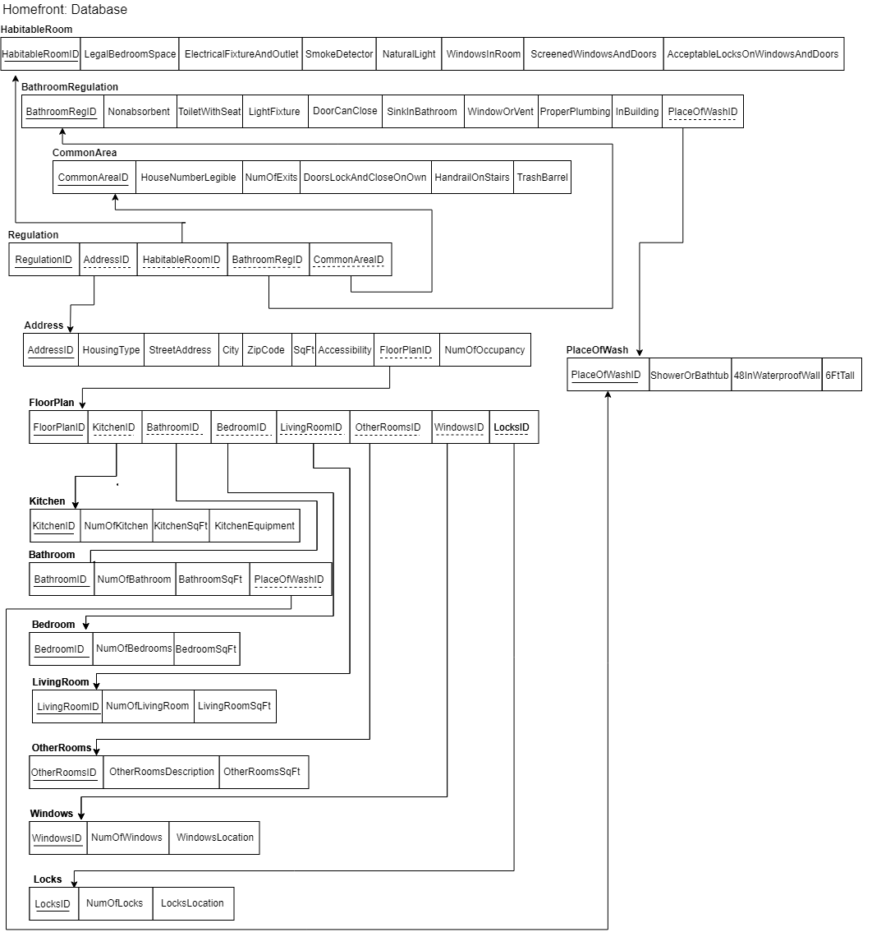
1st Attempt
Database is in 3NF
Made it complicated in the web app

Slide 7
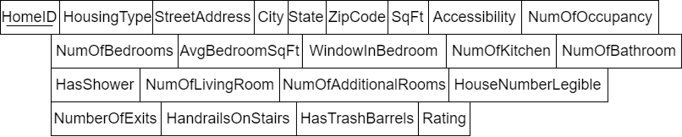
2nd attempt

Slide 8
What we learned
How to use MySQL
Connecting databases and a web app
How to better understand HTML, CSS, SQL, Javascript, Express.js, and ejs
Handling forms
Team work!
Know when to give up on an idea

Slide 9
Future Implementations
Use original database
Possibly get data from different APIs and realtors to get more accurate data
Filter responses from users
Improved score function
History viewer

Slide 10
Questions?

