Slide 1
Defining Queries with IncQuery for MagicDraw
IncQueryLabs Ltd.

Slide 2
Example queries
Signal queries
Signals that are sent but not received (1)
Signals that are received but not sent (2)
Port compatibility queries
Signals sent/received over a port match the port’s flow properties(3)
Detect Pins that are not connected to anything (4)
Detect Pins that are not connected to parameters transitively (5)
Activity Structure queries
Detect cyclic activity calls (6)
State machine queries
Detect potential deadlock states (7)

Slide 3
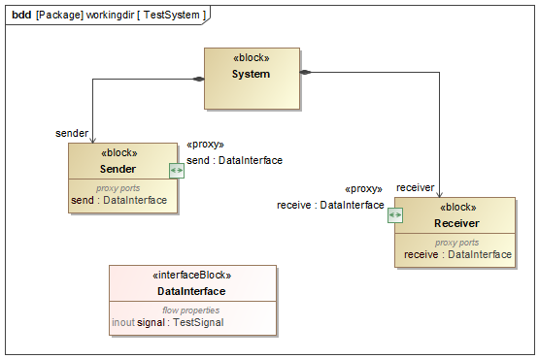
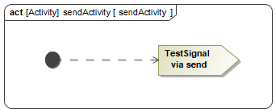
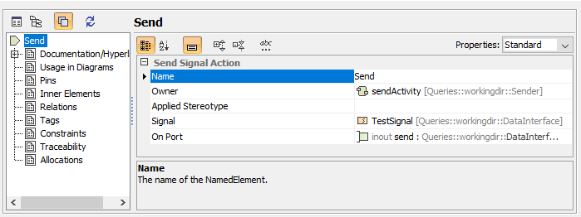
Sent/received signals (3)
Detailed description:
Signals sent over a port match the port’s flow properties.
Detect sent signals that are missing from the associated port’s flow properties

Slide 4
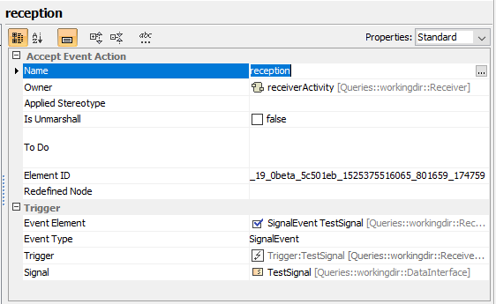
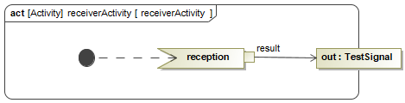
Sent/received signals (3)
Detailed description:
Signals received match an associated port’s flow properties.
Detect received signals that are missing from the associated port’s flow properties

Slide 5
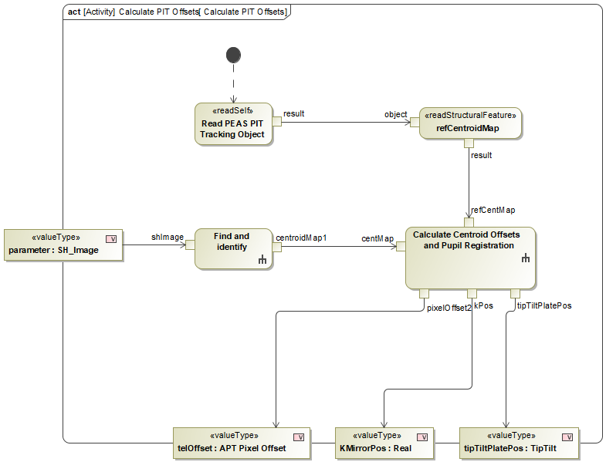
Pins not connected to Parameters (5)
Detailed description:
Detect (output) Pins that are not connected to parameters transitively.
Pins can either be directly connected to Activity parameters or via a more complex object flow.
The query should detect pins that are not connected to parameters in either way

Slide 6
Pins not connected to Parameters (5)
Detailed description:
Detect (output) Pins that are not connected to parameters transitively.
Pins can either be directly connected to Activity parameters or via a more complex object flow.
The query should detect pins that are not connected to parameters in either way

Slide 7
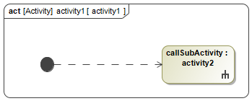
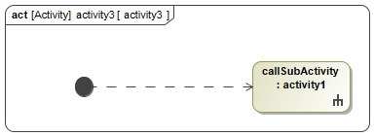
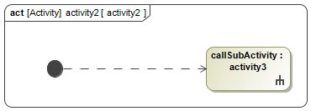
Cyclic Activity calls (6)
Detailed description:
Detect cyclic activity calls.
Activity actions can define (and refer) child-activities.
If this parent child relation is not containment, activity references can result in cycles.

Slide 8
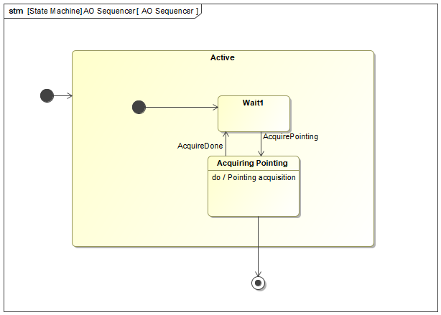
Deadlock States (7)
Detailed description:
Detect potential deadlock states.
Trivial case: Simple state has incoming transitions but no outgoing ones.
Composite states: If no sub-state has a transition that leaves the composite state’s region(s).
Transition leaving the region

Slide 9
Deadlock States (7)
Detailed description:
Detect potential deadlock states.
Trivial case: Simple state has incoming transitions but no outgoing ones.
Composite states: If no sub-state has a transition that leaves the composite state’s region(s).
Potential deadlock state

Slide 10



Contact us
www.incquerylabs.com
info@incquerylabs.com
+36-70/633-3973
@IncqueryLabs

