Slide 1
Inca Querying Interface:
Writing Web Page Clients
Kate Ericson, kericson@sdsc.edu
Inca 2.0 Workshop
February 24, 2006

Slide 2
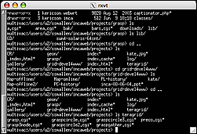
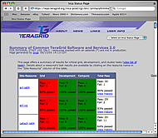
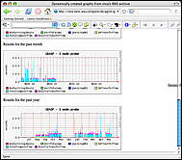
Architecture overview
GUIs display collected data by querying the Depot
Reporter
Repository
Admin
Tool
Suite
R
Reporter
Agent
Depot
Depot
S
S
S
R
R
R
Reporter
Manager
Reporter
Manager
Reporter
Manager
…
Resource N
Resource 1
Resource 2

Slide 3
Depot Queries
Any type of database query is possible
Query with Inca protocol
(soon webservices)
Currently two types of preprogrammed queries return XML:
  Latest suite results
  Series results

Slide 4
Depot Queries: JSP
JavaServer Page (xslt.jsp)
  create dynamic web content
JavaServer Pages (JSP) tag libraries
  define declarative, modular functionality that can be reused by any JSP page
  reduce the amount of Java code in JSP pages (move tag functionality into tag implementation classes)

Slide 5
Depot Queries: JSP tag libraries
Tag Library Descriptor (TLD)
  XML document that describes the library
  contains information about the library and each library tag
  used by a JSP container to validate the tags
<tag>
<name>printXML</name>
<tagclass>edu.sdsc.inca.consumer.tag.PrintXML</tagclass>
<info>print a file line by line</info>
<attribute>
<name>xml</name>
<required>true</required>
</attribute>
</tag>
TLD calls in JSP
(getXML, printXML, applyXSL)
  <%@ taglib uri="xslt.tld" prefix="xslt" %>
  <xslt:printXML xml="<%=xml%>"/>

Slide 6
Depot Queries: Suite Results
Array of report summaries for the latest instance of
each series in the suite (getXML/printXML tags):
<reportSummary>
<hostname>Kate-Ericsons-Computer.local</hostname>
<uri>http://repository/cluster.compiler.any.unit</uri>
<description>java_hello_world</description>
<reportSeriesConfigId>5</reportSeriesConfigId>
<instanceId>73</instanceId>
<body>
<body>
<unitTest>
<ID>javac</ID>
</unitTest>
</body>
</body>
<completed>true</completed>
</reportSummary>
<reportSummary>
…
<body>
<package>
<ID>openssl</ID>
<version>0.9.7i</version>
</package>
</body>
<completed>true</completed>
</reportSummary>
Notes:
Given SuiteName (e.g. TestSuiteLocal)

Slide 7
Depot Queries: Series Results
Results from a series instance (getXML/printXML tags):
<suiteId>1</suiteId>
<reportSeriesConfigId>5</reportSeriesConfigId>
<reportSeriesId>5</reportSeriesId>
<reportId>1</reportId>
<instanceId>73</instanceId>
<reportSeries>
<uri>http://inca.sdsc.edu/2.0/repository/bin/cluster.compiler.any.unit</uri>
<args>
<arg>
<name>version</name>
<value>no</value>
</arg>
…
</args>
<setup/>
<cleanup/>
<nice>false</nice>
<description>java_hello_world</description>
<hostname>Kate-Ericsons-Computer.local</hostname>
</reportSeries>
Notes:
Given config & instance ID

Slide 8
Depot Queries: Series Results
Results from a series instance (cont.):
<report>
<gmt>February 7, 2006 6:38 PM</gmt>
<age>7 mins 4 secs </age>
<hostname>Kate-Ericsons-Computer.local</hostname>
<name>cluster.compiler.any.unit</name>
<args>
<arg>
<name>version</name>
<value>no</value>
</arg>
…
</args>
<args/>
<body>
<unitTest>
<ID>javac</ID>
</unitTest>
</body>
<exitStatus>
<completed>true</completed>
<errorMessage/>
</exitStatus>
</report>
<schedule>
<cron>
<min>8-59/10</min>
<hour>*</hour>
<mday>*</mday>
<wday>*</wday>
<month>*</month>
<suspended>false</suspended>
</cron>
</schedule>
<report>…</report>
<comparisonResult/>
<sysusage>
<wallClockTime>3.004813</wallClockTime>
<memory>10.578125</memory>
<cpuTime>1.475999</cpuTime>
</sysusage>
Notes:
Given config & instance ID

Slide 9
Displaying Queries: Suite Results
Combine XML:
Suite report summaries (depot)
Resource config information (agent)
<resources>
<resource>
<name>siteA</name>
<macros>
<macro>
<name>.regexp</name>
<value>Kate-Ericsons-Computer.local</value>
</macro>
</macros>
</resource>
</resources>
3) XML file ($INCA_INSTALL/etc/common/swStack.xml)

Slide 10
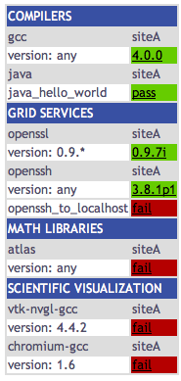
Displaying Queries: Suite Results
Print combined XML:
http://localhost:8080/xslt.jsp? resourceID=defaultvo&
suiteName=TestSuiteLocal
Print combined XML
and apply XSL to display HTML table
(add applyXSL tag):
http://localhost:8080/xslt.jsp? resourceID=defaultvo&
suiteName=TestSuiteLocal&
xsl=http://localhost:8080/swStack.xsl

Slide 11
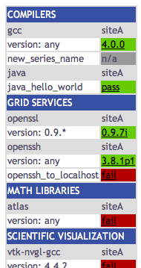
Displaying Queries: Suite Results
Edit
$INCA_INSTALL/etc/common/swStack.xml
to change HTML table:
<package>
<id>gcc</id>
<category>Compilers</category>
<version>any</version>
<versionRE>(^.*)</versionRE>
<tests>
<version>gcc_version</version>
<unitalias>new_series_name</unitalias>
</tests>
</package>

Slide 12
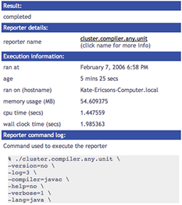
Displaying Queries: Series Results
Print series XML:
http://localhost:8080/xslt.jsp?
instanceID=209&
configID=5
Print series XML
and apply XSL (HTML table):
http://localhost:8080/xslt.jsp?
instanceID=209&
configID=5&
xsl=http://localhost:8080/swStack.xsl

Slide 13
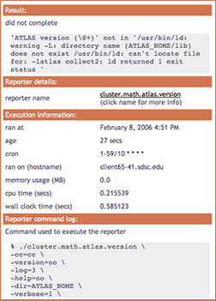
Displaying Queries: Customization
Edit XSL: $INCA_INSTALL/etc/swStack.xsl
XML formatting (e.g. add row to display cron):
<tr>
<td><xsl:text>cron</xsl:text></td>
<td>
<xsl:for-each select="//cron/*[not(self::suspended)]">
<xsl:value-of select="."/><xsl:text> </xsl:text>
</xsl:for-each>
</td>
</tr>
sample has two main templates,
“test” to display series results and
“suite” to display suite results
Edit CSS: $INCA_INSTALL/etc/inca.css
colors (e.g. change .header background-color from #3850A3 to #D07651)
fonts

