Slide 1
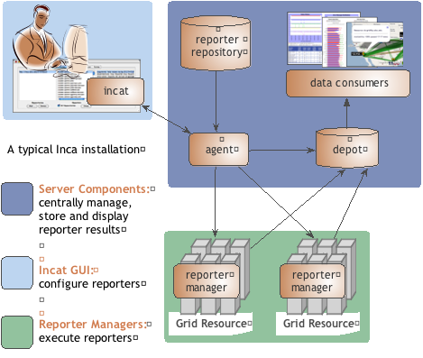
Inca provides user-level grid monitoring
Automates periodic execution of tests and benchmarks
Stores and archives a wide variety of monitoring results
Runs from a standard user account
Provides flexible and comprehensive web status pages
Monitors TeraGrid and 8 other Grids in the U.S., Europe, and Australia
Inca architecture diagram
Notes:
Inca was developed for originally for TeraGrid and now also used by a bunch of other Grids

Slide 2
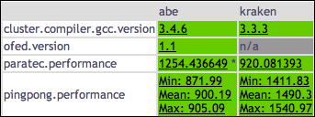
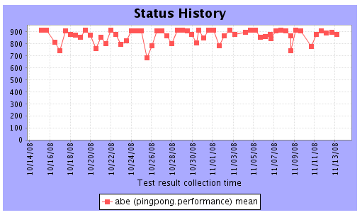
Early results from Inca runs on TeraGrid
Stage 1: MPI ping pong
  Collecting results since Oct 1
  Runs every 12 hours on 16 processors, <10 minutes
  Running on NCSA’s Abe, NICS’ kraken, TACC’s Ranger, PSC’s Pople
Stage 2: PARATEC
  Collecting results since November 1
  Runs every 12 hours on 256 processors, <30 min
  Running on NCSA’s Abe, NICS’ kraken
View latest results from Inca’s web pages
View wall clock history from web pages
Notes:
PingPong reports min, max, mean ??
Paratec reports wall time, %comm, MPI call statistics
Grayed out machines we got results from initially but then removed

