Slide 1
test harness and reporting framework
Data Consumers

Slide 2
Inca Data Display
Current interfaces
  Status pages
  Graphs of performance data
Ideas for future data display
  Interactive reporter details
  Customizable for users:
  portal environment
  Knowledge base

Slide 3
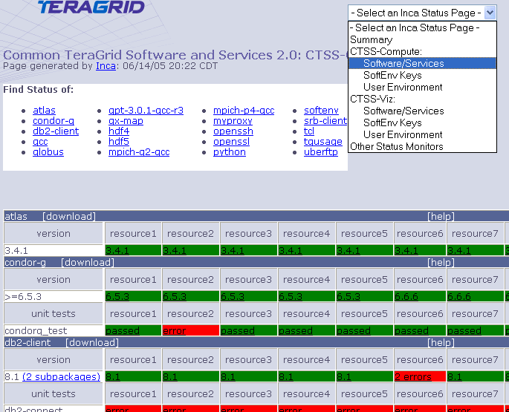
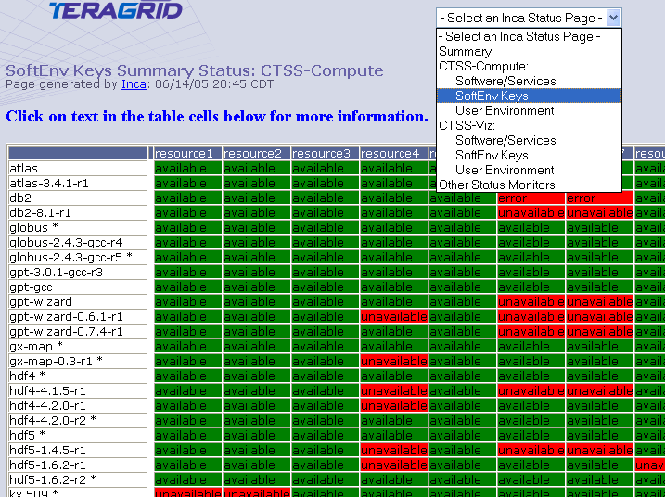
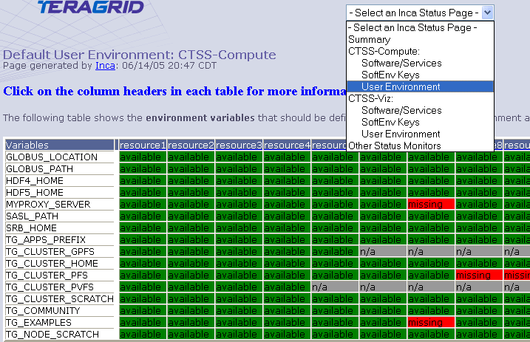
Detailed Status Views
Resources
SW
packages

Slide 4
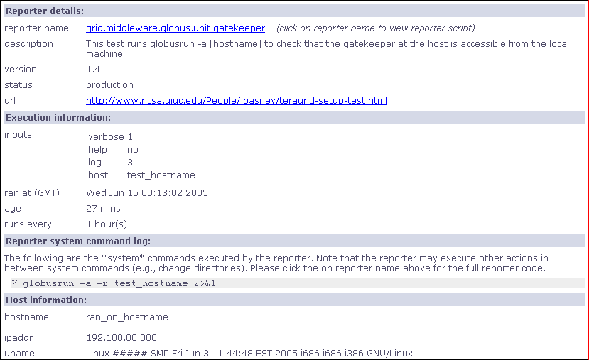
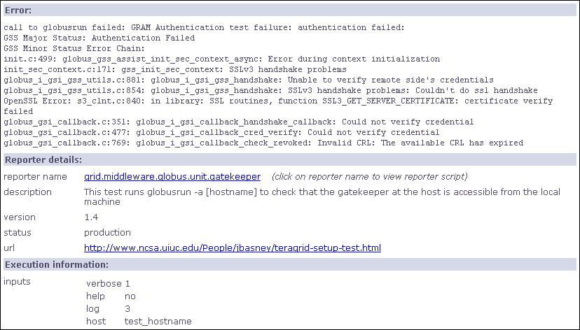
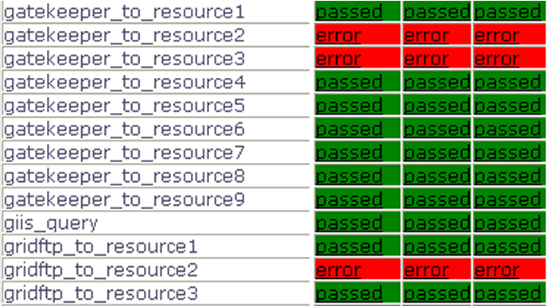
Drill-down capability

Slide 5
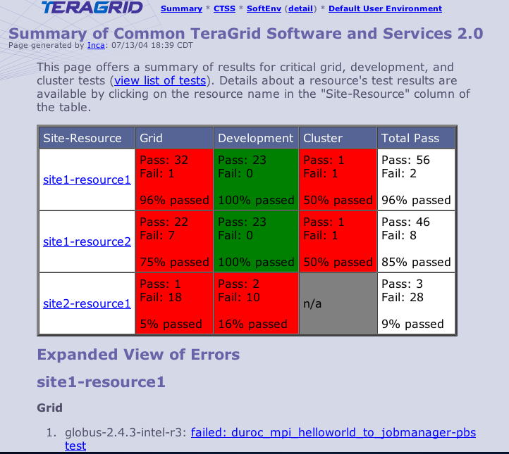
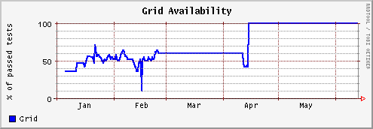
Summary Status
All tests passed: 100%
One or more tests failed: < 100%
Tests not applicable to machine or have not yet been ported
Key
History of percentage of tests passed in “Grid” category for a 6 month period

Slide 6
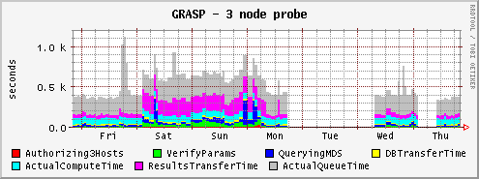
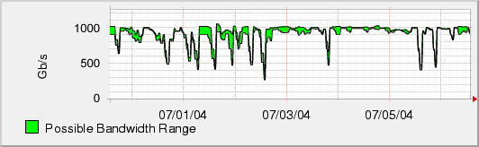
Measuring TeraGrid Performance
GRASP (Grid Assessment Probes)
  test and measure performance of basic grid functions
Pathload [Dovrolis et al]
  measures dynamic available bandwidth
  uses efficient and lightweight probes
1000
500
0

Slide 7
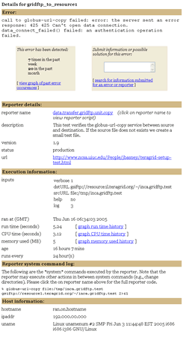
Add Interactive Reporter Details
View error
history
Submit information
or suggestions
View historical graphs
of run time, CPU time,
memory usage

Slide 8
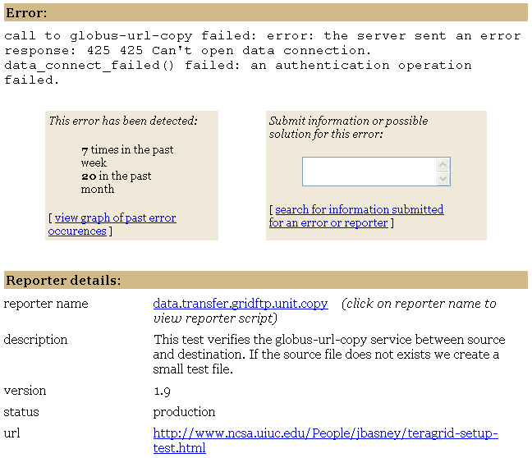
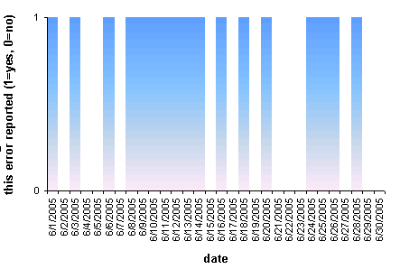
View Error History

Slide 9
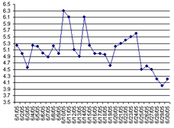
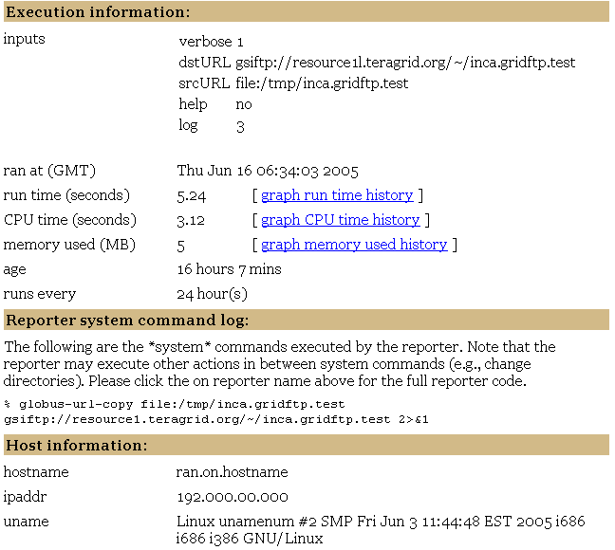
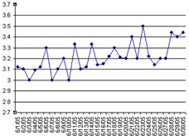
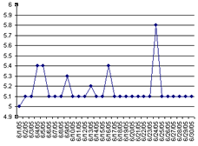
View Resource Usage

Slide 10
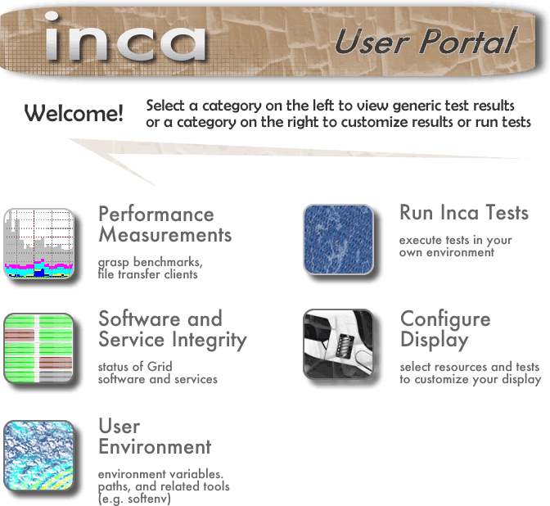
Customize for Users

Slide 11
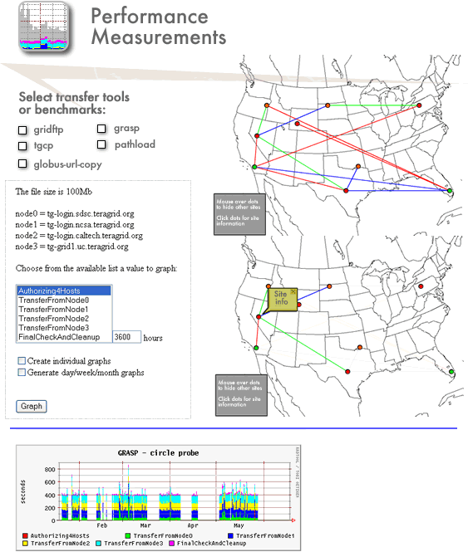

Slide 12
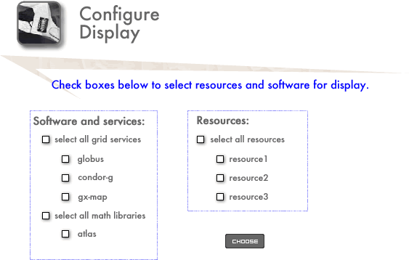


Configure and View
Generic Status Pages

Slide 13

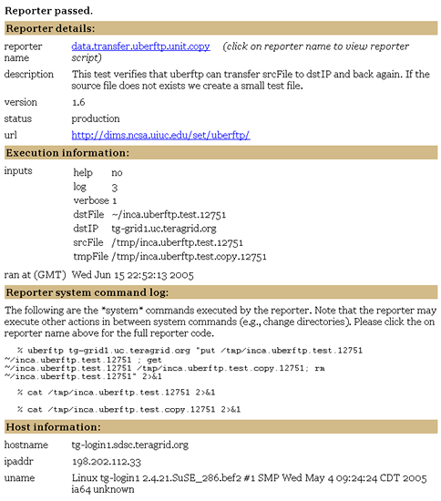
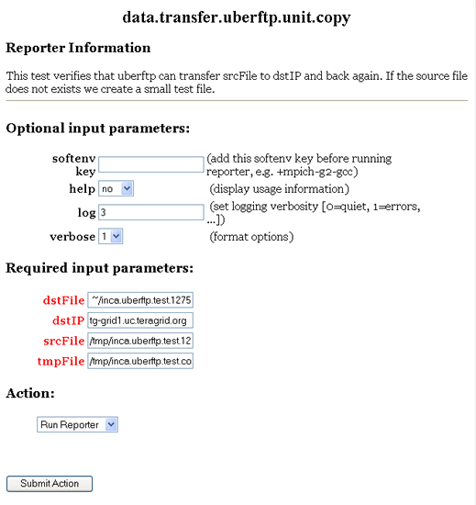
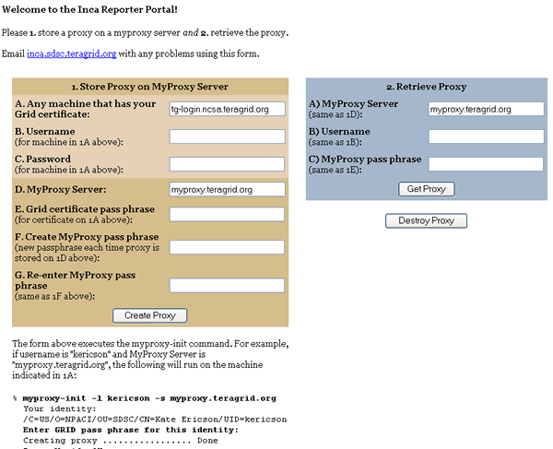
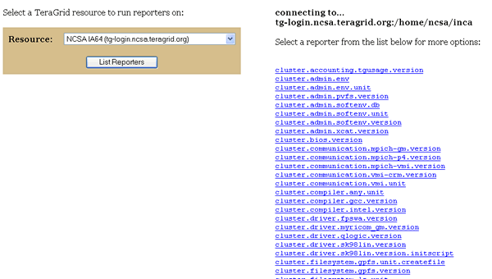

Slide 14
Integrate with Knowledge Base
Narrow down trouble area
Are you having problem(s) with:
Data
Job Management
Security
…
YES: Are you having trouble transferring a file?
YES: Are you seeing poor performance?
…
Narrow down set of reporters
Check to see if you have valid proxy
…
Reporters they can run
Search by Keywords:

