Slide 1
Working with Inca Reporters
Shava Smallen
ssmallen@sdsc.edu
Inca Workshop August 26, 2010

Slide 2
Outline
Reporter Definition
Using the Reporter Libraries
Reporters in an Inca Deployment
Meta-Reporters

Slide 3

Reporters Collect Monitoring Data
A Reporter is an executable program that measures some aspect of the system or installed software
Requirements:
Support four specific command-line options
Write XML (Inca Reporter schema) to stdout
Can be used outside of Inca
Notes:
Any language will do; library support for Perl/Python

Slide 4
Reporters Support Four Options
--help[=yes|no] If yes, reporter prints help, then exits
--version[=yes|no] If yes, reporter prints version, then exits
--log=0|1|2|3|4|error|warn|system|info|debug Selects log messages to include in output
--verbose=0|1|2 Output plain text or Inca Report XML
Notes:
Note single dash
Yes/no value optional--missing means yes
Semantics: -help=yes, -version=yes prints info only; -verbose=0 success/failure, logs; -verbose=1 XML; -verbose=2 extended XML; -log=0|1|2|3|4 cumulative messages; -log=error, etc. specific messages

Slide 5
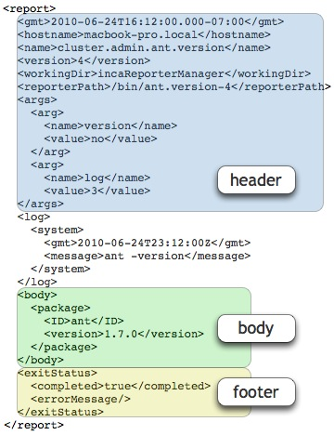
Reporters Output Inca Report XML
ISO8601 format
Optional <log> tag
Well-formed XML; otherwise unrestricted
Optional <help> tag
<errorMessage> tag on failure
Notes:
<help> used by automated tools (e.g., incpack)

Slide 6
<log> Tag Documents Reporter Execution
<log>
<system>
<gmt>2008-08-25T21:21:08Z</gmt>
<message>(gcc src471.c -o src471 &amp;&amp; ./src471)</message>
</system>
<system>
<gmt>2008-08-25T21:21:08Z</gmt>
<message>/bin/rm -f src471*</message>
</system>
</log>
Notes:
System log vs. info logs

Slide 7
<help> Tag Describes Reporter
<help>
<ID>help</ID>
<name>cluster.compiler.any.unit</name>
<version>2</version>
<description>Tests that a specified compiler compiles hello world</description>
<url>http://biokdd.informatics.indiana.edu/…</url>
<argDescription>
<ID>verbose</ID>
<accepted>[012]</accepted>
<description>verbosity level (0|1|2)</description>
<default>1</default>
</argDescription>
. . .
<dependency><ID>Inca::Reporter</ID></dependency>
<dependency><ID>Inca::Reporter::SimpleUnit</ID></dependency>
</help>

Slide 8
Outline
Reporter Definition
Using the Reporter Libraries
Reporters in an Inca Deployment
Meta-Reporters

Slide 9
Libraries Support Common Reporter Tasks
Documentation
http://inca.sdsc.edu/releases/latest/repdocs/perl.html
http://inca.sdsc.edu/releases/latest/repdocs/python.html
Reporter Purpose | Perl Library | Python Library
General report | Inca::Reporter | inca.Reporter
Software version testing | Inca::Reporter::Version | inca.VersionReporter
Software unit testing | Inca::Reporter::SimpleUnit | inca.SimpleUnitReporter
Globus unit testing | Inca::Reporter::GlobusUnit | inca.GlobusUnitReporter
System performance testing | Inca::Reporter::Performance | inca.PerformanceReporter

Slide 10
Reporter Library Implements Base Methods
Inca::Reporter inca.Reporter
Base class for all reporters
Handles command-line parsing
Provides interface for log message generation
Automates generation of Report header information--hostname, time, reporter name, etc.
Supports construction of XML for body
Directly used only by reporters that gather miscellaneous information--user environment, system CPU, etc.

Slide 11
An Example Base Reporter Body
<body>
<env>
<ID>env</ID>
<var>
<ID>HOME</ID>
<value>/Users/jhayes</value>
</var>
<var>
<ID>JAVA_HOME</ID>
<value>/Library/Java/Home</value>
</var>
<var>
<ID>PERL5LIB</ID>
<value>/sw/lib/perl5:/sw/lib/perl5/darwin</value>
</var>
</env>
</body>
ID/Value pairs

Slide 12
Perl Base Reporter Code
use Inca::Reporter;
my $reporter = new Inca::Reporter
(version => 3, description => 'Reports all environment settings');
$reporter->processArgv(@ARGV);
my @varXmls;
foreach my $line(split(/\n/, $reporter->loggedCommand('sh -c set'))) {
my ($var, $value) = $line =~ /(\w+)=(.*)/;
push(@varXmls,
$reporter->xmlElement('var', 0, $reporter->xmlElement('ID', 0, $var),
$reporter->xmlElement('value', 1, $value)));
}
$reporter->setBody(
$reporter->xmlElement('env', 0, $reporter->xmlElement('ID', 0, 'env'), @varXmls));
$reporter->setResult(1);
$reporter->print();

Slide 13
Python Base Reporter Code
import re; import sys; from inca.Reporter import Reporter
reporter = Reporter(version=3, description='Reports all environment settings')
reporter.processArgv(sys.argv[1:])
varXmls = []
for line in reporter.loggedCommandOutput('sh -c set').split('\n'):
parsed = re.match('(\w+)=(.*)', line)
varXmls.append(
reporter.xmlElement('var', 0, reporter.xmlElement('ID', 0, parsed.group(1)),
reporter.xmlElement('value', 1, parsed.group(2))))
reporter.setBody(
reporter.xmlElement('env', 0, reporter.xmlElement('ID', 0, 'env'), *varXmls))
reporter.setResult(1)
reporter.printReport()

Slide 14
Version Reporter Library
Inca::Reporter::Version inca.VersionReporter
Defines common <body> schema for version reporters
Supports subpackage versions
Automates common ways of determining version: gcc --dumpversion grep '#define PVFS_RELEASE_NR': $PVFS_HOME/include/pvfs_config.h gpt_query | grep '^condor.*version:'

Slide 15
A Typical Version Reporter Body
<body>
<package>
<ID>openssh</ID>
<version>3.6.1p1</version>
</package>
</body>
ID/Value pair
Notes:
Note ID/Value pair

Slide 16
Perl Version Reporter Code
use Inca::Reporter::Version;
my $reporter =
new Inca::Reporter::Version(package_name => 'openssh');
$reporter->addArg('ssh', 'ssh command', 'ssh');
$reporter->processArgv(@ARGV);
my $ssh = $reporter->argValue('ssh');
$reporter->setVersionByExecutable
("$ssh -V", 'OpenSSH_([\w\.]+)|GSI ([\w\.\-]+)');
$reporter->print();

Slide 17
Python Version Reporter Code
import sys; from inca.VersionReporter import VersionReporter
reporter = VersionReporter(package_name='openssh')
reporter.addArg('ssh', 'ssh command', 'ssh')
reporter.processArgv(sys.argv[1:])
ssh = reporter.argValue('ssh')
reporter.setVersionByExecutable(
ssh + ' -V', 'OpenSSH_([\w\.]+)|GSI ([\w\.\-]+)')
reporter.printReport()

Slide 18
SimpleUnit Library
Inca::Reporter::SimpleUnit inca.SimpleUnitReporter
Defines common <body> schema for unit test reporters
Tests functionality of libraries and applications
Reporter author determines definition of success
Provides methods for recording test success or failure

Slide 19
A Typical SimpleUnit Reporter Body
<body>
<unitTest>
<ID>posixps</ID>
</unitTest>
</body>

Slide 20
Perl SimpleUnit Reporter Code
use Inca::Reporter::SimpleUnit;
my $reporter = new Inca::Reporter::SimpleUnit(unit_name => 'posixps');
$reporter->processArgv(@ARGV);
my $output = $reporter->loggedCommand('ps -Af');
if($? == 0) {
$reporter->unitSuccess();
} else {
$reporter->unitFailure(output);
}
$reporter->print();

Slide 21
Python SimpleUnit Reporter Code
import sys; from inca.SimpleUnitReporter import SimpleUnitReporter
reporter = SimpleUnitReporter(unit_name='posixps')
reporter.processArgv(sys.argv[1:])
(status, output) = reporter.loggedCommandStatusOutput('ps -Af')
if status == 0:
reporter.unitSuccess()
else:
reporter.unitFailure(output)
reporter.printReport()

Slide 22
GlobusUnit Library
Inca::Reporter::GlobusUnit inca.GlobusUnitReporter
Extends SimpleUnit
Supports reporters that test Globus components
Provides methods for execution via Globus--submitJob and submitCSource

Slide 23
Performance Reporter Library
Inca::Reporter::Performance inca.PerformanceReporter
Defines common <body> schema for system/software performance metric reporters
Allows recording of a collection of benchmarks, each a set of parameters (name/value) and statistics (name/value/units)

Slide 24
A Typical Performance Reporter Body
<body>
<performance>
<ID>ping</ID>
<benchmark>
<ID>ping</ID>
<parameters><parameter>
<ID>host</ID>
<value>cuzco.sdsc.edu</value>
</parameter></parameters>
<statistics><statistic>
<ID>roundtrip</ID>
<value>11.3</value>
<units>ms</units>
</statistic></statistics>
</benchmark>
</performance>
</body>
<body>
<performance ID="ping">
<benchmark ID="ping">
<parameters host="cuzco.sdsc.edu"/>
<statistics roundtrip_ms=”11.3"/>
</benchmark>
</performance>
</body>
New in 2.6 – short format option

Slide 25
Perl Performance Reporter Code
use Inca::Reporter::Performance;
my $reporter = new Inca::Reporter::Performance(measurement_name => 'ping');
$reporter->addArg('host', 'target host');
$reporter->processArgv(@ARGV);
my $host = $reporter->argValue('host');
if(!open(INPUT, "ping $host|")) {
$reporter->setResult(0, 'ping not available');
} else {
my $line = <INPUT>; $line = <INPUT>;
if($line =~ /time *= *([\d.]+) *(\S*)/) {
my $benchmark = $reporter->addNewBenchmark('ping');
$benchmark->setParameter('host', $host);
$benchmark->setStatistic('round_trip', $1, $2);
$reporter->setCompleted(1);
}
}
$reporter->print();

Slide 26
Python Performance Reporter Code
import os; import popen2; import re; import sys
from inca.PerformanceReporter import PerformanceReporter
reporter = PerformanceReporter(measurement_name='ping')
reporter.addArg('host', 'target host')
reporter.processArgv(sys.argv[1:])
host = reporter.argValue('host')
try:
child = popen2.Popen3('ping ' + host)
line = child.fromchild.readline(); line = child.fromchild.readline()
parsed = re.search('time *= *([\d.]+) *(\S*)', line)
benchmark = reporter.addNewBenchmark('ping')
benchmark.setParameter('host', host)
benchmark.setStatistic('round_trip', parsed.group(1), parsed.group(2))
os.kill(child.pid, 9); child.wait()
reporter.setCompleted(1)
except IOError:
reporter.setResult(0, 'ping not available')
reporter.printReport()

Slide 27
Outline
Reporter Definition
Using the Reporter Libraries
Reporters in an Inca Deployment
Meta-Reporters

Slide 28
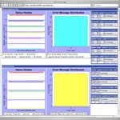
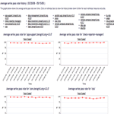
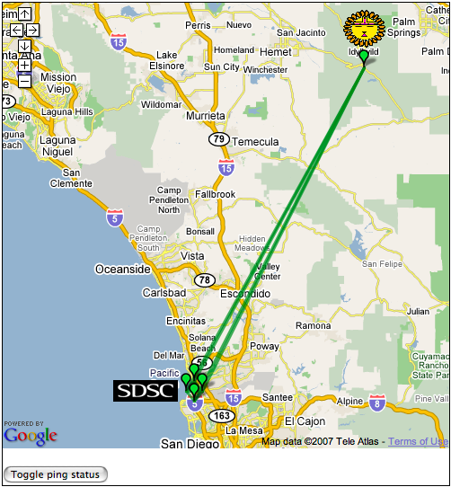
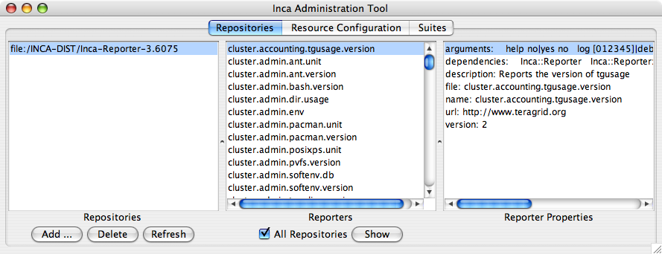

Agent and Managers Work With Reporters
Reporter
Repository
Data Consumers
R
Incat
C
Agent
Depot
S
Agent forwards reporters from Repositories to Reporter Managers
Managers run Reporters as per administrator’s schedule and send output and meta-data to Depot
S
r
S
R
r
R
Reporter
Manager
Reporter
Manager
…
Grid Resource
Grid Resource
Notes:
Meta-data: resource usage, stderr

Slide 29
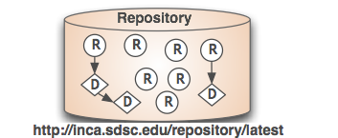
Reporter Repositories Publish Reporters
Collection of files made available via a URL
Inca knows how to handle Reporters, Perl/Python modules, .tar.gz packages
Inca standard repository (http://inca.sdsc.edu/repository/latest) contains Reporter libraries and 199 reporters: 96 version, 87 unit, 16 general
Packages.gz catalog of repository contents allows automated retrieval and update

Slide 30
Packages.gz Lists Reporter Attributes
arguments:
help no|yes no
host .*
log [012345]|debug|error|info|system|warn 0
verbose [012] 1
version no|yes no
dependencies:
Inca::Reporter
Inca::Reporter::Performance
Inca::Reporter::Performance::Benchmark
name: grid.benchmark.performance.ping
file: bin/grid.benchmark.performance.ping
description: Reports the ping time to a given host
url: http://inca.ucsd.edu
version: 2
arguments:
help no|yes no
log [012345]|debug|error|info|system|warn 0
verbose [012] 1
version no|yes no
dependencies:
Inca::Reporter
Inca::Reporter::Version
description: Reports the version of tgresid
file: bin/cluster.admin.tgresid.version
name: cluster.admin.tgresid.version
version: 3
arguments:
help no|yes no
log [012345]|debug|error|info|system|warn 0
verbose [012] 1
version no|yes no
dependencies:
Inca::Reporter
description: Reports top non-root CPU % process
file: bin/cluster.admin.topcpu
name: cluster.admin.topcpu
url: http://inca.sdsc.edu
version: 3
arguments:
dir .*
help no|yes no
log [012345]|debug|error|info|system|warn 0
verbose [012] 1
version no|yes no
dependencies:
Inca::Reporter
Inca::Reporter::Version
description: Reports the version of xcat
file: bin/cluster.admin.xcat.version
name: cluster.admin.xcat.version
url: http://www.suse.org
version: 2`

Slide 31
incpack Tool Edits Packages.gz
incpack [-I path …] [-X] path [[-X] path …]
Creates or appends to Packages.gz by running reporters and reading .attrib files
-I -- include library for running reporters
-X -- exclude path (e.g., test directory) from catalog
E.g.,
% incpack –I lib/perl bin/cluster.compiler.gcc.version

Slide 32
Reporters Can Require Other Packages
Reporter addDependency method notes that a Reporter needs another package to run
Required package must be in Reporter Repository
Agent forwards package to Manager, which builds it via, e.g., configure/make
Reporter dependency on GridProxy pseudo-package indicates that it requires a credential to run
Examples:
$reporter->addDependency('Date::Manip');
$reporter->addDependency('sampleGridJob');
$reporter->addDependency('Inca::Reporter::GridProxy');
Notes:
Requirements w/requirements also work

Slide 33
Multiple package formats supported for dependencies
Must be a tar.gz
Installed in $RM_DIST/var/reporter-packages
Standard
Perl
Autoconf
configure –prefix=…
make
make install
Make
make INSTALL_DIR=…
make install
ExtUtils::MakeMaker
perl Makefile.PL …
make
make install
Module::Build
perl Build.PL …
perl Build
perl Build install

Slide 34
Dependencies require an .attrib file
name: Date::Manip
version: 5.54
description: Collection of date manipulation functions
url: http://search.cpan.org/~sbeck/DateManip-5.44
file: DateManip-5.44.tar.gz
dependencies:
Describes the dependency (tar.gz.attrib)
E.g.,
% incpack share/DateManip-5.44.tar.gz

Slide 35
Outline
Reporter Definition
Using the Reporter Libraries
Reporters in an Inca Deployment
Meta-Reporters

Slide 36
Special Reporter Submits to Batch Queues
cluster.batch.wrapper reports queue wait time or output of a specified reporter
Supports cobalt, dql, loadleveler, lsf, pub, sge
Batch-specific arguments --account, --nodes, --queue, etc.
Example:
cluster.batch.wrapper \
--scheduler=pbs --account=alf63 \
--exec='cluster.compiler.gcc.version'

Slide 37
Summary Reporters Analyze Series
New class of reporters to analyze series history and combine series
Get series data using Inca REST API
Example: summary.successpct.performance reports collective success % of multiple series

Slide 38
An Example Summary Reporter Body
<body>
<performance xmlns:rep='http://inca.sdsc.edu/dataModel/report_2.1'>
<ID>successpct</ID>
<benchmark>
<ID>successpct</ID>
<parameters>
<parameter><ID>filter</ID><value>all2all:gsissh_to_.*</value></parameter>
…
</parameters>
<statistics>
<statistic><ID>all2all:gsissh_to_bg-login1.sdsc.teragrid.org-fail</ID><value>1</value></statistic>
<statistic><ID>all2all:gsissh_to_bg-login1.sdsc.teragrid.org-pct</ID><value>94</value></statistic>
<statistic><ID>all2all:gsissh_to_bg-login1.sdsc.teragrid.org-success</ID><value>18</value></statistic>
…
</statistics>
</benchmark>
</performance>
</body>

Slide 39
Summary
Flexible schema allows multiple types of data can be reported using Inca reporters
Perl and Python APIs ease the process of writing reporters
Reporter and dependencies are published in a repository and automatically deployed by Inca servers
Meta-reporters allow batch mode execution and summaries

Slide 40
Agenda -- Day 1
9:00 - 10:00 | Inca overview
10:00 - 11:00 | Working with Inca Reporters
11:15 - 12:00 | Hands-on: Reporter API and Repository
1:00 - 2:00 | Inca Control Infrastructure
2:00 - 3:00 | Administering Inca with incat
3:15 - 4:00 | Hands-on: Inca deployment (part 1)
Notes:
Check syncs with website

Slide 41
Onto the Tutorial …

