Slide 1
test harness and reporting framework
Shava Smallen
San Diego Supercomputer Center
Grid Performance Workshop
6/22/05

Slide 2
Is the Grid Up?
Can user X run application[s] Y on Grid[s] Z? Access dataset[s] N?
  Are dataset[s] N accessible to user X? Credentials?
  Is there sufficient space to store output data?
  Are Grid services the application[s] use available? Compatible versions?
  …
Community of users (VO)?
Multiple communities of users?

Slide 3
Testing a Grid
If you can define “Grid up” in a machine-readable format, you can test it
User documentation, users, mgmt
Develop and optimize code at Caltech
Run large job at SDSC, store data using SRB.
Run large job at NCSA, move data from SRB to local scratch and store results in SRB
Run larger job using both SDSC and PSC systems together, move data from SRB to local scratch storing results in SRB
Move small output set from SRB to ANL cluster, do visualization experiments, render small sample, store results in SRB
Move large output data set from SRB to remote-access storage cache at SDSC, render using ANL hardware, store results in SRB
Grid up example

Slide 4

What type of testing?
Deployment testing
  Automated, continuous checking of Grid services, software, and environment
  Installed? Running? Configured correctly? Accessible to users? Acceptable performance?
  E.g., gatekeeper ping or scaled down application
Junit,
PyUnit, Tinderbox
Software Package
(unit, integrated)
Software Stack
(interoperability)
NMI
Software
Deployment

Slide 5
Who tests?
Grid/VO Management
  Run from default user account
  Goal: user-level problems detected & fixed before users notice
  Results available to users
User-specific
  Debug user account/environment issues
  Advanced usage: feedback tests
Notes:
Comment: user testing is independent of system testing,
Reporters run independently from the framework

Slide 6
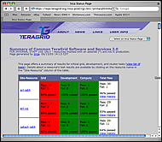
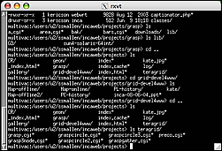
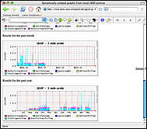
Inca
Framework for the automated testing, benchmarking and monitoring of Grid systems
  Schedule execution of information gathering scripts (reporters)
  Collect, archive, publish, and display results
Inca
Server
Inca
Client
Inca
Client
Inca
Client
…
Resource N
Resource 1
Resource 2

Slide 7
Outline
Introduction
Inca architecture
Case study: V&V on TeraGrid
Current and Future Work
Feedback

Slide 8
Inca Reporters
Self-contained script or executable that outputs XML conforming to Inca specification
Context of execution is required - important for repeatability
  What commands were run?
  What machine?
  What inputs?
Communicate more than pass/fail
  Body XML can be reporter specific - flexibility
  E.g., package version info (software stack availability)
  E.g., SRB throughput (Unusual drop in SRB performance)
Users can run it independently of framework
What time?
What result?

Slide 9
Reporter Execution Framework
How often should reporters run
  Boot-time, every hour, every day?
Modes of execution:
  One shot mode:
    boot-time, after a maintenance cycle, user checking their specific setup
  Continuous mode: cron scheduling
Data can be queried from a web service and displayed in a web page

Slide 10
Outline
Introduction
Inca architecture
Case study: V&V on TeraGrid
Current and Future Work
Feedback

Slide 11
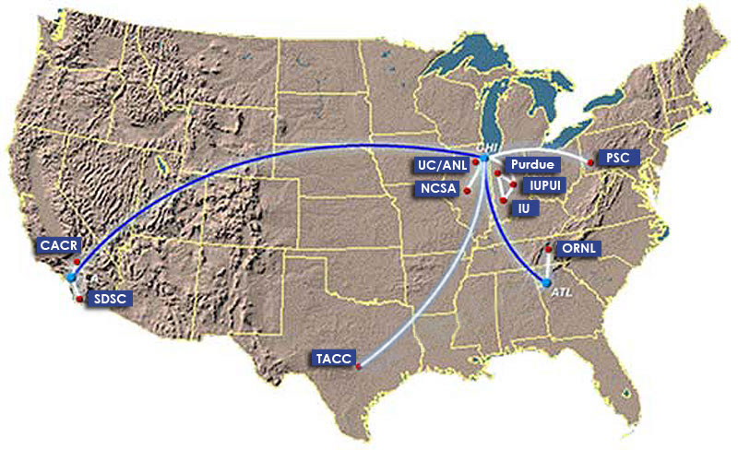
TeraGrid
TeraGrid - an “enabling cyberinfrastructure” for scientific research
  ANL, Caltech, Indiana Univ., NCSA, ORNL, PSC, Purdue Univ., SDSC, TACC
  40+ TF, 1+ PB, 40Gb/s net
Common TeraGrid Software & Services
  Common user environment across heterogeneous resources
  TeraGrid VO service agreement

Slide 12

Validation & Verification
Common software stack:
  20 core packages: Globus, SRB, Condor-G, MPICH-G2, OpenSSH, SoftEnv, etc.
  9 viz package/builds: Chromium, ImageMagick, Mesa, VTK, NetPBM, etc.
  21 IA-64/Intel/Linux packages: glibc, GPFS, PVFS, OpenPBS, intel compilers, etc.
50 version reporters: compatible versions of SW
123 tests/resource: package functionality
  Services: Globus GRAM, GridFTP, MDS, SRB, DB2, MyProxy, OpenSSH
  Cross-site: Globus GRAM, GridFTP, OpenSSH
Notes:
34 unit reporters run 123 unit tests per resource

Slide 13
Validation & Verification (cont.)
Common user environment
  $TG_CLUSTER_SCRATCH, $TG_APPS_PREFIX, etc.
  SoftEnv configuration - manipulate user environment
Verify environment vars defined in default environment
Verify Softenv keys defined consistently across sites

Slide 14
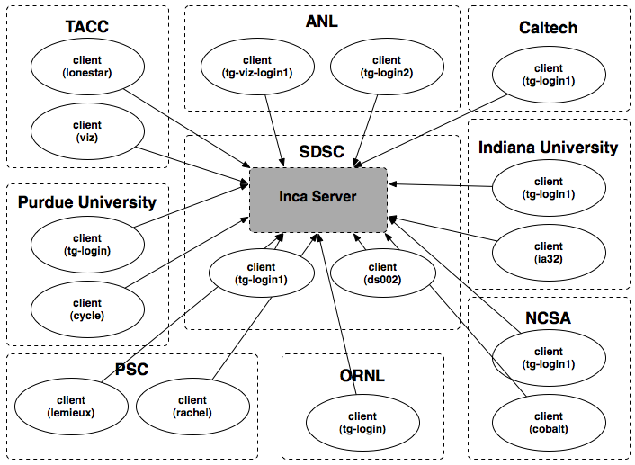
Inca deployment on TeraGrid
9 sites/16 resources
Run under user account inca

Slide 15
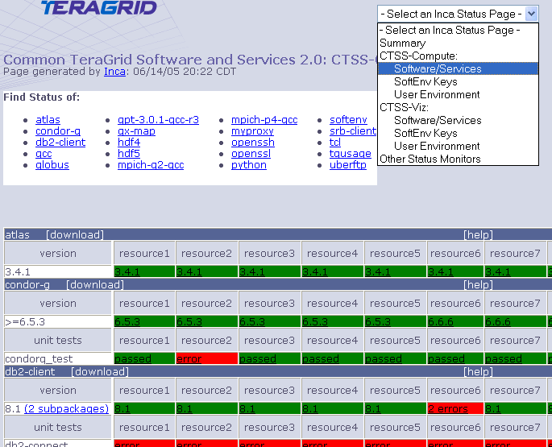
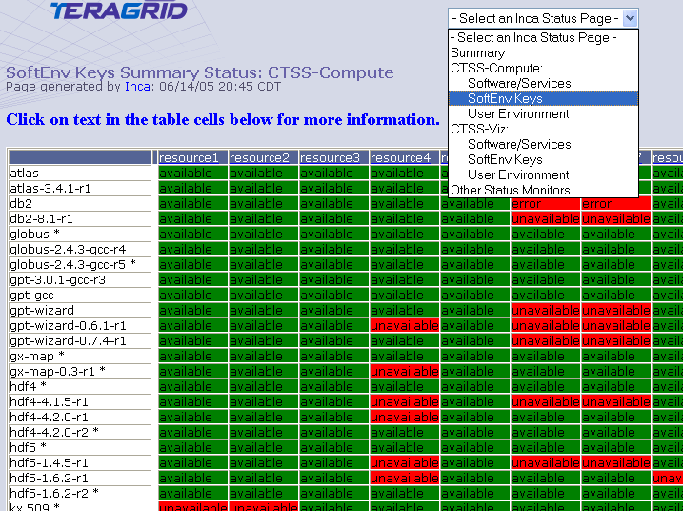
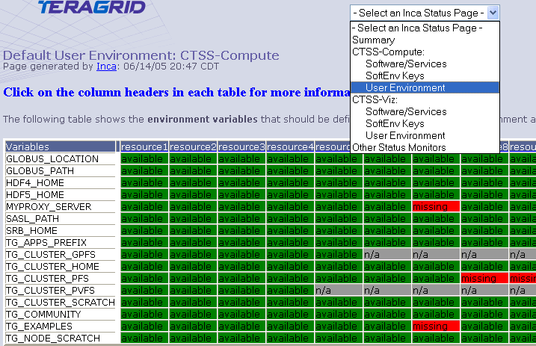
Detailed Status Views
Resources
SW
packages

Slide 16
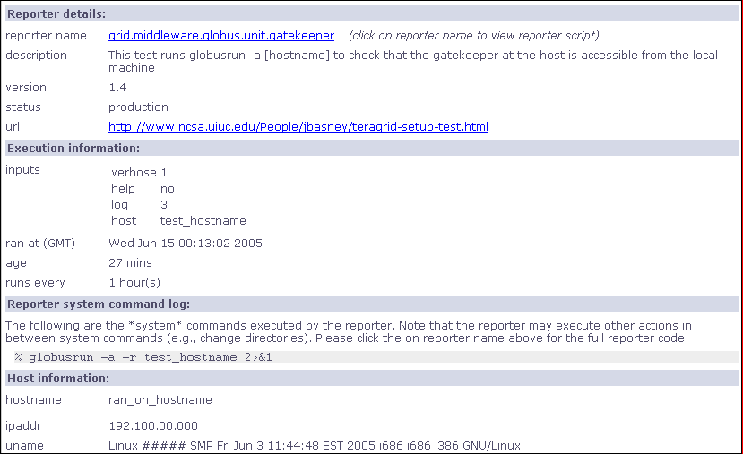
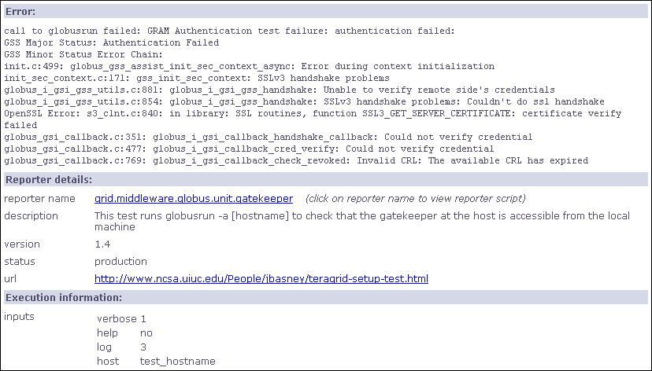
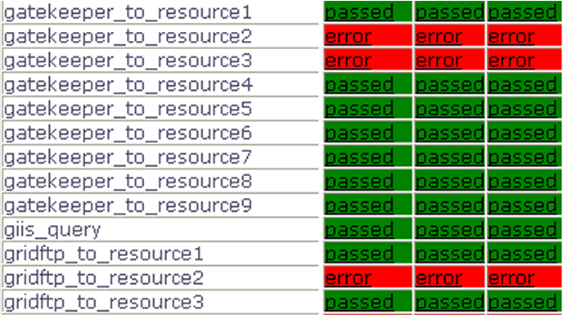
Drill-down capability

Slide 17
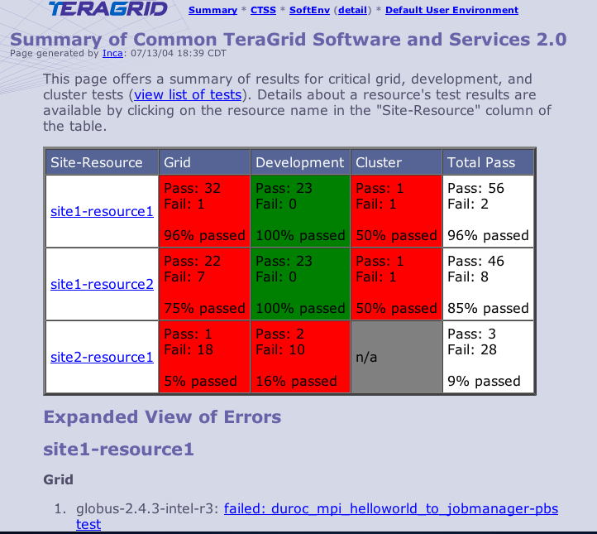
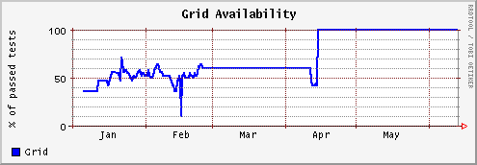
Summary Status
All tests passed: 100%
One or more tests failed: < 100%
Tests not applicable to machine or have not yet been ported
Key
History of percentage of tests passed in “Grid” category for a 6 month period

Slide 18
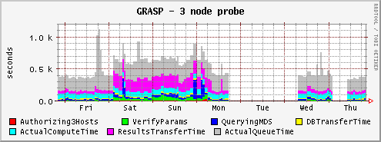
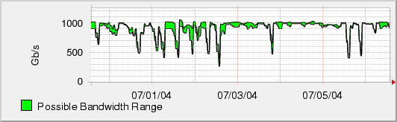
Measuring TeraGrid Performance
GRASP (Grid Assessment Probes)
  test and measure performance of basic grid functions
Pathload [Dovrolis et al]
  measures dynamic available bandwidth
  uses efficient and lightweight probes
1000
500
0

Slide 19
Lessons learned
Initially focused on system administrative view
Moving towards user-centric view
  File transfer functionality and performance
  File system availability
  Job submission
  SRB performance
  Interconnect bandwidth
  Applications: NAMD, AWM

Slide 20
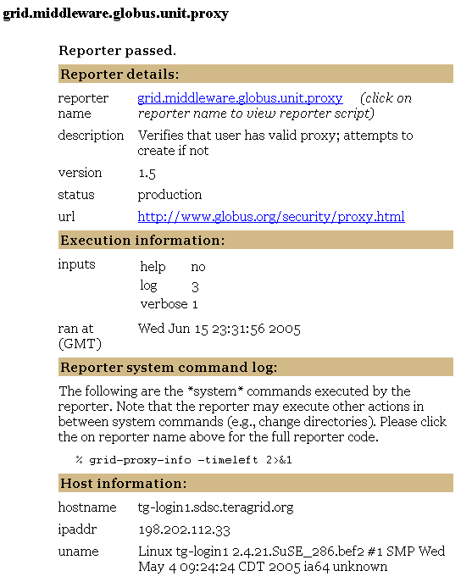
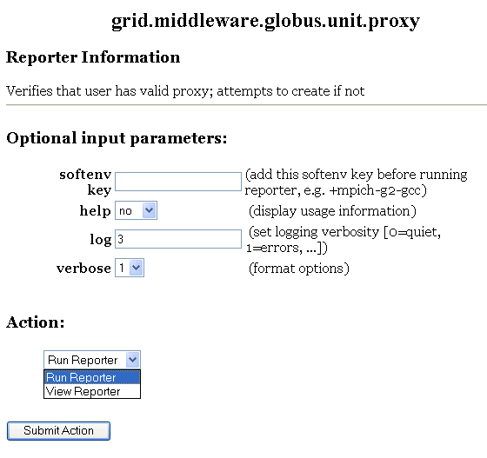
Integration with Knowledge Base
Narrow down trouble area
Are you having problem(s) with:
Data
Job Management
Security
…
YES: Are you having trouble transferring a file?
YES: Are you seeing poor performance?
…
Narrow down set of reporters
Check to see if you have valid proxy
…
Reporters they can run

Slide 21
Outline
Introduction
Inca architecture
Case study: V&V on TeraGrid
Current and Future Work
Feedback

Slide 22





Inca Today
Software available at:
http://inca.sdsc.edu
Current version: 0.10.3
Also available in NMI R7
Users:

Slide 23
Inca 2.0
Initial version of Inca focused on basic functionality
New features:
  Improved storage & archiving capabilities
  Scalability - control and data storage
  Usability - improved installation and configuration control
  Performance - self-monitoring
  Security - SSL, proxy delegation
  Condor integration
Release in 3-6 months

Slide 24
Outline
Introduction
Inca architecture
Case study: V&V on TeraGrid
Current and Future Work
Feedback

Slide 25
Summary
Inca is a framework that provides automated testing, benchmarking, and monitoring
  Grid-level execution to detect problems and report to system administrators
  Users can view status pages and compare to problems they see
  Users can run tests as themselves to debug account/environment problems
    Working to integrate this into a portal/knowledge base
Currently in-use for TeraGrid V&V, GEON, and others

Slide 26
Feedback
How are you monitoring your Grid infrastructure?
What do you need to test?
What diagnostic/debugging tools are available to users?
Displaying test results to users? In what format? How much detail?
Notes:
How tightly managed is the software?
Resource usage vs. update frequency?

Slide 27
More Information
http://inca.sdsc.edu
Current Inca version: 0.10.3
New version in 3-6 months
Email:
ssmallen@sdsc.edu

Slide 28
Related Work
Service Reliability - Globus GRAM Gatekeeper, GSI-SSH, SRB servers, etc.
  NCSA TestGrid Project
Ganglia, CluMon, etc.
MonaLisa
Hawkeye

Slide 29
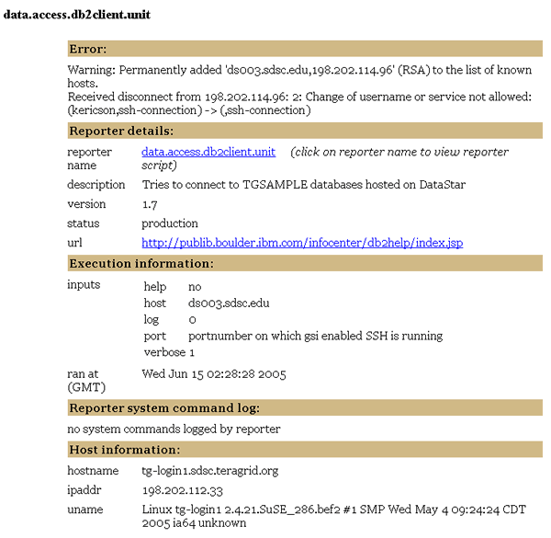
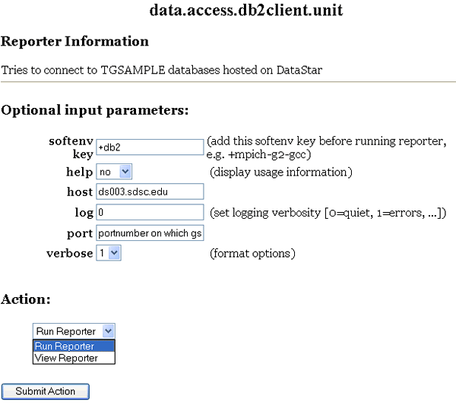
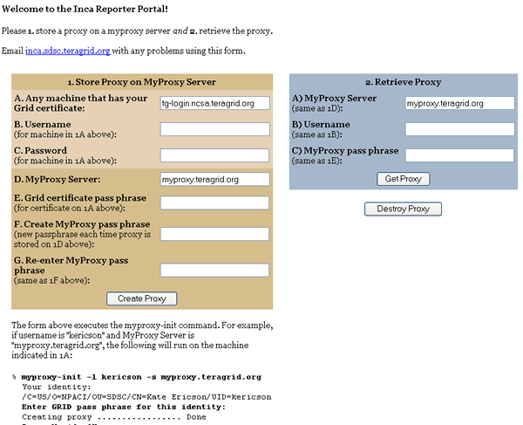
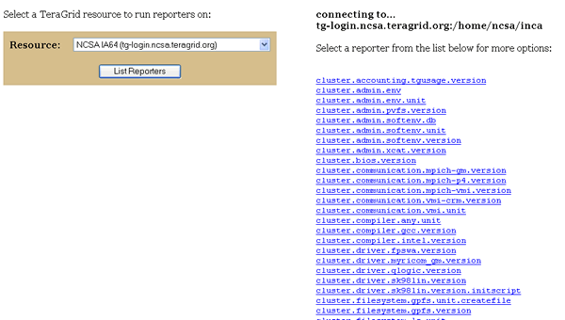
Run Reporters as UserX

