Slide 1
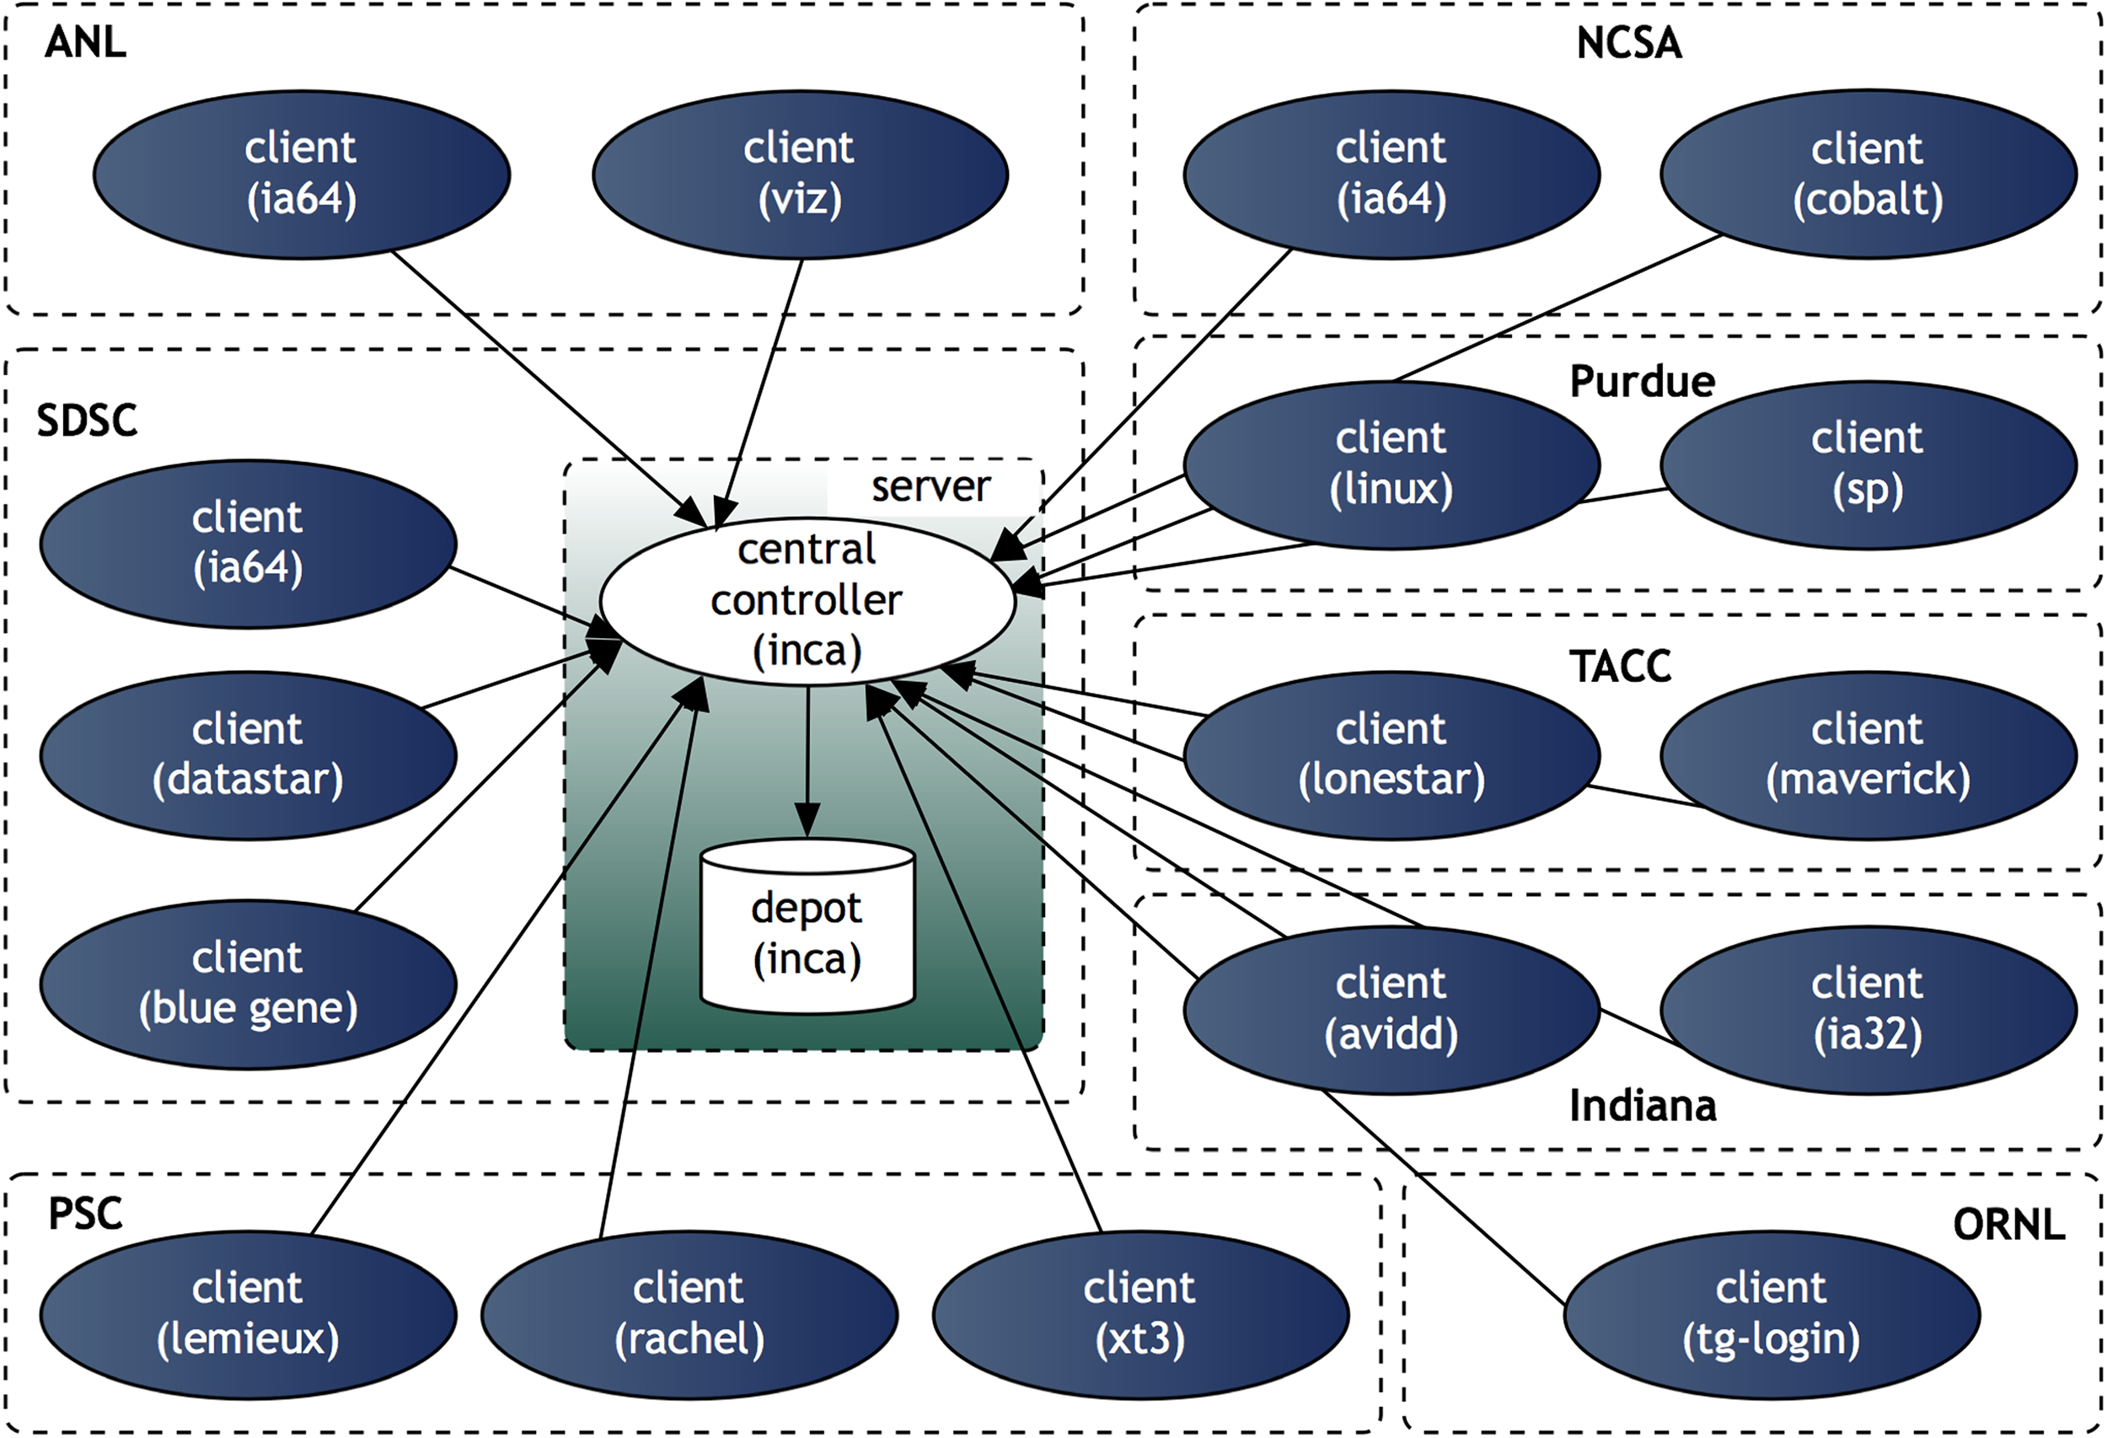
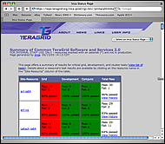
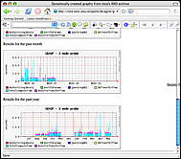
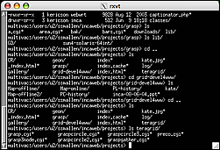


INCA
http://tech.teragrid.org/inca
Inca is a flexible framework for the automated testing, benchmarking and monitoring of Grid systems.
Inca
Server
Inca
Client
Inca
Client
Inca
Client
Deployment of Inca on TeraGrid (November 2005)
…
Resource 1 … Resource n
Contacts: Kate Ericson, kericson@sdsc.edu, SDSC
Shava Smallen, ssmallen@sdsc.edu, SDSC

