Slide 1

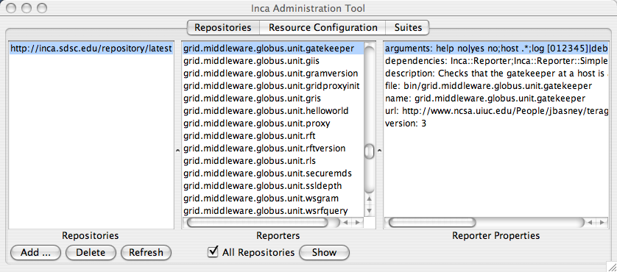
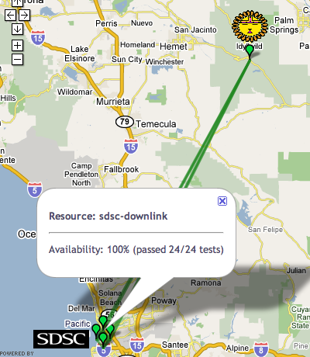
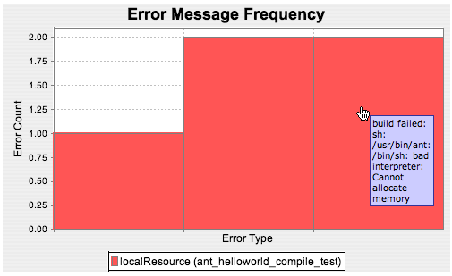
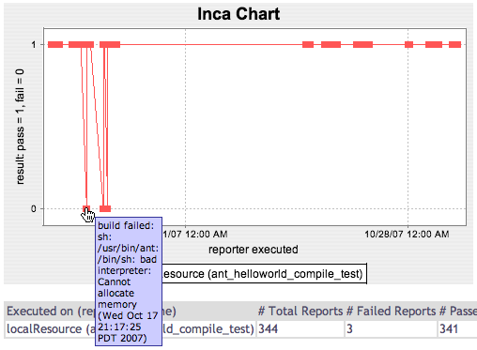
User-level Grid monitoring and performance measurement
Easy to customize, deploy, and maintain
Displays current resource summary status and test details
Provides test history and statistics
Version 2.2 now available.
For more information, visit http://inca.sdsc.edu.

