Slide 1
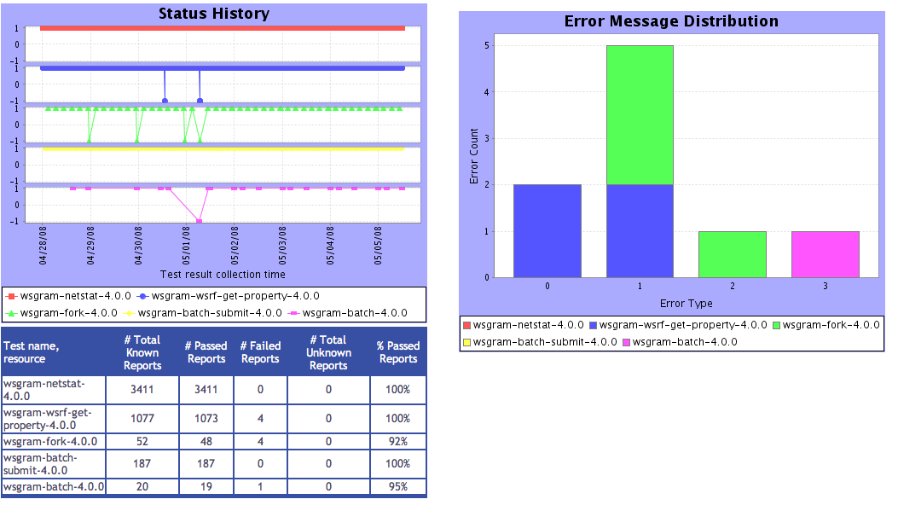
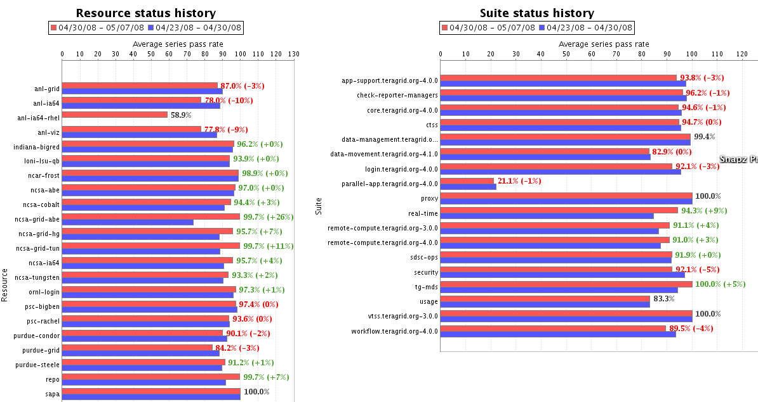
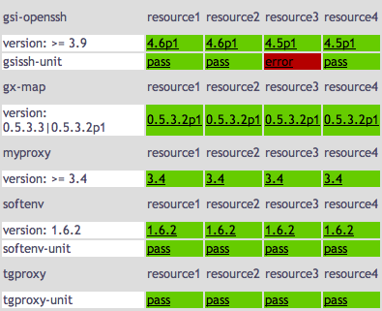
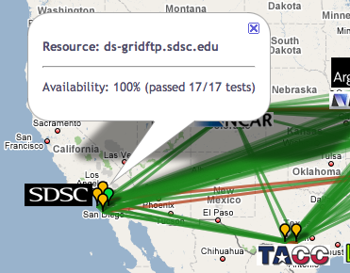

Inca: Verification & Validation
Running on TeraGrid since 2003
External verification of IIS published information through automated, user-level testing
Total of ~2200 tests running on 18 login nodes, 2 grid nodes, and 3 servers
Email notifications for critical services
Status views from detailed test information to summary and historical reports
Data published as XML and translated to HTML using XSLT or graphed using JFreeChart
REST interfaces to view status information in XML or HTML
info.teragrid.org
XSL
XML
CTSS kit
registrations
http://inca.teragrid.org/

