Slide 1

Monitoring User-Level Grid Functionality and Performance using
Shava Smallen
ssmallen@sdsc.edu
SC’07 - November 13, 2007
Notes:
Tool for monitoring Grids. Inca is a tool that was originally developed for the TeraGrid project and served as a motivation for our work.
Audience: current and potential users
* current - what’s new
* potential users - what is it and why use it (easy, robust, and

Slide 2
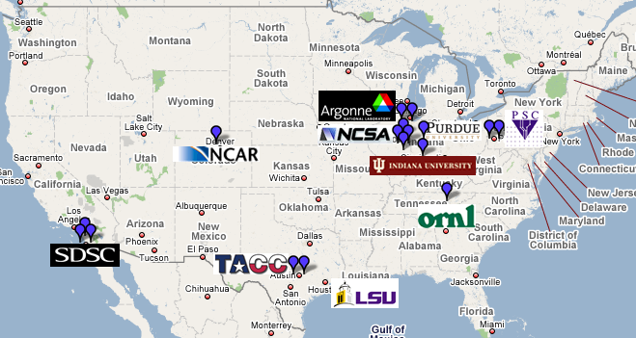

Motivation: Monitoring TeraGrid
Over 250 TF
Over 30 PB of online and archival data storage
Connected via dedicated multi-Gbps links
10 TeraGrid sites, 17 resources
Monitor the deployments of CTSS (Coordinated TeraGrid Software & Services)
Notes:
Motivation for work was TeraGrid
TeraGrid serves a general user community and there are various levels of users that it supports. Many users log into resources directly from any of the 9 sites while others access TG via a science gateway portal. One of its TeraGrid’s activities in order to support and encourage the execution of Grid applications is to provide a coordinated user environment known as CTSS. This was so developers and users could focus their effort of porting their Grid applications to machine architecture differences rather than the middleware.
When CTSS was first deployed, there were many inconsistencies between sites due to misunderstandings of the specifications or misconfigurations of the software itself. These inconsistencies along with software failures in general is something we wanted to monitor in order to provide a stable environment to users.
These days the software stack is modularilzed into capability kits (core, data, compute, etc.) and therefore provides sites with more flexiibility in what they decide to deploy (ie.g., somebody could decide to support the data transfer kit but not the scientific workflow kit).
Now initially, one of the biggest problems when CTSS was first deployed back in 2003 was that deploying a common user environment was very difficult because there is no universal deployment system. Each site individually built and configured the packages of a software stack which resulted in either things not working at all or
These days the builds and deployments are a lot more automated but the problem still exists because not everything is and can be automated and many inconsistencies can arise.

Slide 3
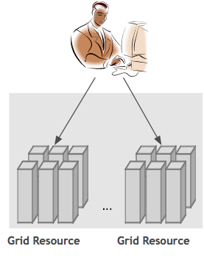
User-level Grid monitoring
Runs from a standard user account
Executes using a standard GSI credential
Uses tests that are developed and configured based on user documentation
Centrally manages monitoring configuration
Automates periodic execution of tests
Verifies user-accessible Grid access points
Easily updates and maintains monitoring deployment
Notes:
Detect and fix Grid infrastructure problems before the user’s notice them by monitoring from a generic, impartial user’s perspective.
The approach we’ve developed over the years to address this is an active monitoring approach that we call user-level monitoring and the idea is that to attempt to emulate a user of the Grid and test the various services and software. In order to provide user-level monitoring a system would need to…
First testing should be done from a standard user account that’s no different than what a new user of a Grid receives. Early on, we found that testing was done from sys admin accounts which oftentimes have special privileges and have custom shell initialization file. So when users logged on to the system, things would not work for them due to permission problems, environment variables, etc.
Second, because many Grid services require a valid GSI credential, testing needed be run with a standard GSI credential that was mapped on resources to our standard user account
Third we really try to develop the tests that are meaningful and as such are based on the commands written in the user documentation because that is what user’s will using. Likewise, all our tests are configured using data from the user documentation. In practice, this is sometimes difficult to achieve because management asks you to test before user documentation is available. But these should be closely coordinated activities. This provides some checks and balances for cases when sysadmins change something but forget to notify user documentation. This helps to ensure that user documentation is correct. And so what we have now in TeraGrid is pulling data from the same source (MDS4). While we do have a number of tests for TeraGrid, we don’t have tests for everything and a lot of that is just getting the time to write them and there are a course load issues when you use active monitoring. But you want to shoot for a representative number of tests and that can often be accomplished by ensuring testing the commands in the user documentation are tested and having one basic test for each software component.
Fourth, is that rather than allowing each sites to configure tests for their resources, the configuration of tests is done centrally and the goal of that is to ensure that resources are being tested consistently across TeraGrid. So, for example sometimes sysadmins will “fix” a test so that it passes for that site but their fix is actually a misunderstanding of the deployment requirements.
Next, as you know, it is important to execute tests periodically because the Grid is so dynamic. And as such, archiving those results will help us understand the Grid behavior over time.
Fifth, due to the dynamic nature of the Grid, it is important for a system to be able to adapt to changes when new versions of software are installed and updated. Another difficulty we’ve encountered is writing tests perfectly the first time around. And the reason for that is the same as writing a Grid application, you have to worry about bugs, porting issues and ensuring that the test is testing the right thing…sometimes we discover bugs in the user documentation
Last, in TeraGrid, a user can log in from any of the 9 sites so has been important for us to run locally on each resource and verify that CTSS is available, there and working, etc.

Slide 4
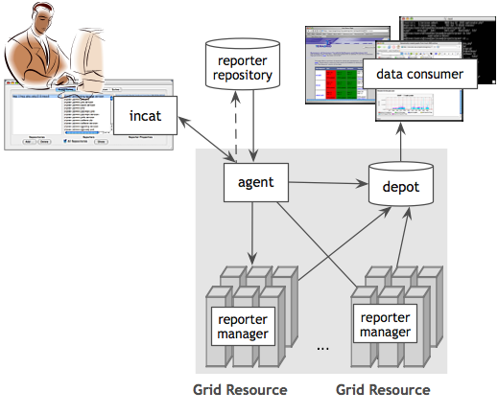
Additional Features of Inca
Stores and archives a wide variety of monitoring results
Captures context of
monitoring result as it executes
Eases the writing, deploying, and sharing of new tests or benchmarks
Securely manages short-term proxies
Notes:
Mention in future work automatically tune frequency based on impact and past history

Slide 5
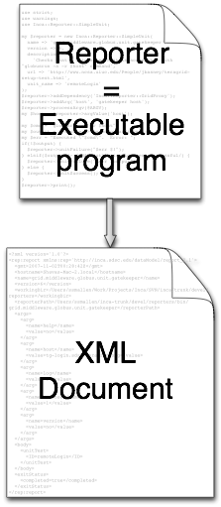
Reporters Collect Monitoring Data
Executable programs that measure some aspect of the system or installed software
Supports a set of command-line options and writes XML to stdout
Supports multiple types of data
Extensive library support for perl scripts (most reporters < 30 lines of code)
Independent of other Inca components
Notes:
Examples of reporters
More than pass/fail information, e.g., gridftp, uptime
Our method of collecting monitoring data from resources is via an executable called a reporter.
The only requirements is that it supports some specific command-line options like help and verbose and that it outputs the result to stdout in XML that complies to a specific schema.
The schema is flexible to allow multiple types of data to be expressed. It really is just some header and footer tags and then any snippet of xml can be placed in the middle.
We also want these reporters to be easy to write so we provide a number of Perl APIs to make it easy to write tests. These APIs take care of the formatting of data in the Inca reporter XML and a number of convenience functions for cleaning up temporary files and timing out system commands. There are also some logging functions which can be useful for showing what commands a reporter executes so for sysadmins who don’t want to read a perl script.
It is also independent of the other Inca components so for example sys admins can execute the usually script by hand while they’re debugging a problem.

Slide 6
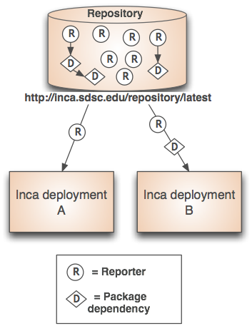
Benefits of Reporter Repositories
Collection of reporters available via a URL
Shared across Inca deployments
Supports package dependencies
Packages versioned to allow for automatic updates
Inca project repository contains 157 reporters
  Version, unit test, performance benchmark reporters
  Grid middleware and tools, compilers, math libraries, data tools, and viz tool

Slide 7
Agent Provides Centralized Configuration and Deployment
Implements the configuration specified by Inca administrator
Stages and launches a reporter manager on each resource
Sends package and configuration updates
Has GUI interface to agent called incat
Screenshot of Inca GUI tool, incat, showing the reporters that are available from a local repository
Notes:
Centralized admin
Gui interface
Configure the reporters to execute on a set of resources
Configuration stored in a XML file and sent to Agent

Slide 8
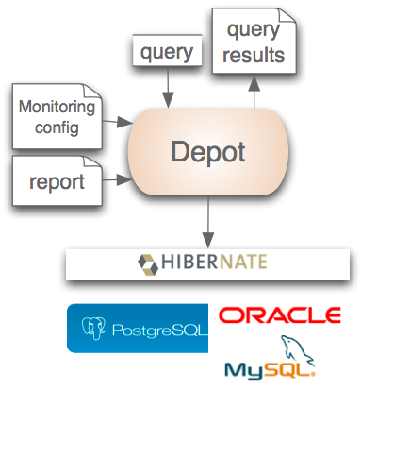
Depot stores and publishes data
Stores configuration information and monitoring results
Uses relational database backend via Hibernate
Provides full archiving of reports
Supports HQL and predefined queries
Supports email notifications
Web services - Query data from depot and return as XML
Notes:
Stores data
Minimize repetitive data

Slide 9



Consumer Displays Data
Web application packaged with Jetty
JSP pages/tags to query data and format using XSLT
CeWolf/JFreeChart to graph data
Current and historical views
Notes:
Display of data to sysadmins
Current Data
Summary Details Individual test details
Google map

Slide 10
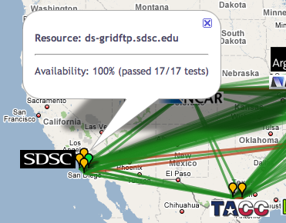
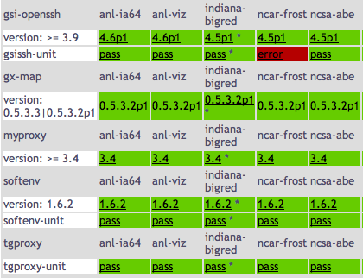
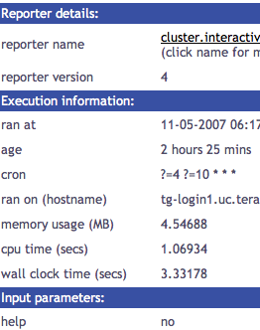
Current data views
Cumulative test status by resource
Test status by package and resource
Individual test details
Notes:
Display of data to sysadmins
Current Data
Summary Details Individual test details
Google map

Slide 11
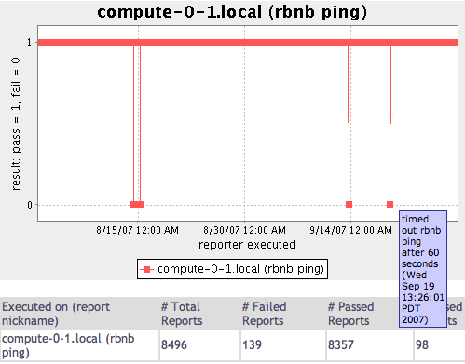
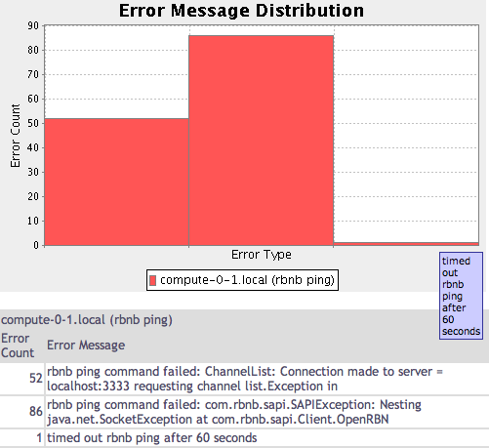
Historical Data Views
Status history of an rbnb ping test
Distribution of errors types _x0003_

Slide 12





Software Status and Deployments
Current software version: 2.2
(available from Inca website)
http://inca.sdsc.edu

Slide 13
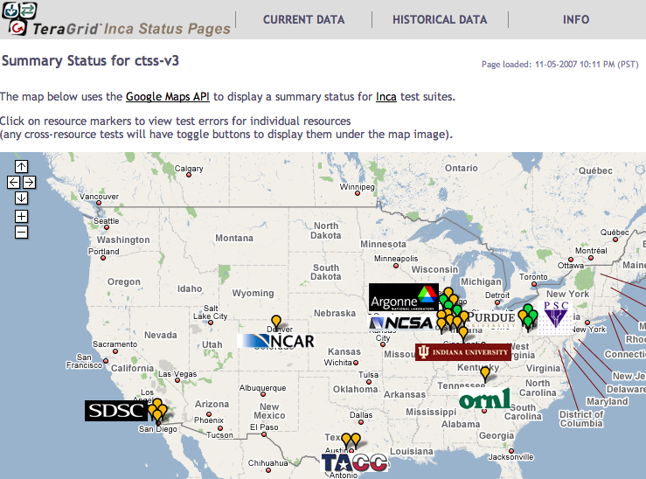
Inca TeraGrid Deployment
Running since 2003
Testing for CTSS
Cross-site tests
GRAM usage
CA certificate and CRL checking
Resource registration in MDS
Screenshot of Inca status pages for TeraGrid
Notes:
numbers

Slide 14
Inca GLEON deployment
Sensors in lake: dissolved oxygen level, temperature, velocity (some), etc.
Monitoring Data Turbine deployments since Oct. 24
Currently deployed for Lake Sunapee and Lake Erken
More about Data Turbine in Paul Hubbard’s talk at 2pm in SDSC booth
Notes:
- gleon - dissolved oxygen level, tempurative at different levels, water
velocity (sometimes), temperature, pressure - buouy - windspeed, velocity
- data stored in on PoP and streamed to Wisconsin
- datalogger different companies
- understand sensors - send technician out
- minimize cell calls
- downlink & dataServer on Wisconsin

Slide 15
Future Work
Add cumulative statistics to better identify problems
Give sites more control over testing on their resources
Improve fault tolerance
Automatically tune test frequency
Add ability to create custom views

Slide 16
Benefits of Using Inca
Detect problems before the users notice them
Easy to write and share tests and benchmarks
Easy to deploy and maintain
Flexible and comprehensive displays
Notes:
Detect problems before the users notice them: Inca provides testing and performance measurement from an impartial user perspective
Easy to write and share tests and benchmarks: Standalone reporter APIs and repositories
Easy to deploy and maintain: Centralized configuration enables uniform monitoring
Flexible and comprehensive display: Data consumer and web services interface enable publishing and displaying of Inca monitoring data
Inca is designed to support testing and measurement from a general user’s perspective
Inca provides testing and performance measurement from an impartial user perspective to detect problems before the users notice them
Standalone reporter APIs and repositories make it easy to write and share tests and benchmarks (reporters)
Centralized configuration enables uniform monitoring and makes it easy to deploy Inca monitoring to a set of resources
Data consumer and web services interface enable publishing and displaying of Inca monitoring data

Slide 17


More Information
Website:
http://inca.sdsc.edu
Announcements:
inca-users@sdsc.edu
Email:
inca@sdsc.edu
Funded by:

Slide 18
Sample Reporter
use Inca::Reporter::SimpleUnit;
my $reporter = new Inca::Reporter::SimpleUnit(
name => 'grid.globus.gramPing',
version => 2,
description => 'Checks gatekeeper is accessible from local machine',
url => 'http://www.globus.org',
unit_name => 'gramPing'
);
$reporter->addDependency('Inca::Reporter::GridProxy');
$reporter->addArg('host', 'gatekeeper host');
$reporter->processArgv(@ARGV);
my $host = $reporter->argValue('host');
my $out = $reporter->loggedCommand("globusrun -a -r $host", 30);
if (!$out) {
$reporter->unitFailure("globusrun failed: $!");
} elsif($out !~ /GRAM Authentication test successful/) {
$reporter->unitFailure("globusrun failed: $out");
} else {
$reporter->unitSuccess();
}
$reporter->print();
Notes:
TODO: Add descriptions of fields

Slide 19
Scheduling and Execution
Reporter manager
  Manages and schedules the execution of reporters on a single resource
  Executes under regular user account
  Monitors reporter system usage and enforces limits
  Sends monitoring result to a depot
Notes:
Enable execution of reporters

