Slide 1
Welcome to the 3rd Inca Workshop Sponsored by the NSF August 26-27, 2008
Presenters:
Shava Smallen ssmallen@sdsc.edu
Kate Ericson kericson@sdsc.edu
Paul Hoover phoover@sdsc.edu

Slide 2
Workshop Goals
Introduce features and benefits of Inca to new or interested users.
Help existing users to better utilize Inca for their Grid.
Gather any feedback on new features, improvements to features, etc.

Slide 3
Agenda -- Day 1
9:00 - 10:00 | Inca overview
10:00 - 11:00 | Working with Inca Reporters
11:15 - 12:00 | Hands-on: Reporter API and Repository
1:00 - 2:00 | Inca Control Infrastructure
2:00 - 3:00 | Administering Inca with incat
3:15 - 4:00 | Hands-on: Inca deployment (part 1)

Slide 4
Agenda -- Day 2
9:00 - 9:30 | Inside the Inca Depot
9:30 – 10:10 | Data display (data consumers)
10:20 - 11:00 | Writing data consumers
11:00 - 12:00 | Hands-on: Data display (data consumers)

Slide 5



Inca Information
Announcements: inca-users@sdsc.edu
Email: inca@sdsc.edu
Website: http://inca.sdsc.edu
Supported by:

Slide 6

Goal: reliable grid software and services for users
Over 750 TF
Over 30 PB of online and archival data storage
Connected via dedicated multi-Gbps links
30-63 software packages and 6-23 services per resource
11 TeraGrid sites, 21 resources

Slide 7






Related Grid monitoring tools
Inca’s primary objective: user-level Grid monitoring
Notes:
There weren’t any Grid monitoring systems when we started Inca but today here is a sampling of the most common onethat have either been developed or adapted to do Grid monitoring. One key difference is Inca’s ability to collect a wide variety of monitoring data from functionality to performance data. But the main difference between Inca and these other tools is our the method of monitoring. A lot of these tools focus on aggregating each site’s system-level monitoring data such such as queue information while we focus on emulating a user’s experience.

Slide 8



User-level grid monitoring
Runs from a standard user account
Executes using a standard GSI credential
Uses tests that are developed and configured based on user documentation
Centrally manages monitoring configuration
Automates periodic execution of tests
Verifies user-accessible Grid access points
Easily updates and maintains monitoring deployment

Slide 9

Who benefits from user-level grid monitoring?
Grid operators
Verify requirements are fulfilled by resource providers
Identify failure trends
System administrators
Email notification
Debugging support
End users
Debug user account/environment issues
Advanced users: feedback to Grid/VO
System
administrators

Slide 10
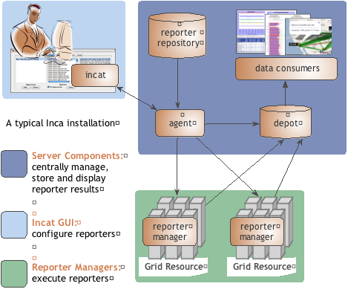
Inca provides user-level grid monitoring
Stores and archives a wide variety of monitoring results
Captures context of monitoring result as it is collected
Eases the writing, deploying, and sharing of new tests or benchmarks
Flexible and comprehensive web status pages
Secure

Slide 11

Reporters collect monitoring data
Executable programs that measure some aspect of the system or installed software
Supports a set of command-line options and writes XML to stdout
Schema supports multiple types of data
Extensive library support for perl and python scripts (most reporters < 30 lines of code)
Independent of other Inca components

Slide 12
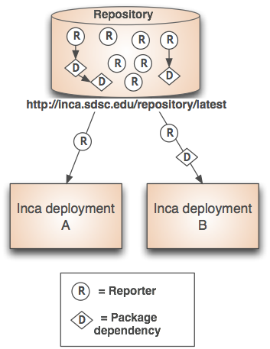
Repositories support sharing
Collection of reporters available via a URL
Supports package dependencies
Packages versioned to allow for automatic updates
Inca project repository contains 150+ reporters
Version, unit test, performance benchmark reporters
Grid middleware and tools, compilers, math libraries, data tools, and viz tool

Slide 13
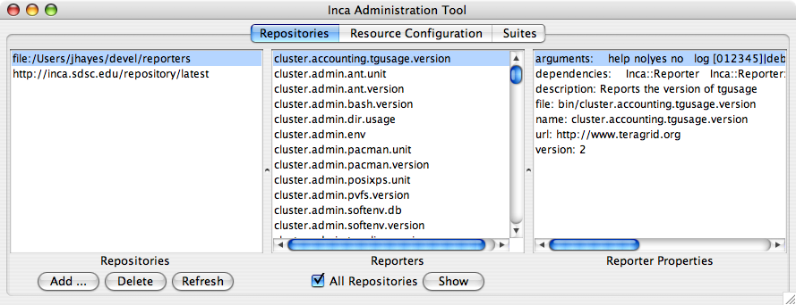
Agent provides centralized configuration and management
Implements the configuration specified by Inca administrator
Stages and launches a reporter manager on each resource
Sends package and configuration updates
Manages proxy information
Administration via GUI interface (incat)
Screenshot of Inca GUI tool, incat, showing the reporters that are available from a local repository

Slide 14
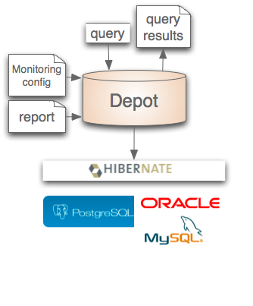

Depot stores and publishes data
Stores configuration information and monitoring results
Provides full archiving of reports
Uses relational database backend via Hibernate
Supports HQL and predefined queries
Supports plug-in customization (e.g., email notifications, downtimes)
Supports fault tolerance
Web services - Query data from depot and return as XML

Slide 15
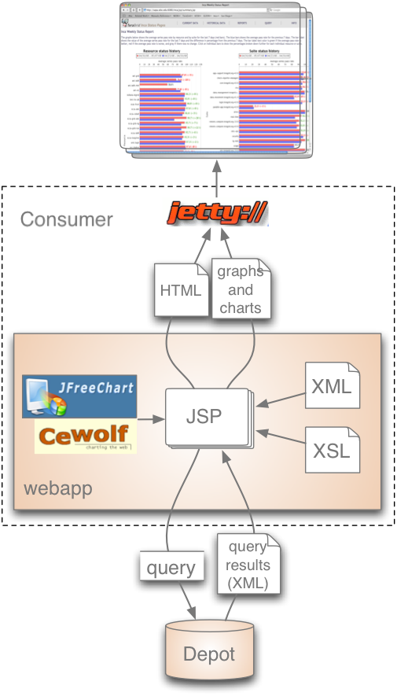
Consumer displays data
Current and historical views
Web application packaged with Jetty
JSP 2.0 pages/tags to query data and format using XSLT
CeWolf/JFreeChart to graph data
Ability to fetch Inca data in HTML or XML format via REST URLs *new*
Allow “run nows” from the Inca web status pages *new*

Slide 16
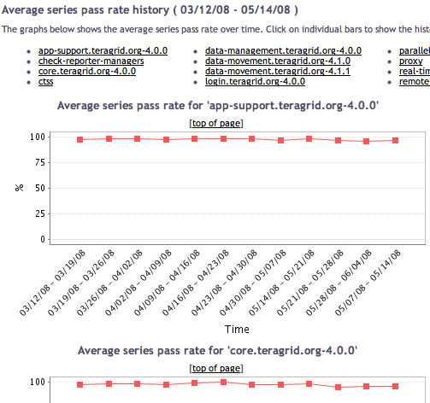
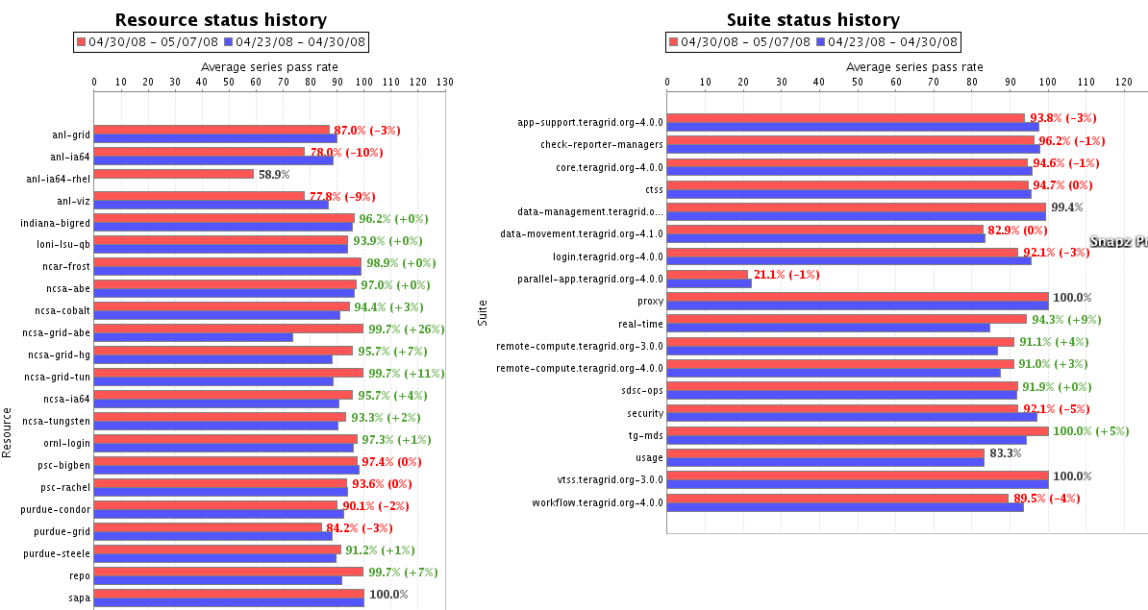
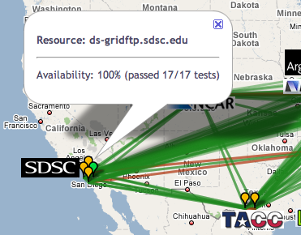
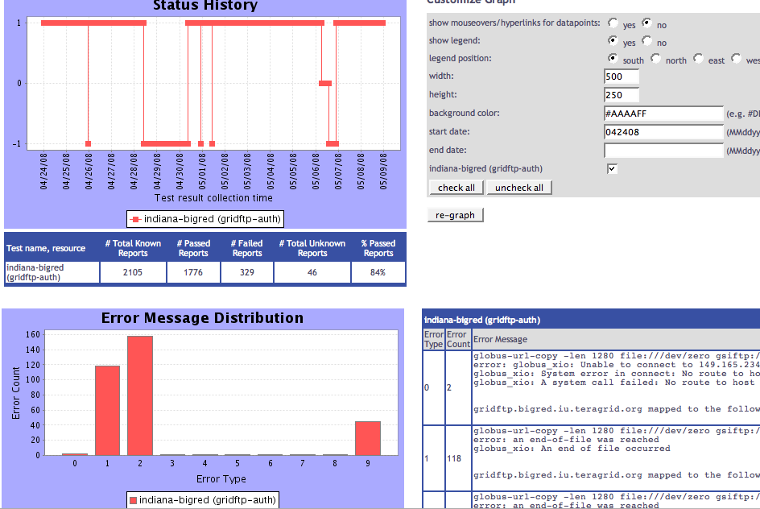
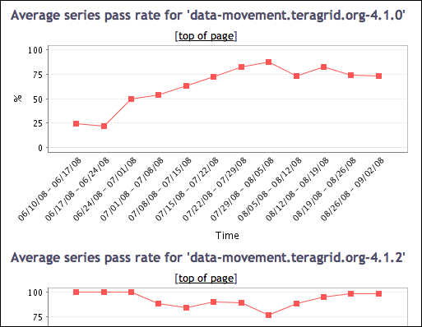
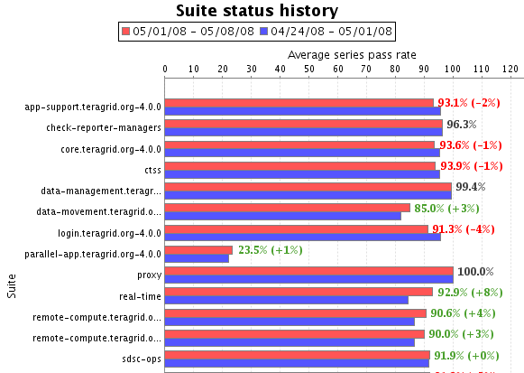
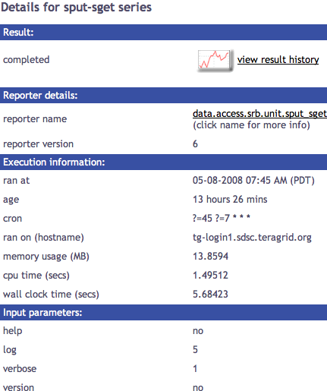
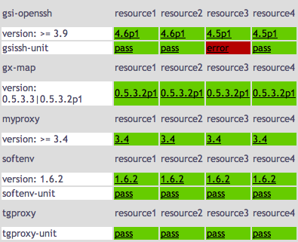
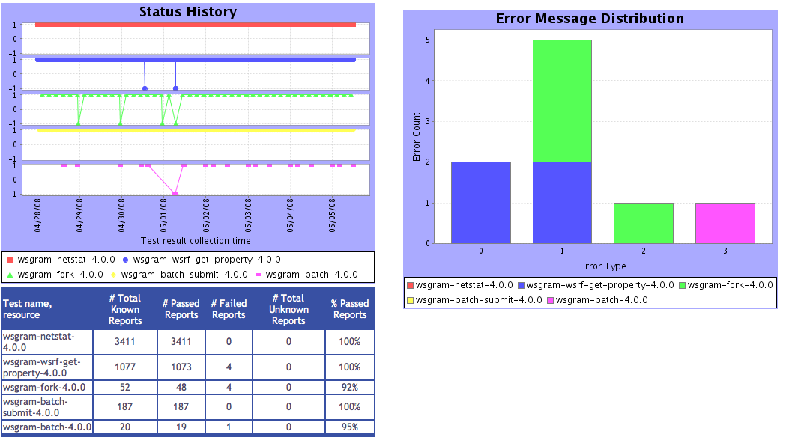
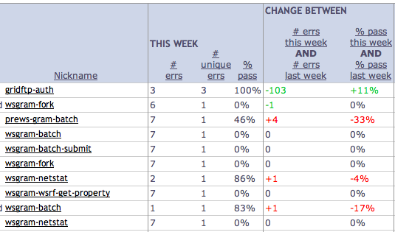
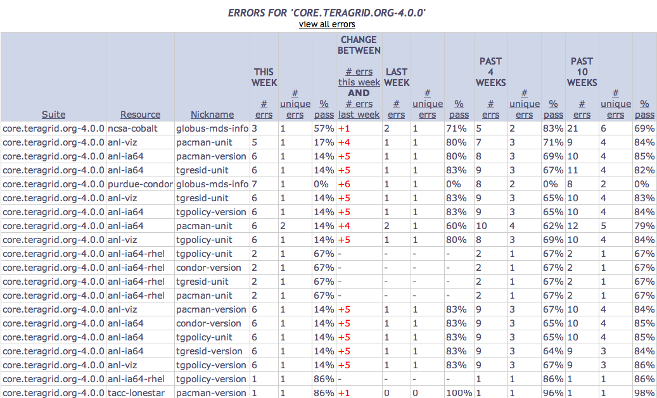
Tests
Summary
Weekly status report
Cumulative test status by resource
Resource status history
Inca’s status pages provide multiple levels of details
Error history summary
Test status by package and resource
Related test histories
Individual test result details
Test
Details
Individual test history
Historical
Current status

Slide 17
Inca components communicate using SSL
Provides credential based authentication for all communication
Credentials created during setup
% inca createauth
Configure via inca.properties
inca.consumer.auth = true | false
inca. consumer.cert=componentcert.pem
inca. consumer.key=componentkey.pem
inca. consumer.trusted=trusted
inca. consumer.password=stdin:password>
# inca.consumer.depot=inca://localhost:6324
inca.consumer.depot=incas://localhost:6324

Slide 18








Software status and deployments
Current software version: 2.5
(final 2.6 release within a month)
http://inca.sdsc.edu

Slide 19
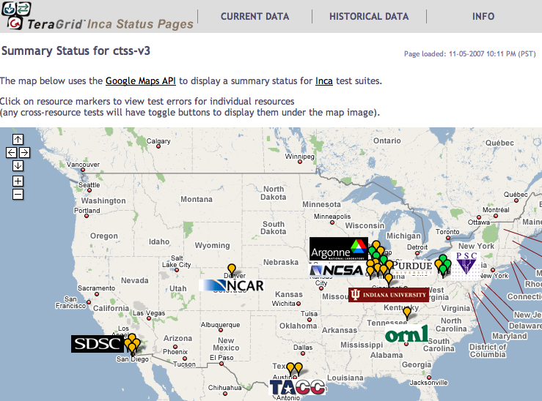
Inca TeraGrid deployment
Running since 2003
Total of 2660 tests running on 20 login nodes, 3 grid nodes, and 3 servers
Coordinated software and services
Cross-site tests
GRAM usage
CA certificate and CRL checking
Resource registration in information services
Screenshot of Inca status pages for TeraGrid
http://inca.teragrid.org/

Slide 20

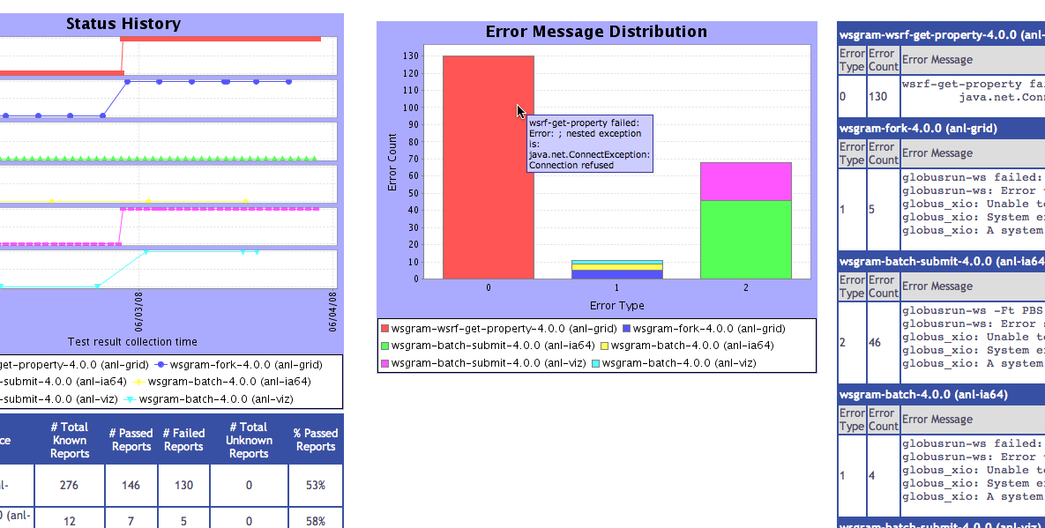
Inca monitoring benefits TeraGrid end users
“Inca reported errors mirror failures we’ve observed and as they are addressed we’ve noticed an improvement in TeraGrid’s stability.”
-- Suresh Marru (LEAD developer)
Tests resources and services used by LEAD. E.g.
Pings service every 3 mins
Verifies batch job submission every hour
Automatically notifies admins of failures
Show week of history in custom status pages

Slide 21
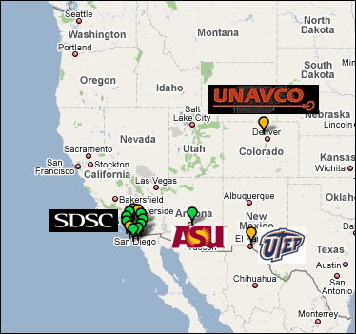
Inca GEON deployment
Running since Feb 2008
Total of 206 tests running on 5 login nodes and 6 servers
LiDAR workflow services
Web servers
Ssh connectivity
Base system information (Rocks, Gcc, Java, etc.)
Screenshot of Inca status map for GEON
http://inca-geon.sdsc.edu

Slide 22
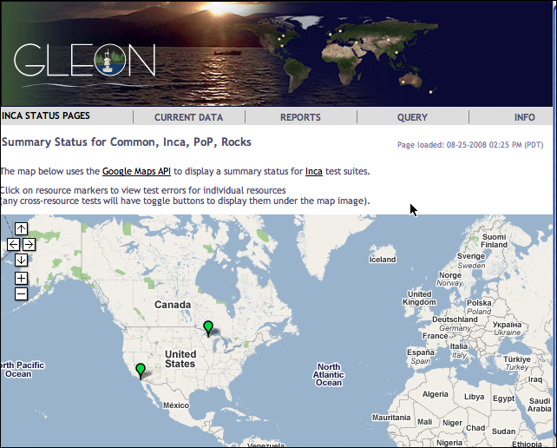

Inca GLEON deployment
Sensors in lake: dissolved oxygen level, temperature, velocity (some), etc.
Monitoring Data Turbine deployments since Oct 2007
Total of 26 tests running on data server at SDSC and windows box in Northern Temperate Lakes in Wisconsin
http://inca-gleon.sdsc.edu

Slide 23
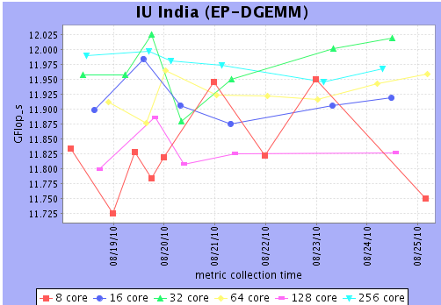

Inca Performance deployments
Past
GrASP performance measurements in 2006
Deployed IPM instrumented MPI applications to TeraGrid in 2009
Current
Deployed HPCC and other planned benchmarks for FutureGrid
Deployed HPCC for SDSC’s Dash
Deployed MADbench, hycomm, and others to TeraGrid
Partial HPCC results on FutureGrid machine at IU

Slide 24

Benefits of using Inca
Detect problems before the users notice them
Easy to write and share tests and benchmarks
Easy to deploy and maintain
Flexible and comprehensive displays

Slide 25
More features planned
More support for benchmarks
Consolidate user interfaces
Publish suites in Inca repository
More data management of Inca report data (e.g., limit on stored histories)

Slide 26
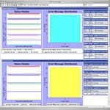
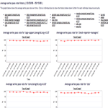
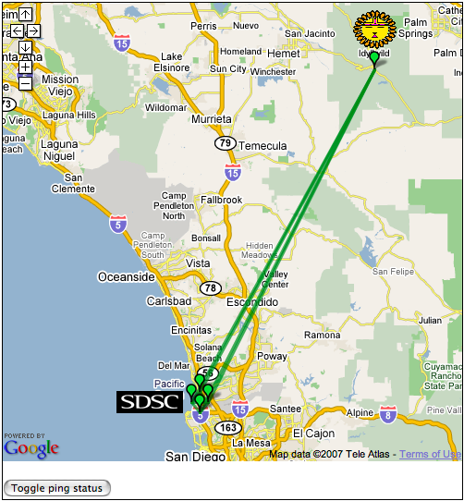
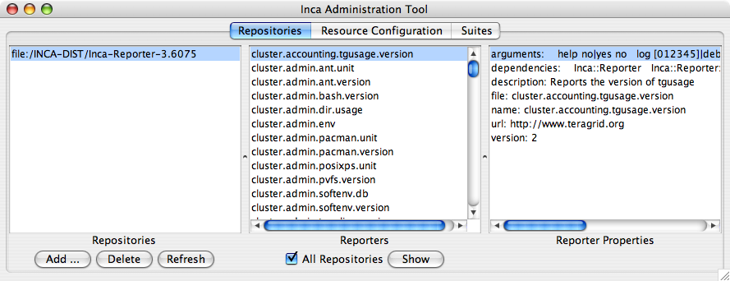
Inca architecture
Reporter
Repository
Data Consumers
R
Incat
C
Agent
S
Depot
A typical Inca installation
S
r
Server Components:
Centrally manage, store and display reporter results
Inca GUI:
Configure reporters
Reporter Managers:
Execute reporters
S
R
r
R
Reporter
Manager
Reporter
Manager
…
Grid Resource
Grid Resource

Slide 27
Agenda -- Day 1
9:00 - 10:00 | Inca overview
10:00 - 11:00 | Working with Inca Reporters
11:15 - 12:00 | Hands-on: Reporter API and Repository
1:00 - 2:00 | Inca Control Infrastructure
2:00 - 3:00 | Administering Inca with incat
3:15 - 4:00 | Hands-on: Inca deployment (part 1)

