Slide 1
Administering Inca with incat
Shava Smallen
ssmallen@sdsc.edu
Inca Workshop
August 26, 2010

Slide 2
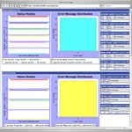
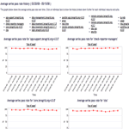
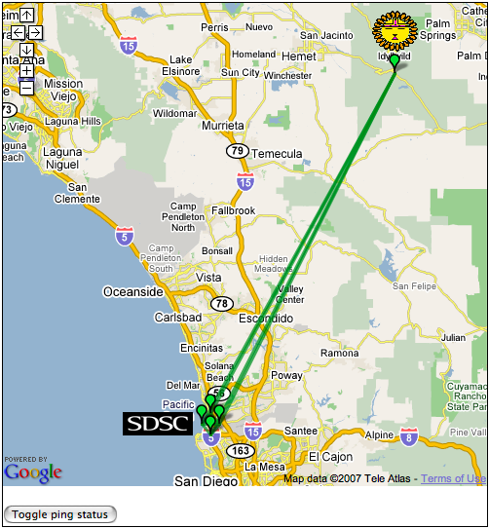
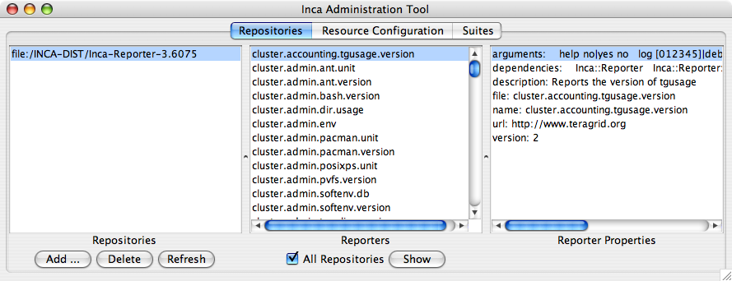

incat
Reporter
Repository
Data Consumers
R
Incat
C
Agent
S
Depot
A graphic editor for an Inca deployment configuration (XML describing repositories, resources, and series)
Retrieves existing configuration from Agent and/or loads specified file
S
S
R
r
r
R
Reporter
Manager
Reporter
Manager
…
Grid Resource
Grid Resource
Notes:
TG 22K lines of XML

Slide 3
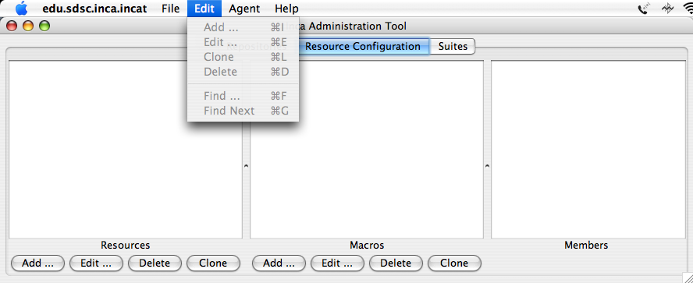
incat Display
Tabs for repositories, resources, and suites
File Open/Save/Save As menu
Edit menu supports modifying and searching selected panel
Agent/Commit sends Inca deployment configuration to Agent
Online user’s guide via Help menu
Notes:
“Clone” combines copy and paste
Edit selections replicated in buttons

Slide 4
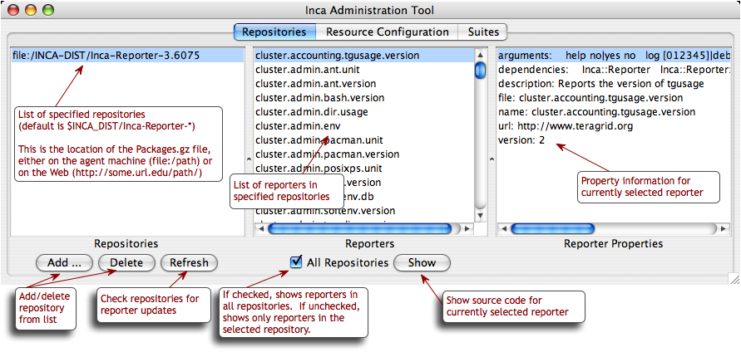
Repositories Tab
Repository list, reporter collection, catalog entry
Reporter information retrieved from connected Agent

Slide 5
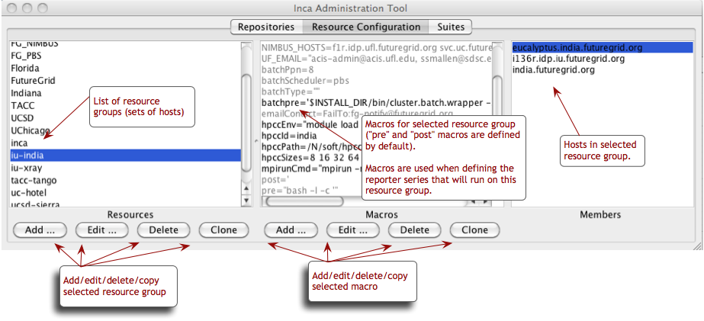
Resource Configuration Tab
Resource name, associated macros, member hosts
Inherited macros shown in gray
Hosts with no IP address shown in red
Resource “Add …”, “Edit …” open resource edit dialog

Slide 6
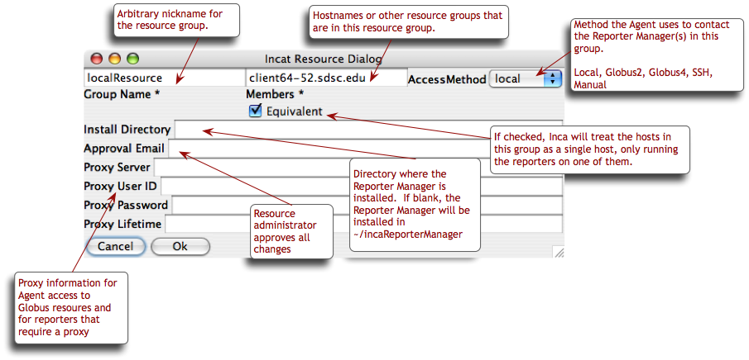
Resource Edit Dialog

Slide 7
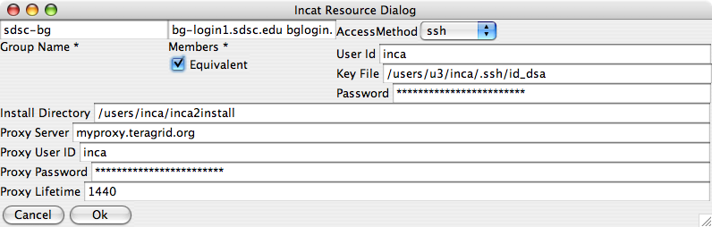
Specifying Ssh Resources
Accessed by Agent using j2ssh classes
Reporter Manager staging via sftp
Passwords stored/transmitted encrypted

Slide 8
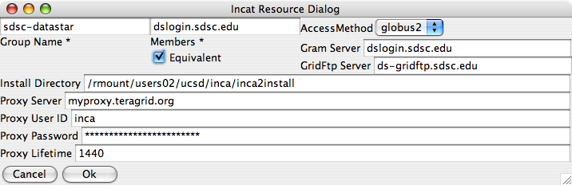
Specifying Globus Resources
Accessed by Agent via Globus CoG Java classes
Globus2 uses pre-WS APIs and Globus4 uses WS APIs
Reporter Manager staged via GridFtp

Slide 9
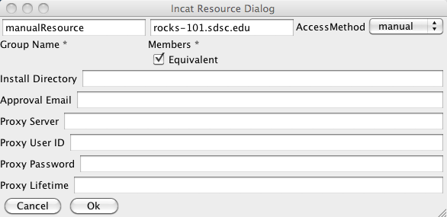
Specifying Manual Resources
Agent cannot use provided automated methods
Resource administrator installs reporter manager manually and connects it to the agent

Slide 10
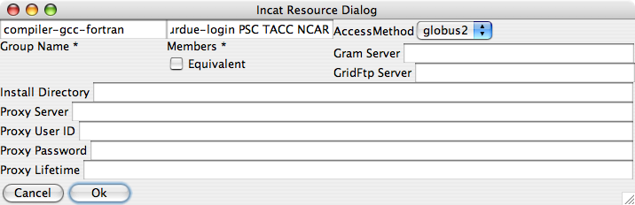
Grouping Resources
Convenience for specifying series to run on multiple resources
Directory, proxy info, etc. are like macros--most specific value is used for each host

Slide 11
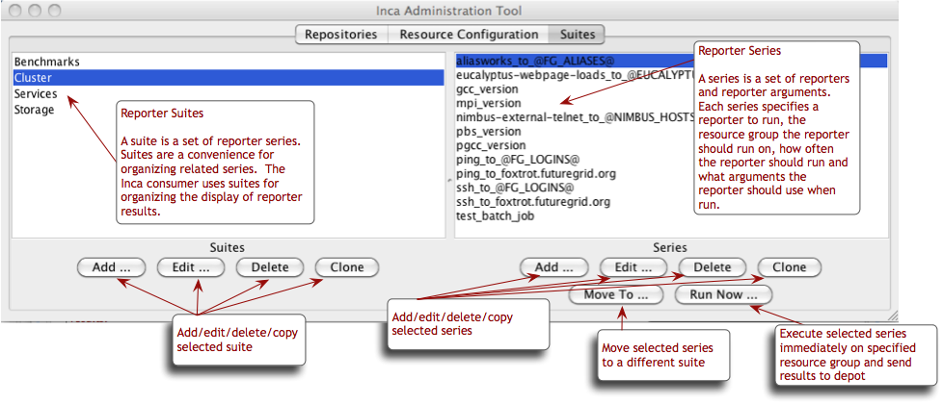
Suites Tab
Grouping of series into suites allows clearer Consumer display
Report series named after reporter or given “nickname”

Slide 12
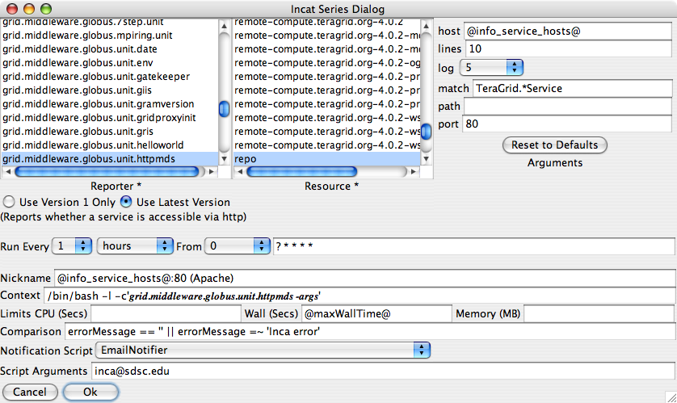
Series Edit Dialog

Slide 13
Series Edit Dialog (Upper)
Select reporter and resource; specify command-line arg values
Argument list determined by reporter
Use latest version automates Reporter updates
Reporter description appears below reporter

Slide 14
Series Edit Dialog (Lower)
Run frequency uses extended cron syntax
Nickname useful in later report display--should be unique
Context allows specialized execution
Reporter killed and error report stored if limits exceeded
Comparison allows more precise definition of reporter success/failure
Notification script run when state changes

Slide 15

Comparisons Refine Success and Failure
<body>
<package>
<ID>openssh</ID>
<version>3.6.1p1</version>
</package>
</body>
ID/Value pair
Comparison can test body, errorMessage, ID values from report body
Supports comparison operators and pattern matching
EmailNotifier, LogNotifier provided; custom notifiers supported
EmailNotifier reports success, failure, or both

Slide 16
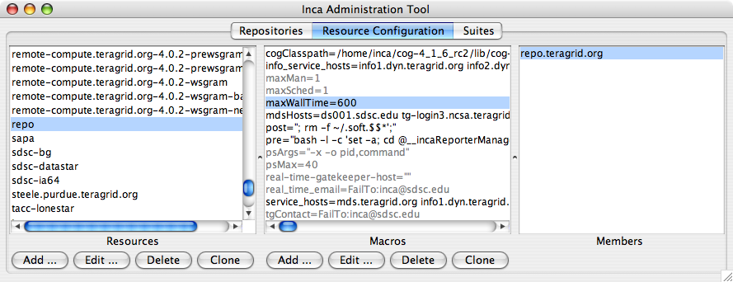
Using Macros in Report Series
Separate series for each macro value
Series with undefined macros references shown in red

Slide 17
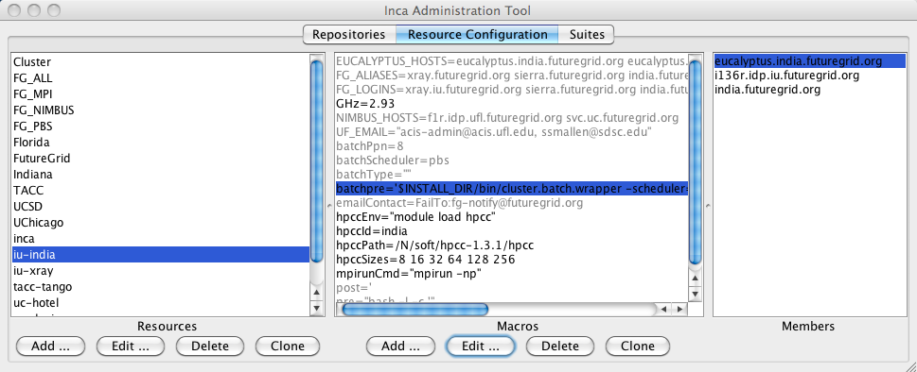
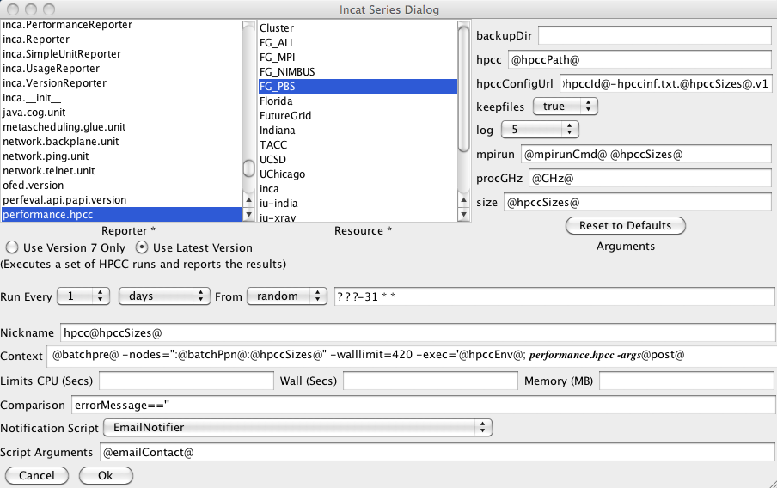
Executing series in batch mode
Define batchPre macro specifying batch wrapper, scheduler type, and special submit params
batchPre=$INSTALL_DIR/bin/cluster.batch.wrapper -scheduler="@batchScheduler@"
Specify batchPre macro in context with extra batch wrapper arguments

Slide 18
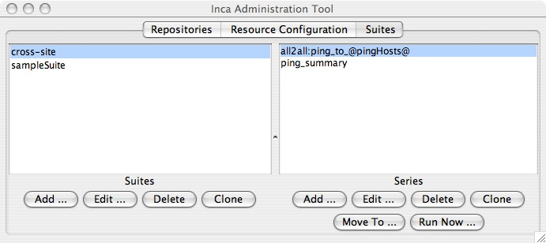
Executing all2all series
Specify an all2all series
Specify a summary reporter series using summary.successpct.performance
Add All2All filter in depot

Slide 19
Agenda -- Day 1
9:00 - 10:00 | Inca overview
10:00 - 11:00 | Working with Inca Reporters
11:15 - 12:00 | Hands-on: Reporter API and Repository
1:00 - 2:00 | Inca Control Infrastructure
2:00 - 3:00 | Administering Inca with incat
3:15 - 4:00 | Hands-on: Inca deployment
Notes:
Check syncs with website

