Slide 1
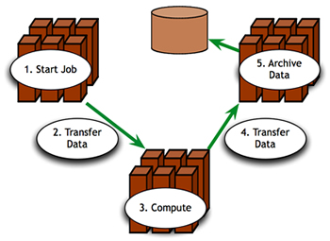
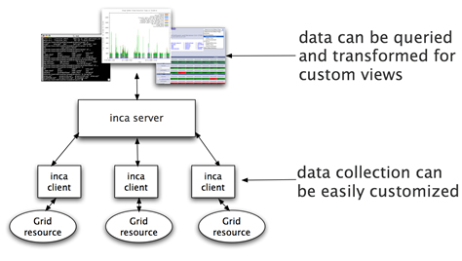


Inca: Grid Reliability
Inca is:
  a framework for automated testing, benchmarking and monitoring
  deployed on all TeraGrid resources
TeraGrid is "up" if the resources, services and software required to run user applications are working as expected.
Above:
A sample application with computation, data transfer and data archival requirements.
Please visit a poster session to discuss how Inca data collection and display can be customized for you.
Notes:
From a user's perspective, a Grid is "up" if the resources, services and software required to run their application are available and working as expected. For example, to successfully run the sample application in this image some user requirements would include the ability to login, have working access to compatible versions of Grid services/software used by the application, and access datasets and credentials.
By detailing a set of software, services, and features that a user needs, a Grid can be tested periodically by an automated system to verify its health and usability. To this end, we've developed Inca as a flexible framework for the automated testing, benchmarking and monitoring of Grid systems.
Inca is deployed on all TeraGrid resources to monitor CTSS 3.0 and to perform other requested system tests and benchmarks
We would like to customize Inca’s data collection and display for users this year.
Please visit a poster session to learn about the Inca project and how TeraGrid users can benefit from Inca tools.

