Slide 1
Inca Data Display:
Writing Web Page Data Consumers (Hands-on)
Kate Ericson, kericson@sdsc.edu
Inca 2.0 Workshop
February 24, 2006

Slide 2
Customize Display
Change:
HTML table layout (swStack.xml)
Style (swStack.xsl and inca.css)
Jetty port

Slide 3
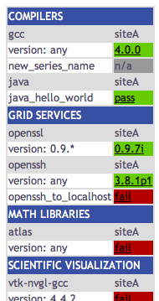
Customize Display: HTML table
1a. Edit $INCA_INSTALL/etc/common/swStack.xml
to change HTML table:
<package>
<id>gcc</id>
<category>Compilers</category>
<version>any</version>
<versionRE>(^.*)</versionRE>
<tests>
<version>gcc_version</version>
<unitalias>new_series_name</unitalias>
</tests>
</package>
-> refresh
http://localhost:8080/xslt.jsp?xsl=http://localhost:8080/swStack.xsl&resourceID=defaultvo&suiteName=TestSuiteLocal

Slide 4
Customize Display: HTML table
1b. Use a file besides swStack.xml to organize HTML table (xslt.jsp looks for swStack.xml by default, but any xml file in $INCA_INSTALL/etc/common can be used with the “xmlFile” parameter).
% cd $INCA_INSTALL/etc/common
% cp swStack.xml new.xml
% vi new.xml
-> remove the “atlas” package from new.xml
-> view jsp using new.xml as input (“atlas” package should be removed):
http://localhost:8080/xslt.jsp?xsl=http://localhost:8080/swStack.xsl&resourceID=defaultvo&suiteName=TestSuiteLocal&xmlFile=new.xml
1c. EXTRA CREDIT:
make a new XML file to display all of the new reporters you’ve written
Notes:
Later we’ll have swStack.xml name be an input

Slide 5
Customize Display: Style
2. Customize style by editing the xsl and css and rebuilding the Jetty war file:
% cd $INCA_INSTALL
% mkdir war; cd war
% jar xvf ../etc/inca-consumers.war
% cp inca.css inca.css.orig; cp swStack.xsl swStack.xsl.orig
% vi inca.css
-> change line 101 to “background-color:#D07651;”
% vi swStack.xsl and add a “cron” table row
-> insert the text at http://inca.sdsc.edu/workshop/xsl.html after line 113 (after </tr>)
-> EXTRA CREDIT: remove “Reporter command log” rows and swap “ran at” and “age” rows

Slide 6
Customize Display: Style
2. (cont)
% rm ../etc/inca-consumers.war ; jar cfv ../etc/inca-consumers.war *
% cd ..; ./bin/inca stop consumer
% ls /tmp | grep Jetty
-> make sure there isn’t a dir like Jetty__8080__
% ./bin/inca start consumer
-> refresh http://localhost:8080/xslt.jsp?xsl=http://localhost:8080/swStack.xsl&resourceID=defaultvo&suiteName=TestSuiteLocal
You should see the changes on the next slide…
Notes:
- SIMPLIFIED LATER - won’t have to recreate war just edit like swStack.xml

Slide 7
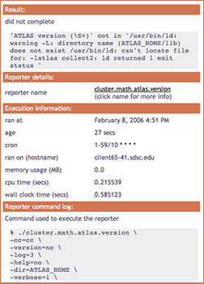
Customize Display: Style
Edit XSL: $INCA_INSTALL/etc/swStack.xsl
XML formatting (e.g. add row to display cron):
swStack.xsl has two main templates,
“test” to display series results and
“suite” to display suite results
Edit CSS: $INCA_INSTALL/etc/inca.css
colors (e.g. change .header background-color
from #3850A3 to #D07651)
fonts

Slide 8
Customize Display: Jetty
3. Configure Jetty to start on port besides 8080 default:
% cd $INCA_INSTALL; vi etc/common/inca.properties
-> change line 69 to “inca.consumer.port=8082”
% ./bin/inca stop consumer
% ./bin/inca start consumer
Jetty should now be started on 8082. Load the new webpage:
http://localhost:8082/xslt.jsp?xsl=http://localhost:8082/swStack.xsl&resourceID=defaultvo&suiteName=TestSuiteLocal

