Slide 1
Inca 2 & TeraGrid
Shava Smallen
4/28/06

Slide 2
Inca
Inca is a framework for the automated testing, benchmarking and monitoring of Grid resources
Inca provides:
  Scheduled execution of information gathering scripts (reporters)
  Data management
    collection
    archiving
    publishing
Notes:
For those who might not be as familiar, we developed about Inca 3 years ago with the goal of doing V&V of the TG software stack and environment. We designed to be general enough to
It provides scheduled execution of information gathering scripts on the various grid resources which we call reporters. A reporter is typically a test of a grid service, a benchmark, or a version query of a grid software package and then formats the result in XML
The framework provides collection of the data generated by reporters on each of the resources, storage and archiving of that data, and then making it available for query/ or publishing the data where it can be displayed by a web page.

Slide 3





Inca today
  Current uses:
Software stack validation
User environment validation
Grid benchmarking
Network bandwidth measurements
Notes:
To this date, vInca has been deployed not only to TeraGrid but to GEON, the European DEISA grid, Italy’s CINECA grid, and the UK’s National Grid Service Grid and the White Rose Grid.
The main uses of it have been the software stack validation and on TeraGrid we have the user environment validation, and also for Grid benchmarking and the collection of user-level network bandwidth measurements.

Slide 4
Outline
Inca 2
Inca deployment on TeraGrid
SDSC reporters
Notes:
next version of Inca that we’ve been working on since last year which we call Inca 2, what out status and plans are
Then will talk about the status of Inca deployment on TeraGrid, how it will be changing over the next few months
Last time I gave a talk at this meeting was in September to describe a set of reporters that a contractor had developed based on input from several folks here at SDSC that we wanted to deploy. So, I just wanted to provide a brief update on that as well.

Slide 5
Motivation for Inca 2
Inca v1 was a prototype
Experiences using Inca:
  Testing is an iterative refinement process
  Testing is a trade-off between freshness of data and impact on resource
  Knowing which failures occur over time is more interesting than simply knowing a service fails over time
Notes:
So what were are motivations for developing Inca 2.
Firstly, for better or worse, version 1 can really be described as a prototype. The main concern we addressed with this version was speed of development, So, naturally, you don’t have the luxury of pondering the best scalable and secure design or time to develop a good set of unit and integration tests. Without tests, software becomes fragile and difficult to maintain software because you have limited capabilities to test changes.
Address scalability, security, and maintainability thru testing
Second, there were a number of things we had learned from our experiences deploying Inca on TeraGrid that we wanted to take into account into this new version:
Second, one of the things that we observed or realized is that testing is really an iterative refinement process. And there are 2 main reasons for that 1) tests have to be ported to several arch/Oses and depending on their complexity, you run into the same complexities of porting an application on the Grid and 2) we’re often asked to test before the documentation is available so we may not know that a site requires a particular parameter unti we deploy it, it fails, and the sys admins complain. So, you frequent reporter and configuration updates are a reality and in Inca v1 most of it was handled manually which was somewhat tedious when you had 5 resources and now with 18 resources become very tedious.
Third we found that oftentimes multiple views of the collected data - nice to have flexible querying interfaces to filter data, etc.
Finally, we had had complaints that Inca testing was taking up too much resources on a machine so we
Enabling multiple views of the collected data

Slide 6
Inca 2 feature: Full Report Archiving
Inca report - completed
Inca report - error
…
<body>
<benchmark>
<ID>download</ID>
<statistic>
<ID>bandwidth</ID>
<value>105.26</value>
<units>kb/sec</units>
</statistic>
</benchmark>
</body>
<exitStatus>
<completed>1</completed>
</exitStatus>
…
…
<body></body>
<exitStatus>
<completed>0</completed>
<errorMessage>wget command failed: --15:29:23-- http://www.nosite/
=&gt; `/dev/null'
Resolving www.nosite... failed: Host not found.
</errorMessage>
</exitStatus>
…
Inca 1 archiving
Inca 2 archiving
Notes:
A reporter is …
These boxes show the result of a simple reporter that just measures the time it takes to download a particular web page. So, we have result which shows the bandwidth that wget returned and then a report result that failed because the site didn’t exist.
So, in version 1 we cached the full reports but were only able to archive numerical data indicated by the cyan.
In version 2, we are able to archive the full reports

Slide 7
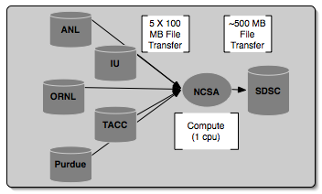
Inca 2 in use: Grid benchmarks
GrASP: Grid Assessment Probes
  C. Olschanowsky, O. Khalili, J. He, H. Casanova, A. Snavely. Acquiring and Using Benchmark Data from Computational Grids, submitted for publication
  Set of probes designed to emulate Grid applications
  Deployed to GEON and TeraGrid
Gather probe on TeraGrid
Notes:
Collect Grid benchmark measurements using GrASP (Grid Assessment Probes) developed by Henri Casanova and Allan Snavely’s groups
Requested queue time is 1 hour, actual compute is less than a minute

Slide 8
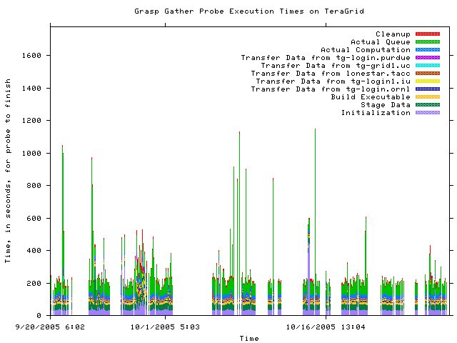
GrASP: Measuring Grid middleware performance
Notes:
This is about 2 months of results from the gather probe running on TG
Y axis is execution time in seconds and x axis the time at which the measurement was taken
Colors indicate stage in execution of the probe
See how the performance varies over time - queue time most variable
white areas indicate probe did not complete due to an error - with version 2, we archive the error messages and can see what types of error messages are occurring

Slide 9
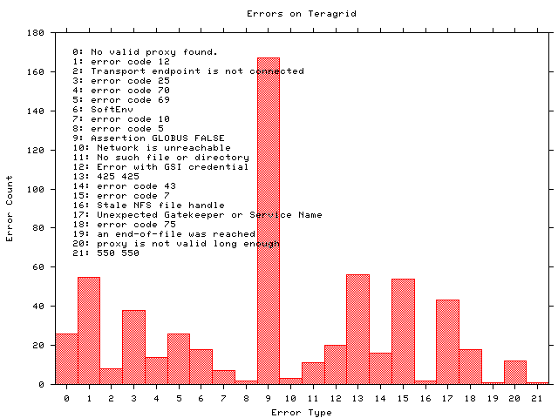
GrASP: Monitoring Grid middleware reliability
Notes:
Histogram shows what types of errors are occuring the most often - error messages are truncated
The highest number of occurrrences in 9 which is the result of a documented Globus 2.0 bug when the GRAM server is under high load
A full report of errors on TG found by the grasp gather probe. This is a new capability in Inca 2.0 -- Inca 1 was unable to archive error messages.

Slide 10
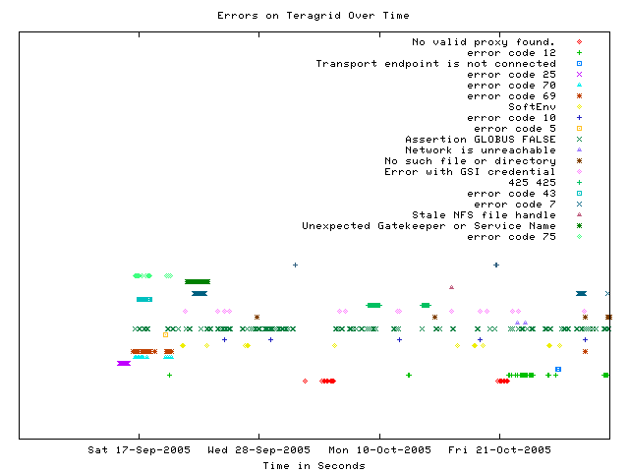
GrASP: Error tracking over time
Notes:
This graph shows when a certain type of error occurs over time
Most errors only occur for a few days before being fixed - for example, the dark green * “Unexpected Gatekeeper of service name” is a configuration error
Dark green xxx’s represent the Globus 2.0 bug over time - a transient error occurs continuously

Slide 11
Inca 2 feature: Improved installation and configuration control
GUI tool for centralized administration
Reporter sharing via repositories
Proxy management via MyProxy
Incat screenshot
Notes:
Going back to one of the things we wanted to incorporate in the new design, lots of configuration and reporter changes which was handled in a mostly manual fashion
So, one of the key new features is that we provide centralized control so that we can make a change in one place and it will be automatically propagated to each resource. We also added a GUI front end which makes it easier to make changes (where is in Inca 1, we edit XML files)
Tests of Grid services need valid proxies and this was another thing that was handled manually. Another feature designed to faciliate deployment was to handle proxy renewal via MyProxy.
3rd, we created reporter repositories for publishing the reporter - this facilitates sharing of reporters and updates

Slide 12
Inca 2: Additional features
Flexible querying interface
Profile reporter system usage
Inca components communicate using SSL

Slide 13
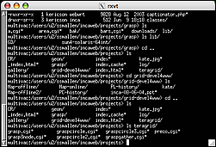
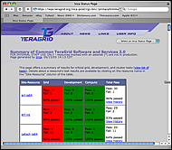
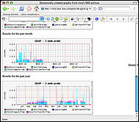
Architecture overview
5. GUIs can display collected data by querying Depot
Reporter
Repository
Incat
Create a “suite”
Data Consumers
Suite
R
Reporter
Agent
Submit suite to Reporter Agent
Depot
Depot
3. Reporter Agent invokes Reporter Managers and distributes suite and reporters
S
S
S
R
R
R
4. Reporter Managers send data to Depot
Reporter
Manager
Reporter
Manager
Reporter
Manager
…
Resource N
Resource 1
Resource 2
Notes:
The Admin Tool is a user interface (java GUI) used by the Inca admin to administer all parts of an Inca deployment; it connects to the Reporter Agent
The Reporter Agent is a server which is the access point to an Inca deployment and is responsible for managing the control flow of an Inca installation
The Reporter Repository is responsible for storing Reporters (scripts that gather data from resources); reporters are packaged as RPMs; can be shared among multiple Inca deployments
The Reporter Manager is responsible for managing the schedule and execution of Reporters on a single resource; receives instructions from one and only one reporter agent.
The Depot is a server that is responsible for storing the data produced by reporters.
The Suite describes where to run the reporters, frequency of execution, and optionally expected values (I.e., instructions for how to collect data)

Slide 14
Architecture overview:
Scalable design
VO B
Incat
Reporter
Repository
VO A
Incat
Reporter
Repository
Forward suite
Reporter
Agent
Reporter
Agent
Depot
Depot
Forward results
Reporter
Manager
Reporter
Manager
Reporter
Manager
Reporter
Manager
Reporter
Manager
Resource 4
Resource 5
Resource 1
Resource 2
Resource 3
Notes:
Inca designed to be scalable in wrt to data collection and storage (e.g., depots can be arranged hierarchically)
For example, suppose VO B has access to resources on VOA. Rather than VO B running duplicate reporters on VO A resources, VO B can request data from VO A (securely) and then VO A will send the results to VO B.

Slide 15
Inca 2 Timeline
Feb 5, 2006 - 2.0 pre-release
February 23-34, 2006 - Inca 2 Workshop @ SDSC
  Talks and hands-on sessions
  ~15 participants from ANL, DEISA, GEON, NCSA, NGS, PSC, PRAGMA, SDSC, TACC, White Rose Grid, Univ. of Southamption
April 17, 2006 - Submitted proposal for SC|06 Tutorial
July - Aug, 2006 - 2.0 production release
Aug - Dec, 2006 - Engage more users (NEES, PRAGMA, BIRN, …) and release major/minor versions

Slide 16
Outline
Inca 2
Inca deployment status on TeraGrid
SDSC reporters

Slide 17
Timeline
Nov 5, 2005 - Began Inca 1 deployment for CTSSv3
March 15, 2006 - Begin Inca 2 deployment for CTSSv3
April 18, 2006 - CTSSv3 defined (JP’s list)
April 24-28, 2006 - Inca 1 updates for CTSSv3/new resources complete
May 5-11, 2006 - Inca 1 deployment for full CTSSv3 on all resources - dependent on tests from gig-pack
June 1, 2006 - Address migration to Inca 2 & expand data collection and display

Slide 18
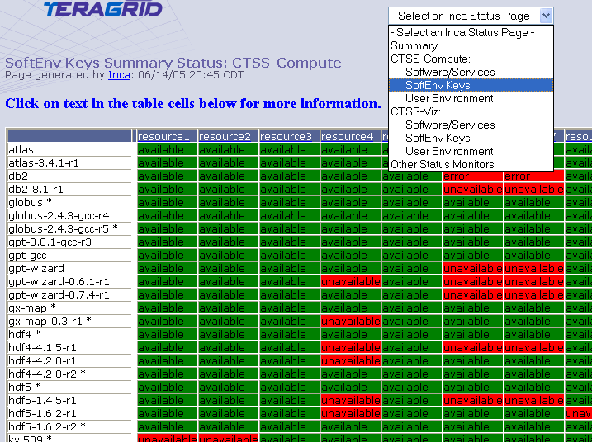
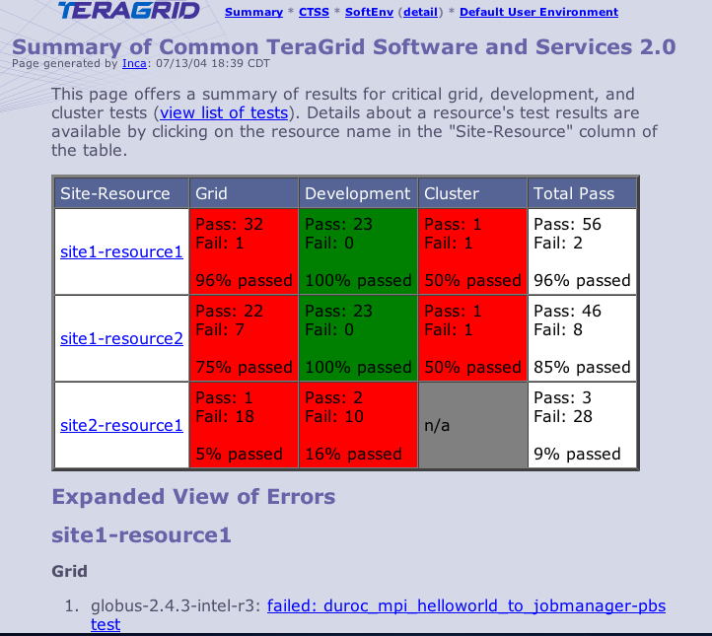
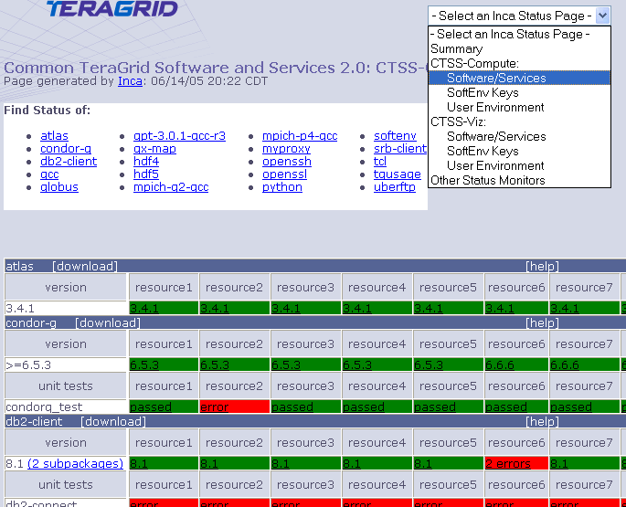
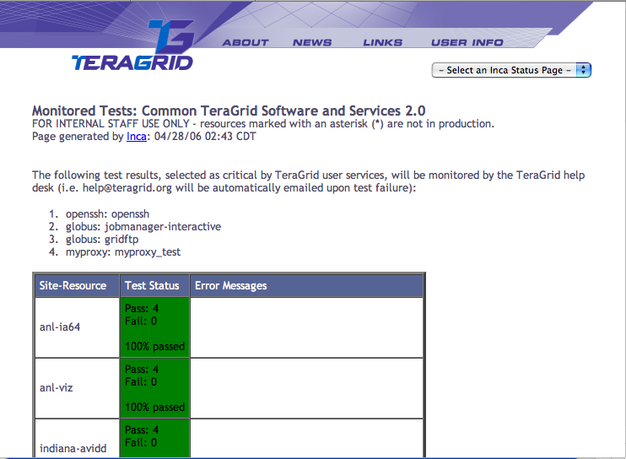
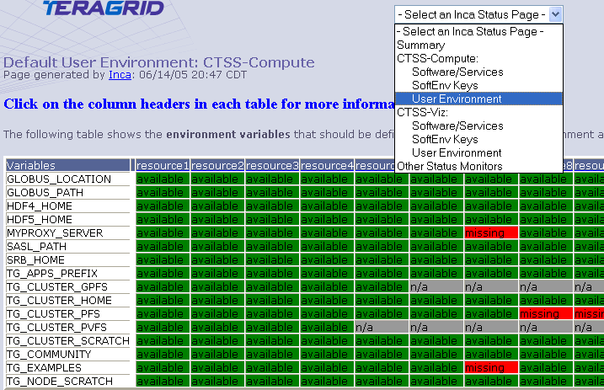
Inca 1 Status Pages
(2004 - April 24, 2006)
CTSSv2
Software Stack
  Detail view
  Summary view
  Monitored test view
User environment
  Softenv Status
  Default environment status
CTSS v3
Software stack detail (Nov 5, 2005) - staff only

Slide 19
Inca 1 Status Pages
(April 24 - June 1, 2006)
CTSSv3 - staff only
  Software stack detail (33+ units, 4 cross-site, 33 versions)
CTSSv2
Software Stack
  Detail view (3 units, 3 cross-site, 0 version)
  Summary view (removed)
  Monitored test view (unchanged)
User environment
  Softenv Status (unchanged)
  Default environment status (unchanged)

Slide 20
Inca 1 Status Pages (CTSSv3)
(June 1 - ?)
CTSSv3
Software Stack
  Detail view
  Summary view?
  Monitored test view
User environment?
  Softenv Status
  Default environment status
CTSSv2 (all removed)

Slide 21
Inca 2 Status Pages (CTSSv3)
(June ? - )
CTSS v3
  Software Stack
    Detail view
    Summary view?
    Monitored test view
  User environment?
    Softenv Status
    Default environment status
  User views?
Security
Globus usage
Other software tests and benchmarks
…

Slide 22
Outline
Inca 2
Inca deployment status on TeraGrid
SDSC reporters

Slide 23
Reporters
Basic Functionality
  File transfer
  Grid Job submission
  File system availability
  Site Job submission
  Compiler Inter-language
  SU Usage
Performance
  Srb
  Effective Bandwidth
Application
  NAMD
  AWM
  Remote Site Access
  HPSS
  Interconnect
  Policy
  Phdf
Deployed
Deploy during May-July

Slide 24
More information
Inca Web Page:
  http://inca.sdsc.edu
TeraGrid Inca Status Pages
  http://repo.teragrid.org
Email
  inca@sdsc.edu

Slide 25
Inca 2 improvements
Full report archiving
Improved installation and configuration control
  GUI tool for centralized administration
  Proxy management via MyProxy
  Reporter sharing via repositories
Enabling multiple views of the collected data
Profile reporter system usage
Inca components communicate using SSL

