Slide 1
Monitoring TeraGrid
Functionality and Performance with Inca
Kate Ericson
San Diego Supercomputer Center

Slide 2
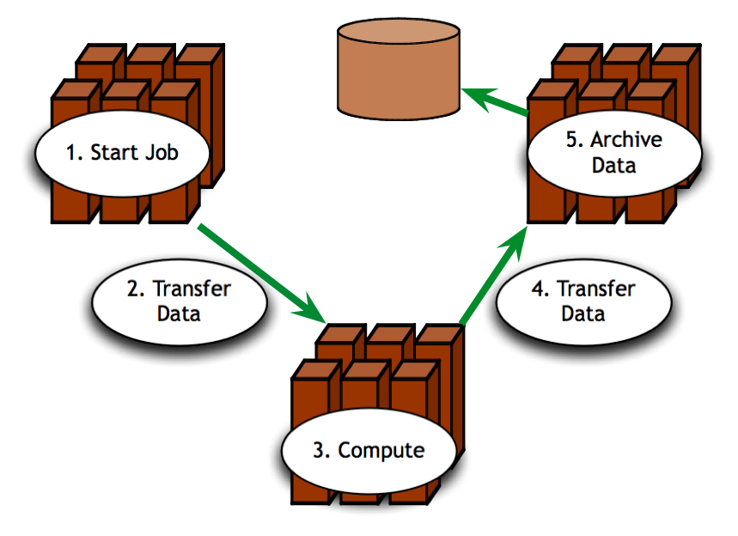
Is TeraGrid Working?
Can users run their applications on TeraGrid? Can they access their datasets?
  Can user login?
  Are Grid services the application[s] use available? Compatible versions?
  Are dataset[s] N accessible to user X? Credentials?
  …
Notes:
Now when we look at what this means for the user, the Grid is up if they can run their particular application on their set of resources, access their dataset, and get “good” performance.
This may seem straightforward but there are actually a lot of things that need to be working underneath the hood in order to make that happen. For example, …
And as you consider the requirements of a community of users and multiple communities of users, those set of requirements can grow quite large.

Slide 3
Testing a Grid
  Iteratively define a set of concrete requirements
  Write tests to verify requirements
  Periodically run tests and collect data
  Publish data
Inca aims to automate steps 3 and 4
Notes:
One way to veriify the user’s requirements are being met is through periodic, automated testing (as you do with software) so that you can have some confidence that when a user logs in, they can get work done
The way you go about this is to define a set of concrete requirements (I.e., machine-readable). These can then be be tested automatically and periodically (important in these dynamic Grid environments).
Some places where you can get requirements from are user documentation, talking to users, proposals, etc.
Note, this is not a simple matter of sitting down once and defining a complete set of requirements
This will be an iterative process as requirements are refined and because the Grid environment will change over time as packages are upgraded, etc.

Slide 4

What type of testing?
Junit,
PyUnit, Tinderbox
Deployment testing
  Automated, continuous checking of Grid services, software, and environment
  Installed? Configured correctly? Running? Accessible to users? Acceptable performance?
  E.g., gatekeeper ping or scaled down application
Software Package
(unit, integrated)
Software Stack
(interoperability)
NMI
Software
Deployment
Notes:
When we refer to testing, we’re talking about testing at the deployment level
This is different than the type of testing you do at the software package level where you’re looking at detailed testing of the software features and checking that it works on all architectures using something like junit, tinderbox, etc.
This is also different than the type of testing that occurs at the software stack level where you’re looking at package version interoperability (e.g., NMI)
We are checking whether packages are installed, running, and configured correctly.
This tests can be something as simple as pinging a Globus gatekeeper service to a more complicated test such as a scaled down version of an application

Slide 5
Who are the consumers?
Grid/VO management
  Responsible for designing & maintaining requirements
  Verify requirements are fulfilled by resource providers
System administrators
  Notified of problems
  Enough information to understand context of problem
End users
  View results and compare to problems they are having
  Debug user account/environment issues
  Feedback to Grid/VO
Notes:
There are different consumers of the testing results: Grid/VO, system administrators, and end users
Our view is that responsibility of the testing should occur at the Grid/VO level. Based on the goals of the Grid, they decide what should be tested and then collect the results - the goal being to detect problems before the users do
While the Grid/VO will decide what to test, system administrators from each of the participating sites will need to be notified of failures and be able to understand how the test was conducted so they can debug their system. This implies that the need to trust the results.
While ideally, we hope that the failures will be caught before users notice them, in practice this is hard to achieve. Therefore, the results of our testing should be made available to users so if they’re having a problem, they can check the results to see if it might be system related.
They should also be able to use the tests to debug user account/environment issues specific to their account (e.g., removing an environment variable accidentally prevents a package from working)
For more advanced users, they could even feedback useful tests to the Grid/VO level.

Slide 6
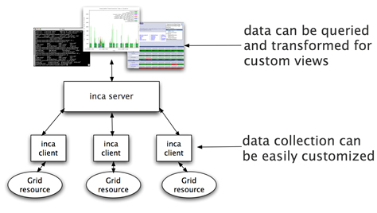
Inca
Inca automates user-level testing and benchmarking of TeraGrid’s services, software and environment
  schedules execution
  of information gathering
  scripts (reporters)
  collects, archives,
  publishes data
Notes:
Inca is… we developed about Inca 3 years ago with the goal of doing Verification&Validation of the TG software stack and environment.
It provides scheduled execution of information gathering scripts on the various grid resources which we call reporters. A reporter is typically a test of a grid service, a benchmark, or a version query of a grid software package and then formats the result in XML
The framework collects data generated by reporters on each of the resources, storage and archiving of that data, and then making it available for query/ or publishing the data where it can be displayed by a web page.
can be customized to show Grid usability from the perspective of a particular user or user community.

Slide 7








Related Grid monitoring tools
MDS
Hawkeye
  Inca’s primary objective:
  user-level Grid functionality testing
  and performance measurement
Notes:
Over the past couple years, several monitoring tools have been developed that are at a high-level similar to Inca wrt to data collection, data storage, and data dissemination
We feel the main difference between Inca and these tools is that ….
Because some of these tools support aggregation like MonALISA and MDS, Inca could be used to feed information into these systems.
Backup
Archiving of the data
some systems use a relational DB like Big Brother (Sybase), GridICE (postgres), MonALISA (MySQL, PostgreSQL, Microsoft SQL Server)
Ganglia uses RRDTool and Nagios uses logs
Tools like MonALISA and GridICE do a lot wrt accounting/job monitoring -- not something we’ve addressed but we could
Inca could complement MonALISA, GridICE, MDS since they are aggregate data.
There’s also the NCSA TestGrid and GITS -- not frameworks
We’re working with GITS’ David Baker to incorporate tests into Inca

Slide 8
Unique features of Inca
Debugging a deployment
  Runs under a regular user account
  Flexibly expresses results
  Captures test context
  Securely re-runs tests
  Archives full reports
  Tests can be run outside Inca framework
Notes:
Here’s what sets us apart as unique -- based on our experience with real Grid deployment on TG. Places noted as v2 will be available to the public early 2006.
Run under regular user account enables user-level testing
Express more than test pass/fail for example different types of performance information
Capture context of reporter execution (script, what machine it ran on, time it ran, inputs, selected environment variables, etc.)
Easy to *securely* re-trigger a test (sys admin fixes a problem -- update the result)
Reports fully archived to understand the how the Grid behaves over time - for example to understand how a service fails over time and if it fails with the same type of error
Reporters can be run outside of the framework by a sysadmin debugging a problem or a user…eventually integrated into a knowledge base

Slide 9
Unique features of Inca (cont.)
Compares results to a specification
Easily and securely configured
  Data collection
  Installation
Profiles and logs Inca component resource use
Notes:
Because analyzing information from resources for display can sometimes be resource-intensive, Inca provides support for comparing results to a specification and storing it (for example, a software stack specification). Comparisons are done each time a new result is collected so the cost is amortized over time rather than doing each time a web page is displayed.
The method to specify the data collection is very expressive to make it easy to configure Inca. Also easy to make changes to an existing deployment (important because resources change over time); uses SSL authentication to make that secure
There’s such a thing as testing too often -- tradeoff of between freshness of data and impact on resource

Slide 10
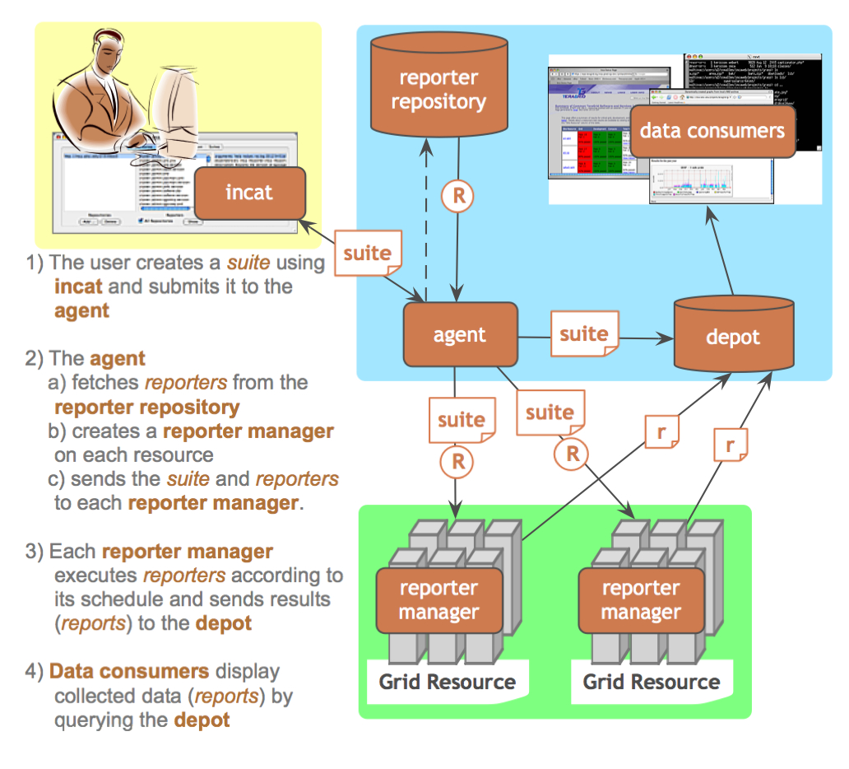
Inca Architecture
Notes:
The Admin Tool is a user interface (java GUI) used by the Inca admin to administer all parts of an Inca deployment; it connects to the Reporter Agent
The Reporter Agent is a server which is the access point to an Inca deployment and is responsible for managing the control flow of an Inca installation
The Reporter Repository is responsible for storing Reporters (scripts that gather data from resources); reporters are packaged as RPMs; can be shared among multiple Inca deployments
The Reporter Manager is responsible for managing the schedule and execution of Reporters on a single resource; receives instructions from one and only one reporter agent.
The Depot is a server that is responsible for storing the data produced by reporters.
The Suite describes where to run the reporters, frequency of execution, and optionally expected values (I.e., instructions for how to collect data)

Slide 11
Motivation for Inca 2
Inca 1 was a prototype
Experiences using Inca:
  Testing is an iterative refinement process
  Testing is a trade-off between freshness of data and impact on resource
  Needed more scalable and flexible data storage
Notes:
Just upgraded all teragrid machine to run latest version of inca
So what were are motivations for developing Inca 2.
version 1 can really be described as a prototype. The main goal with version 1 was speed of development, So, there wasn’t a lot of time to create the most scalable and secure design for version 1 as there was with 2 or time to develop a good set of unit and integration tests.
Second, there were a number of things we had learned from our experiences deploying Inca on TeraGrid that we wanted to take into account into this new version:
one of the things that we observed or realized is that testing is really an iterative refinement process. And there are 2 main reasons for that 1) tests have to be ported to several arch/Oses and you run into the same complexities of porting an application on the Grid and 2) we’re often asked to start testing before the documentation is available so we may not know that a site requires a particular parameter until we deploy it, it fails, and the sys admins complain. So, reporter and configuration updates are frequent and in Inca v1 most of it was handled manually which was somewhat tedious when you had 5 resources and now with 19 resources become very tedious.
Third we found that oftentimes multiple views of the collected data - nice to have flexible querying interfaces to filter data, etc.
Finally, we had had complaints that Inca testing was taking up too much resources on a machine so we added the ability to see how much memory, cpu etc reporters consume when they ran

Slide 12
Inca 2 Feature: Improved installation and configuration control
GUI tool for centralized administration
Reporter sharing via repositories
Proxy management via MyProxy
Incat screenshot
Notes:
Going back to one of the things we wanted to incorporate in the new design, lots of configuration and reporter changes which was handled in a mostly manual fashion
So, one of the key new features is that we provide centralized control so that we can make a change in one place and it will be automatically propagated to each resource. We also added a GUI front end which makes it easier to make changes (where is in Inca 1, we edit XML files)
Tests of Grid services need valid proxies and this was another thing that was handled manually. Another feature designed to faciliate deployment was to handle proxy renewal via MyProxy.
3rd, we created reporter repositories for publishing the reporter - this facilitates sharing of reporters and updates

Slide 13
Inca 2 feature: Full Report Archiving
…
<body>
<benchmark>
<ID>download</ID>
<statistic>
<ID>bandwidth</ID>
<value>105.26</value>
<units>kb/sec</units>
</statistic>
</benchmark>
</body>
<exitStatus>
<completed>1</completed>
</exitStatus>
…
…
<body></body>
<exitStatus>
<completed>0</completed>
<errorMessage>wget command failed: --15:29:23-- http://www.nosite/
=&gt; `/dev/null'
Resolving www.nosite... failed: Host not found.
</errorMessage>
</exitStatus>
…
Inca report - completed
Inca report - error
Inca 1 archiving
Inca 2 archiving
Notes:
Here’s simple XML output for a reporter that just measures the bandwidth it takes to download a particular web page. So, we have result which shows the bandwidth that wget returned and then a report result that failed because the site didn’t exist.
So, in version 1 we cached the full reports but were only able to archive numerical data indicated by the blue boxes.
In version 2, we are able to archive the full reports

Slide 14
Inca 2: Additional features
Flexible querying interface - relational db backend (postgres for TG)
Profile reporter system usage
Inca components communicate using SSL

Slide 15
Outline
Inca 2 overview
CTSSv3 Inca deployment
Current views of data
Future work

Slide 16
Inca 2 TeraGrid Deployment: CTSSv3
32 packages:
Globus, SRB, Condor-G, MPICH, Softenv, etc.
123 possible Inca tests:
45 unit or functionality tests
  Services: BLAS, uberftp, etc.
29 compatible version tests
  Version: HDF, Condor-g, etc.
49 cross-site functionality tests
  Cross-site: Globus GRAM, GridFTP, gsissh

Slide 17
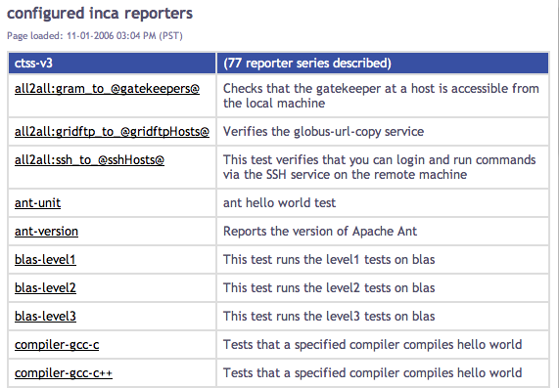
List of Running Tests

Slide 18
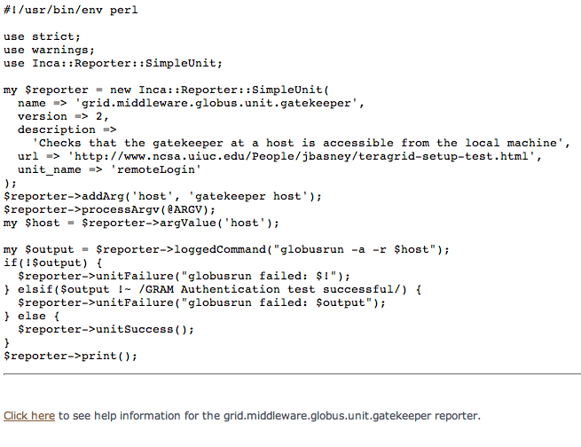
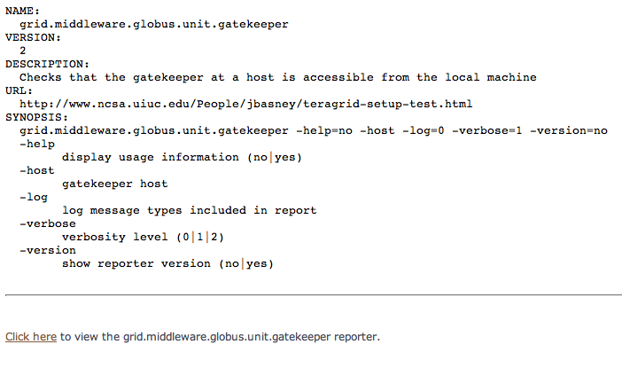
List of Running Tests (cont)

Slide 19
Outline
Inca 2 overview
CTSSv3 Inca deployment
Current views of data
Future work

Slide 20
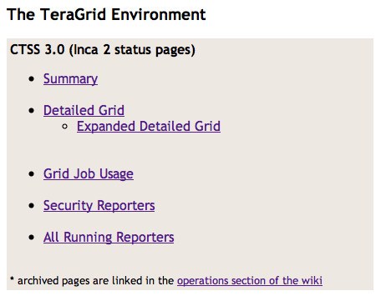
Current Pages Linked from Repo

Slide 21
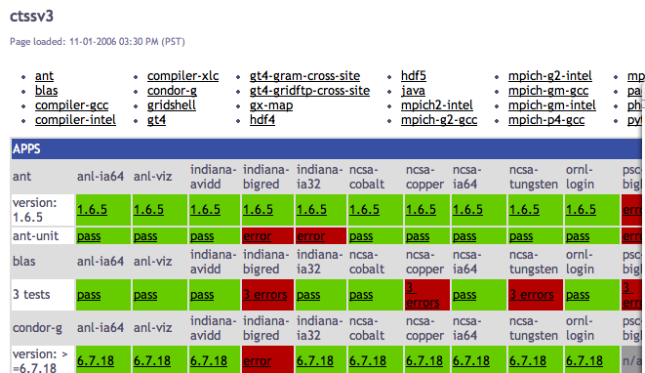
Software Stack Detail View
Resources
SW
packages

Slide 22
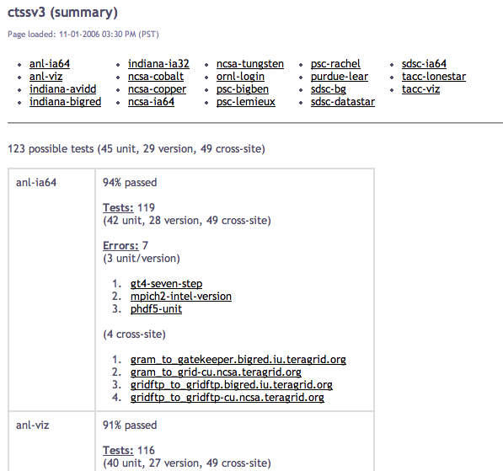
Software Stack Summary View

Slide 23
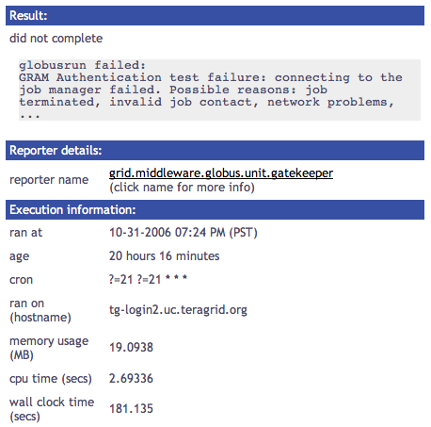
Single Result View

Slide 24
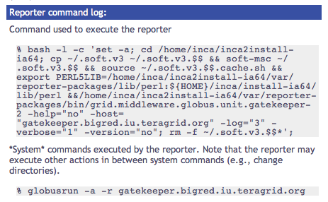
Single Result View (cont.)

Slide 25
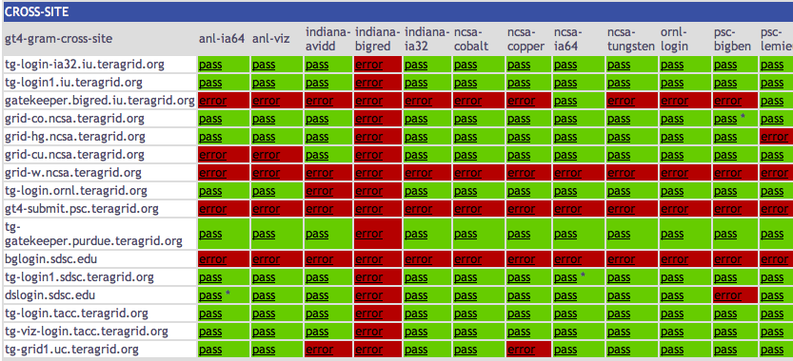
Cross-site Tests
Notes:
Blue gene - get assigned a failure for each machine can’t reach its server, nobody else gets failure for not reaching BG
Big red get client failure for each machine can’t reach
Both client/server get failures in case where others can reach them (datastar, bigben)

Slide 26
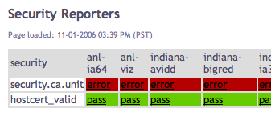
Security Status Page
Notes:
Revised not to check to see that every cert in the dir is expired, just those supported by teragrid

Slide 27
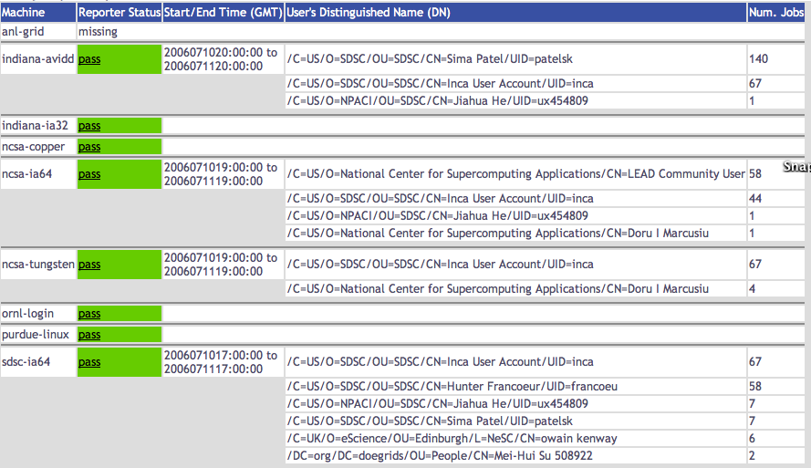
Grid Jobs Status Page (Users)

Slide 28
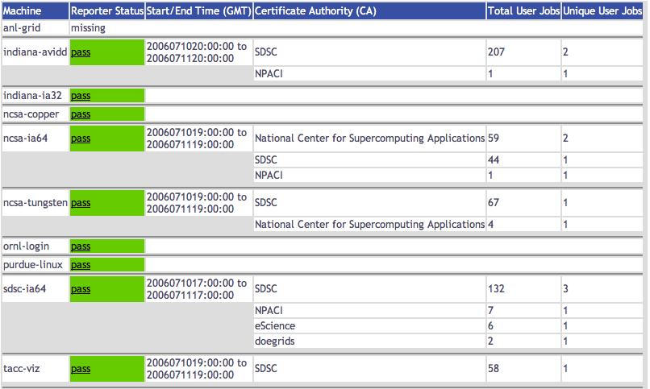
Grid Jobs Status Page (CA)

Slide 29
Outline
Inca 2 overview
CTSSv3 Inca deployment
Current views of data
Future work

Slide 30
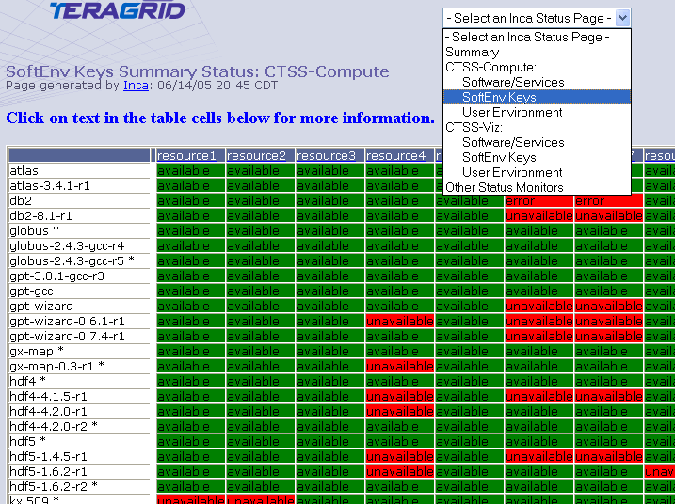
Softenv
Resources
Softenv
keys
Notes:
Run now for admins, bring back some views of data like softenv

Slide 31
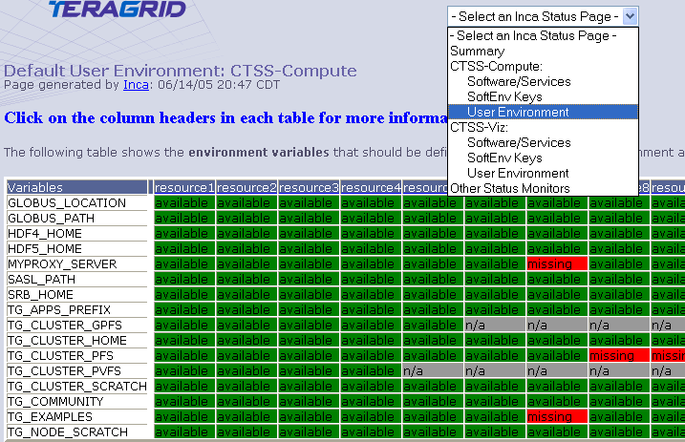
Default Environment
Resources
Environ
variables

Slide 32
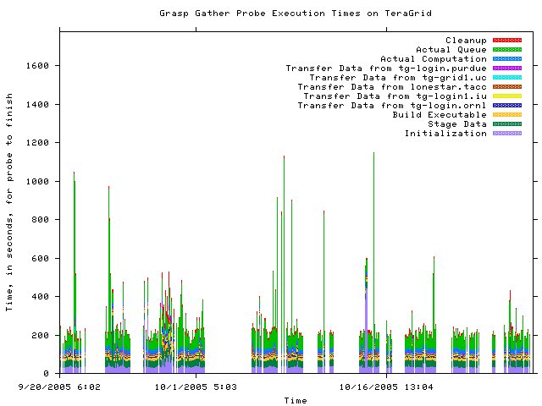
Historical Graphs
Notes:
This is about 2 months of results from the gather probe running on TG
Y axis is execution time in seconds and x axis the time at which the measurement was taken
Colors indicate stage in execution of the probe
See how the performance varies over time - queue time most variable
white areas indicate probe did not complete due to an error - with version 2, we archive the error messages and can see what types of error messages are occurring

Slide 33
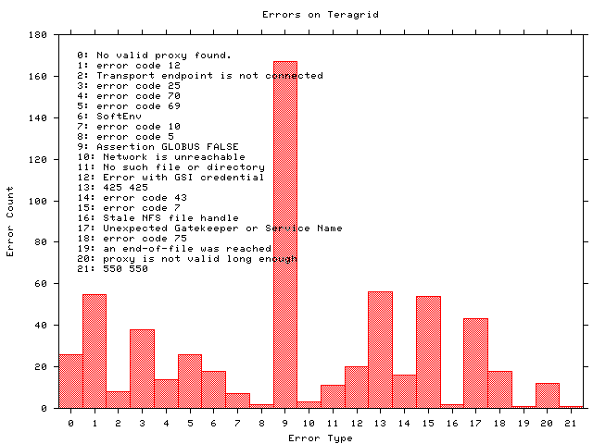
Historical Graphs
Notes:
Histogram shows what types of errors are occuring the most often - error messages are truncated
The highest number of occurrrences in 9 which is the result of a documented Globus 2.0 bug when the GRAM server is under high load
A full report of errors on TG found by the grasp gather probe. This is a new capability in Inca 2.0 -- Inca 1 was unable to archive error messages.

Slide 34
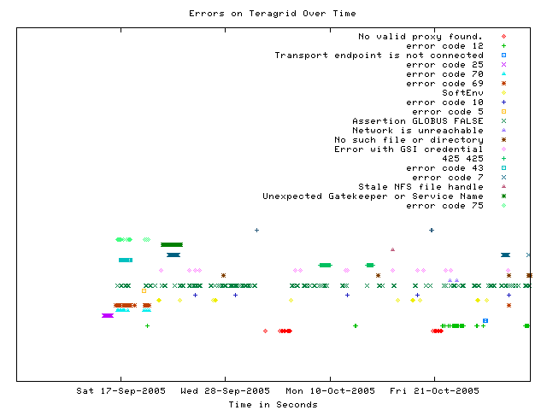
Error tracking over time
Notes:
This graph shows when a certain type of error occurs over time
Most errors only occur for a few days before being fixed - for example, the dark green * “Unexpected Gatekeeper of service name” is a configuration error
Dark green xxx’s represent the Globus 2.0 bug over time - a transient error occurs continuously

Slide 35
More information
Inca Web Page:
  http://inca.sdsc.edu
TeraGrid Inca Status Pages
  http://repo.teragrid.org
Email
  inca@sdsc.edu

