Slide 1
Hands-on: Inca deployment
Part 1
Deploy default Inca installation

Slide 2
Logistics
Handout contains login id and password for:
  279 desktop machines
  MyProxy credential on grid-devel1.rocksclusters.org
  Rocks machines (globus access only)
    rocks-111.sdsc.edu
    rocks-112.sdsc.edu
    rocks-113.sdsc.edu
    rocks-104.sdsc.edu

Slide 3
inca.properties
Configuration file for all Inca components
Property names use the following convention:
inca.<component name>.<property name>
E.g., start the inca agent on port 6323
inca.agent.port=6323
Options can also be specified on the command-line
inca start agent --port=6323

Slide 4
Common component properties
Security related properties
  auth=[true|false]
  cert=<path>
  key=<path>
  password=<password>
  trusted=<path>
Server related properties
  port=<number>
  numthreads=<number>

Slide 5
Log files
$INCA_INSTALL/var/agent.log - Reporter agent log file
$INCA_INSTALL/var/depot.log - Depot log file
$INCA_INSTALL/var/consumer.log - Consumer log file
~/inca2install/build.log - Reporter manager install log
~/inca2install/var/reporter-manager.log - Reporter manager log

Slide 6
Deploy default Inca installation
Follow instructions in Section 2.3 of Inca Installation Guide
http://inca.sdsc.edu/docs/install.html#INSTALL-BIN
To save time, the download of the Inca binary distribution (steps 1-2) has already been done for you
Change to step 7:
inca start incat -A localhost:6323

Slide 7
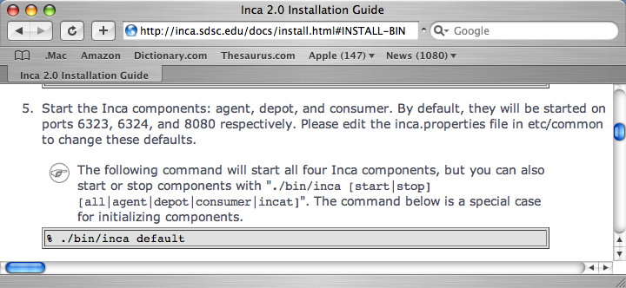
Step 5 explained
Depot initialized
Reporter Agent, Depot, and Consumer servers started
20 second wait to wait for servers to start up

Slide 8
Step 5 explained (cont.)
Suite ‘TestSuiteLocal’ sent to Reporter Agent requesting reporters to be started on localhost using the schedule:
1-59/10 * * * * | cluster.math.atlas.version
2-59/10 * * * * | cluster.compiler.gcc.version
3-59/10 * * * * | cluster.security.openssl.version
4-59/10 * * * * | cluster.interactive_access.openssh.version
5-59/10 * * * * | cluster.interactive_access.openssh.unit
6-59/10 * * * * | viz.lib.vtknvgl.version
7-59/10 * * * * | viz.lib.chromium.version
8-59/10 * * * * | cluster.compiler.any.unit

Slide 9
Step 5 explained (cont.)
Reporter Agent receives suite and installs a reporter manager on the localhost in ~/inca2install (takes 1-5 minutes to build)
  View progress of build ~/inca2install/build.log
When Reporter Manager finishes building, it registers itself with Reporter Agent. Reporter Agent sends reporters, libraries, and schedule to Reporter Manager.
Reporter Manager will execute reporters based on schedule. Should see at least one box filled within 3 minutes.

Slide 10
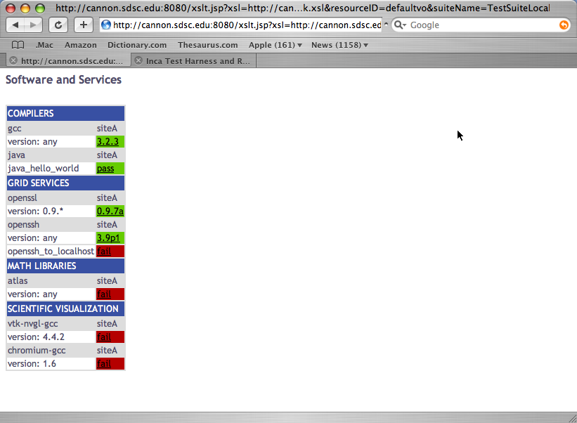
Step 5 Explained (cont.)

Slide 11
Finished early?
Proceed to:
Hands-on: Inca deployment
(part 2)

