Slide 1
Working with Inca Reporters
Jim Hayes
jhayes@sdsc.edu
Inca Workshop
September 4-5, 2008

Slide 2
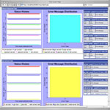
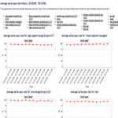
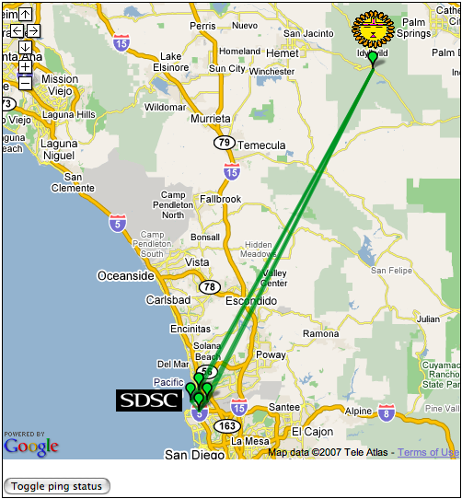
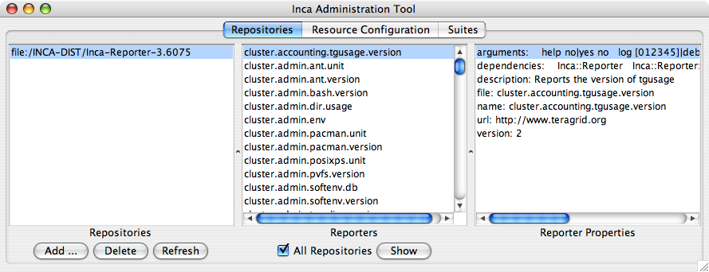
Inca 2 Architecture
Reporter
Repository
Data Consumers
R
Incat
C
Agent
Depot
S
S
r
Agent passes Reporters from Repository to Reporter Manager
Reporter Manager passes reports from Reporters to Depot
R
r
S
R
Reporter
Manager
Reporter
Manager
…
Grid Resource
Grid Resource
Notes:
The Admin Tool is a user interface (java GUI) used by the Inca admin to administer all parts of an Inca deployment; it connects to the Reporter Agent
The Reporter Agent is a server which is the access point to an Inca deployment and is responsible for managing the control flow of an Inca installation
The Reporter Repository is responsible for storing Reporters (scripts that gather data from resources); reporters are packaged as RPMs; can be shared among multiple Inca deployments
The Reporter Manager is responsible for managing the schedule and execution of Reporters on a single resource; receives instructions from one and only one reporter agent.
The Depot is a server that is responsible for storing the data produced by reporters.
The Suite describes where to run the reporters, frequency of execution, and optionally expected values (I.e., instructions for how to collect data)

Slide 3
Outline
Creating Reporters
Using the Perl/Python Reporter Libraries
Using Reporters within Inca

Slide 4
What is an Inca Reporter?
Executable program that measures some aspect of the system or installed software
Requirements:
  Supports specific command-line options
  Writes XML (Inca Reporter schema) to stdout
Independent of other Inca components
Notes:
Any language will do; library support for Perl

Slide 5
Required command-line options
--help[=yes|no]
--version[=yes|no]
--log=0|1|2|3|4|error|warn|system|info|debug
--verbose=0|1|2
Notes:
Note single dash
Yes/no value optional--missing means yes
Semantics: -help=yes, -version=yes prints info only; -verbose=0 success/failure, logs; -verbose=1 XML; -verbose=2 extended XML; -log=0|1|2|3|4 cumulative messages; -log=error, etc. specific messages

Slide 6
Inca Reporter Output
<?xml version='1.0'?>
<rep:report xmlns:rep='http://inca.sdsc.edu/dataModel/report_2.1'>
<gmt>2008-02-07T18:31:08Z</gmt>
<hostname>cuzco.sdsc.edu</hostname>
<name>cluster.compiler.any.unit</name>
<version>2</version>
<workingDir>/home/jhayes/inca/install</workingDir>
<reporterPath>bin/cluster.compiler.any.unit</reporterPath>
<args><arg><name>compiler</name><value>gcc</value></arg> … </args>
<body>
<unitTest>
<ID>gcc</ID>
</unitTest>
</body>
<exitStatus><completed>true</completed></exitStatus>
</rep:report>

Slide 7
Inca Reporter Output (cont.)
<gmt> contents ISO 8601 format
<body> content must be well-formed; otherwise unrestricted
<errorMessage> after false <completed>
<log> after <args> if there are log messages, <help> after <exitStatus> if --help=yes
<help> used by tools (e.g., incpack)
Notes:
<log> not yet stored in depot
<help> might better be called <specification>

Slide 8
<log> Subtag
<log>
<system>
<gmt>2008-08-25T21:21:08Z</gmt>
<message>(gcc src471.c -o src471 &amp;&amp; ./src471)</message>
</system>
<system>
<gmt>2008-08-25T21:21:08Z</gmt>
<message>/bin/rm -f src471*</message>
</system>
</log>

Slide 9
<help> Subtag
<help>
<ID>help</ID>
<name>cluster.compiler.any.unit</name>
<version>2</version>
<description>Tests that a specified compiler compiles hello world</description>
<url>http://biokdd.informatics.indiana.edu/…</url>
<argDescription>
<ID>verbose</ID>
<accepted>[012]</accepted>
<description>verbosity level (0|1|2)</description>
<default>1</default>
</argDescription>
. . .
<dependency><ID>Inca::Reporter</ID></dependency>
<dependency><ID>Inca::Reporter::SimpleUnit</ID></dependency>
</help>

Slide 10
Outline
Creating Reporters
Using the Perl/Python Reporter Libraries
Using Reporters within Inca

Slide 11
Perl / Python Reporter Libraries
Simple APIs for performing common reporter tasks
  Inca::Reporter / inca.Reporter general reporter API
  Inca::Reporter::Version / inca.VersionReporter software versions
  Inca::Reporter::SimpleUnit / inca.SimpleUnitReporter software unit tests
  Inca::Reporter::GlobusUni t/ inca.GlobusUnitReporter Globus unit tests
  Inca::Reporter::Performance / inca.PerformanceReporter system performance metrics
Perldoc / pydoc on-line: http://inca.sdsc.edu/releases/latest/repdocs/perl.html
http://inca.sdsc.edu/releases/latest/repdocs/python.html

Slide 12
Inca::Reporter inca.Reporter
Base class for all types of reporters
Automates determination of hostname, gmt, reporter name, etc.
Handles command-line parsing
Provides interface for log messages
Handles XML generation

Slide 13
Example: cluster.admin.env
use Inca::Reporter;
my $reporter = new Inca::Reporter
(version => 3, description => 'Reports all environment settings');
$reporter->processArgv(@ARGV);
my @varXmls;
foreach my $line(split(/\n/, $reporter->loggedCommand('sh -c set'))) {
my ($var, $value) = $line =~ /(\w+)=(.*)/;
push(@varXmls,
$reporter->xmlElement('var', 0, $reporter->xmlElement('ID', 0, $var),
$reporter->xmlElement('value', 1, $value)));
}
$reporter->setBody(
$reporter->xmlElement('env', 0, $reporter->xmlElement('ID', 0, 'env'), @varXmls));
$reporter->setResult(1);
$reporter->print();

Slide 14
Example: cluster.admin.env
import re; import sys; from inca.Reporter import Reporter
reporter = Reporter(version=3, description='Reports all environment settings')
reporter.processArgv(sys.argv[1:])
varXmls = []
for line in reporter.loggedCommandOutput('sh -c set').split('\n'):
parsed = re.match('(\w+)=(.*)', line)
varXmls.append(
reporter.xmlElement('var', 0, reporter.xmlElement('ID', 0, parsed.group(1)),
reporter.xmlElement('value', 1, parsed.group(2))))
reporter.setBody(
reporter.xmlElement('env', 0, reporter.xmlElement('ID', 0, 'env'), *varXmls))
reporter.setResult(1)
reporter.printReport()

Slide 15
cluster.admin.env <body>
<body>
<env>
<ID>env</ID>
<var>
<ID>HOME</ID>
<value>/Users/jhayes</value>
</var>
<var>
<ID>JAVA_HOME</ID>
<value>/Library/Java/Home</value>
</var>
<var>
<ID>PERL5LIB</ID>
<value>/sw/lib/perl5:/sw/lib/perl5/darwin</value>
</var>
</env>
</body>

Slide 16
Inca::Reporter::Version inca.VersionReporter
Common <body> schema for version reporters
Support for subpackage versions
Provides convenience methods for common ways of determining version

Slide 17
Example: cluster.interactive_access.openssh.version
use Inca::Reporter::Version;
my $reporter = new Inca::Reporter::Version(
version => 3,
description => 'Reports the version of openssh',
package_name => 'openssh'
);
$reporter->addArg('ssh', 'ssh command', 'ssh');
$reporter->processArgv(@ARGV);
my $ssh = $reporter->argValue('ssh');
$reporter->setVersionByExecutable("$ssh -V", 'OpenSSH_([\w\.]+)|GSI ([\w\.\-]+)');
$reporter->print();

Slide 18
Example: cluster.interactive_access.openssh.version
import sys; from inca.VersionReporter import VersionReporter
reporter = VersionReporter(
version=3,
description='Reports the version of openssh',
package_name='openssh'
)
reporter.addArg('ssh', 'ssh command', 'ssh')
reporter.processArgv(sys.argv[1:])
ssh = reporter.argValue('ssh')
reporter.setVersionByExecutable(ssh + ' -V', 'OpenSSH_([\w\.]+)|GSI ([\w\.\-]+)')
reporter.printReport()

Slide 19
cluster.interactive_access.openssh.version <body>
<body>
<package>
<ID>openssh</ID>
<version>3.6.1p1</version>
</package>
</body>

Slide 20
Inca::Reporter::SimpleUnit inca.SimpleUnitReporter
Common <body> schema for unit test reporters
Provides methods for recording results of unit test

Slide 21
Example: grid.admin.gpt.unit
use Inca::Reporter::SimpleUnit;
my $reporter = new Inca::Reporter::SimpleUnit(
version => 3,
description => 'Checks coherant builds using gpt-verify',
unit_name => 'gpt-verify'
);
$reporter->processArgv(@ARGV);
my $output = $reporter->loggedCommand('gpt-verify');
if($?) {
$reporter->unitFailure("gpt-verify failed: $output $!");
} elsif($output !~ /appear to be coherent/) {
$reporter->unitFailure($output);
} else {
$reporter->unitSuccess();
}
$reporter->print();

Slide 22
Example: grid.admin.gpt.unit
import sys; from inca.SimpleUnitReporter import SimpleUnitReporter
reporter = SimpleUnitReporter(
version=3,
description='Checks coherant builds using gpt-verify',
unit_name='gpt-verify'
)
reporter.processArgv(sys.argv[1:])
(status, output) = reporter.loggedCommandStatusOutput('gpt-verify')
if status != 0:
reporter.unitFailure('gpt-verify failed: ' + output)
elif output.find('appear to be coherent') < 0:
reporter.unitFailure(output)
else:
reporter.unitSuccess()
reporter.printReport()

Slide 23
grid.admin.gpt.unit <body>
<body>
<unitTest>
<ID>gpt-verify</ID>
</unitTest>
</body>

Slide 24
Inca::Reporter::GlobusUnit inca.GlobusUnitReporter
Unit tests for Globus components
Provides methods for running Globus jobs

Slide 25
Example: grid.middleware.globus.unit.date
use Inca::Reporter::GlobusUnit;
my $reporter = new Inca::Reporter::GlobusUnit(version => 2, unit_name => 'globus date');
$reporter->addArg('count', 'host_count parameter of rsl', '', '\d+');
$reporter->addArg('host', 'hostname where gatekeeper is running', '');
$reporter->addArg('service', 'the name of the jobmanager', '');
$reporter->addArg('timeout', 'kill the job after this many minutes', '60', '\d+');
$reporter->processArgv(@ARGV);
my ($count, $host, $service, $timeout) =
($reporter->argValue('count'), $reporter->argValue('host'),
$reporter->argValue('service'), $reporter->argValue('timeout'));
my ($date, $err) = $reporter->submitJob
(executable => '/bin/date', service => $service, host => $host,
count => $count, timeout => $timeout, remote => 1);
my $VALID_DATE = '\w{3} \w{3} (\s|\d)\d \d{2}:\d{2}:\d{2}.* \w{3} \d{4}';
if(!defined($date) || $date eq '') {
$reporter->unitFailure("test failed" . (defined($err) ? ": $err" : ''));
} elsif($date !~ /$VALID_DATE/) {
$reporter->unitFailure("job completed but result is suspect: $date");
} else {
$reporter->unitSuccess();
}
$reporter->print();

Slide 26
Example: grid.middleware.globus.unit.date
import re; import sys; from inca.GlobusUnitReporter import GlobusUnitReporter
reporter = GlobusUnitReporter(version=2, unit_name='globus date')
reporter.addArg('count', 'host_count parameter of rsl', '', '\d+')
reporter.addArg('host', 'hostname where gatekeeper is running', '')
reporter.addArg('service', 'the name of the jobmanager', '')
reporter.addArg('timeout', 'kill the job after this many minutes', '60', '\d+')
reporter.processArgv(sys.argv[1:])
(count, host, service, timeout) = (
reporter.argValue('count'), reporter.argValue('host'),
reporter.argValue('service'), reporter.argValue('timeout'))
(date, err) = reporter.submitJob(
executable='/bin/date', service=service, host=host,
count=count, timeout=timeout, remote=1)
VALID_DATE = '\w{3} \w{3} (\s|\d)\d \d{2}:\d{2}:\d{2}.* \w{3} \d{4}'
if date == null or date =='':
reporter.unitFailure('test failed: ' + err))
elif not re.match(VALID_DATE, date):
reporter.unitFailure('job completed but result is suspect: ' + date)
else:
reporter.unitSuccess()
reporter.printReport()

Slide 27
grid.middleware.globus.unit.date <body>
<body>
<unitTest>
<ID>globus date</ID>
</unitTest>
</body>

Slide 28
Inca::Reporter::Performance inca.PerformanceReporter
Common <body> schema for system/software performance metric reporters
Produces a collection of benchmarks, each a set of parameters (name/value) and statistics (name/value/units)

Slide 29
Example: grid.benchmark.performance.ping
use Inca::Reporter::Performance;
use Inca::Reporter::Performance::Benchmark;
my $reporter = new Inca::Reporter::Performance(measurement_name => 'ping');
$reporter->addArg('host', 'target host');
$reporter->processArgv(@ARGV);
my $host = $reporter->argValue('host');
if(!open(INPUT, "ping $host|")) {
$reporter->setResult(0, 'ping not available');
} else {
my $line = <INPUT>; $line = <INPUT>;
if($line =~ /time *= *([\d.]+) *(\S*)/) {
my $benchmark = $reporter->addNewBenchmark('ping');
$benchmark->setParameter('host', $host);
$benchmark->setStatistic('round_trip', $1, $2);
$reporter->setCompleted(1);
}
}
$reporter->print();

Slide 30
Example: grid.benchmark.performance.ping
import os; import popen2; import re; import sys
from inca.PerformanceReporter import PerformanceReporter
reporter = PerformanceReporter(measurement_name='ping')
reporter.addArg('host', 'target host')
reporter.processArgv(sys.argv[1:])
host = reporter.argValue('host')
try:
child = popen2.Popen3('ping ' + host)
line = child.fromchild.readline(); line = child.fromchild.readline()
parsed = re.search('time *= *([\d.]+) *(\S*)', line)
benchmark = reporter.addNewBenchmark('ping')
benchmark.setParameter('host', host)
benchmark.setStatistic('round_trip', parsed.group(1), parsed.group(2))
os.kill(child.pid, 9); child.wait()
reporter.setCompleted(1)
except IOError:
reporter.setResult(0, 'ping not available')
reporter.printReport()

Slide 31
grid.benchmark.performance.ping <body>
<body>
<performance>
<ID>ping</ID>
<benchmark>
<ID>ping</ID>
<parameters><parameter>
<ID>host</ID>
<value>cuzco.sdsc.edu</value>
</parameter></parameters>
<statistics><statistic>
<ID>round_trip</ID>
<value>11.3</value>
<units>ms</units>
</statistic></statistics>
</benchmark>
</performance>
</body>

Slide 32
Outline
Creating Reporters
Using the Perl Reporter Libraries
Using Reporters within Inca

Slide 33
Reporter Repository
Collection of files made available via a URL
Reporters, Perl/Python modules, .tar.gz packages
Packages.gz catalog of repository contents contains name:value pairs of package attributes

Slide 34
Inca Standard Repository
http://inca.sdsc.edu/repository/latest
Perl Reporter libraries and 177 reporters--91 version, 73 unit, 13 general

Slide 35
Typical Packages.gz Entry
arguments:
help no|yes no
log [012345]|debug|error|info|system|warn 0
verbose [012] 1
version no|yes no
dependencies:
Inca::Reporter
Inca::Reporter::Version
description: Reports the version of tgusage
file: cluster.accounting.tgusage.version
name: cluster.accounting.tgusage.version
url: http://www.teragrid.org
version: 2

Slide 36
Creating Packages.gz Catalog
incpack [-a yes|no] [-I path …] [-X path] path …
Creates Packages.gz by running reporters and reading .attrib files
Important attributes name, dependencies, arguments
Attribute file provided by incpack
Optional attributes version, description, url

Slide 37
cluster.batch.wrapper
Special reporter for running via batch queue
Supports cobalt, dql, loadleveler, lsf, pub, sge
Reports queue wait time or output of a specified reporter

Slide 38
summary.successpct.performance
Summarizes results of one or more other series
First of a new class of reporters
Reports success %
Connects to consumer or web service

