Slide 1
Monitoring TeraGrid
Functionality and Performance with Inca
Kate Ericson
San Diego Supercomputer Center

Slide 2
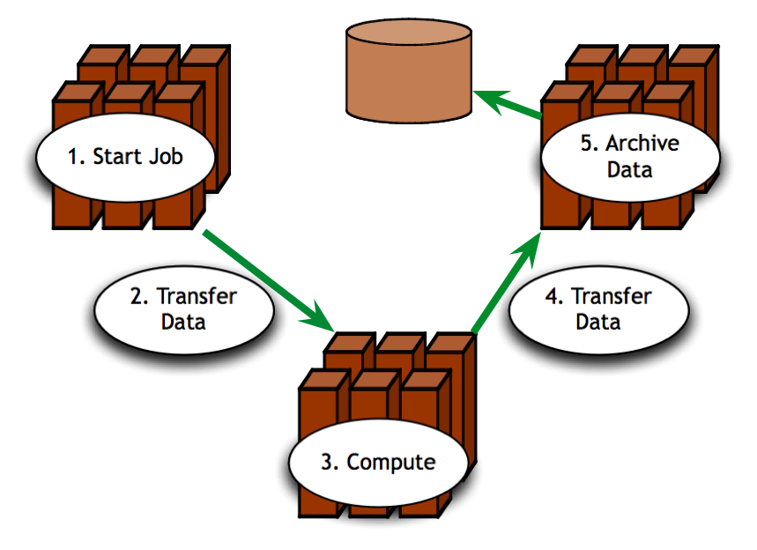
Is TeraGrid working?
Can TeraGrid users run their applications? Can they access their datasets?
  Can user login?
  Are Grid services the application[s] use available? Compatible versions?
  Are dataset[s] N accessible to user X? Credentials?
  …
Notes:
Now when we look at what this means for the user, TeraGrid is up if they can run their particular application on the set of resources they want, access their dataset, and get “good” performance.
In order for a Grid to be working from a user’s perspective they need to be able to login and find that the software and services their application requires function as expected
If you consider the requirements of a community of users and multiple communities of users, like the science gateways, those set of requirements can grow quite large.

Slide 3

What type of testing?
User-level deployment testing
  Automated, continuous checking of Grid services, software, and environment
  Installed? Configured correctly? Running? Accessible to users? Acceptable performance?
  E.g., gatekeeper ping or scaled down application
Notes:
When we refer to testing, we’re talking about testing at the deployment level
This is different than the type of testing you do at the software package level where you’re looking at detailed testing of the software features and checking that it works on all architectures using something like junit, tinderbox, etc.
This is also different than the type of testing that occurs at the software stack level where you’re looking at package version interoperability (e.g., NMI)
We are checking whether packages are installed, running, and configured correctly.
This tests can be something as simple as pinging a Globus gatekeeper service to a more complicated test such as a scaled down version of an application

Slide 4
Who is testing for?
TeraGrid management
  Responsible for designing & maintaining requirements
  Verify requirements are fulfilled by resource providers
System administrators
  Notified of problems
  Need enough information to understand context of problem
End users
  View results and compare to problems they are having
  Debug user account/environment issues
  Feedback to Grid/VO
Notes:
There are different consumers of the testing results: Grid/VO, system administrators, and end users
Based on the goals of the Grid, they decide what should be tested - the goal being to detect problems before the users do
While the Grid/VO will decide what to test, system administrators from each of the participating sites will need to be notified of failures and be able to understand how the test was conducted so they can debug their system. This implies that the need to trust the results.
While ideally, we hope that the failures will be caught before users notice them, in practice this is hard to achieve. Therefore, the results of our testing should be made available to users so if they’re having a problem, they can check the results to see if it might be system related.
They should also be able to use the tests to debug user account/environment issues specific to their account (e.g., removing an environment variable accidentally prevents a package from working)
For more advanced users, they could even feedback useful tests to the Grid/VO level to detect problem earlier

Slide 5
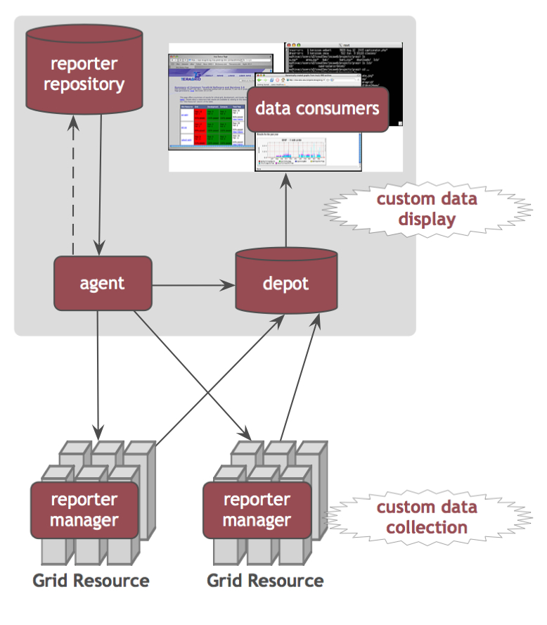
Inca
Inca automates user-level testing and benchmarking of TeraGrid’s services, software and environment
  schedules execution
  of information gathering
  scripts (reporters)
  collects, archives,
  publishes data
Notes:
Inca is… we developed about Inca 4 years ago with the goal of doing Verification&Validation of the TG software stack and environment.
It provides scheduled execution of information gathering scripts on the various grid resources which we call reporters. A reporter is typically a test of a grid service, a benchmark, or a version query of a grid software package and then formats the result in XML
The Inca system collects data generated by reporters on each of the resources, storage and archiving of that data, and then making it available for query/ or publishing the data where it can be displayed by a web page.
can be customized to show Grid usability from the perspective of a particular user or user community.
An Inca reporter is an executable program that tests or measures some aspect of a system or installed software. A reporter could be a simple Globus gatekeeper ping test or a more complex Grid application benchmark. Reporters must support certain command line options and produce XML according to the Inca reporter schema.
The Admin Tool is a user interface (java GUI) used by the Inca admin to administer all parts of an Inca deployment; it connects to the Reporter Agent
The Reporter Agent is a server which is the access point to an Inca deployment and is responsible for managing the control flow of an Inca installation
The Reporter Repository is responsible for storing Reporters (scripts that gather data from resources); reporters are packaged as RPMs; can be shared among multiple Inca deployments
The Reporter Manager is a lightweight process responsible for managing the schedule and execution of Reporters on a single resource; receives instructions from one and only one reporter agent.
The Depot is a server that is responsible for storing the data produced by reporters.
The Suite describes where to run the reporters, frequency of execution, and optionally expected values (I.e., instructions for how to collect data)

Slide 6
Some Features of Inca
  Runs under a regular user account
  Archives full reports
  Easy to customize data collection and display
  Profiles and logs test resource use
  Secure (SSL, MyProxy)
Notes:
Here’s what sets us apart as unique -- based on our experience with real Grid deployment on TG.
Run under generic user account enables user-level testing
Reports fully archived to understand the how the Grid behaves over time - for example to understand how a service fails over time and if it fails with the same type of error
The method to specify the data collection is very expressive to make it easy to configure Inca. Also easy to make changes to an existing deployment (important because resources and requirements change over time)
There’s such a thing as testing too often -- tradeoff of between freshness of data and impact on resource
Components use ssl to communicate, myproxy used to install reporter managers and for tests that need a proxy

Slide 7
Some Features of Inca
  Test schema is flexible
  (can monitor functionality and performance)
  Tests can be run from command line
  Captures test context
  Compares test results to a specification
Notes:
Express more than test pass/fail for example different types of performance information
Reporters can be run outside of the framework by a sysadmin debugging a problem or a user
Capture context of reporter execution (script, what machine it ran on, time it ran, inputs, selected environment variables, etc.)
Because analyzing historical error information can sometimes be resource-intensive, Inca can compare results to a specification and storing it (for example, a software stack specification). E.g. test to see if disk is under certain level

Slide 8
Inca on TeraGrid
Notes:
System admins are familiar with how inca is deployed today and current status pages, but I’ll review what we have for science gateway users so we can later discuss how it might be customized for gateways
I’ll also mention some of the near term milestones for system administrators

Slide 9
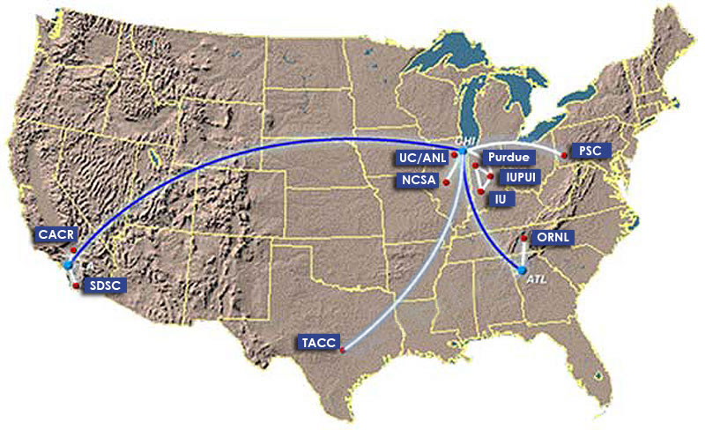
TeraGrid’s Inca Deployment
Currently monitoring all allocated TeraGrid resources at:
  ANL, Indiana, NCAR, NCSA, ORNL, PSC, Purdue, SDSC and TACC
Coordinated TeraGrid
Software & Services (CTSS)
  Coordinated user environment across heterogeneous resources
  TeraGrid VO service agreement
Notes:
Have been using inca since 2003 to monitor ctssv2, currently using to monitor ctssv3 and ctssv4

Slide 10
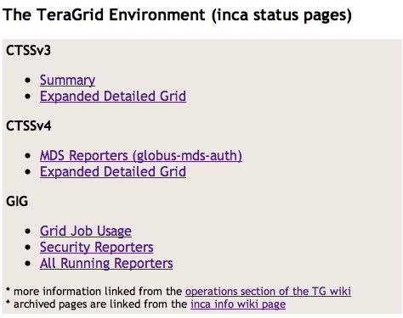
Current Inca Data Display
  All pages linked from repo.teragrid.org (staff)
  CTSSv3 page linked from www.teragrid.org user guide (users)

Slide 11
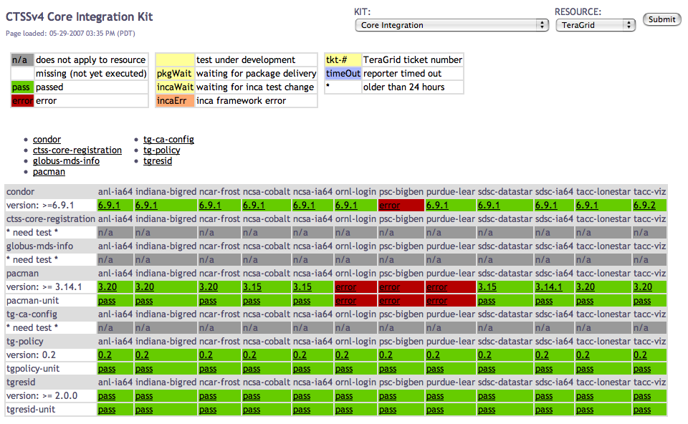
Current Inca Data Display: CTSSv4
Status of selected kit(s) on selected resource(s)
Notes:
used on TG since 2004

Slide 12
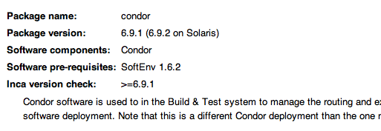
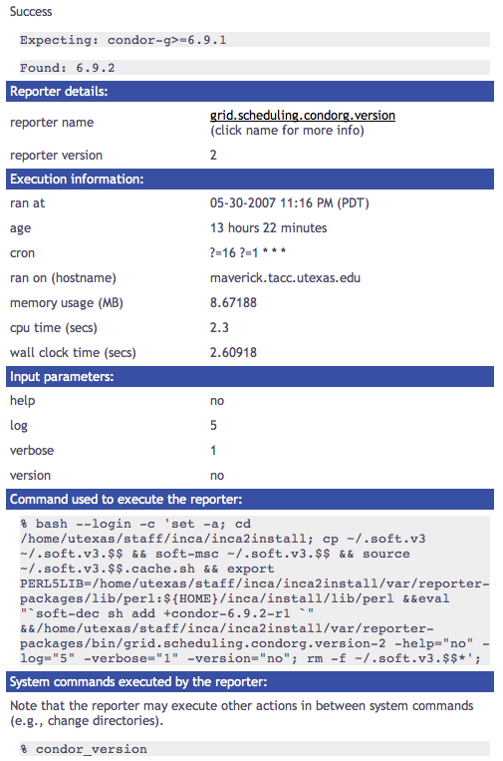
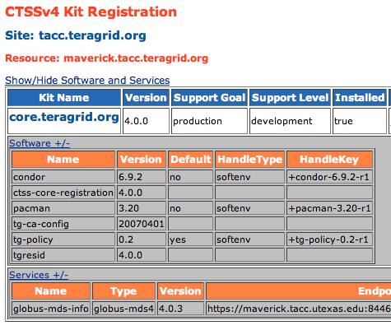
Current Inca Data Display: CTSSv4
Configured based on kit Integration Implementation wiki pages and MDS registered information
Notes:
used on TG since 2004
Example of reporter details in a single result view

Slide 13
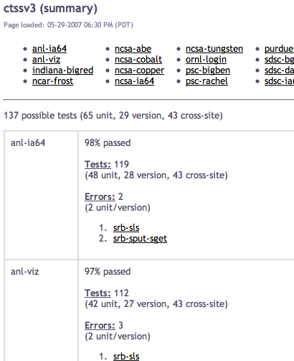
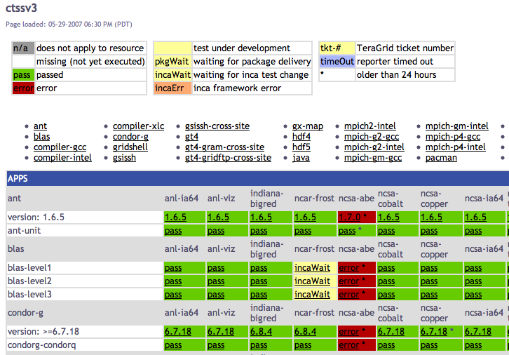
Current Inca Data Display: CTSSv3

Slide 14
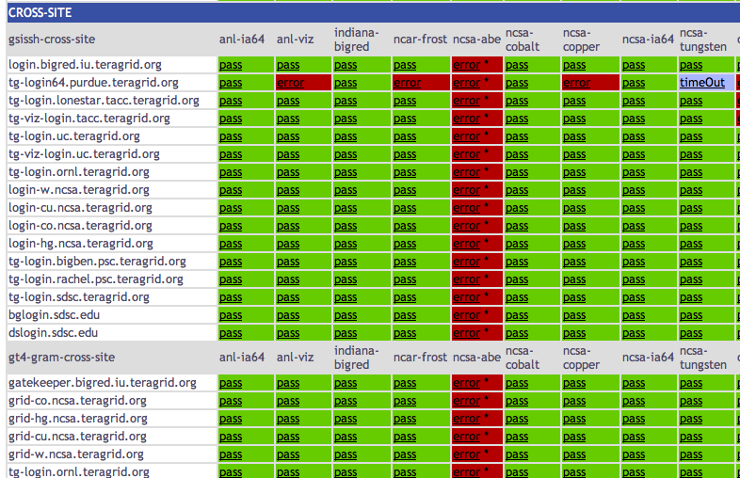
Current Inca Data Display: Cross-site Tests
Notes:
screenshot taken before abe was in production - also how a machine in downtime will look until database is integrated
Tests run randomly to reduce impact on systems, why a machine in maintenance will start to appear with a few errors
Timeout - test didn’t pass or fail, limits for reporters

Slide 15
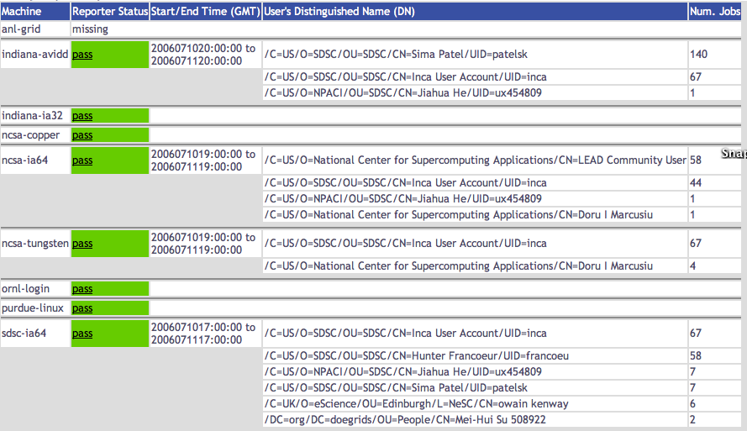
Current Inca Data Display: Grid Jobs
Notes:
Num of Grid jobs by user and by CA

Slide 16
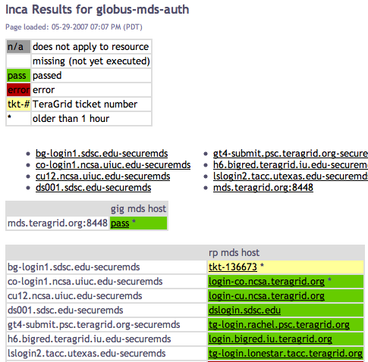
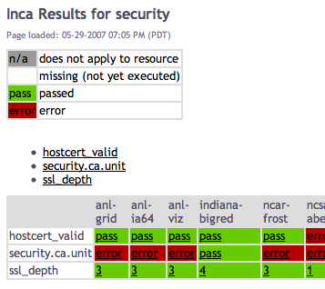
Current Inca Data Display:
Other Requested Status Pages
Notes:
Revised not to check to see that every cert in the dir is expired, just those supported by teragrid

Slide 17
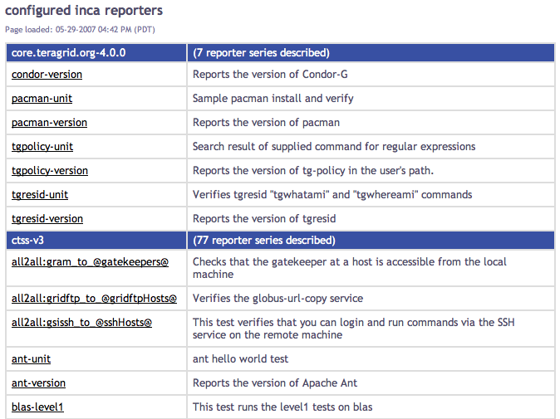
Current Inca Data Display:
List of Running Tests

Slide 18
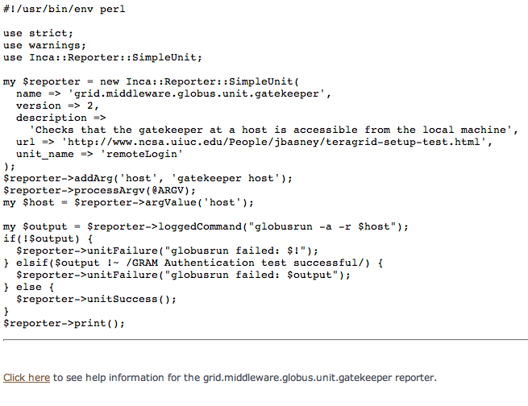
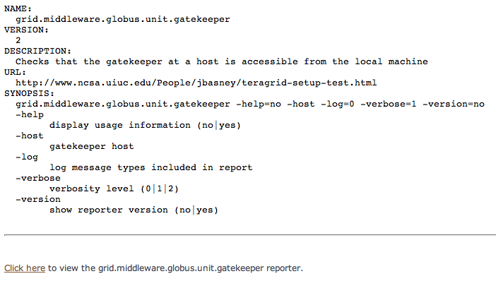
Current Inca Data Display:
List of Running Tests (cont)

Slide 19
Development Plans

Slide 20
Development Plans (near completion)
Run now capability (system admins):
  ability to execute configured reporters on demand and send reports to depot immediately
Comments form:
  staff will be able to view reporter execution details and add their own comments

Slide 21
Development Plans
Downtime handling:
  tests will not execute during planned downtime and status pages will display news with downtime information
State change reports (weekly ops call):
  report a summary of test status changes for a selected time period

Slide 22
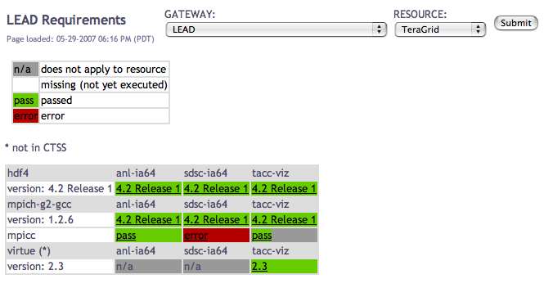
Custom Science Gateway Status
  Customize views of existing data, in future add new tests for gateway application
  Allow users to test and confirm that their Grid applications’ requirements are being met
Notes:
Application test suite - hypothetical

Slide 23
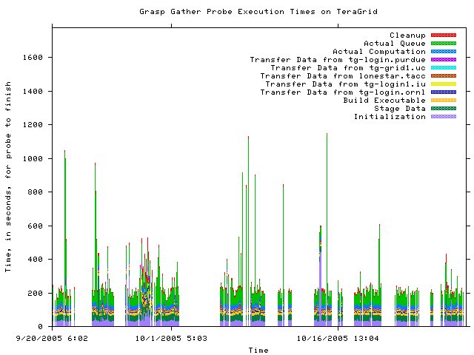
Historical Graphs
Notes:
Next three slides are example of historical graphs, not actively running
right now we have csv historical information
This is about 2 months of results from the gather probe running on TG in 2005
Y axis is execution time in seconds and x axis the time at which the measurement was taken
Colors indicate stage in execution of the probe
See how the performance varies over time - queue time most variable
white areas indicate probe did not complete due to an error - with version 2, we archive the error messages and can see what types of error messages are occurring

Slide 24
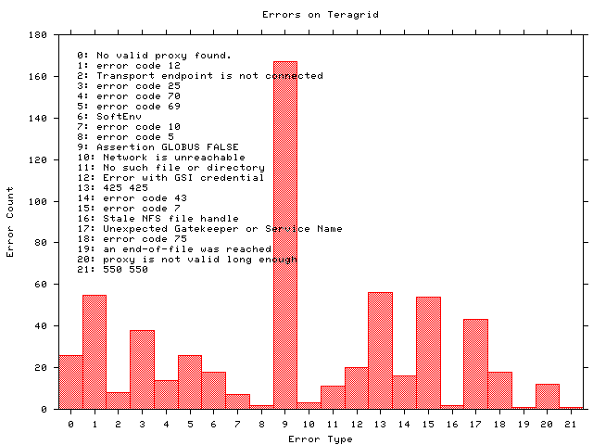
Historical Graphs
Notes:
Histogram shows what types of errors are occuring the most often - error messages are truncated
The highest number of occurrrences in 9 which is the result of a documented Globus 2.0 bug when the GRAM server is under high load
A full report of errors on TG found by the grasp gather probe. This is a new capability in Inca 2.0 -- Inca 1 was unable to archive error messages.

Slide 25
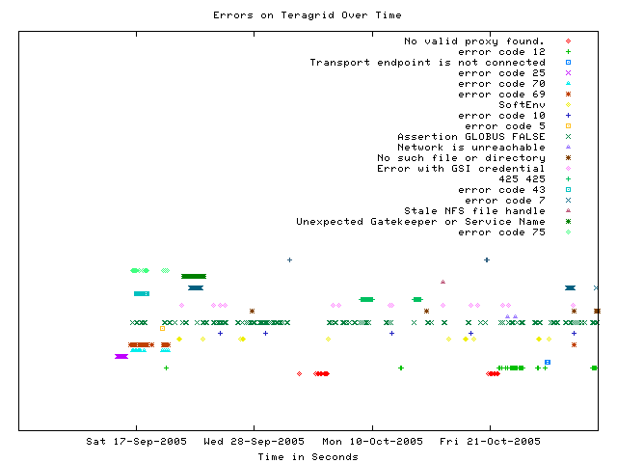
Displaying errors over time
Notes:
This graph shows when a certain type of error occurs over time
Most errors only occur for a few days before being fixed - for example, the dark green * “Unexpected Gatekeeper of service name” is a configuration error
Dark green xxx’s represent the Globus 2.0 bug over time - a transient error occurs continuously

Slide 26
More information
Inca Web Page:
  http://inca.sdsc.edu
TeraGrid Inca Status Pages:
  Staff: https://repo.teragrid.org/
  Users: http://www.teragrid.org/userinfo/monitor.php
Email:
  inca@sdsc.edu
Notes:
That was our current plan for future development, we’ll be updating system administrators about the status of work on the call
if science gateway interested in setting up custom view of data for their application, please come talk

Slide 27








Related Grid monitoring tools
MDS
Hawkeye
  Inca’s primary objective:
  user-level Grid functionality testing
  and performance measurement
Notes:
Over the past couple years, several monitoring tools have been developed that are at a high-level similar to Inca wrt to data collection, data storage, and data dissemination
We feel the main difference between Inca and these tools is that ….
While other Grid monitoring tools provide system-level information on the utilization of Grid resources, the Inca system provides user-level Grid monitoring with periodic, automated testing of the software and services required to support persistent, reliable Grid operation.
Tools such as MonALISA and GridICE can aggregate and display data from existing cluster or system administrator monitoring tools such as Ganglia, CluMon, and Nagios. This provided a centralized, systems-level view of Grid resources where low-level host statistics and queue information can be examined. This type of monitoring information was useful for showing the utilization of Grid resources, however, it did not provide the type of high-level monitoring needed to detect user problems within the Grid infrastructure.
Because some of these tools support aggregation like MonALISA and MDS, Inca could be used to feed information into these systems.
Backup
Archiving of the data
some systems use a relational DB like Big Brother (Sybase), GridICE (postgres), MonALISA (MySQL, PostgreSQL, Microsoft SQL Server)
Ganglia uses RRDTool and Nagios uses logs
Tools like MonALISA and GridICE do a lot wrt accounting/job monitoring -- not something we’ve addressed but we could
Inca could complement MonALISA, GridICE, MDS since they are aggregate data.
There’s also the NCSA TestGrid and GITS -- not frameworks
We’re working with GITS’ David Baker to incorporate tests into Inca

