Slide 1
Inca TeraGrid Deployment Status & Upgrade Plans
Shava Smallen
July 13, 2006

Slide 2
Outline
Inca 1
CTSSv2 Inca deployment
CTSSv3 Inca deployment
Inca 2
Upgrade plans
Notes:
Goal: describe the features of a second version of Inca that we’ve been working on since last year and discuss Inca upgrade plans and how that will affect the current Inca deployment CTSSv3
useful to discuss at a high-level the Inca architecure and review the current and past status pages
So, I will first describe the Inca v1 architecture and then talk about how it was utilized to verify CTSSv2 and show the web status pages that we developed
I’ll then discuss how we transitioned over to CTSSv3 and what is currently available
Then I’ll go over the new features of Inca v2 and give a high-level view of its architecture.
Finally, I’ll discuss the current upgrade plans that we are developing.

Slide 3
Inca
Inca is a framework for the automated testing, benchmarking and monitoring of Grid resources
Inca provides:
  Scheduled execution of information gathering scripts (reporters)
  Data management
    collection
    archiving
    publishing
Notes:
For those who might not be as familiar, we developed about Inca 3 years ago with the goal of doing V&V of the TG software stack and environment. We designed to be general enough to
It provides scheduled execution of information gathering scripts on the various grid resources which we call reporters. A reporter is typically a test of a grid service, a benchmark, or a version query of a grid software package and then formats the result in XML
The framework provides collection of the data generated by reporters on each of the resources, storage and archiving of that data, and then making it available for query/ or publishing the data where it can be displayed by a web page.

Slide 4
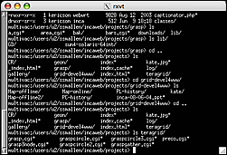
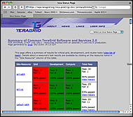
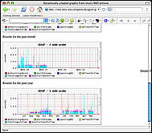
Inca 1 architecture overview
R
Reporter
Data Consumers
S
Schedule and execution instructions
Depot
Controller
Controller
Controller
…
Runs under regular user account ‘inca’
S
R
R
S
R
R
S
R
R
Resource 1
Resource 2
Resource N
Notes:
Runs under regular user account ‘inca’
Reporter runs test, query, or benchmark and formats the output as XML
XML needs to include some required tags (I.e., header) so that data can be identified at storage and to collect context about how the reporter was executed but the rest (body) of the report can be anything -- we provide perl libraries to make it easier to generate the reports --
The specification describes how often to run the reporters and with what arguments. You can specify different frequencies for each reporter. Uses a perl module that implements cron to handle the scheduling.
The Depot collected the xml from all reporters from all sites and stored as a single XML document. This document could then be queried and web status pages generated to show the machine status. The Depot also utilized RRDTool to do numerical archiving so you could do queries there too.

Slide 5
Outline
Inca 1
CTSSv2 Inca deployment
CTSSv3 Inca deployment
Inca 2
Upgrade plans
Notes:
Goals:
* discuss the Inca upgrade plans and how that will affect the current Inca deployment
* useful to describe Inca v1 architecture at a high level
* talk about the Inca deployment of CTSSv2 and how things we encountered there led to Inca v2
* CTSSv3 deployment
* Then I want to go over the Inca v2 architecture and some of its features
* Then finally I’ll review the upgrade plan

Slide 6
Inca 1 TeraGrid deployment: CTSSv2 V&V
Common software stack:
  20 core packages: Globus, SRB, Condor-G, MPICH-G2, OpenSSH, SoftEnv, etc.
  9 viz package/builds: Chromium, ImageMagick, Mesa, VTK, NetPBM, etc.
  21 IA-64/Intel/Linux packages: glibc, GPFS, PVFS, OpenPBS, intel compilers, etc.
50 version reporters: compatible versions of SW
123 tests/resource: package functionality
  Services: Globus GRAM, GridFTP, MDS, SRB, DB2, MyProxy, OpenSSH
  Cross-site: Globus GRAM, GridFTP, OpenSSH
Softenv db and default environment reporters
Notes:
34 unit reporters run 123 unit tests per resource

Slide 7
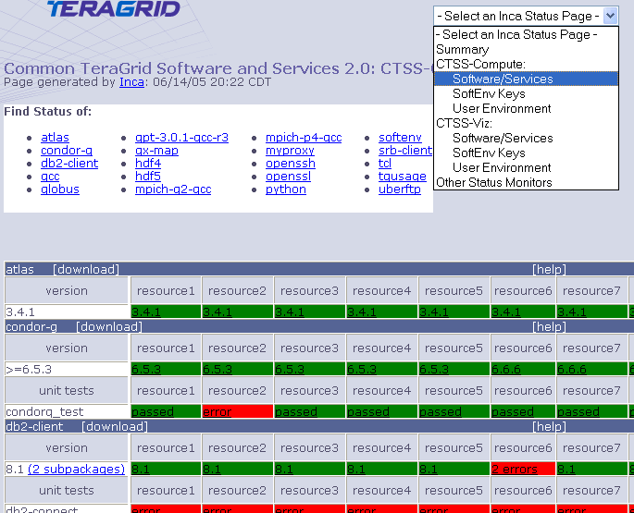
Software Stack Detail Status View
Resources
SW
packages

Slide 8
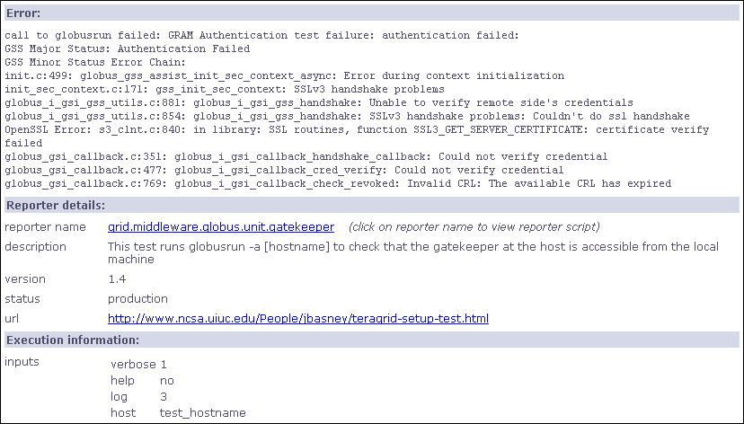
Single result view

Slide 9
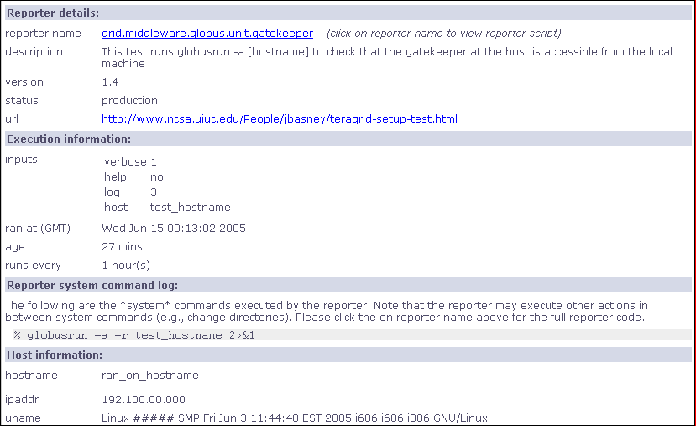
Single result view

Slide 10
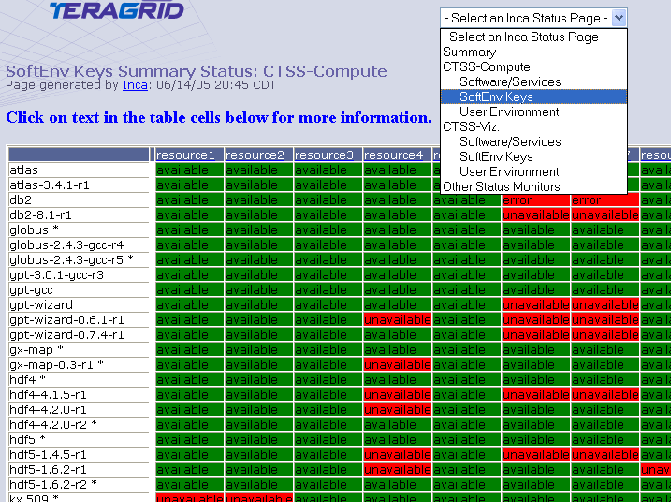
Softenv Status Page
Resources
Softenv
keys

Slide 11
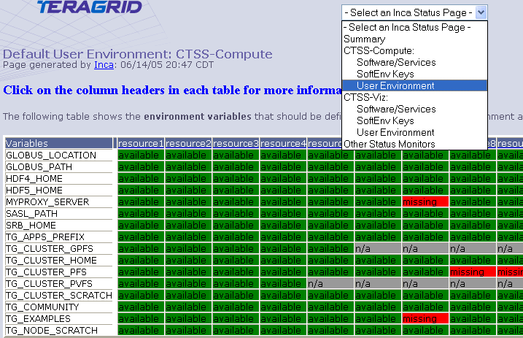
Default Environment Status Page
Resources
Environ
variables

Slide 12
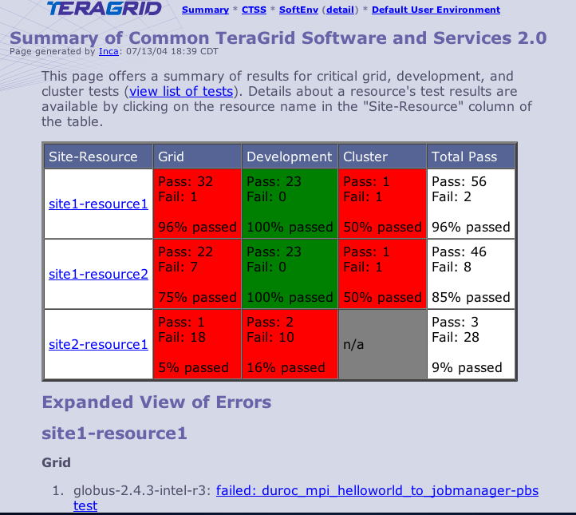
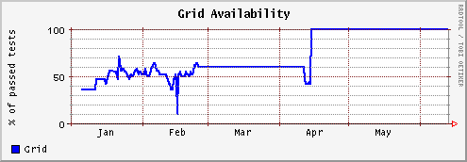
Summary status page
All tests passed: 100%
One or more tests failed: < 100%
Tests not applicable to machine or have not yet been ported
Key
History of percentage of tests passed in “Grid” category for a 6 month period
Notes:
Graph shows that it took about 3 months to get the Grid functionality working and then it was fairly stable.

Slide 13
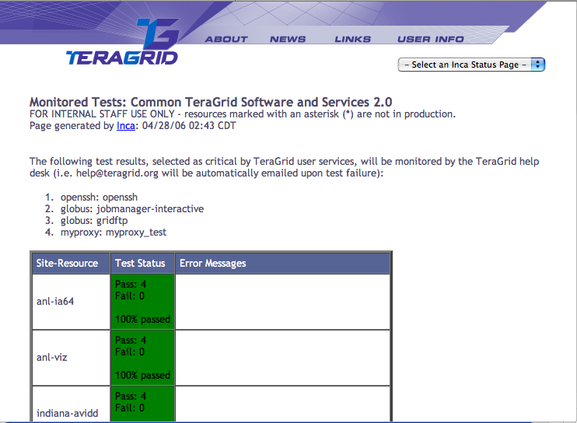
Critical Tests Status Page
Sent email to help@teragrid.org on error
Resources

Slide 14
Inca 1 Status Pages
(2004 - April 24, 2006)
CTSSv2
Software Stack
  Detail view
  Summary view
  Critical test view
User environment
  Softenv Status
  Default environment status
CTSS v3
Software stack detail (Nov 5, 2005) - staff only

Slide 15
Outline
Inca 1
CTSSv2 Inca deployment
CTSSv3 Inca deployment
Inca 2
Upgrade plans
Notes:
Goals:
* discuss the Inca upgrade plans and how that will affect the current Inca deployment
* useful to describe Inca v1 architecture at a high level
* talk about the Inca deployment of CTSSv2 and how things we encountered there led to Inca v2
* CTSSv3 deployment
* Then I want to go over the Inca v2 architecture and some of its features
* Then finally I’ll review the upgrade plan

Slide 16
Inca 1 Status Pages
(April 24 - June 19, 2006)
CTSSv3 - staff only
  Software stack detail (33+ units, 4 cross-site, 33 versions)
    Split across 2 Inca servers
CTSSv2 (reduced)
Software Stack
  Detail view (3 units, 3 cross-site, 0 version)
  Summary view (removed)
  Critical test view (unchanged)
User environment
  Softenv Status (unchanged)
  Default environment status (unchanged)
Notes:
The deployment of CTSSv3 was done in a 2 main stages. Although we had a page for CTSSv3 up since November, it wasn’t until April when the definition of CTSSv3 was finalized that we made more noticeable changes. Due to time constraints we were only able to put up the software stack detailed page for CTSSv3. Since there was a good amount of overlap in CTSSv2 and CTSSv3, we reduced the CTSSv2 deployment so it was only running a small subset (that which powered the critical monitored test status page. We still had the softenv and environment pages.

Slide 17
Inca 1 Status Pages (CTSSv3)
(June 19 - today)
CTSSv3
  Software stack detail (33+ units, 4 cross-site, 33 versions)
CTSSv2 (all removed)
Notes:
Then once CTSSv3 went production, we removed CTSSv2 pages and just held onto the CTSSv3

Slide 18
Outline
Inca 1
CTSSv2 Inca deployment
CTSSv3 Inca deployment
Inca 2
Upgrade plans
Notes:
Goals:
* discuss the Inca upgrade plans and how that will affect the current Inca deployment
* useful to describe Inca v1 architecture at a high level
* talk about the Inca deployment of CTSSv2 and how things we encountered there led to Inca v2
* CTSSv3 deployment
* Then I want to go over the Inca v2 architecture and some of its features
* Then finally I’ll review the upgrade plan

Slide 19
Motivation for Inca 2
Inca 1 was a prototype
Experiences using Inca:
  Testing is an iterative refinement process
  Testing is a trade-off between freshness of data and impact on resource
  Needed more scalable and flexible data storage
Notes:
So what were are motivations for developing Inca 2.
Firstly, for better or worse, version 1 can really be described as a prototype. The main concern we addressed with this version was speed of development, So, naturally, you don’t have the luxury of pondering the best scalable and secure design or time to develop a good set of unit and integration tests. Without tests, software becomes fragile and difficult to maintain software because you have limited capabilities to test changes.
Address scalability, security, and maintainability thru testing
Second, there were a number of things we had learned from our experiences deploying Inca on TeraGrid that we wanted to take into account into this new version:
Second, one of the things that we observed or realized is that testing is really an iterative refinement process. And there are 2 main reasons for that 1) tests have to be ported to several arch/Oses and depending on their complexity, you run into the same complexities of porting an application on the Grid and 2) we’re often asked to test before the documentation is available so we may not know that a site requires a particular parameter unti we deploy it, it fails, and the sys admins complain. So, you frequent reporter and configuration updates are a reality and in Inca v1 most of it was handled manually which was somewhat tedious when you had 5 resources and now with 18 resources become very tedious.
Third we found that oftentimes multiple views of the collected data - nice to have flexible querying interfaces to filter data, etc.
Finally, we had had complaints that Inca testing was taking up too much resources on a machine so we
Enabling multiple views of the collected data

Slide 20
Inca 2 feature: Full Report Archiving
Inca report - completed
Inca report - error
…
<body>
<benchmark>
<ID>download</ID>
<statistic>
<ID>bandwidth</ID>
<value>105.26</value>
<units>kb/sec</units>
</statistic>
</benchmark>
</body>
<exitStatus>
<completed>1</completed>
</exitStatus>
…
…
<body></body>
<exitStatus>
<completed>0</completed>
<errorMessage>wget command failed: --15:29:23-- http://www.nosite/
=&gt; `/dev/null'
Resolving www.nosite... failed: Host not found.
</errorMessage>
</exitStatus>
…
Inca 1 archiving
Inca 2 archiving
Notes:
A reporter is …
These boxes show the result of a simple reporter that just measures the time it takes to download a particular web page. So, we have result which shows the bandwidth that wget returned and then a report result that failed because the site didn’t exist.
So, in version 1 we cached the full reports but were only able to archive numerical data indicated by the cyan.
In version 2, we are able to archive the full reports

Slide 21
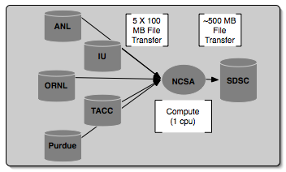
Inca 2 in use: Grid benchmarks
GrASP: Grid Assessment Probes
  Set of probes designed to emulate Grid applications
  Deployed to GEON and TeraGrid
Gather probe on TeraGrid
Notes:
Collect Grid benchmark measurements using GrASP (Grid Assessment Probes) developed by Henri Casanova and Allan Snavely’s groups
Requested queue time is 1 hour, actual compute is less than a minute

Slide 22
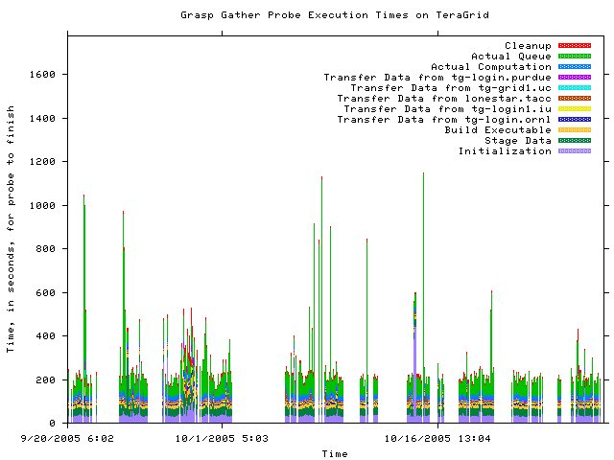
GrASP: Measuring Grid middleware performance
Notes:
This is about 2 months of results from the gather probe running on TG
Y axis is execution time in seconds and x axis the time at which the measurement was taken
Colors indicate stage in execution of the probe
See how the performance varies over time - queue time most variable
white areas indicate probe did not complete due to an error - with version 2, we archive the error messages and can see what types of error messages are occurring

Slide 23
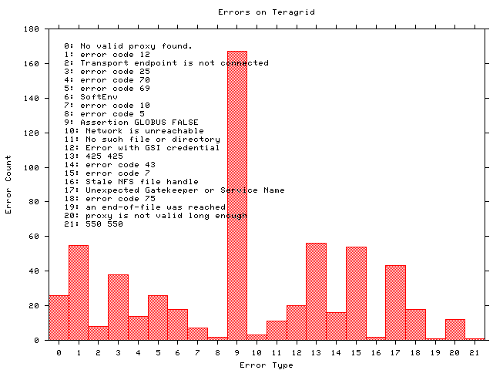
GrASP: Monitoring Grid middleware reliability
Notes:
Histogram shows what types of errors are occuring the most often - error messages are truncated
The highest number of occurrrences in 9 which is the result of a documented Globus 2.0 bug when the GRAM server is under high load
A full report of errors on TG found by the grasp gather probe. This is a new capability in Inca 2.0 -- Inca 1 was unable to archive error messages.

Slide 24
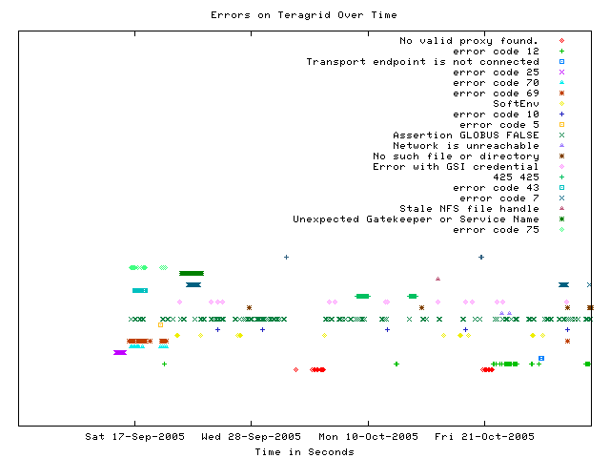
GrASP: Error tracking over time
Notes:
This graph shows when a certain type of error occurs over time
Most errors only occur for a few days before being fixed - for example, the dark green * “Unexpected Gatekeeper of service name” is a configuration error
Dark green xxx’s represent the Globus 2.0 bug over time - a transient error occurs continuously

Slide 25
Inca 2 feature: Improved installation and configuration control
GUI tool for centralized administration
Reporter sharing via repositories
Proxy management via MyProxy
Incat screenshot
Notes:
Going back to one of the things we wanted to incorporate in the new design, lots of configuration and reporter changes which was handled in a mostly manual fashion
So, one of the key new features is that we provide centralized control so that we can make a change in one place and it will be automatically propagated to each resource. We also added a GUI front end which makes it easier to make changes (where is in Inca 1, we edit XML files)
Tests of Grid services need valid proxies and this was another thing that was handled manually. Another feature designed to faciliate deployment was to handle proxy renewal via MyProxy.
3rd, we created reporter repositories for publishing the reporter - this facilitates sharing of reporters and updates

Slide 26
Inca 2: Additional features
Flexible querying interface - relational db backend
Profile reporter system usage
Inca components communicate using SSL

Slide 27
Inca 2 architecture overview
5. GUIs can display collected data by querying Depot
Reporter
Repository
Incat
Create a “suite”
Data Consumers
Suite
R
Reporter
Agent
Submit suite to Reporter Agent
Depot
Depot
3. Reporter Agent invokes Reporter Managers and distributes suite and reporters
S
S
S
R
R
R
4. Reporter Managers send data to Depot
Reporter
Manager
Reporter
Manager
Reporter
Manager
…
Resource N
Resource 1
Resource 2
Notes:
The Admin Tool is a user interface (java GUI) used by the Inca admin to administer all parts of an Inca deployment; it connects to the Reporter Agent
The Reporter Agent is a server which is the access point to an Inca deployment and is responsible for managing the control flow of an Inca installation
The Reporter Repository is responsible for storing Reporters (scripts that gather data from resources); reporters are packaged as RPMs; can be shared among multiple Inca deployments
The Reporter Manager is responsible for managing the schedule and execution of Reporters on a single resource; receives instructions from one and only one reporter agent.
The Depot is a server that is responsible for storing the data produced by reporters.
The Suite describes where to run the reporters, frequency of execution, and optionally expected values (I.e., instructions for how to collect data)

Slide 28
Architecture overview:
Scalable design
VO B
Incat
Reporter
Repository
VO A
Incat
Reporter
Repository
Forward suite
Reporter
Agent
Reporter
Agent
Depot
Depot
Forward results
Reporter
Manager
Reporter
Manager
Reporter
Manager
Reporter
Manager
Reporter
Manager
Resource 4
Resource 5
Resource 1
Resource 2
Resource 3
Notes:
Inca designed to be scalable in wrt to data collection and storage (e.g., depots can be arranged hierarchically)
For example, suppose VO B has access to resources on VOA. Rather than VO B running duplicate reporters on VO A resources, VO B can request data from VO A (securely) and then VO A will send the results to VO B.

Slide 29
Outline
Inca 1
CTSSv2 Inca deployment
CTSSv3 Inca deployment
Inca 2
Upgrade plans
Notes:
Goals:
* discuss the Inca upgrade plans and how that will affect the current Inca deployment
* useful to describe Inca v1 architecture at a high level
* talk about the Inca deployment of CTSSv2 and how things we encountered there led to Inca v2
* CTSSv3 deployment
* Then I want to go over the Inca v2 architecture and some of its features
* Then finally I’ll review the upgrade plan

Slide 30
Upgrade Timeline
7/3-7/14 (2 weeks) - Initial Inca 2 deployment (3 new reporters). Adds 2 new status pages:
  Grid jobs by CA/DN
  Security - verify host certificates (>14days) and CRLs are valid
7/17-7/28 (2 weeks) - Migrate Inca1 web status page display features to Inca 2 (e.g. groupings)
7/31-8/11(2 weeks) - Migrate CTSSv3 reporters to Inca2 on first half TeraGrid machines (ANL, SDSC, NCSA).
8/14-8/18 (1 week) - Migrate CTSSv3 reporters to Inca2 on second half TeraGrid machines (Indiana, ORNL, PSC, Purdue, TACC page).

Slide 31
Upgrade Timeline
8/21-8/28 (1 week) - Revive softenv status page, allow filtering by resources in status pages. Discuss with gig-pack and software-wg other views of CTSSv3 data they would like to see.
Post 8/28: Develop views of CTSSv3 data, including historical views. Work with gig-pack to plan Inca 2's role for CTSSv4.
New Items:
(1-2 weeks) Re-deploy 7-step tests + mpich-g2
(2 weeks) - Revive critical test status page, email notification
(1-2 weeks?) Accounting monitoring

Slide 32
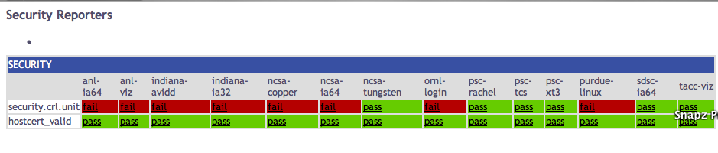
Security Status Page

Slide 33
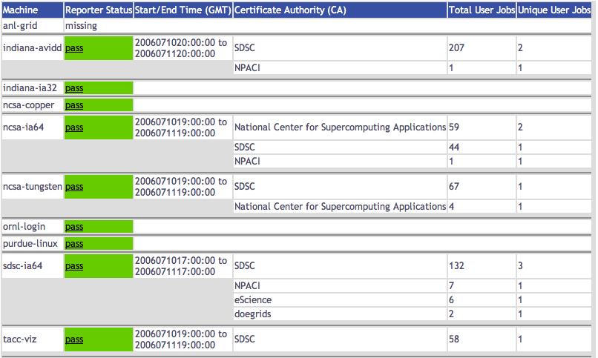
Grid Jobs Status Page (CA)

Slide 34
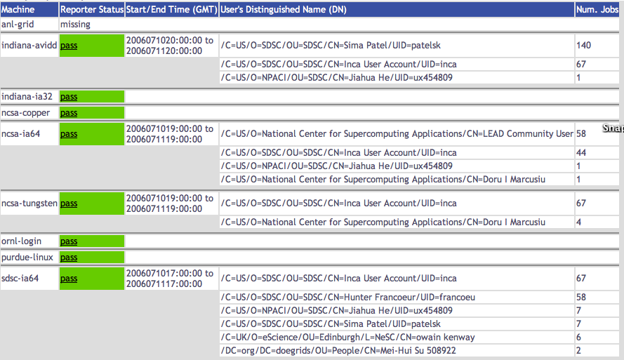
Grid Jobs Status Page (Users)

Slide 35
More information
Inca Web Page:
  http://inca.sdsc.edu
TeraGrid Inca Status Pages
  http://repo.teragrid.org
Email
  inca@sdsc.edu

