Slide 1
Administering Inca with incat
Jim Hayes
jhayes@sdsc.edu
Inca Workshop
September 4-5, 2008

Slide 2
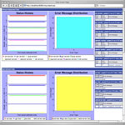
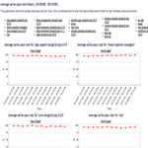
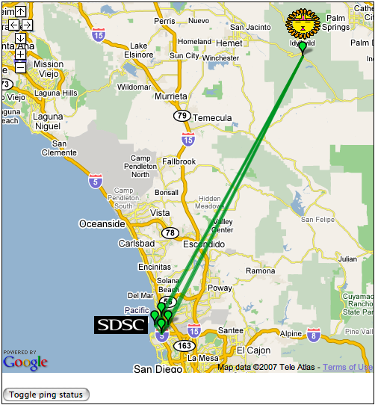
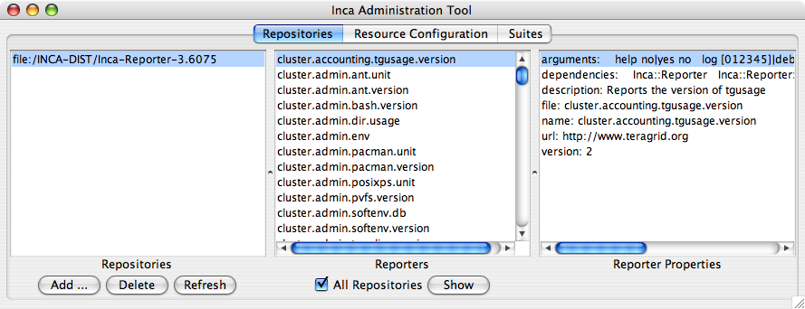
incat
Reporter
Repository
Data Consumers
R
Incat
C
Agent
Depot
S
A graphic editor for an Inca deployment configuration--XML that describes repositories, resources, and series
S
r
S
R
r
R
Reporter
Manager
Reporter
Manager
…
Grid Resource
Grid Resource
Notes:
TG 22K lines of XML

Slide 3
Launching incat
“inca start incat” to start
Can work with a local file (--file path), an Agent (--agent host:port), or both
Retrieves existing configuration from Agent and/or loads specified file

Slide 4
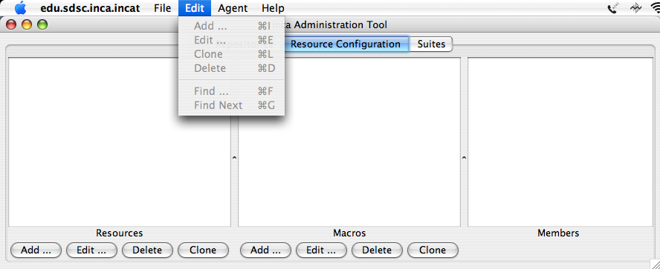
incat Display
Tabs for repositories, resources (shown), and suites (series collections)
File Open/Save/Save As menu
Edit menu supports modifying and searching selected panel
Agent/Commit sends Inca deployment configuration to Agent
Online user’s guide via Help menu

Slide 5
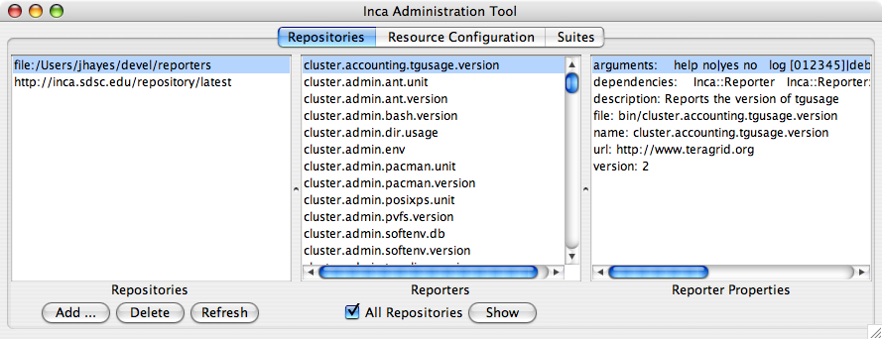
Repositories Tab
Repository list, reporter collection, catalog entry
Reporter information retrieved from connected Agent
file:// URLs relative to Agent

Slide 6
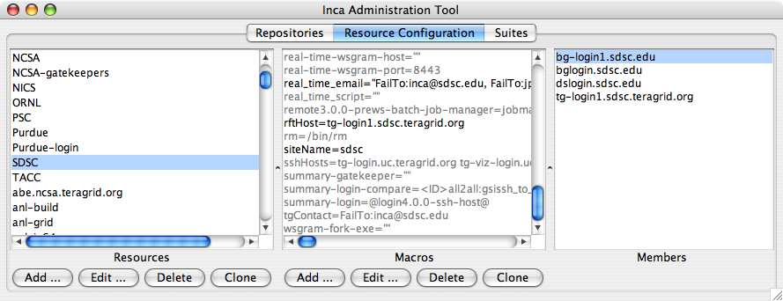
Resource Configuration Tab
Resource name, associated macros, member hosts
Supports grouping resources
Macro values “inherited”; macro of most specific group applies

Slide 7
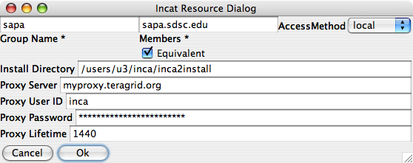
Specifying Resources
Equivalent resources use only one Reporter Manager
Local resource is machine where Agent runs
Install directory defaults to ~/incaReporterManager
Proxy information for Agent access to Globus resources and for Reporters that require a certificate

Slide 8
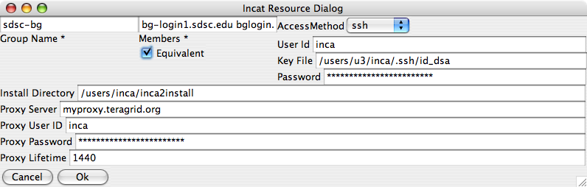
Specifying Ssh Resources
Accessed by Agent using j2ssh classes
Reporter Manager staging via sftp
Password stored/transmitted encrypted

Slide 9
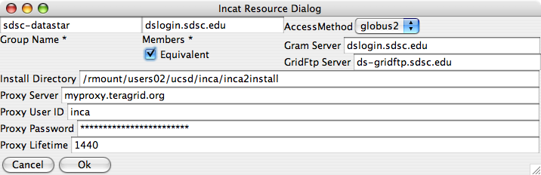
Specifying Globus Resources
Accessed by Agent via Globus CoG Java classes
Reporter Manager staging via GridFtp

Slide 10
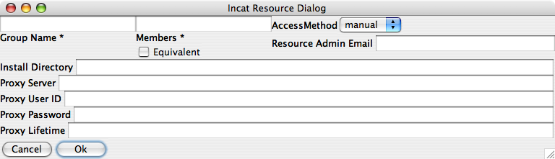
Specifying Manual Resources
Agent has no access
Email sent to sysadmin when changes need to be made

Slide 11
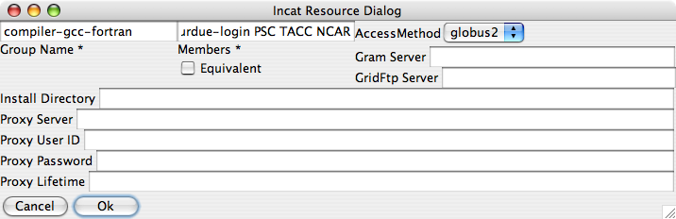
Grouping Resources
Convenience for specifying series to run on multiple resources
Directory, proxy info, etc. are like macros--most specific value is used for each host

Slide 12
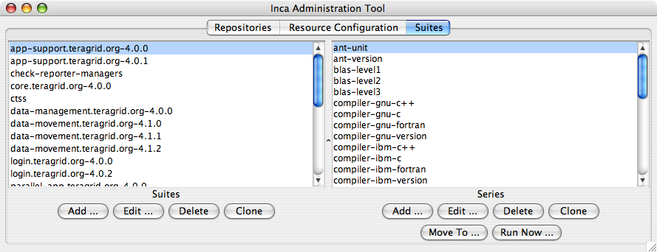
Suites Tab
Suites and series
Grouping of series into suites allows clearer Consumer display
Report series named after reporter or given “nickname”
“Move To …” allows shifting series between suites
“Run Now …” allows immediate Reporter execution

Slide 13
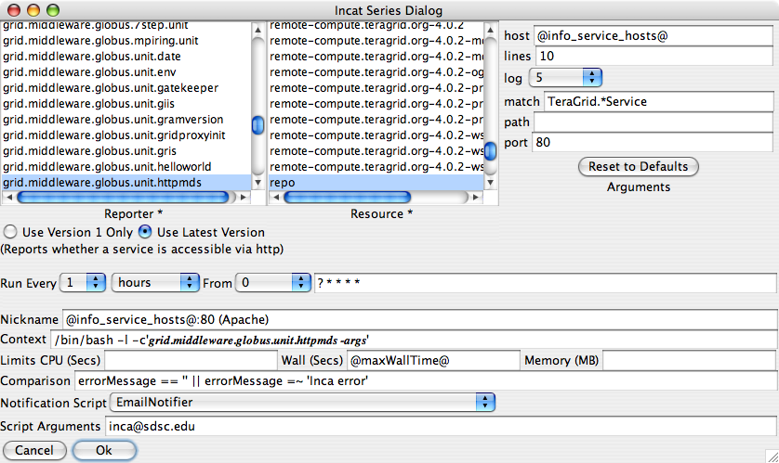
Report Series Editor

Slide 14
Report Series Editor (Upper)
Select reporter and resource; specify command-line arg values
Argument list determined by reporter
Use latest version automates Reporter updates
Reporter description appears below reporter

Slide 15
Report Series Editor (Lower)
Run frequency uses extended cron syntax
Nickname useful in later report display--should be unique
Context allows specialized execution
Reporter killed and error report stored if limits exceeded
Comparison allows more precise definition of reporter success/failure
Notification script run when state changes

Slide 16

Comparisons Refine Success and Failure
<body>
<package>
<ID>openssh</ID>
<version>3.6.1p1</version>
</package>
</body>
ID/Value pair
Comparison can test body, errorMessage, ID values from report body
Supports comparison operators and pattern matching
Email, Log notifiers provided; custom notifiers supported
Email notifier reports success, failure, or both

Slide 17
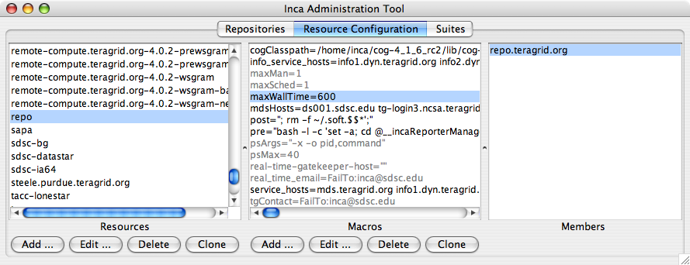
Using Macros in Report Series
Separate series for each macro value
Undefined macros flagged by incat

Slide 18
Agenda -- Day 1
9:00 - 10:00 | Inca overview
10:00 - 11:00 | Working with Inca Reporters
11:15 - 12:00 | Hands-on: Reporter API and Repository
1:00 - 2:00 | Inca Control Infrastructure
2:00 - 3:00 | Administering Inca with incat
3:15 - 4:00 | Hands-on: Inca deployment (part 1)
Notes:
Check syncs with website

