Slide 1
Inca 2 Design
Shava Smallen
Cathie Olschanowsky
Jim Hayes

Slide 2
Introduction
Inca is a framework for doing automated testing, benchmarking, and monitoring of a Grid
VO-level reliability testing and diagnostic tool
Initial version focused on functionality
Redesign Themes:
  Scalability
  Usability
  Performance
  Security
  Fault Tolerance

Slide 3
Terminology
Reporter - a script or executable that runs a test, query, or benchmark
Suite - an XML document that describes a data set and collection policies; implemented via a set of reporters

Slide 4
Outline
Requirements
Components Overview
Scenarios
Component Details
Security

Slide 5
Functional Requirements
Data collected should not be lost due to the failure of a single component.
Data should be archived.
Data about an entire virtual organization should be available from a single point.
Data collection scheduling and execution should be flexible and configurable.
Installation, setup, and maintenance of the Inca deployment should be simple, straightforward, configurable, and pain-free.
Security
Self-monitoring

Slide 6
Performance Requirements
The Inca framework should have a minimal impact on the resources it is monitoring.
Scalable

Slide 7
Resource Characteristics
A resource may belong to one or more VOs
A resource may have multiple points of login

Slide 8
Outline
Requirements
Components Overview
Scenarios
Component Details
Security

Slide 9
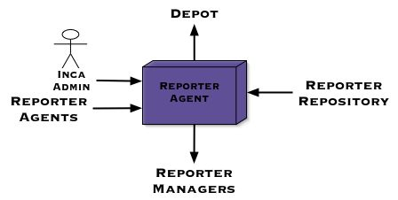
Reporter Agent
Functions
  Coordinates the collection of specified data sets and configures their storage requirements
  Manage a set of Reporter Managers and cooperate with other reporter agents
  Access point to Inca deployment
Requirements
  Ease of administration
  Security

Slide 10
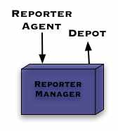
Reporter Manager
Functions
  Data collection on a resource
  Profile system use
Requirements
  Low System Impact

Slide 11
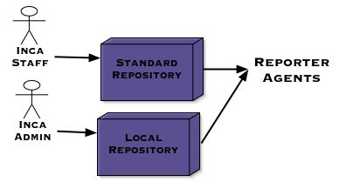
Reporter Repository
Functions
  Provide Reporters to RAs
Requirements
  Extensibility
  Easy admin

Slide 12
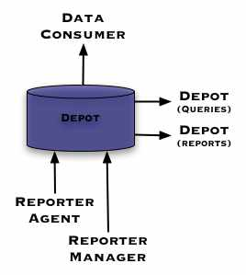
Depot: Data Storage/Access
Functions
  Receive Reports
  Forward Reports
  Service Queries
  Save Limited Configuration
Requirements
  Limited Growth

Slide 13
Outline
Requirements
Components Overview
Scenarios
Component Details
Security

Slide 14
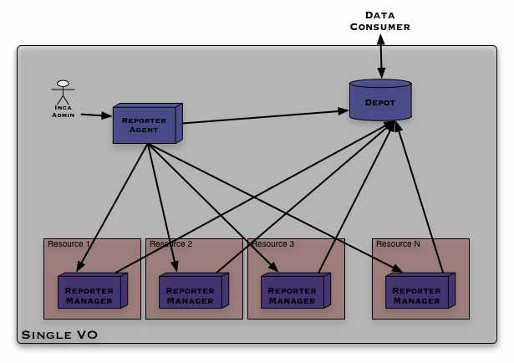
Usage Scenario: Single VO
Notes:
Things to note here: The depot represents a peer to peer network of depots… All of the resources belong to a single VO so there is only a need for a single Reporter Agent. Each resource has its own reporter manager.

Slide 15
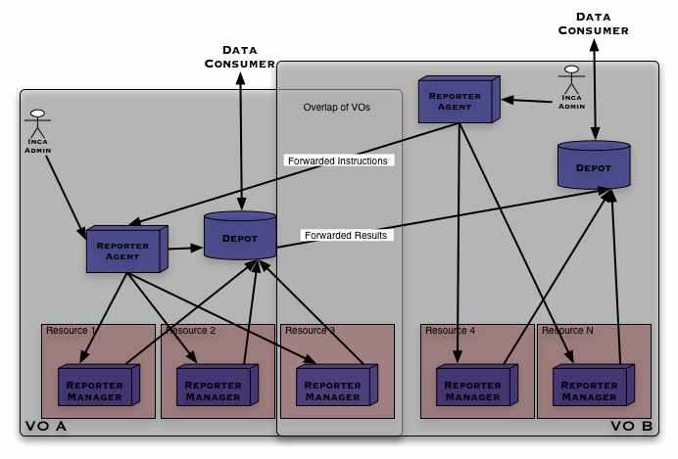
Usage Scenario: Multiple VOs
Notes:
Resource 3 is used by both Vos -> take note of which data is transferred between Vos. The security must be handled between those components.
Resource 3’s primary VO is VO A in this case.

Slide 16
Outline
Requirements
Components Overview
Scenarios
Component Details
Security

Slide 17
Control [Requirements]
The Inca framework should have a minimal impact on the resources it is monitoring.
Data collection scheduling and execution should be flexible and configurable.
Installation, setup, and maintenance of the Inca deployment should be simple, straightforward, configurable, and pain-free.
In order to test Grid functionality, access to a valid credential is needed from a reporter.

Slide 18
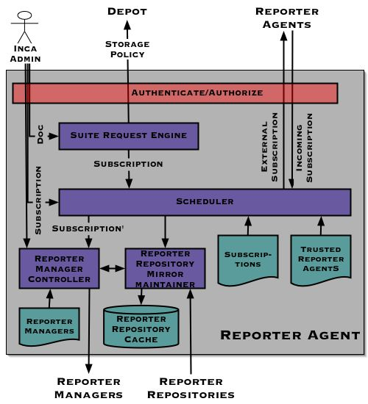
Reporter Agent
Translate suite descriptions into execution schedules
Manage set of Reporter Managers [fault detection]
Configure storage policy
Cooperate with other VO Reporter Agents

Slide 19
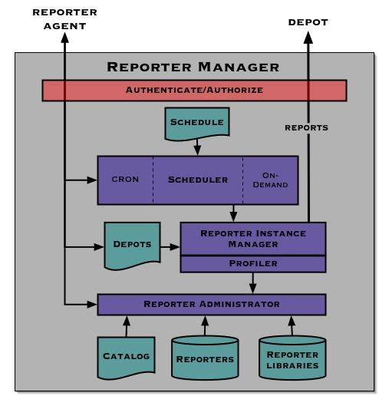
Reporter Manager
Collects data and send to Depot for storage
Cron and on-demand scheduling
Support scheduler plug-ins
Profiling

Slide 20
Repository Requirements
Data collection scheduling and execution should be flexible and configurable.
Installation, setup, and maintenance of the Inca deployment should be simple, straightforward, configurable, and pain-free.
Security

Slide 21
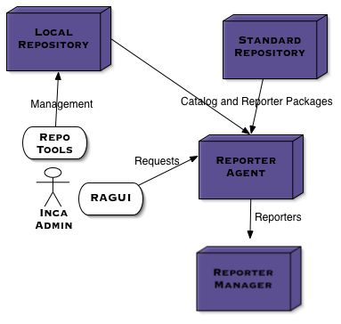
Notes:
Resource 3 is used by both Vos -> take note of which data is transferred between Vos. The security must be handled between those components.
Resource 3’s primary VO is VO A in this case.

Slide 22
Repository Details
Reporters stored in a (standard) package format (Debian?)
Packaging stripped by RA; not sent to RM
RA authenticates RAGUI and Repository, verifies packages

Slide 23
Depot [Requirements]
Data should be collected from the resources and moved away from the resource to be stored.
Installation, setup, and maintenance of the Inca deployment should be simple. For the data collection this implies that the addition of new data should require no configuration.
Data should be archived.
Data collected should not be lost due to the failure of a single component.
Data pertaining to a single VO should be available from a central location.
Response time for updates and queries should be fast.

Slide 24
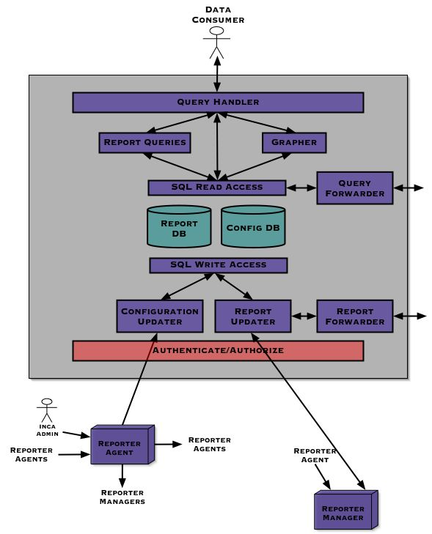
Depot
Store and archive reports
Queries
Configured by RA
Depot peers
Implemented around a DB
Service agreement verification

Slide 25
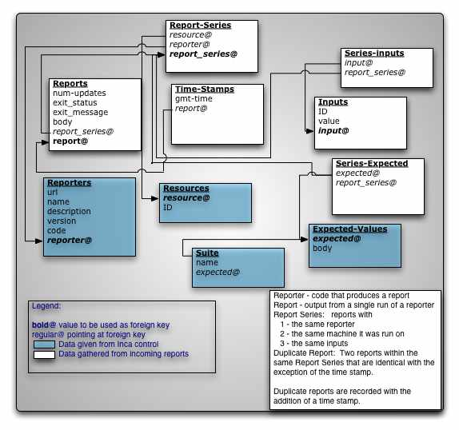
Depot [DB]

Slide 26
Inca Core Distribution
Multiple packaging formats, including GPT, Debian, RPM
Single authenticating tool to do installation for an entire VO?

Slide 27
Outline
Requirements
Components Overview
Scenarios
Component Details
Security

Slide 28
Security
Attack: A malicious reporter executes on a resource and either attempts to compromise the resource or report false data.
  User account privileges
  Trusted reporter repository
  Profiled execution
  Sandbox execution?

Slide 29
Security
Attack: An attacker gains control over a reporter manager or a reporter agent and attempts to load the system by running reporters at a very high frequency.
  Certificates/ACL
  Reporter manager polls
  User authentication
  Secure machine for reporter agent
Attack: An attacker attempts to impersonate a reporter manager and send false data about one or more resources to the depot.
  Certificates/ACL

Slide 30
Security
Attack: An attacker attempts to change or delete data on the depot (e.g., by breaking into the database)
  Authenticate to its backend database either by certificate or user account privileges (i.e., no passwords).
Attack: An attacker attempts to impersonate a depot with their own depot.
  A reporter manager will authenticate a depot before it sends data to it to ensure data is getting to the right place.
  Queries will not be authenticated.

Slide 31
Security
Requirement: In order to test Grid functionality, access to a valid credential is needed from a reporter.
  Executes under user account with DN entry
  Delegate proxy from reporter agent to reporter managers
  Secure reporter agent machine

