Slide 1
Welcome to the 2nd
Inca Workshop
Sponsored by the NSF
September 4 & 5, 2008
Presenters:
Shava Smallen ssmallen@sdsc.edu
Jim Hayes jhayes@sdsc.edu

Slide 2












Thank you for attending

Slide 3
Workshop Goals
Introduce features and benefits of Inca to new or interested users.
Help existing users to better utilize Inca for their Grid.
Gather any feedback on new features, improvements to features, etc.

Slide 4
Agenda -- Day 1
9:00 - 10:00 | Inca overview
10:00 - 11:00 | Working with Inca Reporters
11:15 - 12:00 | Hands-on: Reporter API and Repository
1:00 - 2:00 | Inca Control Infrastructure
2:00 - 3:00 | Administering Inca with incat
3:15 - 4:00 | Hands-on: Inca deployment (part 1)

Slide 5
Agenda -- Day 2
9:00 - 9:30 | Inside the Inca Depot
9:30 - 10:00 | Inca APIs
10:00 - 11:00 | Data display (data consumers)
11:15 - 12:00 | Hands-on: Inca deployment (part 2)
1:00 - 2:00 | Hands-on: Data display (data consumers)
2:00 - 3:00 | Future work and wrap up

Slide 6

Inca Information
Announcements:
inca-users@sdsc.edu
Email:
inca@sdsc.edu
Website:
http://inca.sdsc.edu
Supported by:

Slide 7
Inca Overview
Shava Smallen
ssmallen@sdsc.edu
Inca Workshop
September 4, 2008

Slide 8

Goal: reliable grid software and services for users
Over 750 TF
Over 30 PB of online and archival data storage
Connected via dedicated multi-Gbps links
30-63 software packages and 6-23 services per resource
11 TeraGrid sites, 21 resources

Slide 9


User-level grid monitoring
Runs from a standard user account
Executes using a standard GSI credential
Uses tests that are developed and configured based on user documentation
Centrally manages monitoring configuration
Automates periodic execution of tests
Verifies user-accessible Grid access points
Easily updates and maintains monitoring deployment

Slide 10

Who benefits from user-level grid monitoring?
Grid operators
  Verify requirements are fulfilled by resource providers
  Identify failure trends
System administrators
  Email notification
  Debugging support
End users
  Debug user account/environment issues
  Advanced users: feedback to Grid/VO
System
administrators

Slide 11
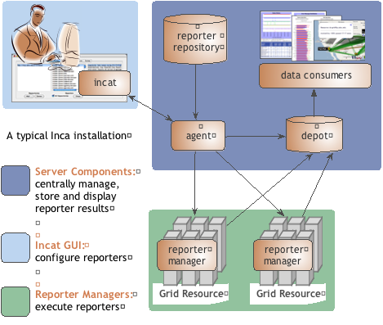
Inca provides user-level grid monitoring
Stores and archives a wide variety of monitoring results
Captures context of monitoring result as it is collected
Eases the writing, deploying, and sharing of new tests or benchmarks
Flexible and comprehensive web status pages
Secure

Slide 12

Reporters collect monitoring data
Executable programs that measure some aspect of the system or installed software
Supports a set of command-line options and writes XML to stdout
Schema supports multiple types of data
Extensive library support for perl and python scripts (most reporters < 30 lines of code)
Independent of other Inca components

Slide 13
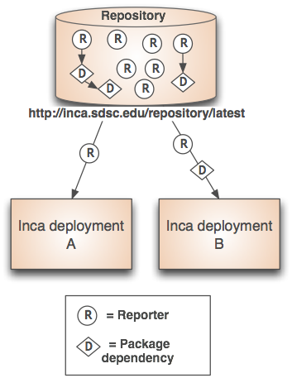
Repositories support sharing
Collection of reporters available via a URL
Supports package dependencies
Packages versioned to allow for automatic updates
Inca project repository contains 150+ reporters
  Version, unit test, performance benchmark reporters
  Grid middleware and tools, compilers, math libraries, data tools, and viz tool

Slide 14
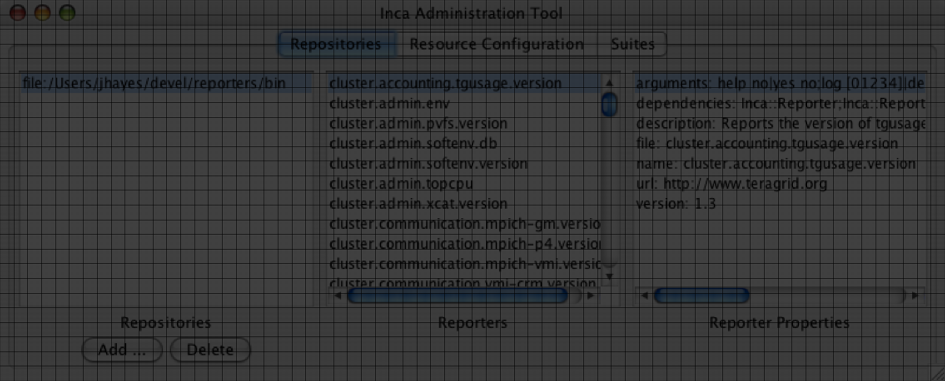
Agent provides centralized configuration and management
Implements the configuration specified by Inca administrator
Stages and launches a reporter manager on each resource
Sends package and configuration updates
Manages proxy information
Administration via GUI interface (incat)
Screenshot of Inca GUI tool, incat, showing the reporters that are available from a local repository

Slide 15
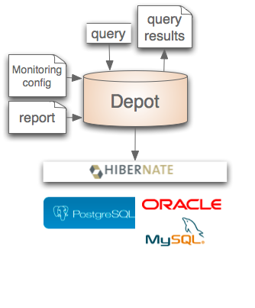

Depot stores and publishes data
Stores configuration information and monitoring results
Provides full archiving of reports
Uses relational database backend via Hibernate
Supports HQL and predefined queries
Supports plug-in customization (e.g., email notifications, downtimes)
Web services - Query data from depot and return as XML

Slide 16
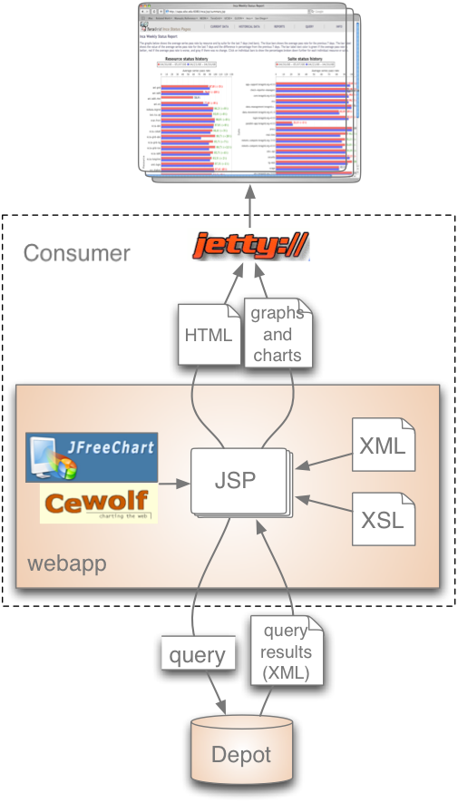
Consumer displays data
Current and historical views
Web application packaged with Jetty
JSP 2.0 pages/tags to query data and format using XSLT
CeWolf/JFreeChart to graph data

Slide 17
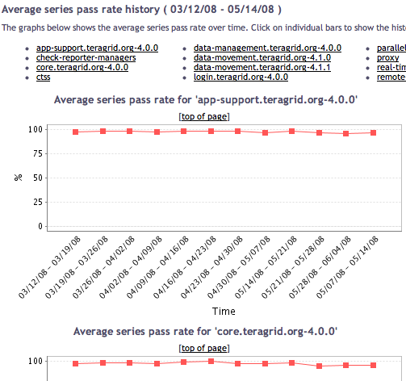
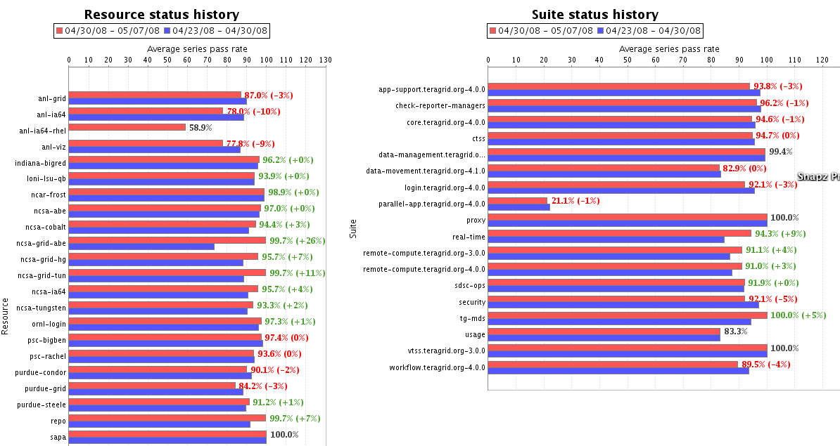
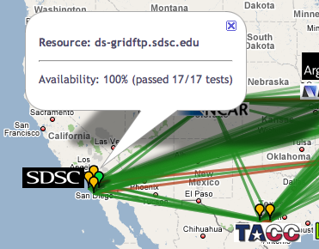
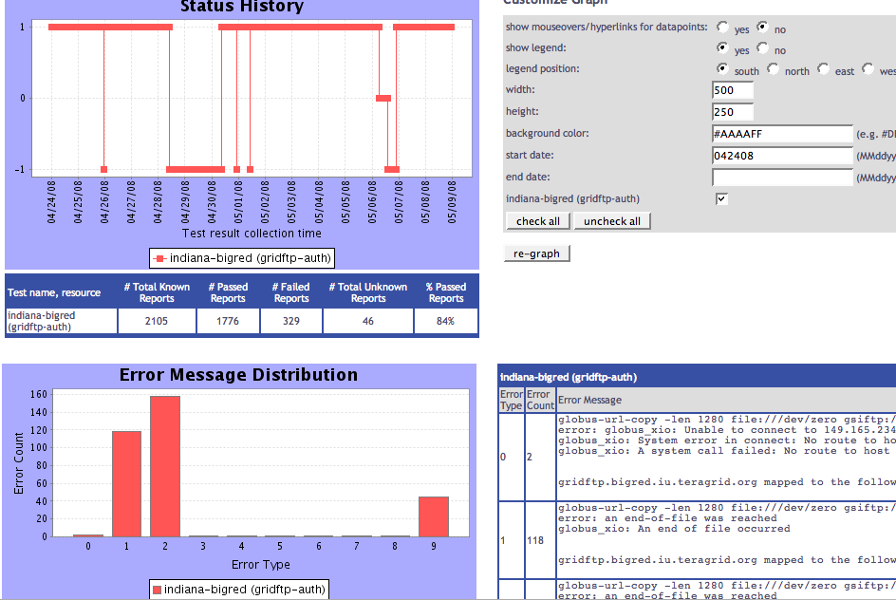
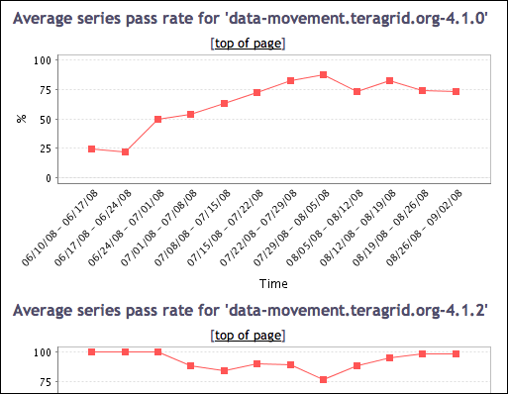
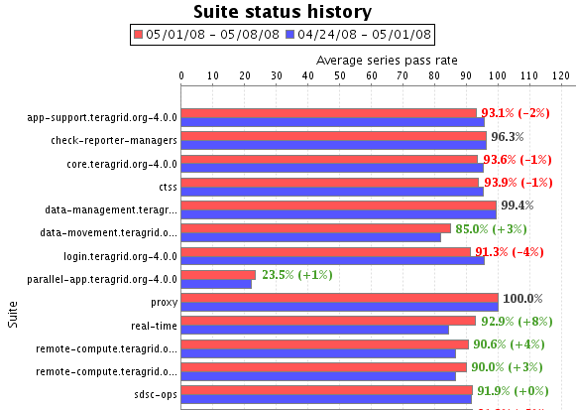
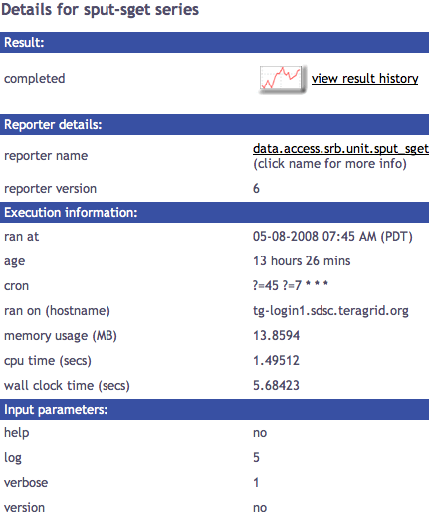
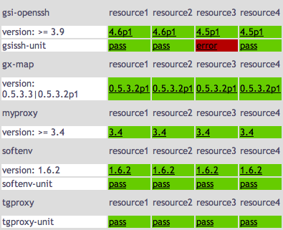
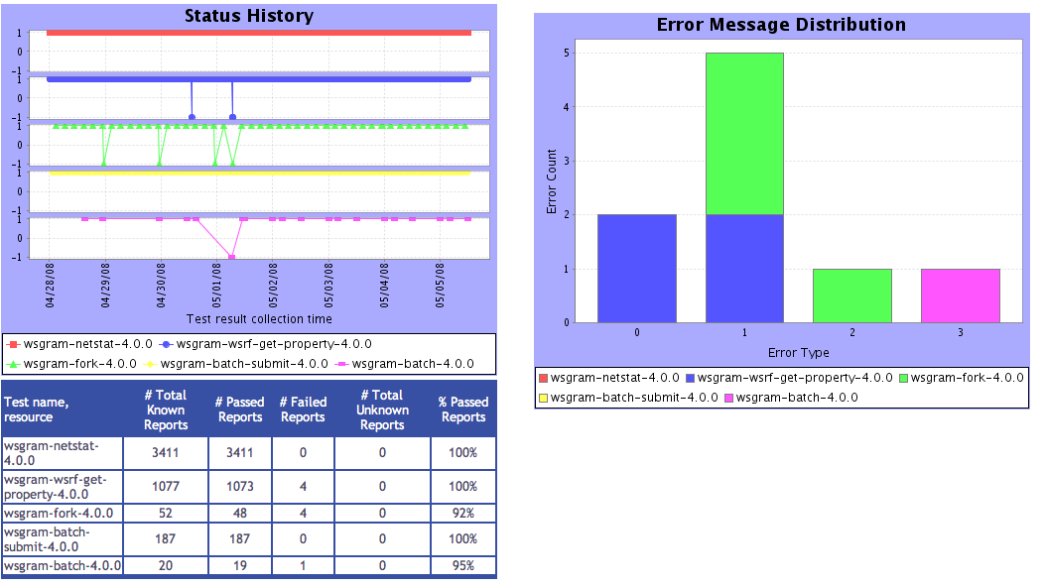
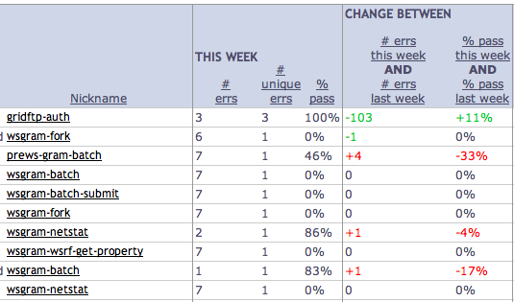
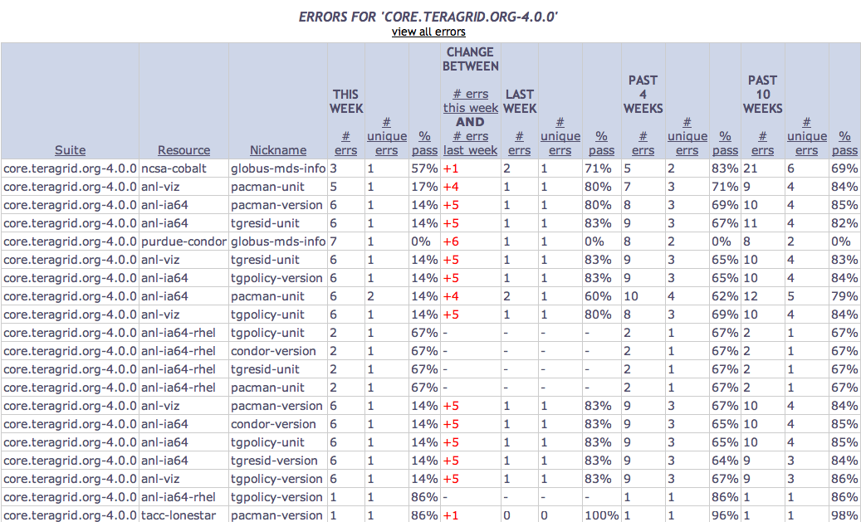
Tests
Summary
Weekly status report
Cumulative test status by resource
Resource status history
Inca’s status pages provide multiple levels of details
Error history summary
Test status by package and resource
Related test histories
Individual test result details
Test
Details
Individual test history
Historical
Current status

Slide 18
Inca components communicate using SSL
Provides credential based authentication for all communication
Credentials created during setup
% inca createauth
Configure via inca.properties
  inca.consumer.auth = true | false
  inca. consumer.cert=componentcert.pem
  inca. consumer.key=componentkey.pem
  inca. consumer.trusted=trusted
  inca. consumer.password=stdin:password>
  # inca.consumer.depot=inca://localhost:6324
  inca.consumer.depot=incas://localhost:6324

Slide 19




Software status and deployments
Current software version: 2.4
(available from Inca website)
http://inca.sdsc.edu

Slide 20
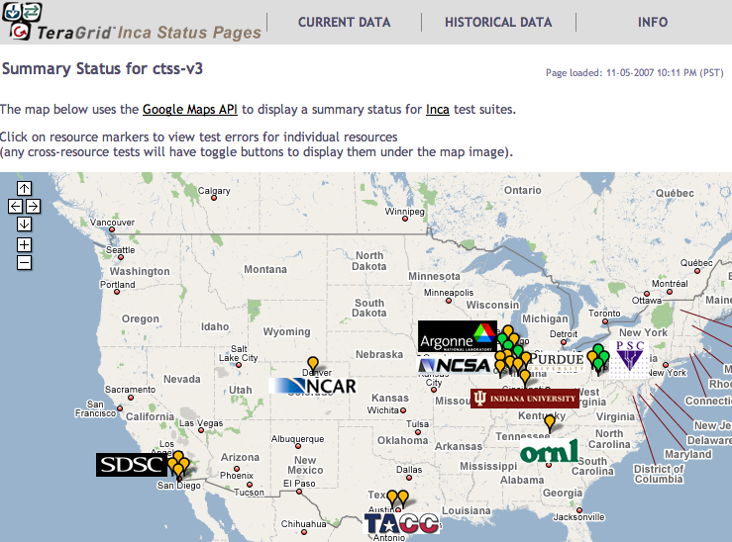
Inca TeraGrid deployment
Running since 2003
Total of 2660 tests running on 20 login nodes, 3 grid nodes, and 3 servers
Coordinated software and services
Cross-site tests
GRAM usage
CA certificate and CRL checking
Resource registration in information services
Screenshot of Inca status pages for TeraGrid
http://inca.teragrid.org/

Slide 21

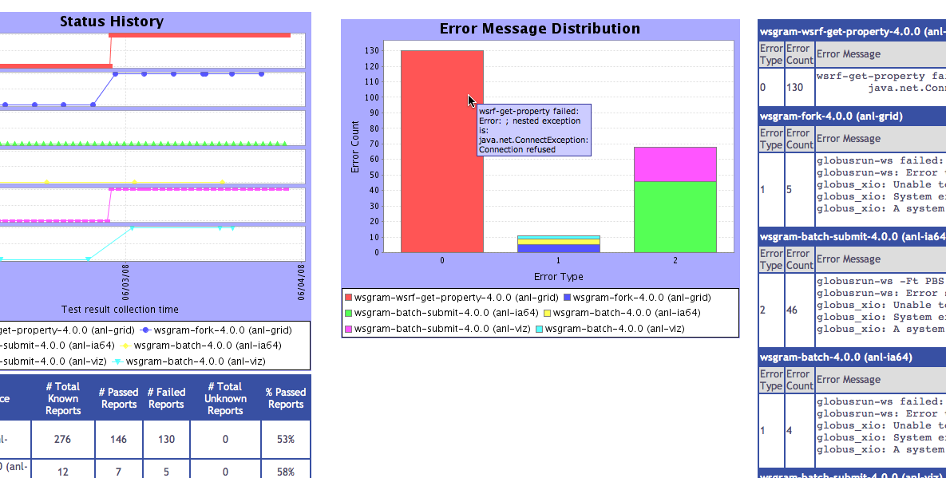
Inca monitoring benefits TeraGrid end users
“Inca reported errors mirror failures we’ve observed and as they are addressed we’ve noticed an improvement in TeraGrid’s stability.”
-- Suresh Marru (LEAD developer)
Tests resources and services used by LEAD. E.g.
  Pings service every 3 mins
  Verifies batch job submission every hour
Automatically notifies admins of failures
Show week of history in custom status pages

Slide 22
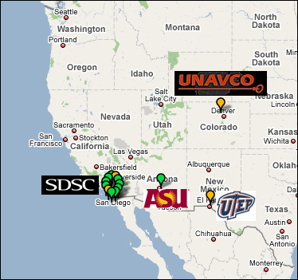
Inca GEON deployment
Running since Feb 2008
Total of 206 tests running on 5 login nodes and 6 servers
LiDAR workflow services
Web servers
Ssh connectivity
Base system information (Rocks, Gcc, Java, etc.)
Screenshot of Inca status map for GEON
http://inca-geon.sdsc.edu

Slide 23
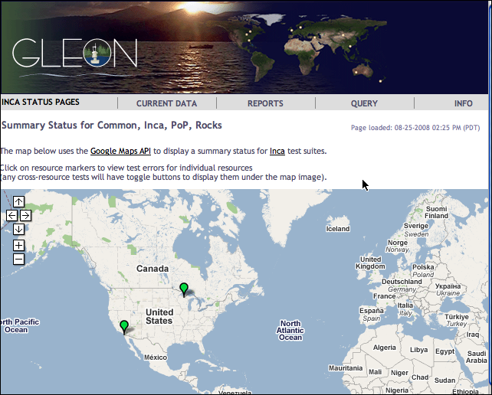

Inca GLEON deployment
Sensors in lake: dissolved oxygen level, temperature, velocity (some), etc.
Monitoring Data Turbine deployments since Oct 2007
Total of 26 tests running on data server at SDSC and windows box in Northern Temperate Lakes in Wisconsin
http://inca-gleon.sdsc.edu

Slide 24
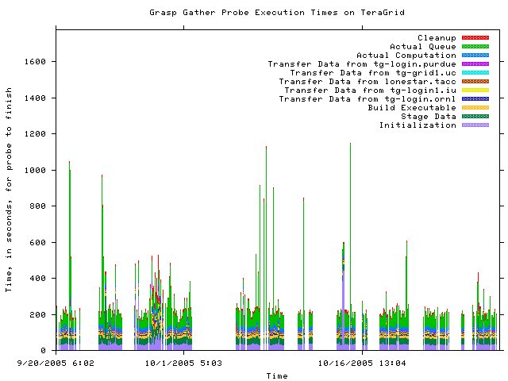
Inca performance deployments
GrASP performance measurements in 2006
Deploying IPM instrumented MPI applications to TeraGrid

Slide 25






Related Grid monitoring tools
Inca’s primary objective: user-level Grid functionality testing and performance measurement

Slide 26

Benefits of using Inca
Detect problems before the users notice them
Easy to write and share tests and benchmarks
Easy to deploy and maintain
Flexible and comprehensive displays

Slide 27
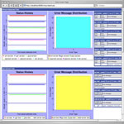
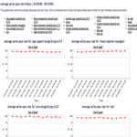
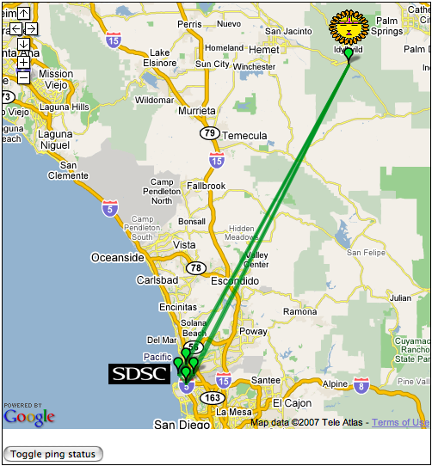
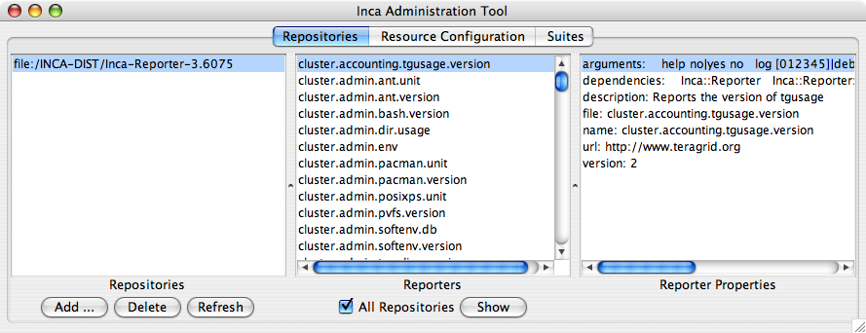
Inca architecture
Reporter
Repository
Data Consumers
R
Incat
C
Agent
S
Depot
A typical Inca installation
S
r
Server Components:
Centrally manage, store and display reporter results
Inca GUI:
Configure reporters
Reporter Managers:
Execute reporters
S
R
r
R
Reporter
Manager
Reporter
Manager
…
Grid Resource
Grid Resource

Slide 28
Agenda -- Day 1
9:00 - 10:00 | Inca overview
10:00 - 11:00 | Working with Inca Reporters
11:15 - 12:00 | Hands-on: Reporter API and Repository
1:00 - 2:00 | Inca Control Infrastructure
2:00 - 3:00 | Administering Inca with incat
3:15 - 4:00 | Hands-on: Inca deployment (part 1)

